Slide 1
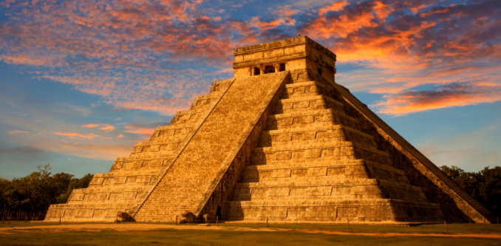
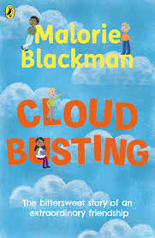
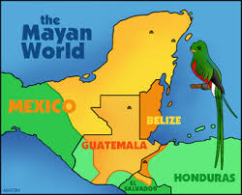
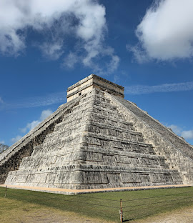
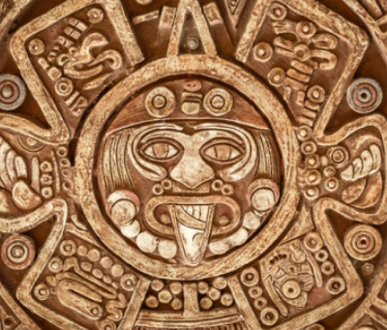
Marvellous Maya
Year 5 Summer Term 1
2026
History
In history, we will be
exploring the exciting topic
of the Mayan
Civilisation. We will be evaluating the importance of the Maya and how their discoveries impacted their lives and way of living. We will also research and offer our own opinion of why the Maya Civilisation collapsed.
English
During this half term, we will be reading Cloud Busting by Malorie Blackman. We will be exploring and creating a variety of poems, with a continued focus on figurative language and using the senses. The text also introduces themes such as friendship, belonging, and bullying. Through this, children will have the opportunity to discuss these topics in a safe and supportive environment, considering how unkind behaviour can be challenged and exploring ways to support others. These discussions will reinforce our school’s values and expectations around kindness, respect, and inclusion.
Maths
During this term, we will be focusing on Shape, Position and Direction and Decimals.In Shape, Position and Direction, children will be using protractors to accurately identify and measure angles, whilst developing our understanding of how shapes and objects can be described, moved, and turned in different ways. In Decimals, we will build on prior learning by practising how to add, subtract, multiply, and divide decimals, applying these skills to a range of problems We will also be using Times Tables Rock Stars three times a week to improve fluency and speed with times tables.
Science
This term, we will move on to look at Living
Things and their Habitats, learning to describe the differences in the
life cycles of a mammal, an amphibian, an insect and a bird. We will also
learn about the life process of reproduction in some plants and animals.
R.E
This term Year 5 will be learning all about Judaism. Throughout the topic we will be learning about festivals, lifestyles, beliefs and the Torah.
French and Music
In French this half term, year 5 will be role playing a visit to the doctors and describing how they feel using the verbs 'etre' and 'avoir'. In Music children will be introduced to ‘ti ri te’ (semi-quaver, quaver) rhythms in all possible combinations, and add to and improve their sight-reading using the pentatonic scale.
Computing
This half term in Year 5 computing, we will be developing our Google Docs word processing skills. We will learn how to format and edit text, use appropriate filenames, and adjust the layout of documents. We will also practise inserting and formatting images and using tables to organise information clearly.Finally, we will combine all of these skills to create and review a well-presented factsheet.
DT
In this unit our focus will be Food (Culture and Seasonality) children will be learning skills of cutting, measuring and following a recipe. In this unit children will design, make and evaluate a fruit crumble using locally sourced ingredients.
P.E
Our focus for the upcoming term is Cricket and Rounders. We will be learning how to bowl, catch and bat correctly using identified techniques.

