Slide 1

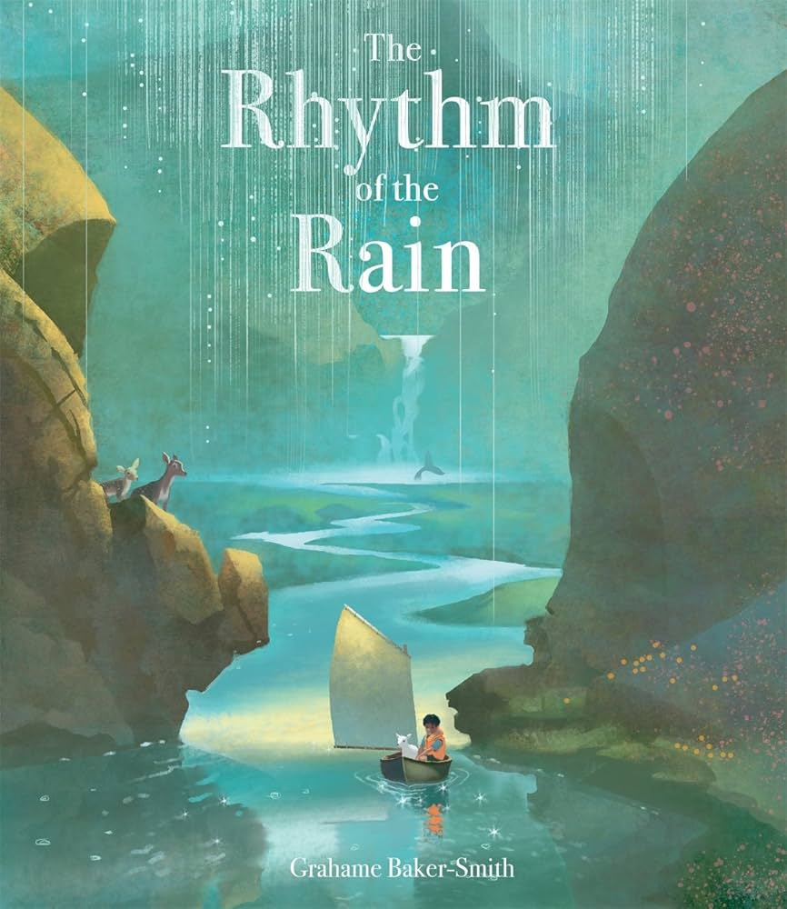
English
In English, we will be studying the book ‘ Rhythm of the Rain’ to deepen our understanding of the water cycle. After that, we will be exploring the depths of the ocean looking at writing some of our own non-fiction texts about the deadly and most unusual creatures of the deep!
Science
In science we are starting our unit on States of Matter where children will group materials by their properties and observe changes to materials when they are heated and cooled. We will learn about the Water Cycle and the role of evaporation and condensation.
Maths
We will continue with our recall of times tables. Ahead of the MTC, children will have daily tables practise in school. Our Spring 2 unit gives us more time to deepen our understanding of mixed numbers and improper fractions including addition and subtraction. We will also be finding fractions of amounts. Some of our learning time this half term will be dedicated to revision of formal methods of ‘the 4 operations’.
The Wonders of Water
Year 4 Spring Term 2
RE and PSHE
In RE, we will be asking: Why do Christians call the day Jesus died ‘Good Friday’? The children will explore the Easter story and consider it from the point of view of different people.
This half term in PSHE, Year 4 pupils will explore identity, respect and understanding others. They will learn about prejudice, protected characteristics, fairness and empathy, and how to treat people kindly. Pupils will also consider different jobs and how stereotypes can influence choices.
French and Music
In French Year 4 will construct negative sentences using ne pas and give opinions as 'Eurovision' song judges
In Music, Year 4 will be reinforcing high do, low la and low so in the pentatonic scale, and practice these through sight-reading in combination with all rhythm names to date.
Geography
In this topic, we will find out about the journey of a river from source to mouth. Pupils will investigate how human decisions impact on a river. We will also study the main rivers of the world. Throughout the topic we will practise our map reading skills and improve knowledge of location and place.
Art and DT
We will study the work of JMW Turner, discussing our likes and dislikes. We will mix shades of green and blue to produce our own versions of his work. We will create tones, tints and shades to create watercolour paintings of land and waterscapes.
Computing
In computing, Year 4 will be exploring what makes audiobooks and podcasts effective and identify the key features that make them engaging.
They will plan and write a script for an engaging audiobook; record clear narration and add sound effects to an audiobook and edit, improve and finalise an audiobook using recording and sound design tools.
PE
This half term in PE, Year 4 will be exploring the skills needed for basketball and hockey. We will also continue with our weekly swimming lessons each Wednesday afternoon.

