Slide 1
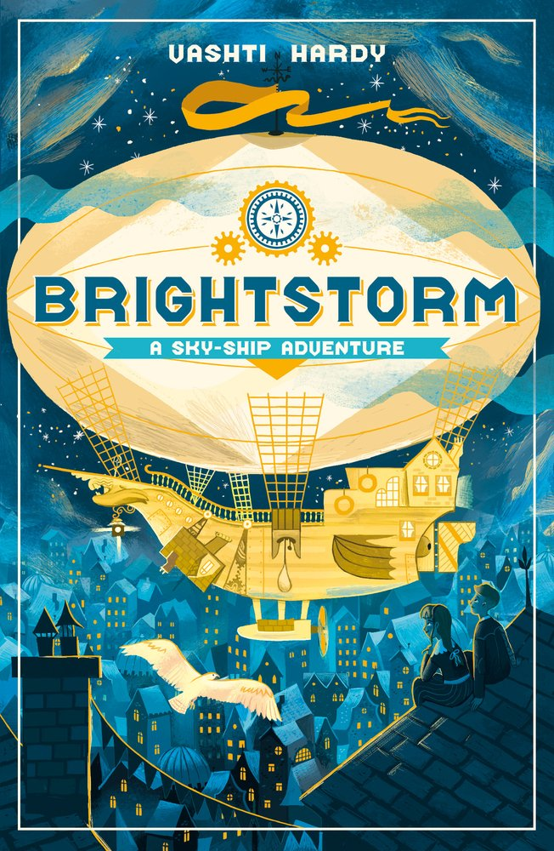
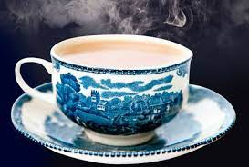
English
During this half term we will continue to develop our Spelling, Punctuation and Grammar with particular focus on commas, brackets and dashes. Our class fictional text is “Brightstorm” by Vashti Hardy which will drive all our English work; we will be learning the ‘art of persuasion’ and will be creating persuasive tourist brochures for the Citadel, persuasive letters to allow us to board the Sky Ship and an exciting Dragon’s Den project to persuade the Dragons to invest in our new explorer’s inventions!
Maths
This term we will be extending our knowledge of fractions, multiplication and division. The children in Year 5 will also continue to complete their times table Rockstar sheets three times per week. We will also be learning about fractions, and further building on our Year 4 knowledge.
P.E
Year 5 will be continuing to work with the Newcastle United Foundation this term focusing on attacking and defending with particular focus on Tag Rugby. In their additional PE lesson, children will also attend swimming lessons once a week to work towards their 25 metre badge.
Science
Our focus this term will be how to separate materials. The children will be developing their understanding of how materials change when water or heat is added.
Children will learn about solubility, flexibility, magnetism and much more during this unit. They will be extending their scientific study by carrying out experiments and fair tests.
Exploring our Local Area
(The Great Heddon Tea Robbery!)
R.E
This term the children will be exploring how Christians believe that following God can bring freedom and justice. This includes looking at the story of Moses and people working for justice today.
History
During this term we will be focusing on our local area. This gives the children the opportunity to look back in time to see how Heddon and the surrounding areas have changed. We will focus on the Great Heddon Tea Robbery and how transport has also changed from the late 1800’s until now.
Computing
This term children in Year 5 will be learning all about databases. They will be able to search for key information on a database quickly and efficiently. Whilst they will be creating a class database to record specific information they will be working towards creating their own database and identifying its uses and its effectiveness.
DT
During this unit the children will be using Computer Aided Design (CAD) to design and create an bag for an explorer. This unit will focus on creating templates using CAD, joining textiles and how to create a seam. Children will then make and evaluate their final products.
French and Music
Children in Year 5 will be continuing to learn and build upon conversational French techniques and phrases taught to them by Mrs Magee.
In music this term we will be extending our knowledge of the history of music and focusing on the Classical Era (1750-1820)

Slide 2
English
During this half term we will continue to develop our Spelling, Punctuation and Grammar with particular focus on commas, brackets and dashes. Our class fictional text is “Brightstorm” by Vashti Hardy which will drive all our English work; we will be learning the ‘art of persuasion’ and will be creating persuasive tourist brochures for the Citadel, persuasive letters to allow us to board the Sky Ship and an exciting Dragon’s Den project to persuade the Dragons to invest in our new explorer’s inventions!
Maths
This term we will be extending our knowledge of fractions, multiplication and division. The children in Year 5 will also continue to complete their times table Rockstar sheets three times per week. We will also be learning about fractions, and further building on our Year 4 knowledge.
P.E
Year 5 will be continuing to work with the Newcastle United Foundation this term focusing on attacking and defending with particular focus on Tag Rugby. In their additional PE lesson, children will also attend swimming lessons once a week to work towards their 25 metre badge.
R.E
This term the children will be focusing on the story of Moses and his journey throughout the Old Testament with particular focus on slavery.
Science
Our focus this term and next will be “Properties and changes of materials.” The children will be developing their understanding of how materials change when water or heat is added.
Children will learn about solubility, flexibility, magnetism and much more during this unit. They will be extending their scientific study by carrying out experiments and fair tests.
Exploring our Local Area
(The Great Heddon Tea Robbery!)
History
During this term we will be focusing on our local area. This gives the children the opportunity to look back in time to see how Heddon and the surrounding areas have changed. We will focus on the Great Heddon Tea Robbery and how transport has also changed from the late 1800’s until now.
Computing
This term children in Year 5 will be learning all about databases. They will be able to search for key information on a database quickly and efficiently. Whilst they will be creating a class database to record specific information they will be working towards creating their own database and identifying its uses and its effectiveness.
DT
During this unit the children will be using Computer Aided Design (CAD) to design and create an bag for an explorer. This unit will focus on developing their textile skills as they explore different bag designs and learn how to join, cut and assemble materials.
French and Music
Children in Year 5 will be continuing to learn and build upon conversational French techniques and phrases taught to them by Mrs Magee.
In music this term we will be extending our knowledge of the history of music and focusing on the Classical Era (1750-1820)

