Slide 1
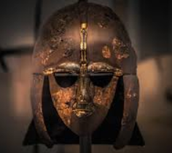
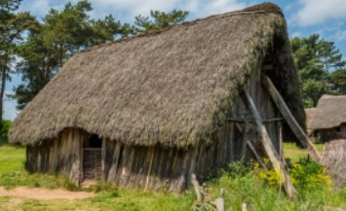
English
This term, our class novel is “Winter of the Wolves” by Tony Bradman and we will be developing our reciprocal reading strategies (such as inference, prediction, questioning and summarising) through the study of this exciting text set in the Anglo-Saxon era. In grammar, we will be learning to use and recognise passive verbs, modal verbs and expanded noun phrases.
Science
Our science topic this term is all about Earth and Space. We will be looking into the solar system and how the Earth and other planets orbit the Sun. We will use the idea of the Earth’s rotation to explain day and night and the apparent movement of the Sun across the sky.
P.E
The children will take part in two sessions per week. One of these sessions will take place at Ponteland Leisure centre on Wednesday afternoons. Children will be working towards their 25m swimming badge. In their additional lesson they will be taking part inTag Rugby.
Computing
Children will refresh their understanding of e-safety that applies to school and home. This will benefit the children in Year 5 by helping them identify and report issues they may come across whilst being online.
Awesome
Anglo-Saxons
Year 5 Autumn 1 Term 2024
French and Music
This term we find out about how French children get ready for school. Children will be learning how to say what stationery they need for each subject, while also interpreting a school timetable in French. In Music Year 5 will be building on their prior knowledge of the pentatonic scale, whilst improving their understanding of written music.
History
In this half term we will be studying the Anglo-Saxons from 410AD to 793AD. We will focus on settlements, kingdoms, place names and village life. We will also study the conversion from Paganism to Christianity, and what that meant for the kingdoms within Britain.
Maths
In Maths we will continue to develop our multiplication and division skills by completing the ‘Rockstars Times Table Challenge’ three times a week. We will also continue to work on and develop our skills for place value and addition and subtraction. Children will also complete daily mental maths challenges related to prior and current topics.
R.E and PSHE
The children will be learning what is meant when God is described as Holy and Loving. This term, they will also deepen their understanding of God's grace and forgiveness.
In PSHE, we will be looking at managing peer influence and friendships.
Art
During this term we will focus on “God is loving and holy.” Year 5 will be creating stained glass windows using acetate pages to create their designs.

