Slide 1
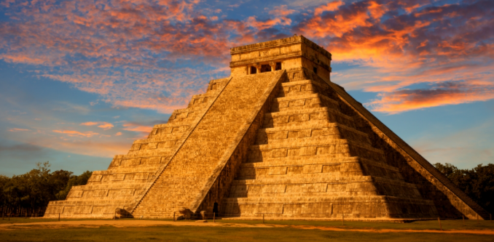
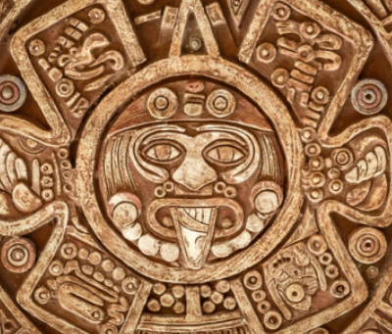
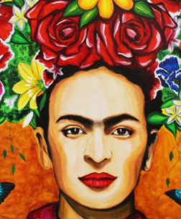
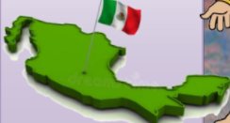
Marvellous Maya and Mexico
Year 5 Summer Term 1
2023
History
In history, we will be
exploring the exciting topic
of the Mayan
Civilisation. We will be evaluating the importance of the Maya and how their discoveries impacted their lives and way of living. We will also research and offer our own opinion of why the Maya Civilisation collapsed.
English
Our new class novel is ‘Middleworld’ the first
book in the Jaguar Stones trilogy. It’s an
exciting adventure story following Max and Lola
who unearth some strange secrets while Max’s
archaeologist parents are on a dig in Central
America and who mysteriously vanish under
suspicious circumstances...
During this unit the children in Year 5 will be able to develop and improve upon their skills of setting descriptions, formal and informal writing and Chronological reports.
Maths
During this term we will be focusing on Fractions, Decimals and Percentages. Children will be representing fractions, decimals and percentages in different ways using counters, place value grids and 100 squares. Following this unit children will be studying Area and Perimeter. Children will continue to complete daily mental maths tasks as well as Rockstars three times a week
Science
This term, we will move on to look at Living
Things and their Habitats, learning to describe the differences in the
life cycles of a mammal, an amphibian, an insect and a bird. We will also
learn about the life process of reproduction in some plants and animals.
Computing
Our topic for this term will be creating our own Computer Game. This will be linked to our class text Middleworld and the children in Year 5 will be able to use their imagination to create their own unique game environment.
French and Music
In French this term we will
continue to explore French
culture and will learn some new
French vocabulary. We will begin
to look at composing
grammatically correct sentences.
In Music this term we will be learning about Duration. We will be focusing on Syncopated rhythms, Polyrhythms and Ostinatos.
DT
In this unit our focus will be Food (Culture and Seasonality) children will be learning skills of cutting, measuring and following a recipe. In this unit children will design, make and evaluate a fruit crumble using locally sourced ingredients.
R.E
This term Year 5 will be learning all about Judaism. Throughout the topic we will be learning about festivals, lifestyles, beliefs and the Torah.
P.E
Our focus for the upcoming term is Athletics and Fitness. During this unit we will be learning about long and short distance running events and several field sports.

