Slide 1
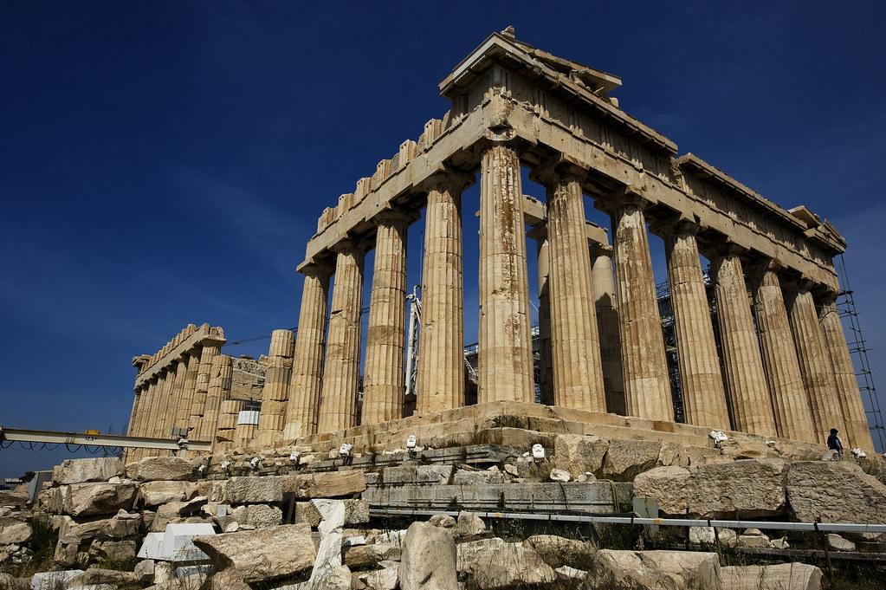
English
In English, the class will begin by reading and studying ‘Stitch Head’ by Guy Bass. Through this text we will explore character development and the language devices Guy Bass uses to engage readers. We will continue to develop our knowledge of word classes, speech marks and fronted adverbials in grammar sessions.
Science
In science we will begin our unit about living things and their habitats. Using both local and wider environments, children will explore and use classification keys to group, identify and name a variety of living things. We will also study how environments can change and that this can sometimes pose dangers to living things.
Maths
This half term children will build on their knowledge of fractions and decimals. We will investigate numbers with two decimal places. We will also look at statistics including data presentation and interpretation. Year 4 will continue their mastery of multiplications in preparation for the Multiplication Tables Check in June.
Year 4 Summer Term 2023
RE and PSHCE
Our RE topic this term is Pilgrimage. We will find out about the importance of religious sites in different religions and why people choose to visit them. In PSHCE, we will think about making decisions about money, and using and keeping money safe.
French and Music
We will learn names for animals and how a French composer portrayed them in music: Carnaval des Animaux. Mrs Milner will continue to teach musicianship in weekly music lessons.
Geography
Following on from our study of Ancient Greece, children will study modern Greece. We will look at both physical and human features and compare these to features of the UK, particularly our local area.
Computing
Using Purple Mash children will learn techniques for effective searching such as how to locate specific information, using a search to answer a series of questions and analysing the contents of a web page for clues about the credibility of the information.
Art and DT
Children will make box for Stitch Head’s potions, so he doesn’t need to carry them in his bag. We will investigate how boxes are made; learn a skill of making and using nets; design a container for Stitch Head; make the box; evaluate our work.
PE
This term Year 4 will go swimming every Wednesday afternoon. In addition they will take part in a weekly NUFC session with a focus of developing athletic skills.

