Slide 1
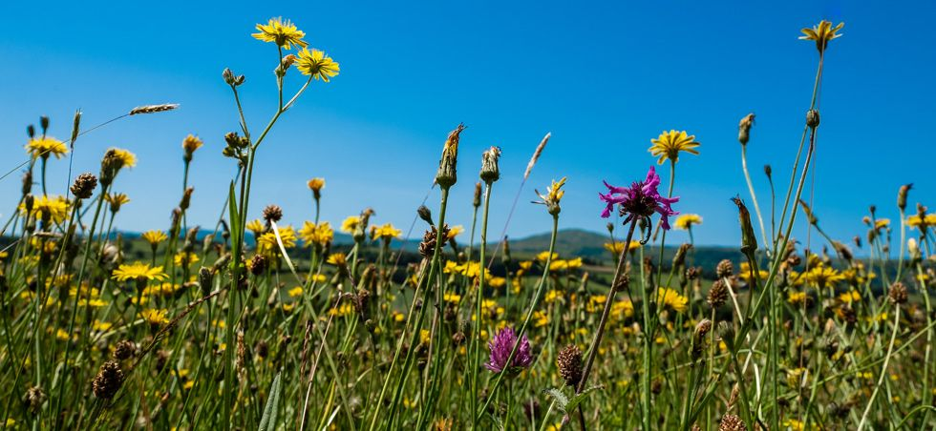
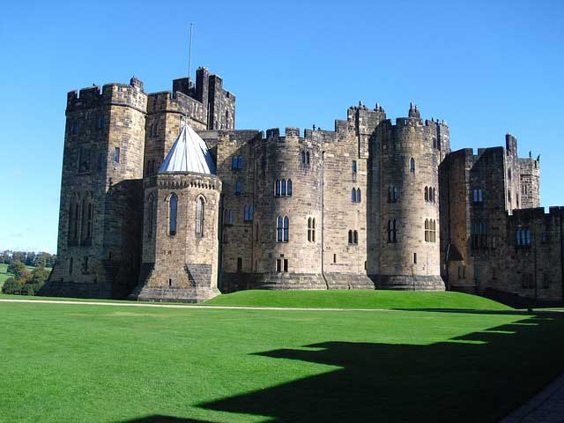
Geography
We will be learning about climates and biomes in Geography this half term. We will use our atlas skills to locate major biomes around the world, understand how some plants survive in extreme environments and explore the role of plants in agriculture.
English
This half term will have a specific focus on poetry, using Michael Rosen’s collection of poems from “Jelly Boots Smelly Boots” as inspiration. We will explore the use of figurative language, rhyme and imagery in his work and attempt to replicate some of his ideas in our own pieces of poetry.
We will be going to Alnwick Castle on 20.06.22, as part of our “Made In The North East” week.
Art
Our art focus this half term will be on observational drawing skills. We will use a variety of pencils to add shade and tone to sketches.
PE
Our PE sessions will continue with the NUFC Foundation, and we will be focusing on Athletics and Fitness in preparation for Sports day.
Plants Of The World
Computing
This half term we will be broadening our knowledge of coding. Having used Purple Mash coding software earlier in the year, the children will gain experience using Scratch to code a musical sequence.
YEAR 3 Summer Term 2
CURRICULUM MAP 2022
Science
We will continue to learn about the human body, with a specific focus on the skeletal and muscular system. We will look at the role the skeleton plays in support, protection, and movement. We will also learn about the skeletons of different animals and the difference between vertebrates and invertebrates.
Music
In lessons with Mrs Milner, we will begin to use instruments to compose our own piece of music.
Maths
In maths, we will be learning to tell the time to the nearest minute, understand the difference between AM and PM and practise accurately using a 24 hour clock. We will also be learning about the properties of shape, with a specific focus on angles and parallel/perpendicular lines.
RE & PSHE
In Re Lessons we will revisit our learning on Hinduism from earlier in the year to gain an in-depth understanding of Hindu beliefs and traditions. In PSHE, our unit title is “Valuing differences and keeping safe”.
French
We put our knowledge of body parts into action to describe injuries and ailments, and learn about Marie Curie’s life in France.

