Slide 1
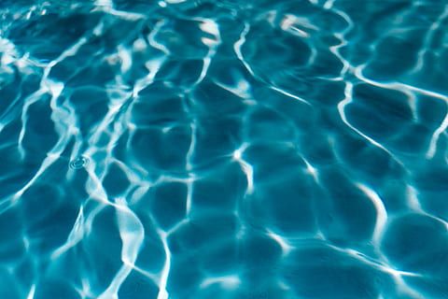
English
In English, the class will begin by reading and studying ‘The Firework Maker’s daughter’ by Philip Pullman. We will compare this modern fairy tale to traditional tales. In SPaG, we will revise word classes and fronted adverbials. The children will continue to have a weekly spelling test.
Science
In science we are starting our unit on States of Matter where children will group materials by their properties and observe changes to materials when they are heated and cooled. We will learn about the Water Cycle and the role of evaporation and condensation.
Maths
We will complete our mastery of times tables by doing the 7, 9, 11 and 12 tables. We will work on fractions and decimals. Children will identify equivalent fractions; add and subtract fractions with the same denominator; divide numbers by 10 and 100 to create tenths and hundredths. Pupils will then write these tenths and hundredths as decimals.
The Wonders of Water
Year 4 Spring Term 2022
RE and PSHCE
Why do Christians call the day Jesus died ‘Good Friday’? The children will explore the Easter story and consider it from the point of view of different people.In PSHCE, Year 4 will consider work and money, including making decisions about money; and using and keeping money safe. We will also find out about the effects of alcohol and its risks.
French and Music
In French, we will learn about gender of nouns as we practise names of animals and learn playground songs from French speaking Europe.
In music, children will be playing untuned percussion instruments and will also have the opportunity to compose using their Musicianship knowledge. In class we will listen to a range of music genres and discuss our likes and dislikes.
Geography
In this topic, we will find out about the journey of a river from source to mouth. Pupils will investigate how human decisions impact on a river. We will also study the main rivers of the world. Throughout the topic we will practise our map reading skills and improve knowledge of location and place.
Art and DT
We will base our learning on the Amazon River and the plants and animals living there. We will look at shape, form and proportion when sketching animals. We will also study the work of Henri Rousseau, discussing our likes and dislikes. We will mix shades of green to produce our own versions of his work.
Computing
Using Purple Mash children will learn to animate using the programme 2Animate. Children will create animations on paper before learning to produce them electronically. They will learn to add effects and backgrounds as well as using stop motion techniques.
PE
PE will be taught by NUFC. This term the focus will be football. The children will continue to take part in Commando Joe’s activities.

