Slide 1
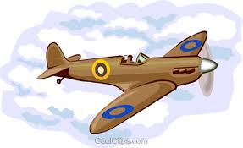
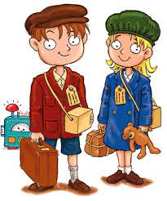
English
This term we will focus on playscripts and poetry. Texts will be linked to the topic. In grammar pupils will study direct and indirect speech, as well as revisiting pronouns and determiners. We will read the novel ‘An Eagle in the Snow’ by Michael Morpurgo at story time.
History
We will look at the causes of the war, the blitz, evacuation, the Holocaust and the end of the war with a focus on the following objectives: To give reasons why key events in history happened; to be aware that the same time in history can be represented in different ways; to discuss the impact of historical events on their locality; to talk about the impact of historical changes and their impact on life in Britain.
Maths
In maths, we are going to revisit fractions and begin work on decimals. We will continue to practise formal calculations with problems and also focus on problems involving money. Children will continue to work hard to memorise times tables up to 12 x 12.
World war II
Year 4 Summer 2021
DT
Linking their skills from science children will be required to design, make and evaluate an object which includes a simple series circuit. Children will be required to consider suitability of materials as well as selecting appropriate joining techniques.
PSHE and RE
As part of our topic, we will explore the concepts of tolerance and equality and relate this to WW2 and today’s society.
In RE we will look at different places of worship.
Science
This half term in science we will learn about Electricity. Children will identify common appliances that run on electricity, construct simple series electrical circuits, understand how circuits can be open or closed and identify common conductors and insulators.
Computing
We will be using Scratch software to develop coding skills this half term. Children will develop an educational computer game using selection and repetition. We will also begin to use ‘debugging’ to predict and overcome coding problems.
Music
We will continue to use Oak Academy to complete the Pulse and Metre unit before moving on to Timbre where we will explore different sounds and develop body percussion.
French
Carnaval des animaux
We learn names for animals and how a French composer portrayed them in music. We ‘compose’ our own animals by playing with French phonemes.
PE
Pupils will play cricket and practise throwing, catching and fielding skills.

