Slide 1
Thursday 4th March 2021
04.03.2021

Slide 2
Before we begin the day’s celebrations… Watch this quick message from one of our favourite authors, Stephen Fry!
https://www.youtube.com/watch?v=I-zISnJ-oao

Slide 3
https://www.worldbookday.com/digital-book-token/
Register at this link to receive your free digital book token!
The World Book Day £1 book tokens will be valid from Thursday 18 February – Sunday 28 March 2021. Children are encouraged to take their token to their local bookseller or supermarket to: - swap it for one of the TWELVE exclusive new and completely FREE World Book Day books
- get £1 off any full price book or an audiobook

Slide 4
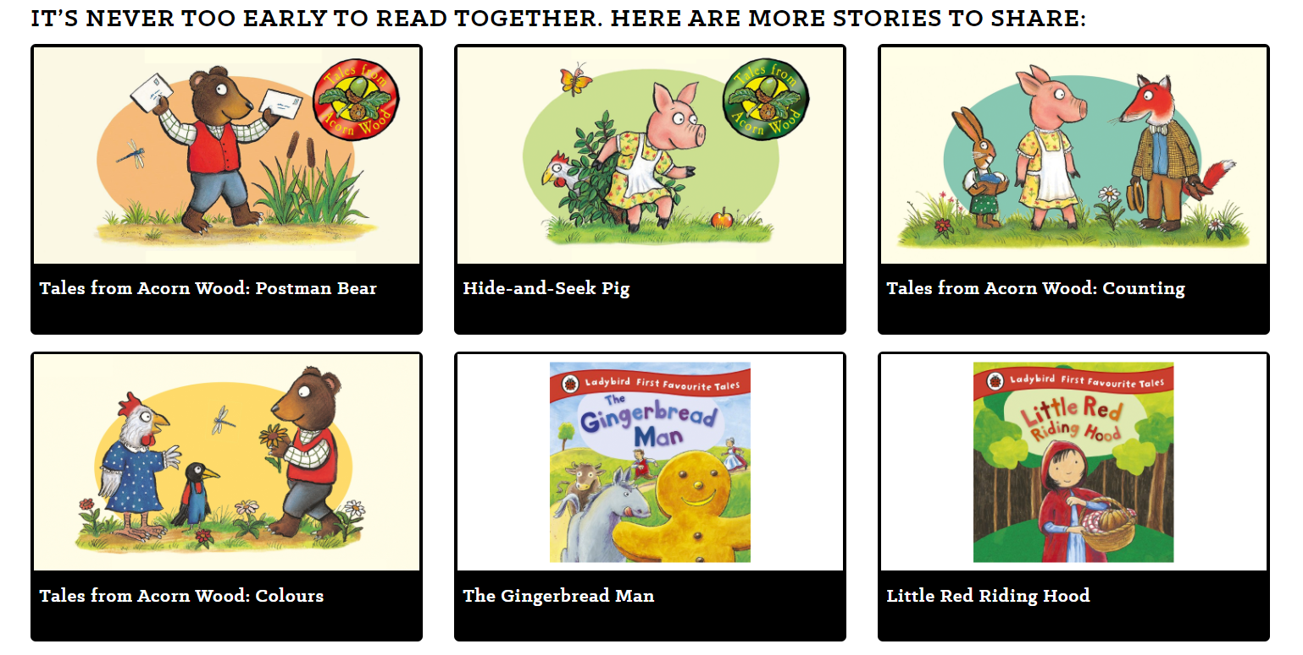
EYFS
Share a story!
Take ten minutes to share stories with your little ones.
Our Share A Story Corner videos have familiar characters and easy to follow stories, and tips for reading together. Look at the pictures together, guess what the characters are up to and ask your child what they think will happen next.
https://www.worldbookday.com/share-a-story-corner/

Slide 5
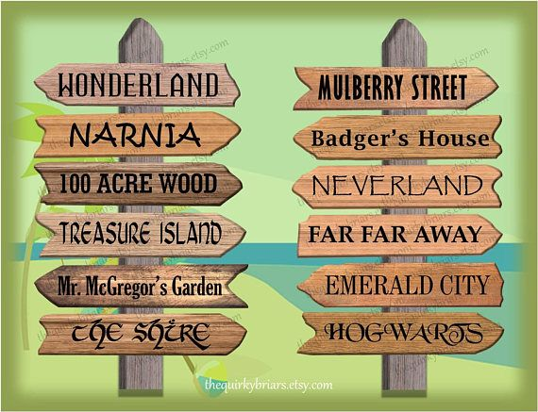
ACTIVITY ONE
Send a postcard from a book!
Just imagine, for one day only, you could visit any fictional setting from any book … where would you go? What would you do there?
Tell us all about your trip by writing us a postcard from your fictional place! Don’t forget to design a fantastic cover image too. The best postcards will be used on our school’s social media.

Slide 6
ACTIVITY TWO
Can you write a six-word story?
I thought I could trust you…
We are all made of stars.
The reflection was of a lion.
Fall often. Always get back up.
The most inspiring or intriguing stories will be shared on our school’s social media.

Slide 7
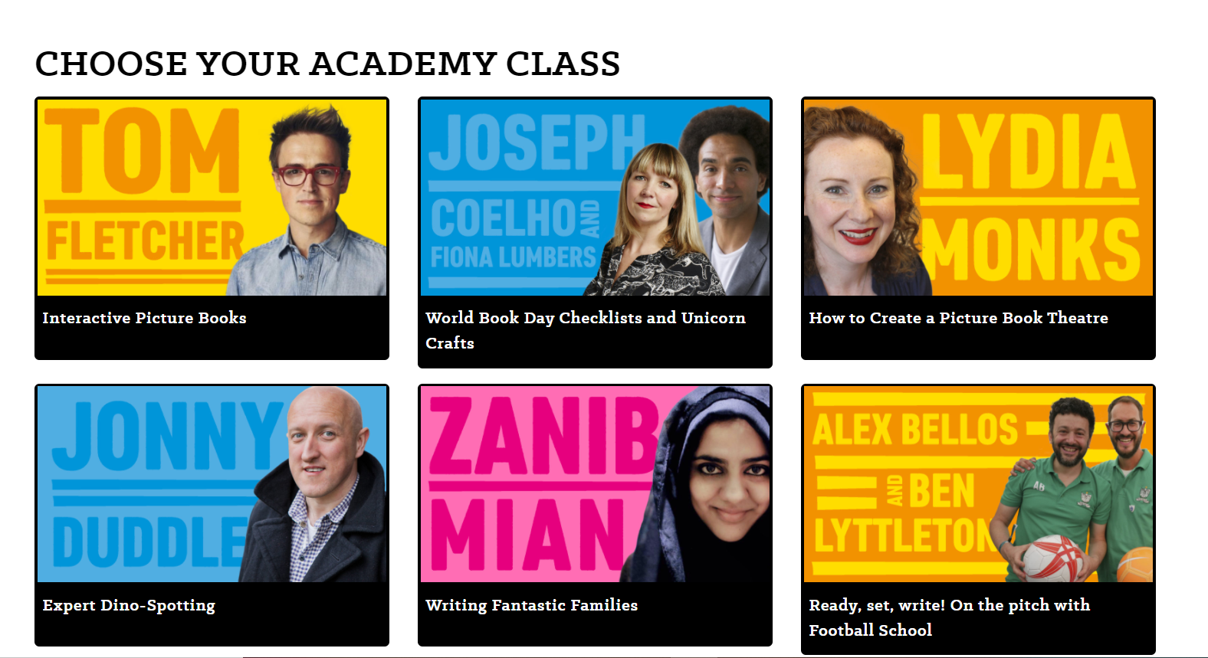
ACTIVITY THREE
Pick a masterclass!
https://www.worldbookday.com/online-masterclasses/
Click on the link and choose a masterclass! The Author & Illustrator Academy will beam famous authors & illustrators right into your home so you can meet the creative minds behind some of your favourite books.
Choose an Academy Lesson that takes your fancy then press play and let our brilliant authors and illustrators inspire you!

Slide 8
ACTIVITY FOUR
Take part in the St. Andrew’s Big Book Quiz!
Get your family together and test your knowledge of children’s literature! How many can questions can you answer correctly? The winning teams will be announced on the school website.

Slide 9
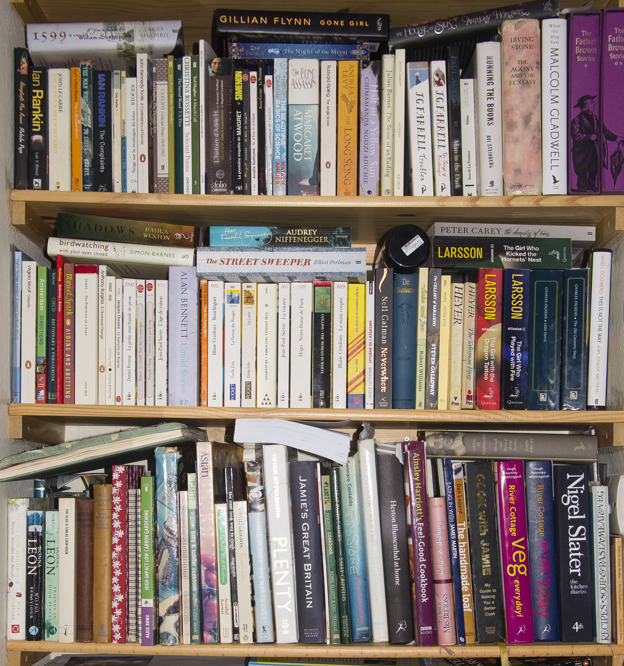
ACTIVITY FIVE
Can you match the #selfie to the #shelfie?
Look carefully at the pictures of these book shelves...
Which member of staff do you think they belong to? Are there any clues? Pay attention to the book titles… you might recognise a few!

Slide 10
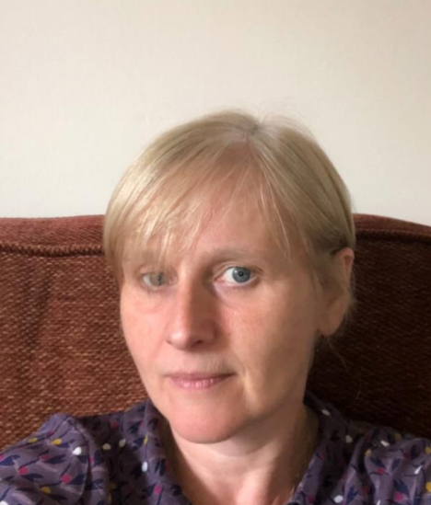
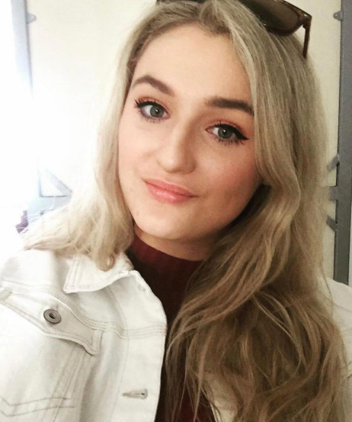
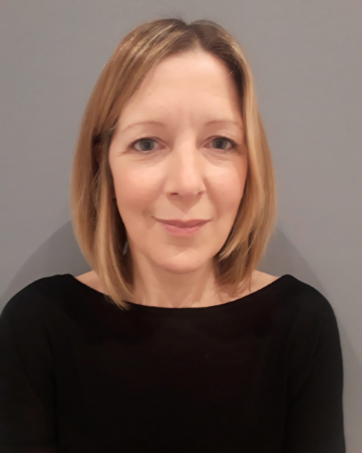
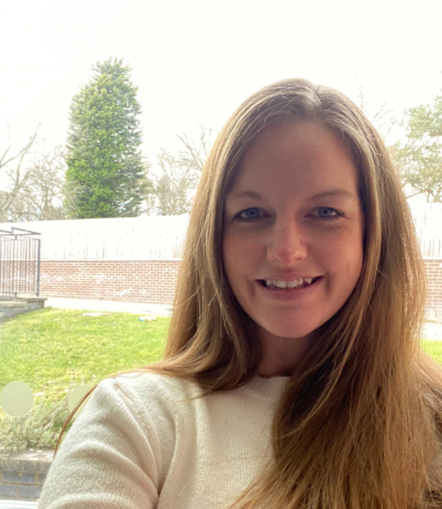
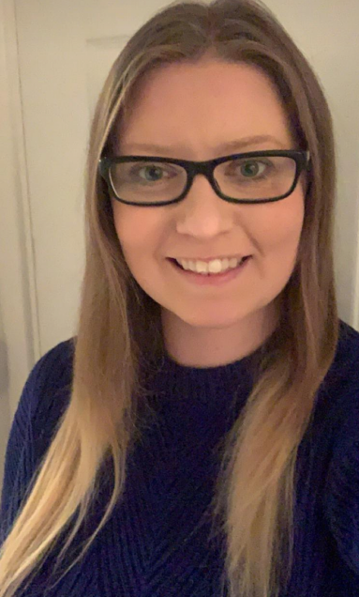
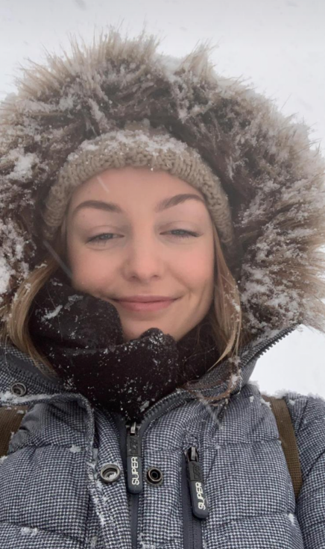
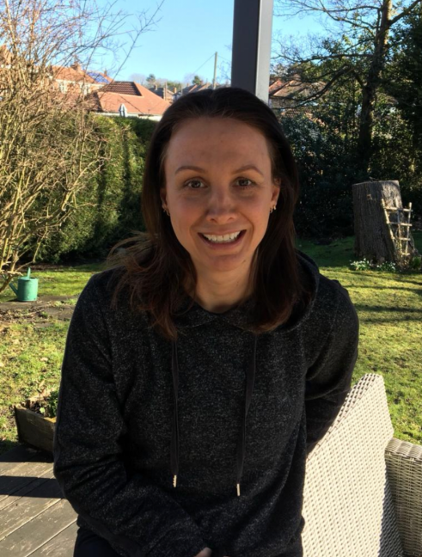
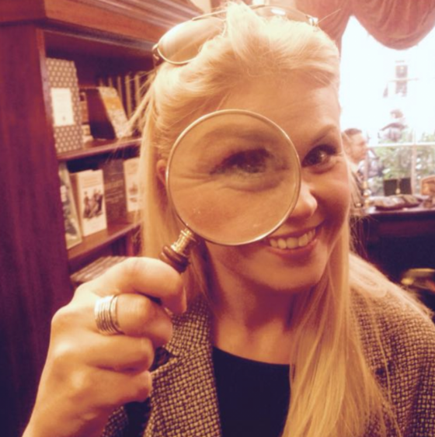

Slide 11
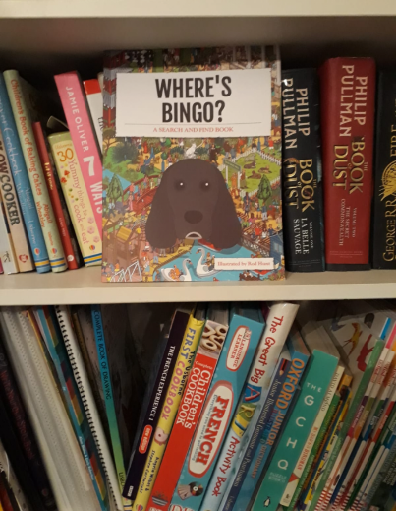
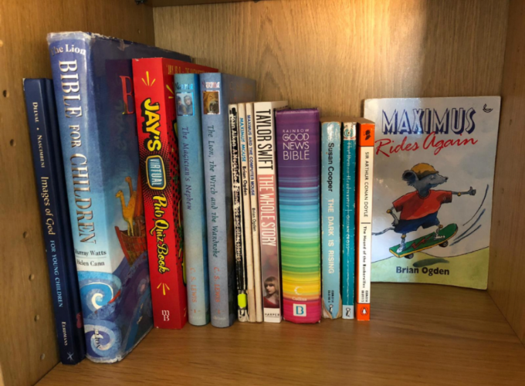
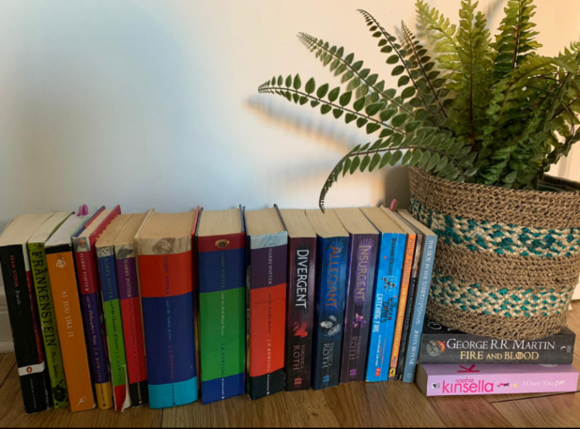
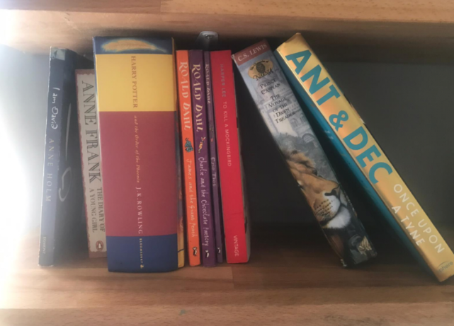

Slide 12
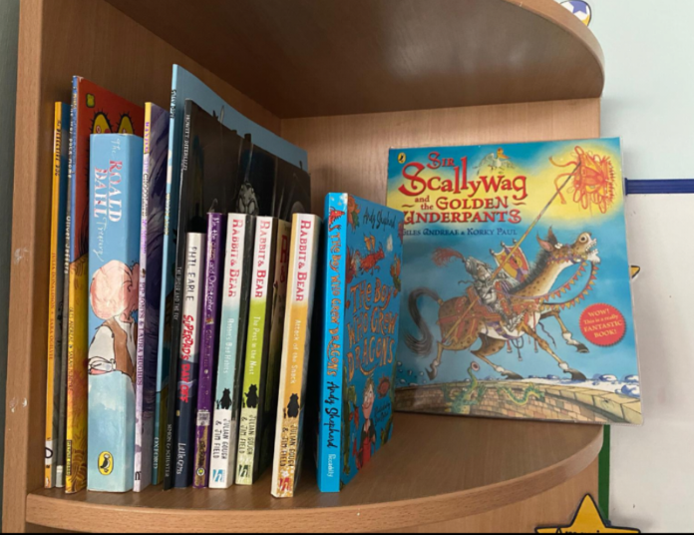
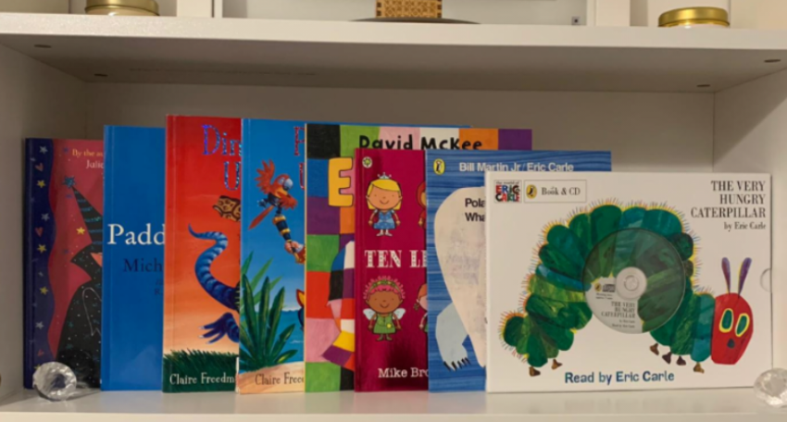
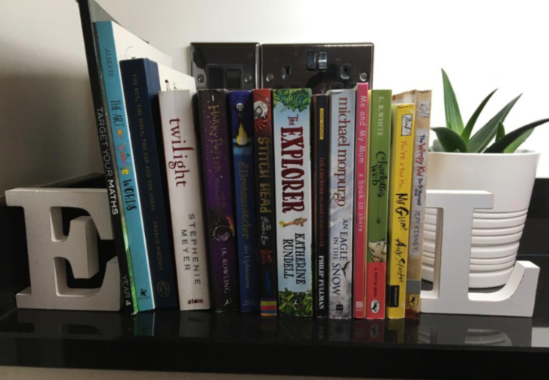
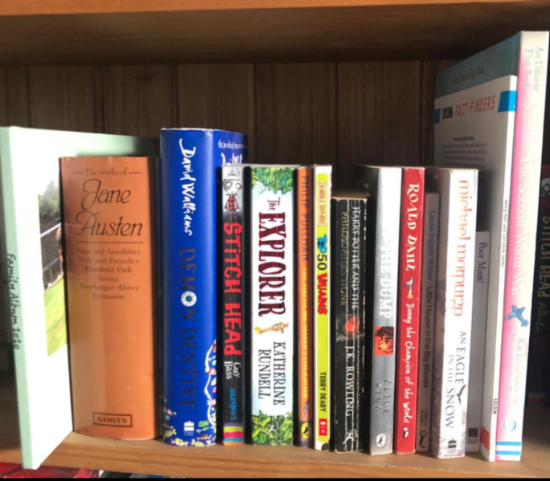
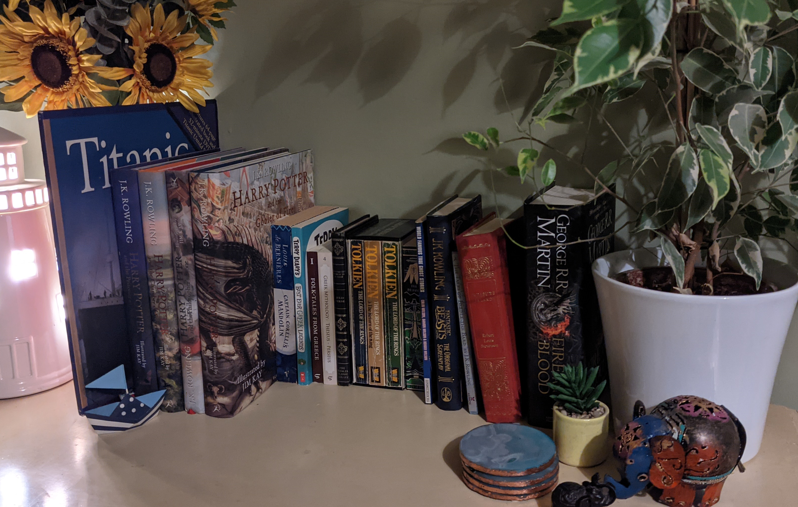

Slide 13
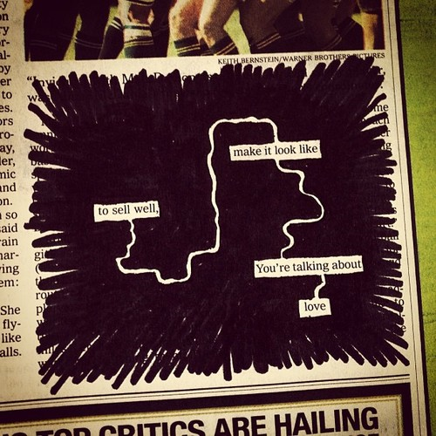
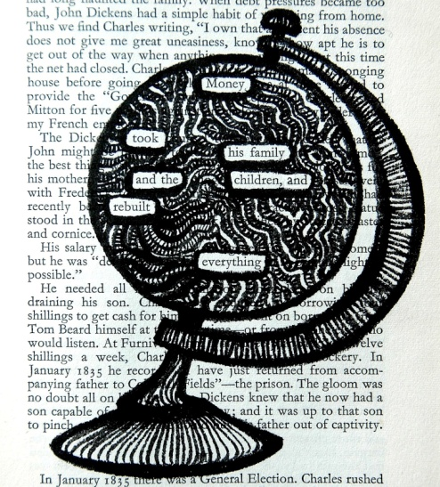
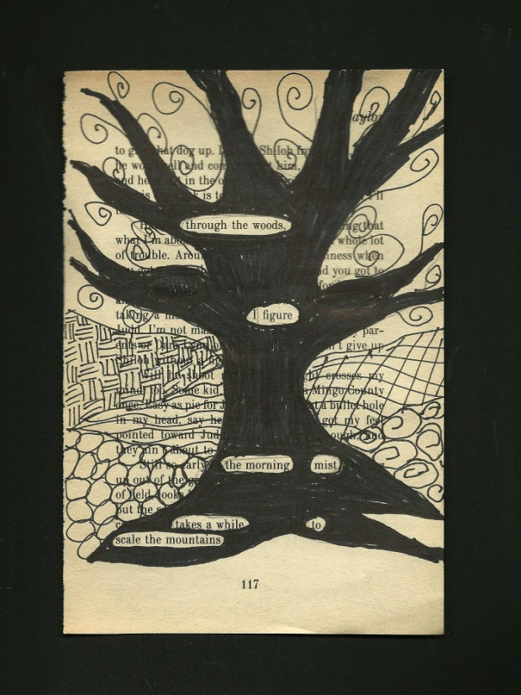
ACTIVITY SIX
Try your hand at some ‘Blackout Poetry!’
Have you ever wanted to write poetry but found it hard to find the words?
Here’s the answer…
Blackout poetry is taking a page from a book and creating a poem by deleting words.
It is what you choose to leave behind that is important.

Slide 14
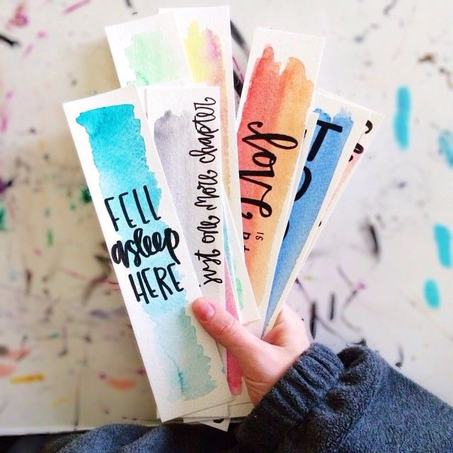
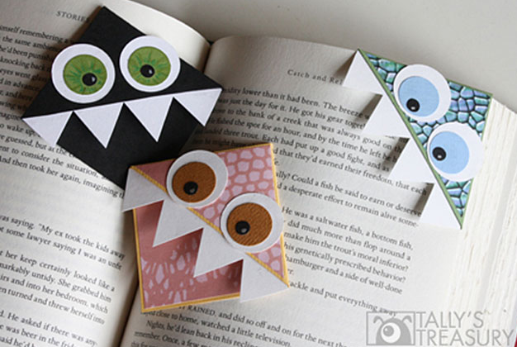
Can you design a bookmark for your favourite book? You could include a special quote from the story or even try one of these origami corner bookmarks here: https://www.redtedart.com/origami-bookmark/
ACTIVITY SEVEN
Design a bookmark

