Slide 1
Hello Year 2!
On Thursday it is World Book Day. There will be a lot of exciting activities for you to do related to books.
For our googlemeet on that day, you can dress up if you fancy or even create a mask to wear of your favourite character.
You can all share what you have been doing to celebrate wonderful books!
Have a lovely day,
from Mrs Southern

Slide 2
Mental Maths
https://www.topmarks.co.uk/maths-games/daily10
Choose: level 2 ➔ addition ➔ two-digit numbers
You choose the time intervals. We are trying to improve your speed but you also need to be accurate.

Slide 3
Phonics
Group 1:
Practise writing 3 of your spelling words within a sentence today.
Group 2 and 3:
Read Write inc – Ruth Misken Read/write session online
Lexia
Write out spellings for this week.

Slide 4
Reading Comprehension
Chapter 2 of the story is on purple mash.
I hope you enjoy it.

Slide 5
2.3.21
Re-read the story of Sir Scalleywag and The Golden Underpants.
Choose a section of the text to practise reading out loud. Can you change your voice for the different characters?

Slide 6
Apostrophe for possession
Today we are going to look at how apostrophes ( ‘ ) are used to show something belongs to someone else.
This is an apostrophe
Watch the video
https://www.bbc.co.uk/bitesize/topics/zvwwxnb/articles/zx9ydxs

Slide 7
Look at the pictures of the characters on the next slide and some of their possessions (nouns). Write some sentences, using an apostrophe to show the noun (the thing) belongs to them.
For example
The Giant’s red and white striped trousers.

Slide 9
Maths!
Today’s lesson is counting edges on 3D shapes.
Watch the video and then complete the worksheet on the website.
https://vimeo.com/514236813

Slide 10
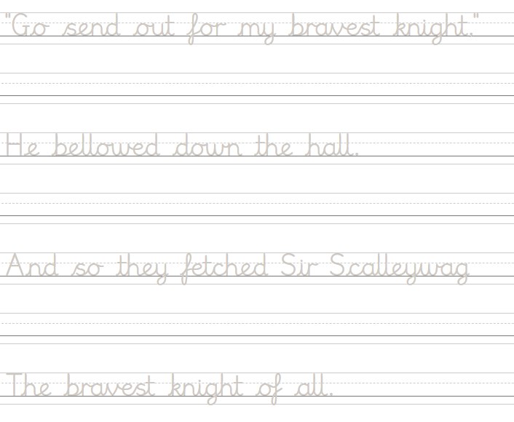
Handwriting

Slide 11
Choose a subject to do this afternoon, from the grid on the website!
Enjoy!

