Slide 1
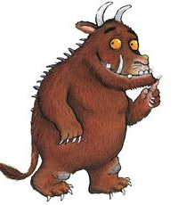
1. Who is this character?

Slide 2
2. What book is this character from?

Slide 3
3. Whose house does this character break into?

Slide 4
4. What is this character called?

Slide 5
5. What is this bear called?

Slide 6
6. What is the name of this character?

Slide 7
7. What is this book called?

Slide 8
8. What did this character come to the little girl’s house for?

Slide 9
9. What is the name of this elephant?

Slide 10
10. Who is this superhero?

Slide 11
11. What are these character’s going on?

Slide 12
12. What is the name of this book?

Slide 13
13. Who do these characters live with?

Slide 14
14. What is the name of this character?

Slide 15
15. Can you name 2 different books that this character is in?

Slide 16
16. What is this book called?

Slide 17
17. What is the name of the book that this character belongs to?

