Slide 1
Wednesday 3rd February 2021

Slide 2
Morning Job
Once you have completed this task. You can challenge yourself and pick another 4 digit number and complete the steps again.
Divide by 2
Make it into a Part Whole Model
Multiply by 100
2608
Make it into a Bar Model
Add 5600
Take away 1780

Slide 3
Rockstars

Slide 4
Maths
I can divide 4-digits by 1-digit

Slide 5
Have a look…
https://vimeo.com/492054136

Slide 8
1) 48 $÷$ 4 $=$
2) 480 $÷$ 4 $=$
3) 72 $÷$ 9 $=$
4) $÷$ 9 $=$ 800

Slide 9
12
1) 48 $÷$ 4 $=$
2) 480 $÷$ 4 $=$
3) 72 $÷$ 9 $=$
4) $÷$ 9 $=$ 800
120
8
7,200
72 $×$ 100

Slide 11
There are 4,884 crayons and they come
in packs of 4
How many packs are there?

Slide 12
There are 4,884 crayons and they come
in packs of 4
How many packs are there?
1,221 packs
Thousands | Hundreds | Tens | Ones
4 | 4 | 8 | 8 | 4
1
2
2
1

Slide 13
9,306 $÷$ 3
Have a think
Thousands | Hundreds | Tens | Ones
3 | 9 | 3 | 0 | 6
3
1
0
2

Slide 14
4,324 $÷$ 2
Thousands | Hundreds | Tens | Ones
2 | 4 | 3 | 2 | 4
2
1
6
2
1

Slide 15
Have a think
6,115 $÷$ 5
Thousands | Hundreds | Tens | Ones
5 | 6 | 1 | 1 | 5
1
2
2
3
1
1
1

Slide 16
Have a go at questions 1 - 3 on the worksheet

Slide 17
3 skateboards cost £72.99
How much does one cost?
.
3 | 7 | 2 | 9 | 9
2
4
.
3
3
1
1 skateboard $=$ £24.33

Slide 18
 | 9 | 4 | 2
3
1
4
3
3
1
9
Thousands | Hundreds | Tens | Ones

Slide 19
Have a go at the rest of the worksheet

Slide 20
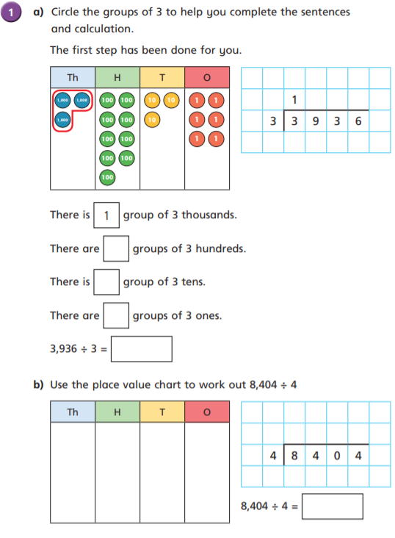
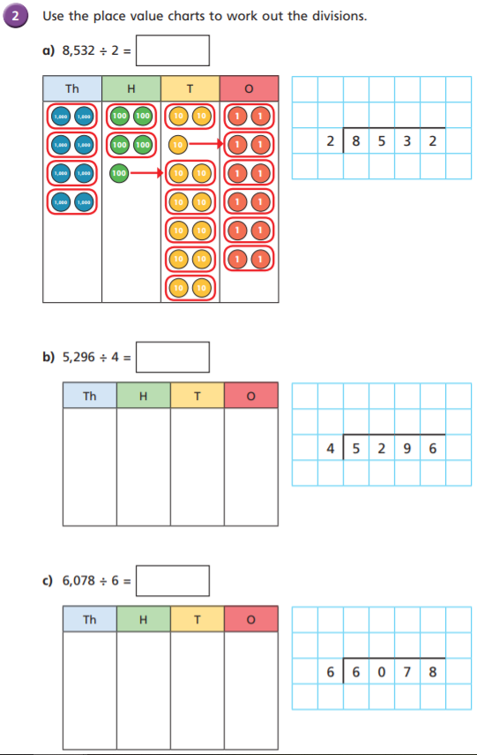

Slide 21
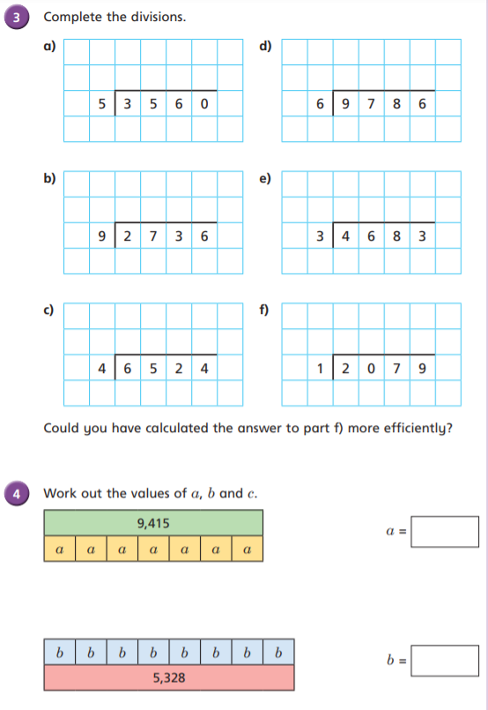
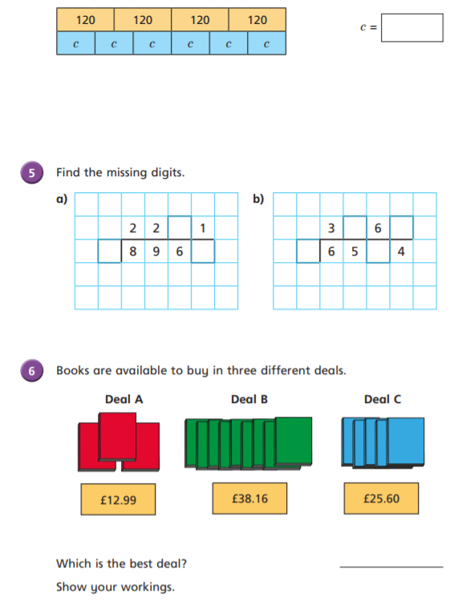

Slide 22
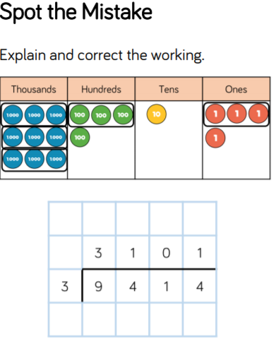
Optional Challenge:

Slide 23
Break

Slide 24
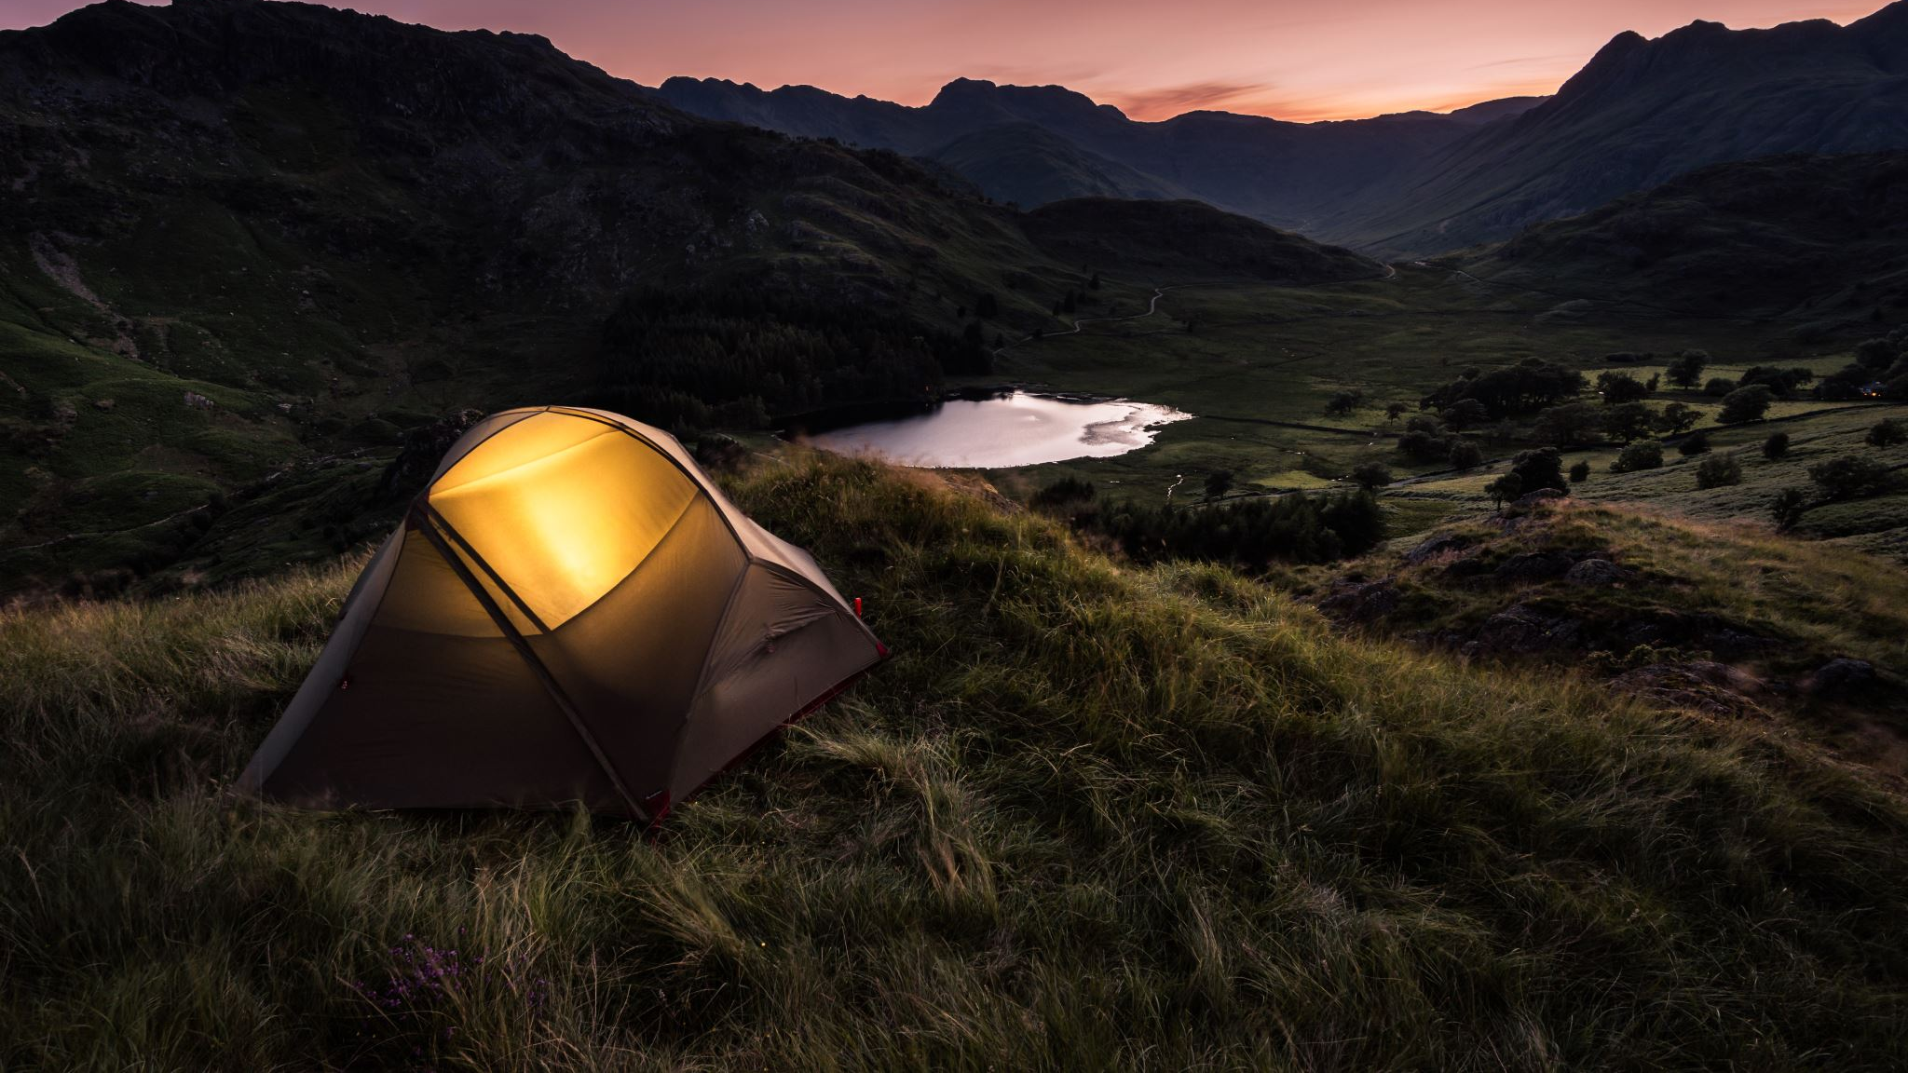
English
I can create a Newspaper report.

Slide 25
Brightstorm - Chapter 23 – The Plan

Slide 26
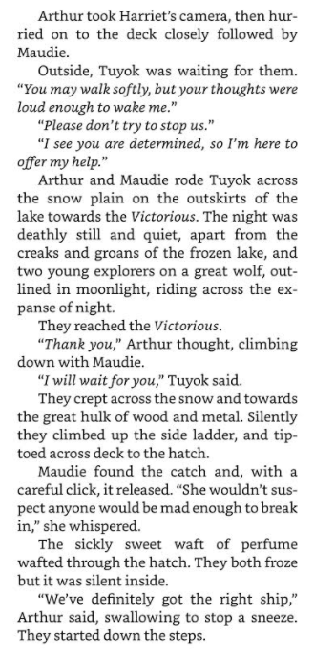
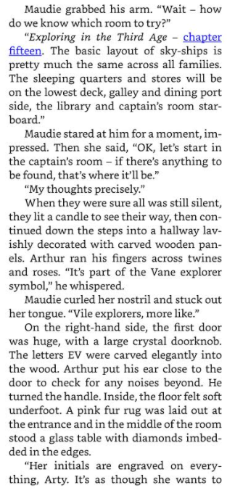

Slide 27
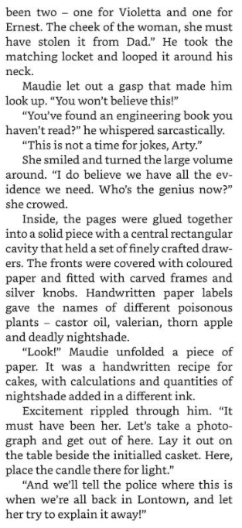
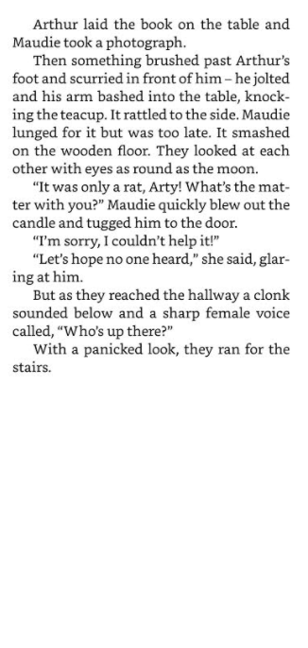

Slide 28
Activity – Wednesday and Thursday
Over the next 2 days you are going to create a Newspaper report. So DO NOT RUSH to complete this all in one day, push yourself and try your best.
I would advise you to complete - (Wed – Heading, Sub heading, Byline, Lead and ½ of the body)
I would then advise you to complete (Thursday – other ½ of your main body and then the tail paragraph)
Also on Thursday you can add colour to your border and headlines/titles, but most importantly go through and check your spelling and correct use of tense throughout!

Slide 29
Structure of a newspaper report
Headline and byline
Lead
Body
Tail

Slide 30
Headline
Headline and byline
For a good headline, you need to:
Catch the reader’s attention so they want to read the rest of the report;
Sum up the story in a few words;
Use powerful and interesting language;
Write in the present tense – even if the report is about an event that has already happened;
Include alliteration or wit at times.
Lead
Body
Tail

Slide 31
Byline
Headline and byline
Lead
For a good byline, you need:
The writer’s name;
The writer’s speciality (for example, Sports reporter, Food correspondent, Crime editor, Deputy politic editor, Senior fashion reporter);
A link to the writer’s Twitter account (for example, @dgoodman).
Body
Tail

Slide 32
Lead
Headline and byline
For a good lead paragraph, you need to;
Make the paragraph short and snappy so that it briefly explains what has happened;
Ensure that, even if the reader stopped reading at this point, they would still know roughly what happened;
Use past tense in most cases;
Make sure the first paragraph answers as many of these six questions as you can –
Who? What? Where? Why? When? How?
Lead
Body
Tail

Slide 33
Body
For a good body section, you need to:
Add more information and detail to your lead paragraph;
Include background information, evidence, facts and quotes from people involved in or connected to the event/story;
Continue to write in order of importance, putting the most important information in the first few paragraphs of the body section.
Headline and byline
Lead
Body
Having quotes from witnesses or experts
will make your report more credible and interesting.
Tail
Be sure to use correct punctuation for quotes!

Slide 34
Tail
For a good tail section:
Give the reader the opportunity to gain additional information if they are particularly interested in the topic of the news report;
Include links to previous news reports or useful websites;
Include a final quote from a witness or expert that helps to sum up the story or that could hint at what might happen next.
Headline and byline
Lead
This ‘Tail’ information can be useful but is not always needed. It tends to be the least important information in the report.
Body
Tail

Slide 35
You can use this template or create your own!

Slide 36
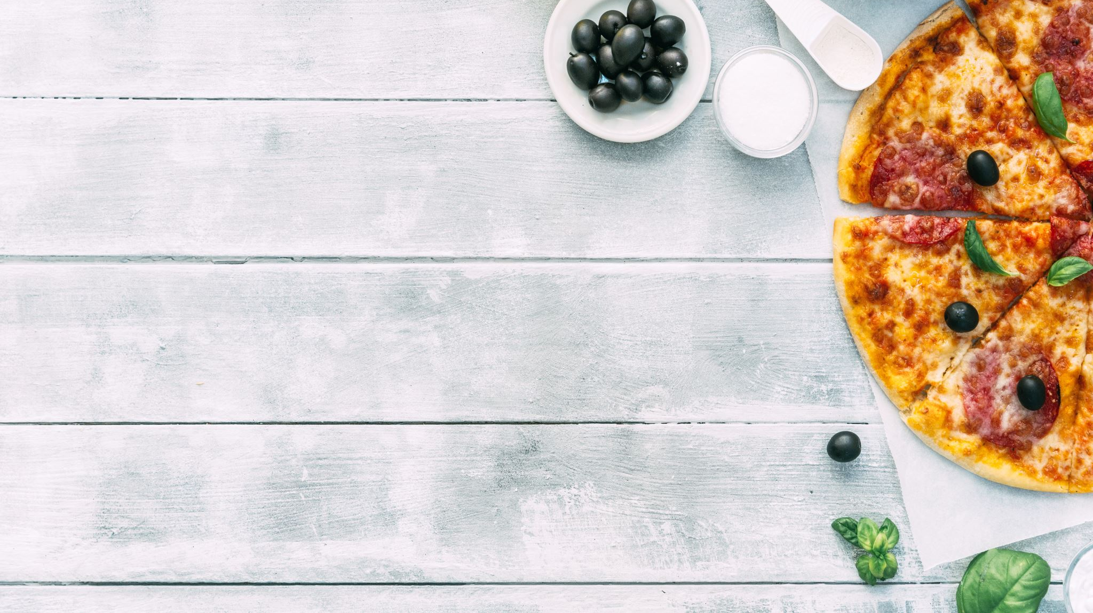
Lunch

Slide 37
History George Stephenson
I can discuss the impact and causes of historical changes in Britain.

Slide 38
Legacy

Slide 39
Tell me about some significant figures from the North East. What is their legacy?

Slide 40
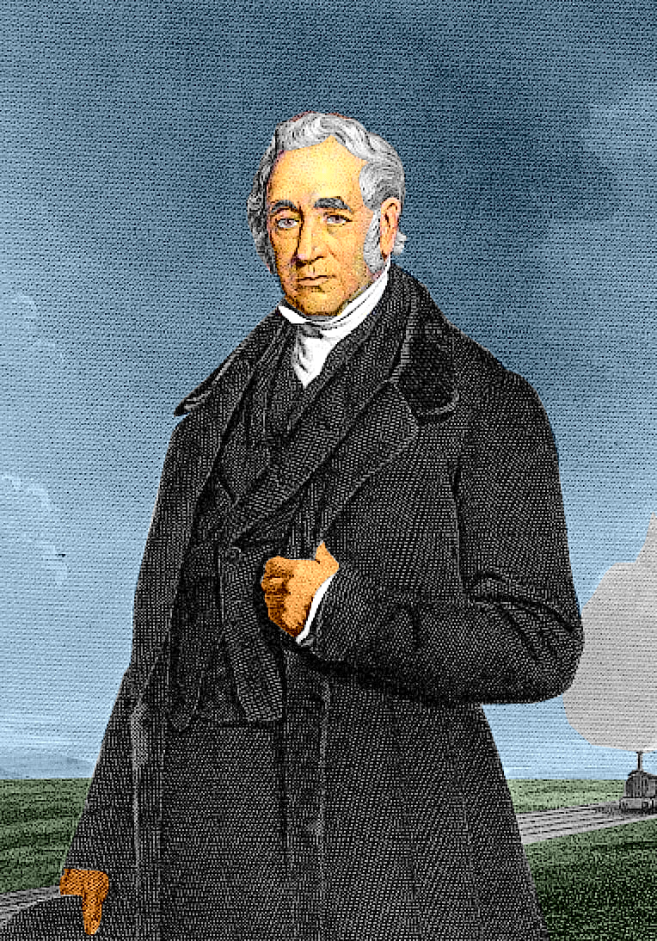
George Stephenson
Do you have any existing knowledge?

Slide 41
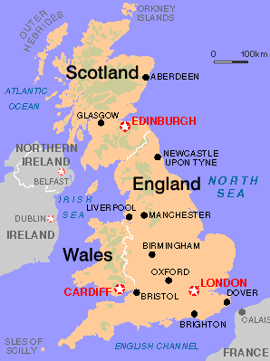
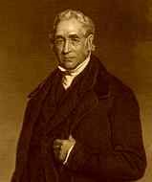
George Stephenson was born on June 9, 1781, in Wylam near Newcastle-upon-Tyne.
His father worked in a colliery as a fireman.

Slide 42
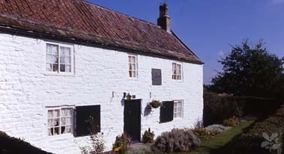
This is the cottage where George Stephenson was born. His whole family lived in the one room.

Slide 43
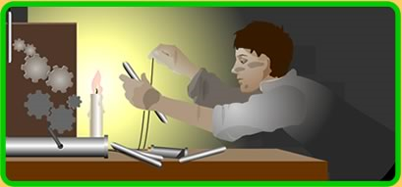
When George Stephenson was younger, he was interested in machinery and how it worked.

Slide 44
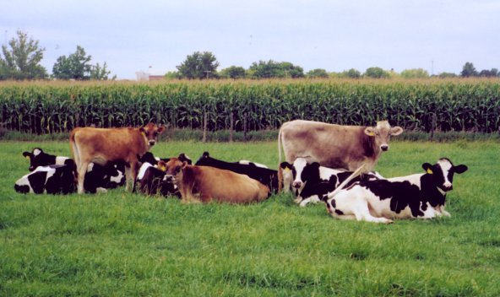
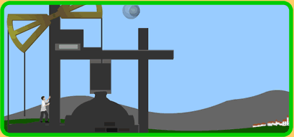
He went to work at the age of 8 herding cows.
At 14 he joined his father at the Dewley Colliery.

Slide 45
He did not go to school until he was 18. He went 3 times a week after work in the evening and learnt to read and write.

Slide 46
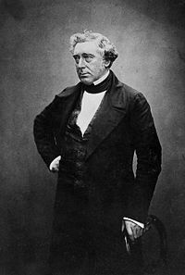
In 1802 Stephenson became a colliery engineman. Later that year, he married Frances Henderson, a servant at a local farm.
To earn extra money, in the evenings, he repaired clocks and watches. On 16th October, 1803, his only son, Robert was born.
Robert Stephenson

Slide 47
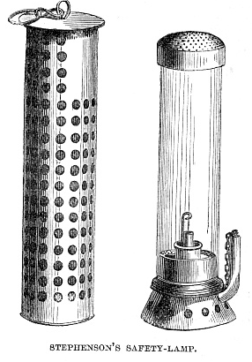
In 1815, he invented a safety lamp for use in coalmines, nicknamed the 'Geordie'.

Slide 48
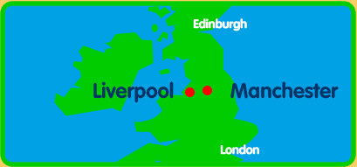
In 1819, George Stephenson got the chance to build his first railway at Hetton Colliery.
In 1829, it was decided that there would be a railway built between Liverpool and Manchester. George Stephenson built the railway.

Slide 49
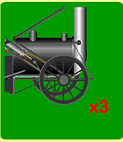
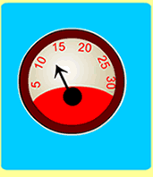
The owners of the railway decided to have a competition to find the best kind of locomotive to pull heavy loads over long distances.
There was a prize of £500 for winning. Each locomotive had to pull 3 times its own weight.
The speed had to be at least 10 mph.

Slide 50
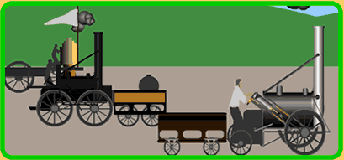
The competition was held at a place called Rainhill. Rainhill is the place outside Liverpool where the trials were held. The competition took place over several days and each of the engines did the trial, on their own, against the clock. Ten engines entered the competition originally. Thousands of people came to watch this event.

Slide 51
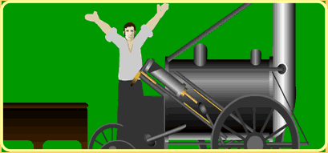
At the end of the competition, the judges decided that the 'Rocket' built by George Stephenson had won.

Slide 52
On 30th September 1830 the Manchester to Liverpool railway opened. It was a grand event.

Slide 53
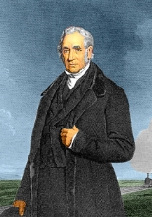
George Stephenson went on to build many other railways. George Stephenson died in 1848.

Slide 54
ACTIVITY
To discuss the impact of historical changes
You will be given a piece of information about how George Stephenson changed lives and the effect his work had on thousands of people.
Your challenge:
To create a poster which shows how life changed because of George Stephenson.
Slides 43- 51 will help you gather the information for your poster

Slide 55
Top Tips

Slide 61
Source H: RJ Huggins, 1997. The speed at which trains could travel also changed the food that people could eat. Fresh eggs, milk and fish could be carried into the new industrial towns. Fish and chips began to replace pigs’ trotters as a cheap working class supper! Differences between different areas started to break down as people from different areas came into contact with each other. For example, local accents and dialects became less noticeable as people began to mix and talk to each other.

Slide 63
Hometime

