Slide 1
Tuesday 9th February 2021

Slide 2
Morning Job
Optional Challenge: If you have finished, create 3 of your own sentences.

Slide 3
P.E 0930-1030

Slide 4
Break

Slide 5
Maths
Equivalent Fractions

Slide 6
Please watch…
https://vimeo.com/498327458

Slide 9
1)
2)
3)
4)
$$\frac{\text{1}}{\text{4}}$$
$$\frac{\text{1}}{\text{2}}$$
$$\frac{\text{1}}{\text{2}}$$
$$\frac{\text{7}}{\text{14}}$$
$$\frac{\text{13}}{\text{26}}$$
$$\frac{\text{15}}{\text{31}}$$
$$\frac{\text{3}}{\text{5}}$$
$$\frac{\text{2}}{\text{5}}$$

Slide 10
1)
2)
3)
4)
$$\frac{\text{1}}{\text{4}}$$
<
$$\frac{\text{1}}{\text{2}}$$
$$\frac{\text{1}}{\text{2}}$$
=
$$\frac{\text{7}}{\text{14}}$$
$$\text{13 }\text{is} \text{half} \text{of}\text{ 26}$$
$$\frac{\text{13}}{\text{26}}$$
>
$$\frac{\text{15}}{\text{31}}$$
$$\frac{\text{13}}{\text{26}}$$
$$\frac{\text{1}}{\text{2}}$$
$$\text{=}$$
$$\frac{\text{3}}{\text{5}}$$
>
$$\frac{\text{2}}{\text{5}}$$
$\text{15 }\text{is} \text{less} \text{than} \text{half} \text{of}$31
$$\frac{\text{15}}{\text{31}}$$
$$\frac{\text{1}}{\text{2}}$$
$$<$$

Slide 12
Equivalent
Equal
The same value

Slide 13
$$\frac{\text{1}}{\text{4}}$$
Numerator –
How many of the parts we are using
Denominator –
How many equal parts there are
$$\frac{\text{2}}{\text{8}}$$
$\frac{\text{1}}{\text{4}}$ is equivalent to $\frac{\text{2}}{\text{8}}$
$\frac{\text{2}}{\text{8}}$ is equivalent to $\frac{\text{1}}{\text{4}}$
What do you notice?

Slide 14
Is $\frac{\text{6}}{\text{9}}$ equivalent to $\frac{\text{2}}{\text{3}}$ ?
$\frac{\text{6}}{\text{9}}$ is equivalent to $\frac{\text{2}}{\text{3}}$
$\frac{\text{2}}{\text{3}}$ is equivalent to $\frac{\text{6}}{\text{9}}$

Slide 15
Have a think
Odd One Out
$$\frac{\text{4}}{\text{9}}$$
$$\frac{\text{6}}{\text{9}}$$
$$\frac{\text{4}}{\text{6}}$$

Slide 16
$\frac{\text{1}}{\text{6}}$ = $\frac{\text{2}}{\text{12}}$
$\frac{\text{3}}{\text{4}}$
$=$ $\frac{\text{6}}{\text{8}}$
$=$ $\frac{\text{9}}{\text{12}}$
$\frac{\text{2}}{\text{3}}$
$=$ $\frac{\text{4}}{\text{6}}$
$=$ $\frac{\text{6}}{\text{9}}$
$=$ $\frac{\text{8}}{\text{12}}$
Have a think
1
$\frac{\text{1}}{\text{2}}$
$\frac{\text{1}}{\text{3}}$
$\frac{\text{2}}{\text{3}}$
$\frac{\text{1}}{\text{4}}$
$\frac{\text{3}}{\text{4}}$
$\frac{\text{1}}{\text{5}}$
$\frac{\text{1}}{\text{6}}$
$\frac{\text{4}}{\text{6}}$
$\frac{\text{1}}{\text{7}}$
$\frac{\text{1}}{\text{8}}$
$\frac{\text{6}}{\text{8}}$
$\frac{\text{1}}{\text{9}}$
$\frac{\text{6}}{\text{9}}$
$\frac{\text{1}}{\text{10}}$
$\frac{\text{1}}{\text{11}}$
$\frac{\text{1}}{\text{12}}$
$\frac{\text{2}}{\text{12}}$
$\frac{\text{8}}{\text{12}}$
$\frac{\text{9}}{\text{12}}$

Slide 17
Have a go at questions 1 - 4 on the worksheet

Slide 18
Always, sometimes, never?
“The greater the numerator, the
greater the fraction.”
$\frac{\text{1}}{\text{7}}$ $\frac{\text{4}}{\text{7}}$

Slide 19
Always, sometimes, never?
“The greater the numerator, the
greater the fraction.”
$\frac{\text{1}}{\text{3}}$ $\frac{\text{2}}{\text{10}}$

Slide 20
Have a go at question 5 on the worksheet

Slide 21
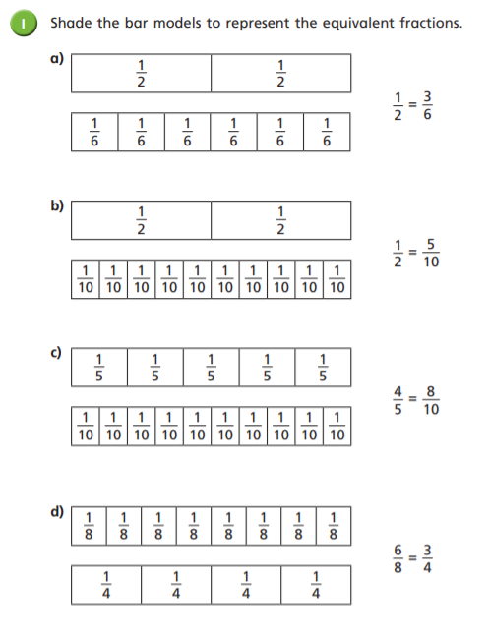
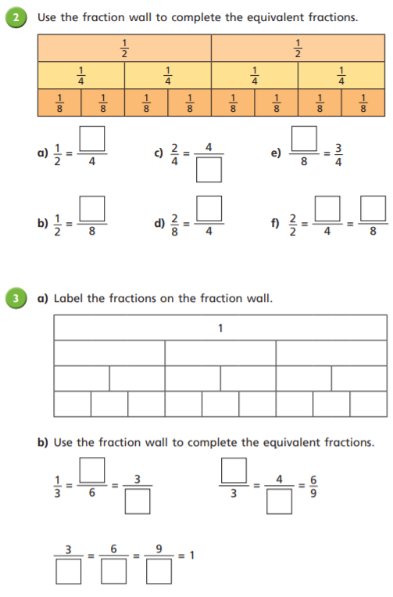

Slide 22
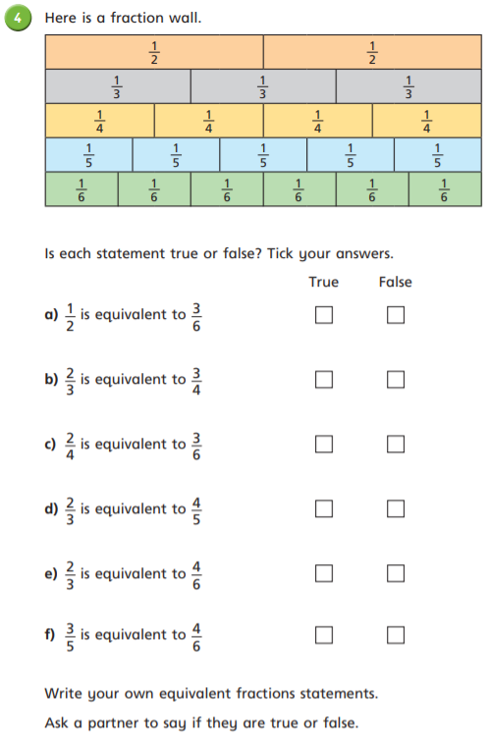
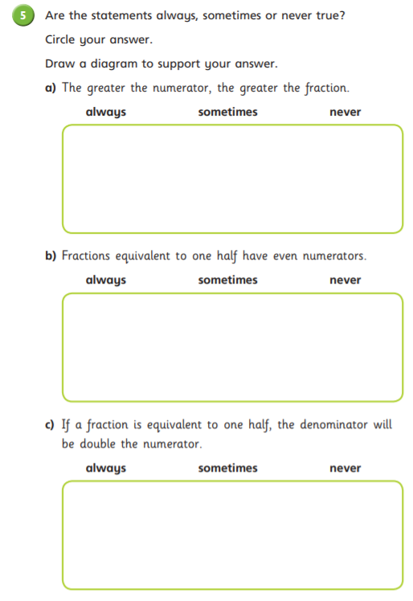

Slide 23
Lunch

Slide 24
English – Chapter 27 – The Southern Aurora

Slide 25
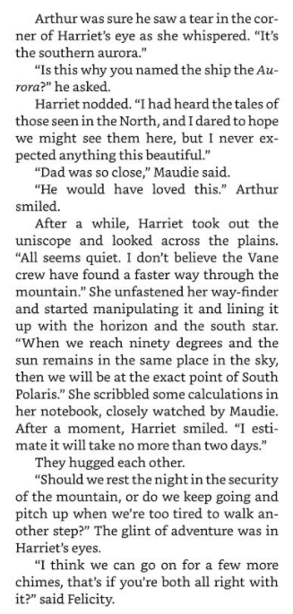
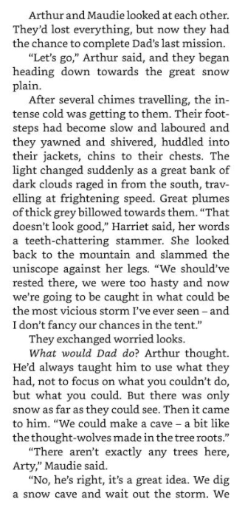

Slide 26
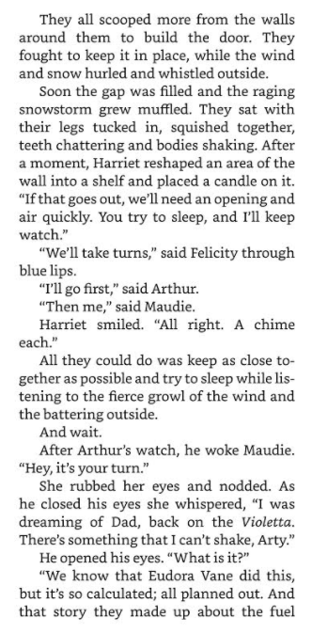
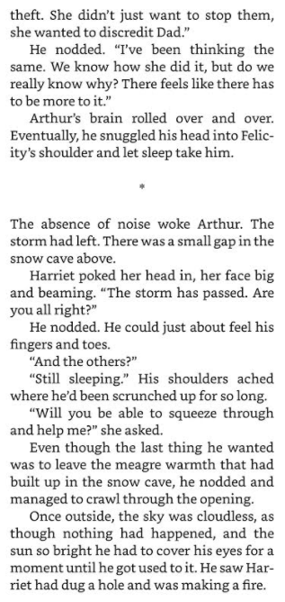

Slide 27
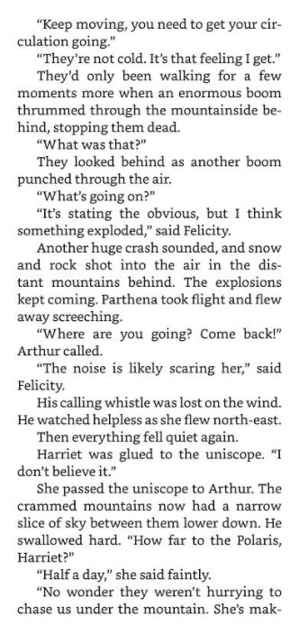
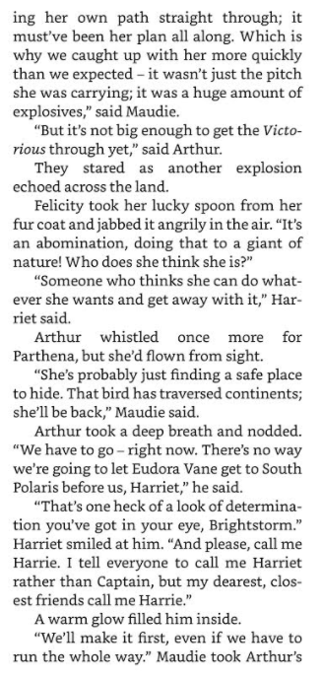

Slide 28
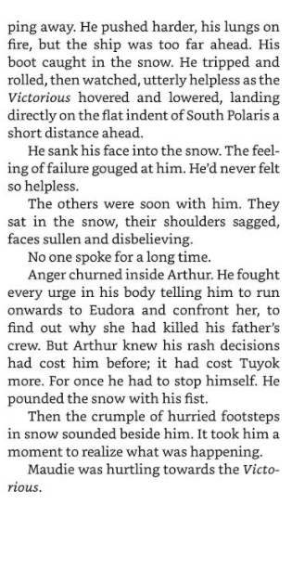

Slide 29
Modal verbs are auxiliary verbs which cannot usually work alone.
They are used with a main verb.
These are modal verbs:
might
will
should
may
would
can
could
must
shall
ought to

Slide 30
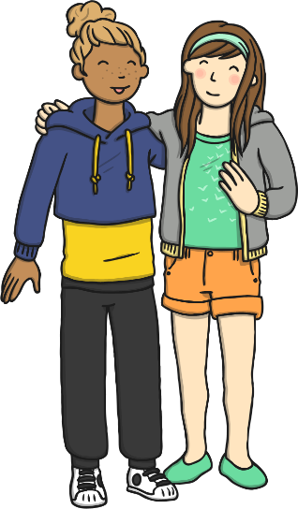
Modal verbs make questions by inversion.
She can go out.
Can she go out?
We could drive there.
Could we drive there?
Children should eat fruit.
Should children eat fruit?

Slide 31
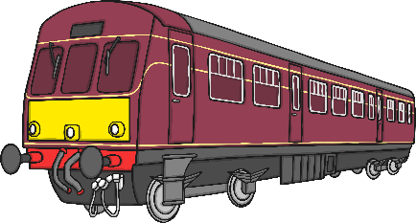
Modal verbs can be used to show how possible something is,
or how likely it is to happen/have happened.
For example:
He’s very late. He could have missed the train.
It’s snowing so it must be very cold outside.
They will lock the windows when they go out.

Slide 32
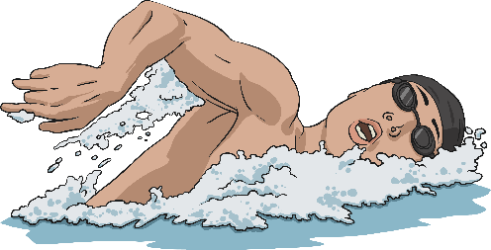
Can you spot the Modal verbs used
to show possibility in these sentences?
might
Mum might take us swimming after school.
could
You could eat a banana instead of those sweets.
will
Hurry up!
“Hurry up! We will be late!” said Dad
can
We can go the other way – it’s quicker.
You ought to go to bed earlier.
ought

Slide 33
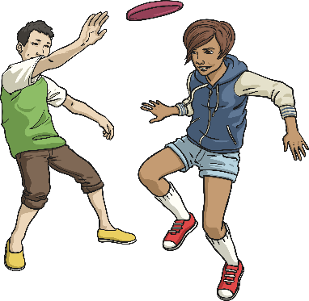
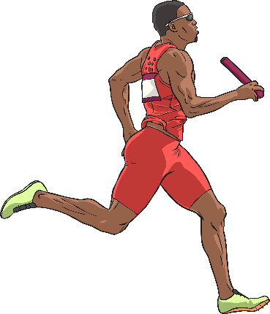
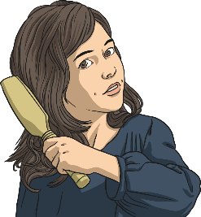
Which Modal verbs are missing
from these sentences?
must
You be hot in that thick coat.
shall
If it’s dry, we play outside?
He’s so fast, he win the race.
should
I’m fed up with my long hair. I have it cut.
might
Did you choose these modal verbs?
Which others could you have used?

Slide 34
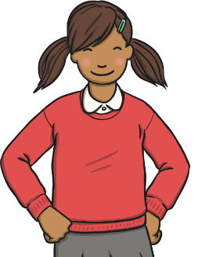
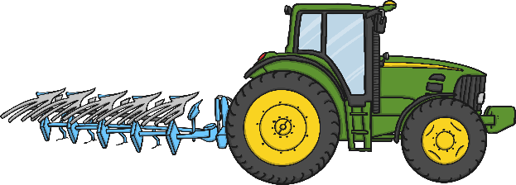
Modal verbs can also be used to show:
advice or obligation
habits
I will often have cereal for
my breakfast.
We shall always enjoy a
walk in the park.
Pupils must wear a uniform.
You should not smoke.
permission
ability
May I leave a few minutes early?
Could we go to the post
box on the way?
Please can we have an
ice cream?
I can drive a tractor.
My grandfather could
draw very well.

Slide 35
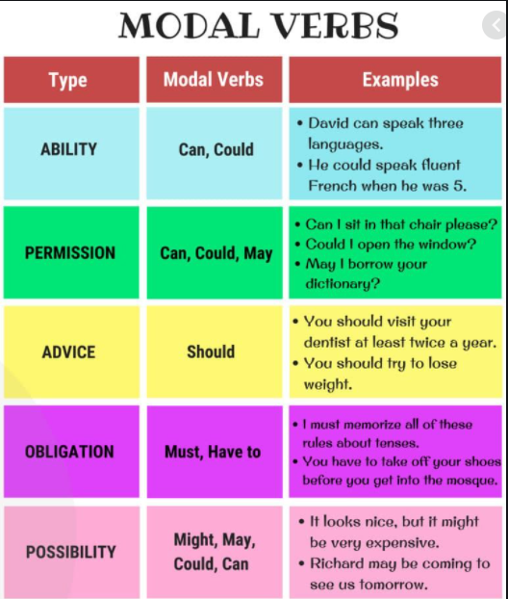

Slide 36
Activity -
Highlight the Modal Verbs below:
1. The crew might not believe their eyes when they see the end of the tunnel.
2. Harriet couldn’t wait to be outside again.
3. The crew might not see such a beautiful sight again such as the Aurora.
Fill in the missing space:
1. Felicity ______ want to travel deeper into the snow plain for a few more chimes.
2. Maudie thought that they _____ not survive in the storm.
3. Arthur _______ stray too far away from Maudie in case he gets lost.
Challenge: Create 3 sentences of your own (related to Brightstorm Chapter 27) that include a Modal verb!

