Slide 1
Tuesday 2nd February 2021

Slide 2
Morning Job – Reading and Spelling
Read your library/reading book for 15 minutes with an adult and discuss what you have read!
Challenge: Practice 12/9/7 times tables

Slide 3
PE 0930 -1030

Slide 4
Break

Slide 5
Maths
I can divide 3-Digits by 1-Digit.

Slide 6
Have a look…
https://vimeo.com/492054040

Slide 9
1) 84 ÷ 3 =
2) 85 ÷ 3 =
3) 83 ÷ 3 =
4) 490 ÷ 7 =

Slide 10
1) 84 ÷ 3 =
2) 85 ÷ 3 =
3) 83 ÷ 3 =
4) 490 ÷ 7 =
28
84
28 r 1
60
24
27 r 2
÷ 3
÷ 3
20
8
70

Slide 12
609 ÷ 3 =
2
0
3
H | T | O

Slide 13
576 ÷ 4 =
144
H | T | O
576
400
16
160
÷ 4
÷ 4
÷ 4
100
4
40

Slide 14
115 ÷ 5 =
23
H | T | O
115
100
15
÷ 5
÷ 5
20
3

Slide 15
765 ÷ 5 =
153
Have a think
67
2) 201 ÷ 3 =
H | T | O
H | T | O
201
765
500
15
180
21
250
÷ 3
÷ 5
÷ 3
÷ 5
÷ 5
100
3
60
50
7

Slide 16
776 ÷ 4 =
194
776 $−$ 400 = 376
776
400
16
360
÷ 4
÷ 4
÷ 4
100
4
90

Slide 17
Have a go at questions 1 - 5 on the worksheet

Slide 18
638 ÷ 3 =
212 r 2
638
638
600
8
600
2
30
36
÷ 3
÷ 3
÷ 3
÷ 3
÷ 3
÷ 3
200
2 r 2
200
r 2
10
12

Slide 19
Have a think
1) 708 ÷ 7 =
101 r 1
2) 865 ÷ 4 =
216 r 1
708
865
700
8
800
25
0
40
÷ 7
÷ 7
÷ 4
÷ 4
÷ 7
÷ 4
100
1 r 1
200
6 r 1
0
10

Slide 20
Have a think
Tom has £317
He gives each of his 5 grandchildren an equal amount of whole pounds.
How much money does Tom have left?
£2
317 ÷ 5 =
63 r 2
300 ÷ 10 =
30
317
30 × 2 =
60
300
17
÷ 5
÷ 5
60
3 r 2

Slide 21
Have a go at questions 6 - 9 on the worksheet

Slide 22
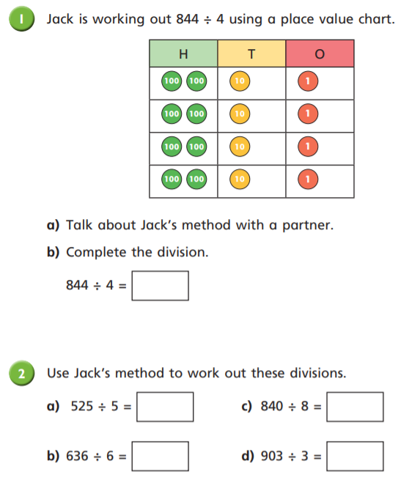
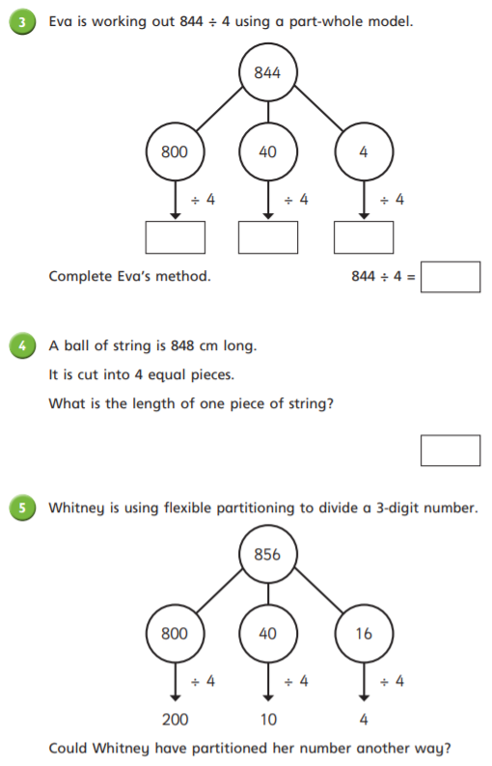

Slide 23
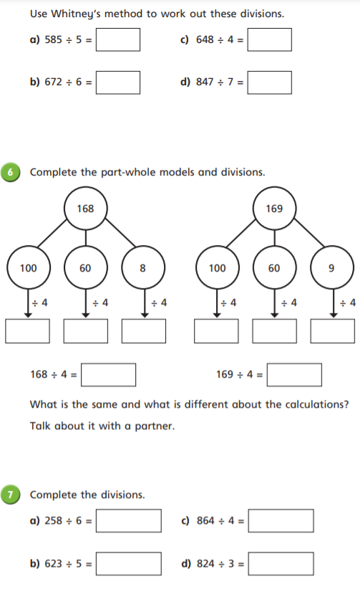
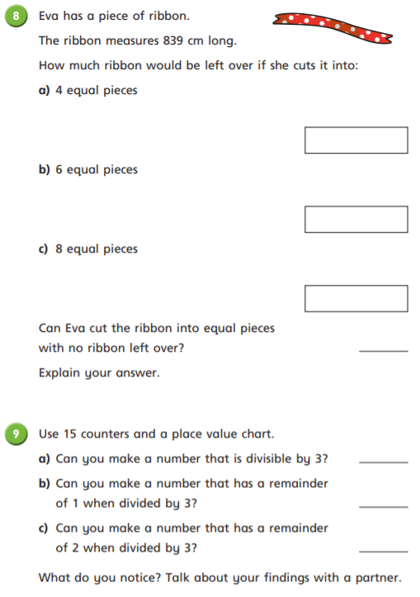

Slide 24
English
I can

Slide 25
Brightstorm Chapter 22 – Ghost Sky-Ship

Slide 26
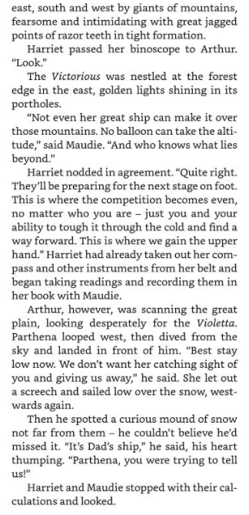
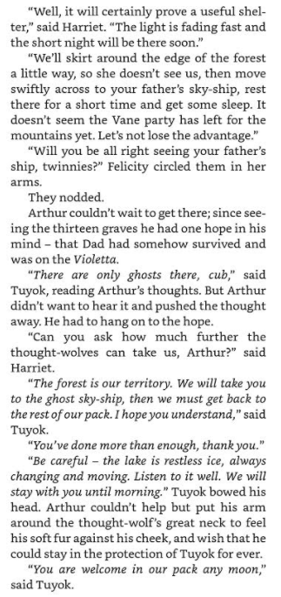

Slide 27
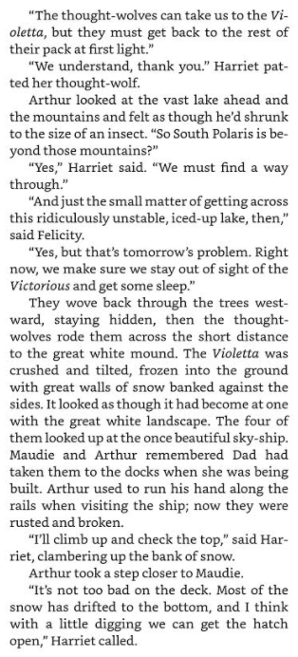
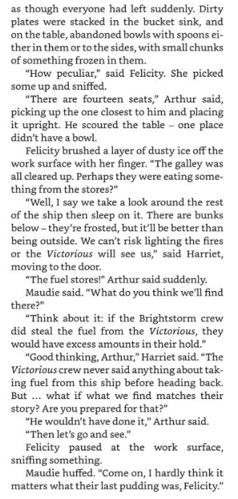

Slide 28
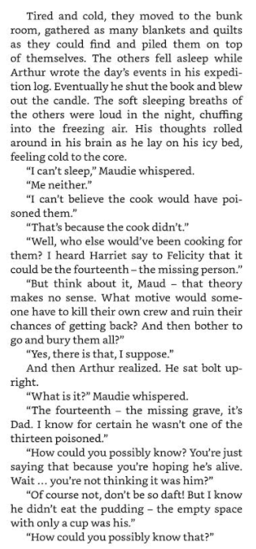
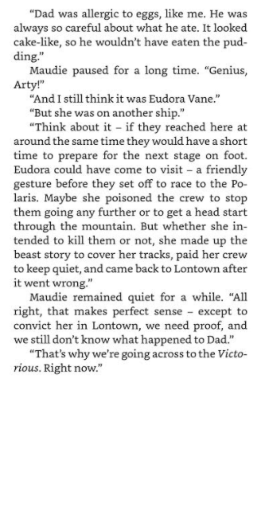

Slide 29
Activity – Plan
You are going to need to plan your Newspaper Article.
Task:
You are a news reporter who has arrived in South Polaris just behind the Aurora, and you see the sky-ship crash deep into the forest.
Your job is to cover the events of the crash!
Who was there?
What happened?
Why it happened?
What happened after and who was involved?
What did the characters say when you interviewed them

Slide 30
Before you write the article…
You need to plan what you are going to write in each section:
Bullet point some ideas for each section that you could cover in your report!
Headline:
Byline:
Intro:
Lead:
Body:
Tail:

Slide 31
Example of Activity:I have given you the first few points to give you an idea of what I expect.
Headline – Lontown Locals Come Crash Down To Earth
Byline – by Mr Hall: Reporter for Lontown News Today find or find on Tatter: @MrHallisapunintendedhero.
Lead – Disaster strikes the Aurora Sky Ship! Arthur and Maudie Brightstorm along with Harriet Culpepper (and their crew) have hit a snag in their expedition as they crash into a forest in South Polaris.
Focus on putting your work into the body:
Body – Add more information and detail to your lead paragraph; Include background information, evidence, facts and quotes from people involved in or connected to the event/story;
Continue to write in order of importance, putting the most important information in the first few paragraphs of the body section.
Tail- Give the reader the opportunity to gain additional information if they are particularly interested in the topic of the news report;
Include a final quote from a witness or expert that helps to sum up the story or that could hint at what might happen next.

Slide 32
Lunch

Slide 33
ART – John Dobson

Slide 34
Who is John Dobson?
John Dobson (1787 – 8 January 1865) was a 19th-century English architect in the neoclassical tradition. He became the most noted architect in the North of England.
During his career he designed more than 50 churches and 100 private houses. However, he is best known for designing Newcastle railway station and for his work with Richard Grainger developing the centre of Newcastle in a neoclassical style.

Slide 35
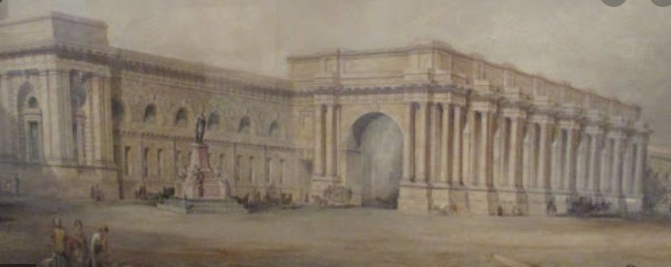
Newcastle Railway Station

Slide 36
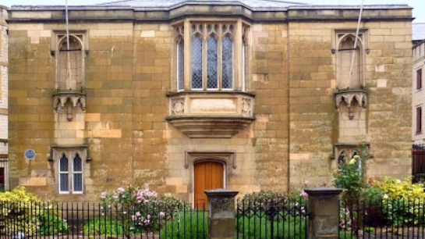
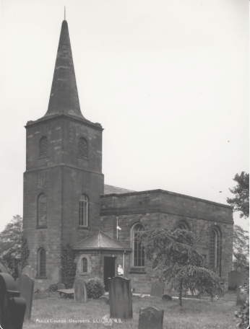
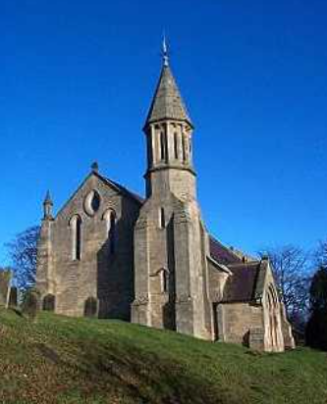
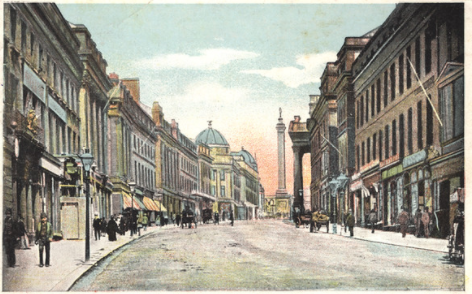
Neoclassical style

Slide 37
Activity – You are going to…
Research deeper into John Dobson and Neoclassical style – Do not make this a research project!!! (Computer chromebook)
The reason for further research is to get a clearer understanding of what John Dobson did and what Neoclassical design consisted of!
This just to inspire and influence your drawings
Then you are going to pick one of his designs to recreate using a pencil drawing or sketch.
Take your time as you will be adding more detail (shading etc) next week.

