Slide 1
Good morning Year 2!
I am looking forward to seeing you all for the live story session at 1:00pm.
Please can you all make sure your grown-ups have completed the consent form for googlemeet, so that you can attend the session.
Let me know if you can’t log in, before the session so we can sort it.
From Mrs Southern xx

Slide 2
Mental Maths
I hope you are all managing to improve your mental maths. Don’t forget that accuracy is important too so don’t go too fast that you are getting the answers wrong. Adapt the interval time between each questions to suit you!
Daily 10 is a perfect game for this;
https://www.topmarks.co.uk/maths-games/daily10
Choose: level 2 ➔ subtraction ➔ missing numbers: 10’s up to 100.
10 seconds might be a good place to start with this, but you can choose longer or shorter intervals depending on your confidence!

Slide 3
SPAG
Complete the SPAG mats 3 and 4 on the website. These mats review what you have already learned. Read the questions carefully.
Each ‘mat’ has 3 levels of sheets. Choose the sheet which is best for you. 1 is a bit easier and 3 is more of a challenge. Most of you should try the 2nd sheet.

Slide 4
25.2.21
Did you enjoy the first part of the book? I really liked learning about the different characters. Sir Scalleywag is my favourite because he’s so small but still brave but King Colin really makes me laugh.
At school we were imagining that our pants had powers. What could yours do?
Read the next few pages on the slides. Remember to read with fluency and rhythm. You might want to re-read the pages from yesterday too.

Slide 5
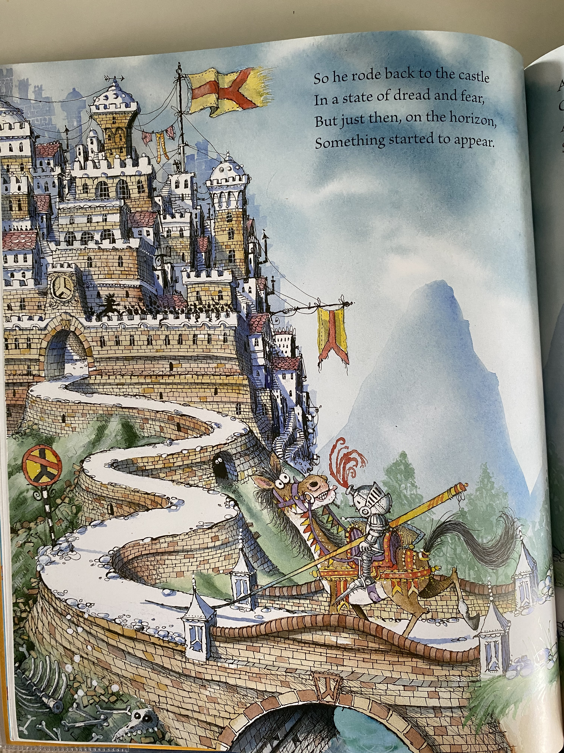

Slide 6
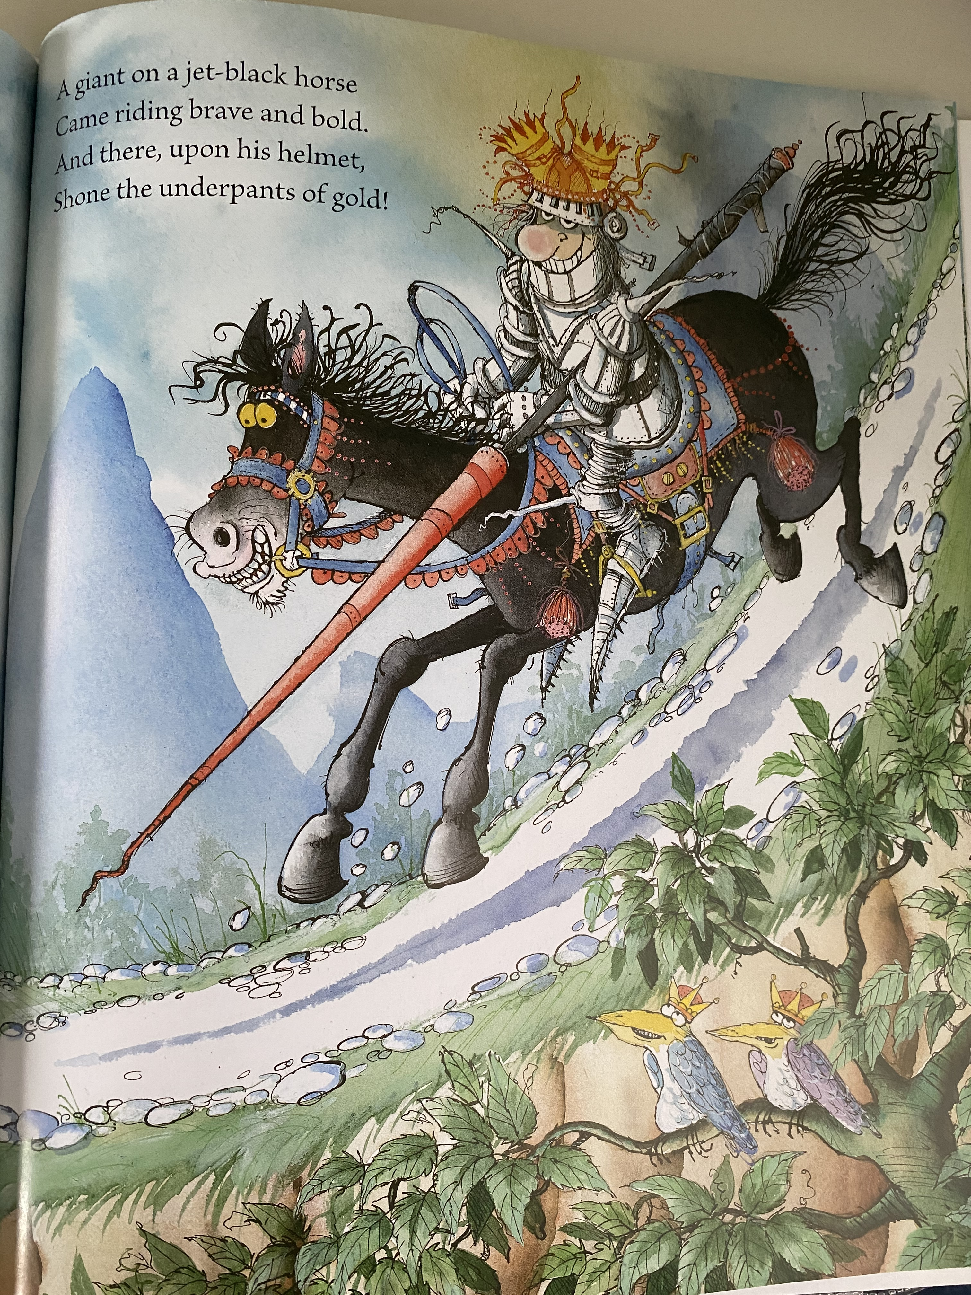

Slide 7
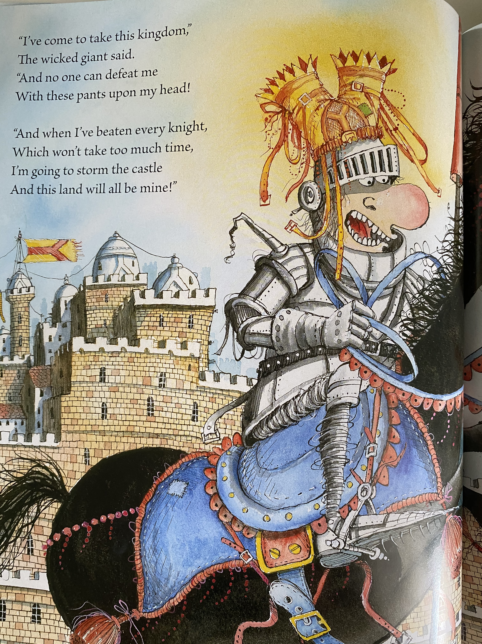

Slide 8
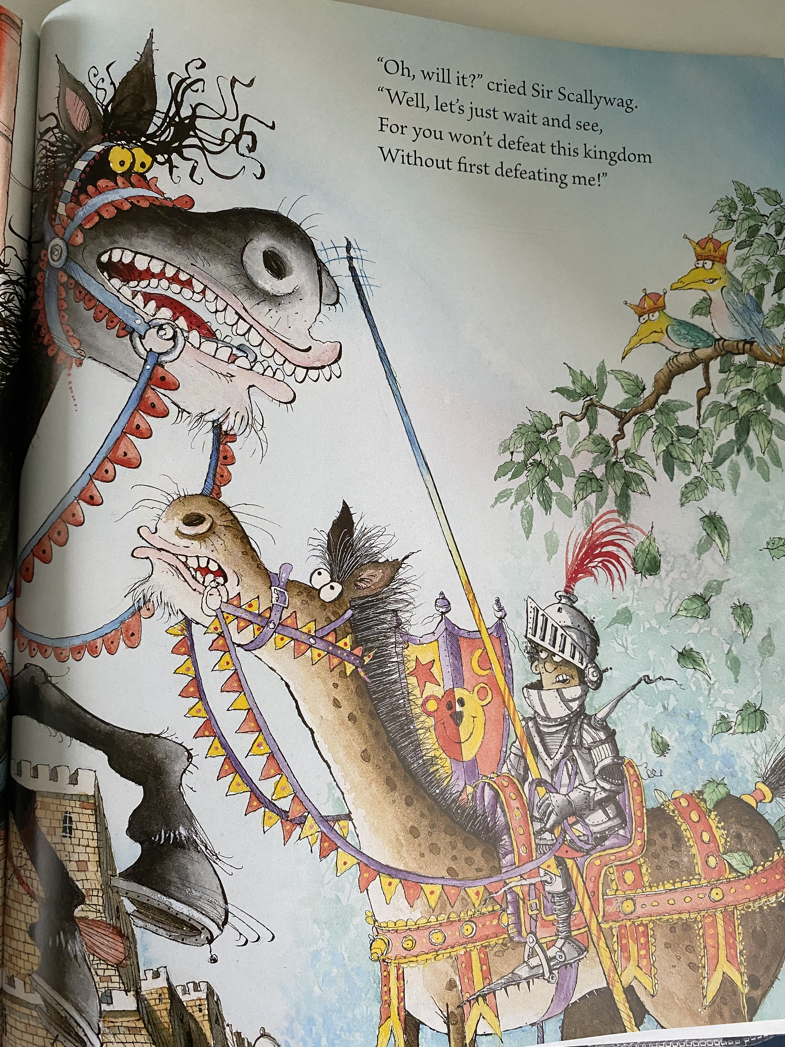

Slide 9
Complete the comprehension questions on the website.
Oh no, what a terrible Giant! I wonder what will happen next? Do you have any ideas?
If you read book band colours yellow, blue, green, orange or turquoise – look at comprehension 1
If you read purple, gold, white, lime or brown – look at comprehension 2

Slide 10
Freeze Frame!
Have a look at the pictures on the following page. Choose 1 and imagine that you are the character. Have a go at acting being them and then freezing. This is called ‘freeze frame’.
How do you feel as the character?
What might they be thinking?
What do you think you will say next?
What will you do?

Slide 12
Maths!
Today’s lesson is about sorting 2D shapes
Watch the video and then complete the worksheet on the website.
https://vimeo.com/508433384

Slide 13
Handwriting
Handwriting sheets, writing the sentences in the correct order, are on the website.

Slide 14
Choose a subject to do this afternoon, from the grid on the website!
Enjoy!

