Slide 1
Thursday 4th January 2021

Slide 2
Morning Job – Spellings and Mental Maths
Multiply by 24
Multiply by 2
7790
LOOK – COVER – WRITE - CHECK
Divide by 10
Multiply by 2

Slide 3
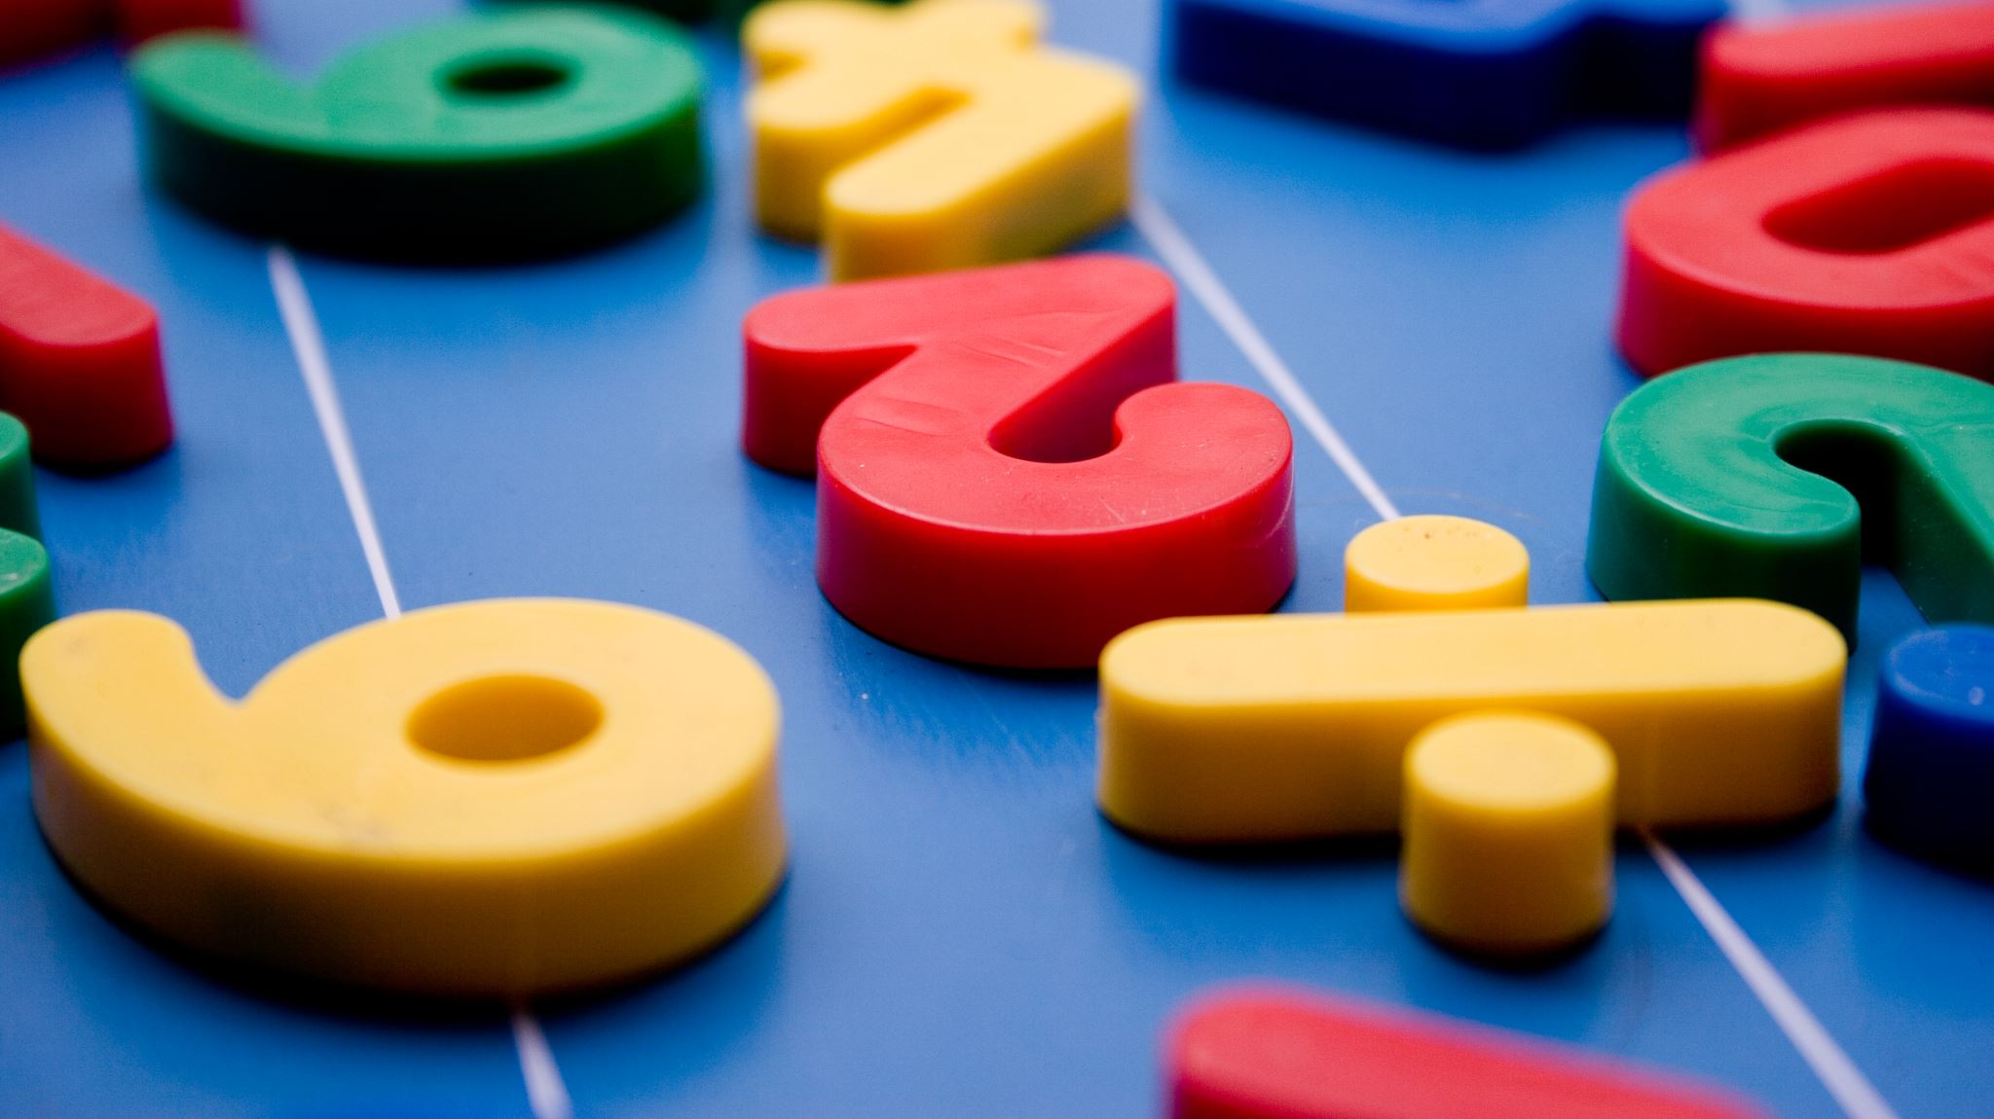
Maths
I can divide with remainders.

Slide 4
Give this a watch…
https://vimeo.com/492054148

Slide 7
1) 55 $÷$ 5 $=$
2) $÷$ 5 $=$ 1,100
3) 550 $÷$ 50 $=$

Slide 8
1) 55 $÷$ 5 $=$
2) $÷$ 5 $=$ 1,100
3) 550 $÷$ 50 $=$
11
5,500
11

Slide 10
Eva has 13 straws. She wants to make them into triangles. How many triangles can she make?
13 $÷$ 3 $=$
4 r1

Slide 11
Tommy has 14 straws. He wants to make them into triangles. How many triangles can he make?
Dora has 15 straws. She wants to make them into triangles. How many triangles can she make?
Jack has 16 straws. He wants to make them into triangles. How many triangles can he make?
Have a think

Slide 12
Tommy has 14 straws. He wants to make them into triangles. How many triangles can he make?
14 $÷$ 3 $=$
4 r2

Slide 13
Dora has 15 straws. She wants to make them into triangles. How many triangles can she make?
15 $÷$ 3 $=$
5

Slide 14
Jack has 16 straws. He wants to make them into triangles. How many triangles can he make?
16 $÷$ 3 $=$
5 r1

Slide 15
Have a think
Could these calculations be correct?
3,924 $÷$ 3 $=$ 1,307 r3
3,242 $÷$ 4 $=$ 810 r2
5,626 $÷$ 5 $=$ 1,124 r6
Could be correct | Definitely incorrect

Slide 16
5,291 $÷$ 4
$=$ 1,322 r3
Thousands | Hundreds | Tens | Ones
4 | 5 | 2 | 9 | 1
1
3
2
2
r3
1
1

Slide 17
Have a go at questions 1 - 3 on the worksheet

Slide 18
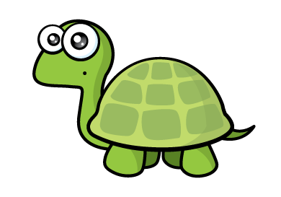
Have a think
5,627 $÷$5 $=$ 1,126
The 5 times table is in a pattern: 5, 10, 15, 20 ..
5,627 is a whole number but it doesn’t end in a 5 or a 0 so the answer must have a remainder.
5,627 $÷$5 $=$ 1,125 r2

Slide 19
There are 349 people at a wedding. They are sitting at tables in groups of 8
How many tables are needed?
8 | 3 | 4 | 9
0
4
3
r5
3
2
We need 44 tables.
We need 43 tables.
Have a think

Slide 20
Have a go at the rest of the worksheet

Slide 21
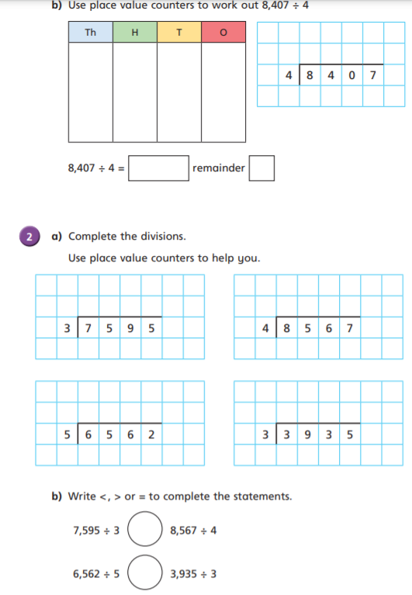
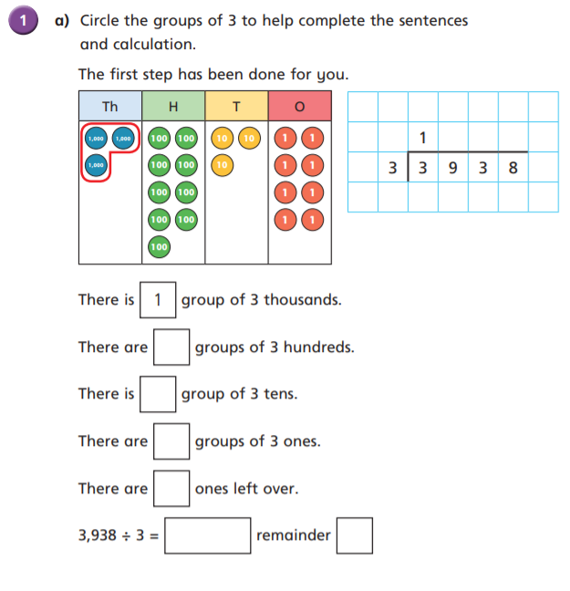

Slide 22
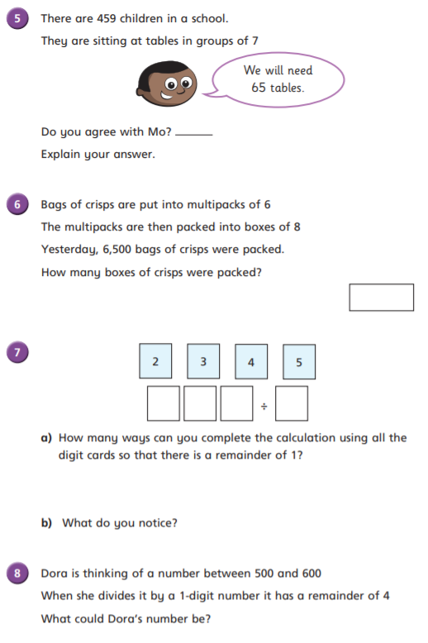
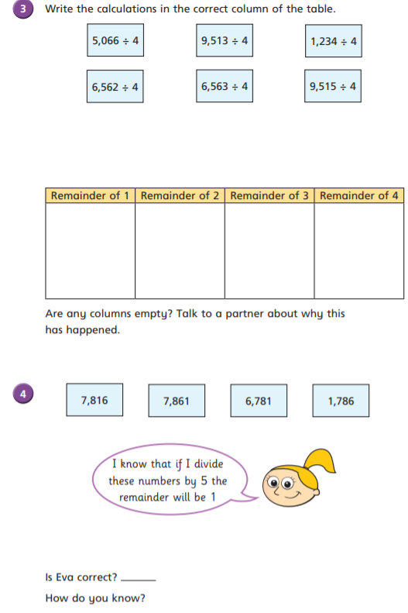

Slide 23
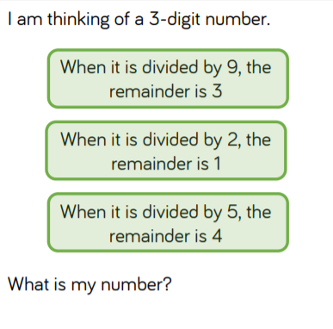
Optional Challenge:

Slide 24
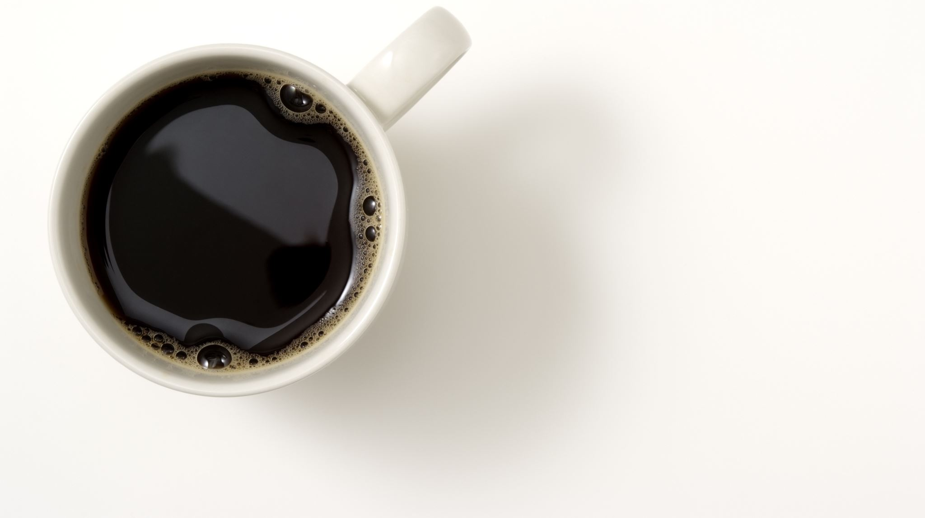
Break

Slide 25
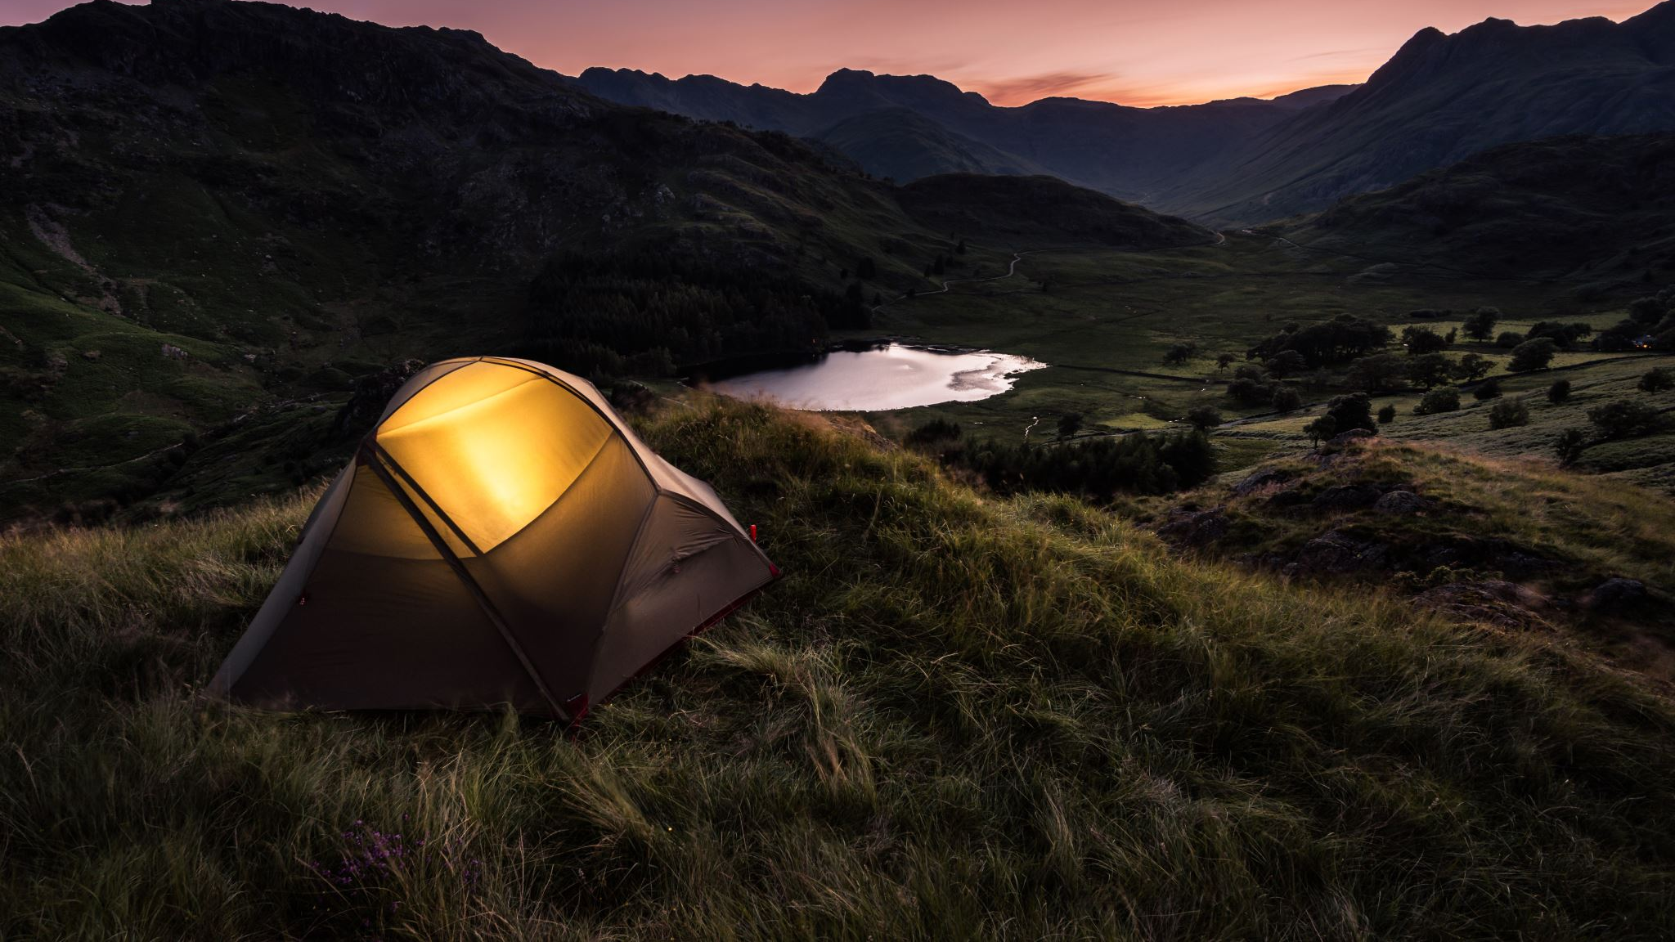
English
I can create a Newspaper report.

Slide 26
Brightstorm Chapter 24 - Evidence

Slide 27
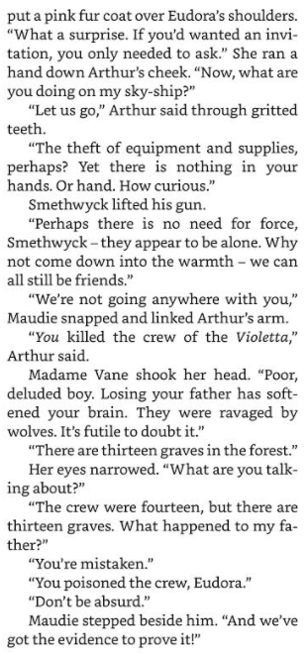
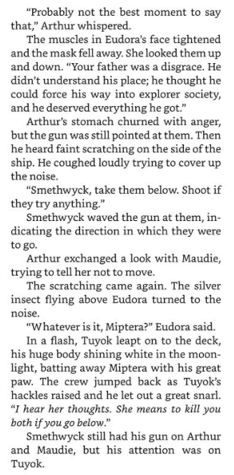

Slide 28
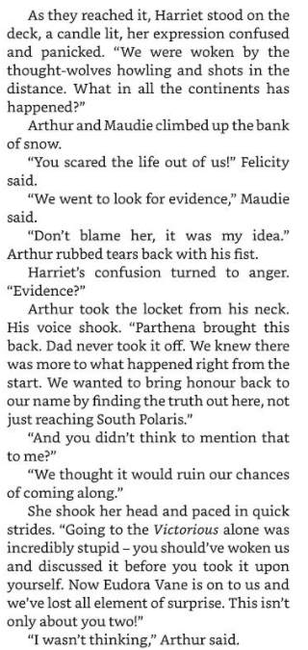
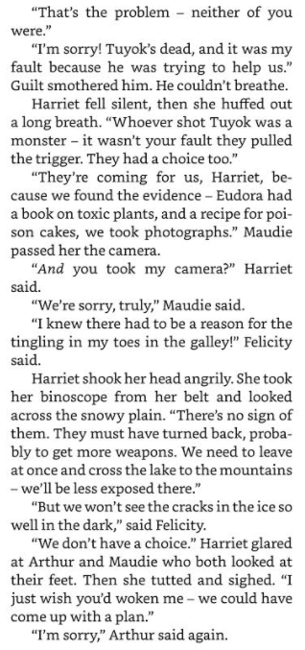

Slide 29
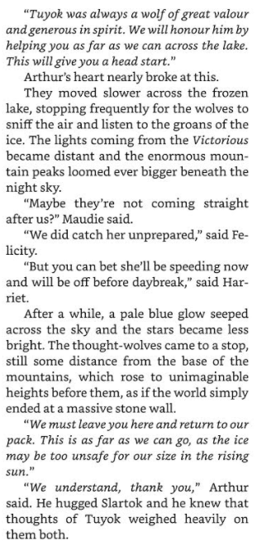

Slide 30
Activity – Wednesday and Thursday
Over the next 2 days you are going to create a Newspaper report. So DO NOT RUSH to complete this all in one day, push yourself and try your best.
I would advise you to complete - (Wed – Heading, Sub heading, Byline, Lead and ½ of the body)
I would then advise you to complete (Thursday – other ½ of your main body and then the tail paragraph)
Also on Thursday you can add colour to your border and headlines/titles, but most importantly go through and check your spelling and correct use of tense throughout!

Slide 31
Structure of a newspaper report
Headline and byline
Lead
Body
Tail

Slide 32
Headline
Headline and byline
For a good headline, you need to:
Catch the reader’s attention so they want to read the rest of the report;
Sum up the story in a few words;
Use powerful and interesting language;
Write in the present tense – even if the report is about an event that has already happened;
Include alliteration or wit at times.
Lead
Body
Tail

Slide 33
Byline
Headline and byline
Lead
For a good byline, you need:
The writer’s name;
The writer’s speciality (for example, Sports reporter, Food correspondent, Crime editor, Deputy politic editor, Senior fashion reporter);
A link to the writer’s Twitter account (for example, @dgoodman).
Body
Tail

Slide 34
Lead
Headline and byline
For a good lead paragraph, you need to;
Make the paragraph short and snappy so that it briefly explains what has happened;
Ensure that, even if the reader stopped reading at this point, they would still know roughly what happened;
Use past tense in most cases;
Make sure the first paragraph answers as many of these six questions as you can –
Who? What? Where? Why? When? How?
Lead
Body
Tail

Slide 35
Body
For a good body section, you need to:
Add more information and detail to your lead paragraph;
Include background information, evidence, facts and quotes from people involved in or connected to the event/story;
Continue to write in order of importance, putting the most important information in the first few paragraphs of the body section.
Headline and byline
Lead
Body
Having quotes from witnesses or experts
will make your report more credible and interesting.
Tail
Be sure to use correct punctuation for quotes!

Slide 36
Tail
For a good tail section:
Give the reader the opportunity to gain additional information if they are particularly interested in the topic of the news report;
Include links to previous news reports or useful websites;
Include a final quote from a witness or expert that helps to sum up the story or that could hint at what might happen next.
Headline and byline
Lead
This ‘Tail’ information can be useful but is not always needed. It tends to be the least important information in the report.
Body
Tail

Slide 37
You can use this template or create your own!

Slide 38
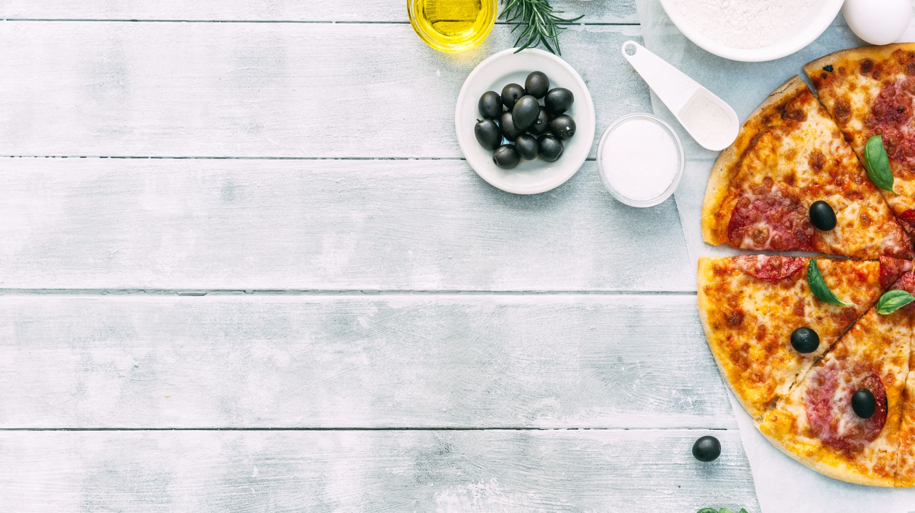
Lunch

Slide 39
Science

Slide 46
ACTIVITY 1

Slide 47
ACTIVITY 2

Slide 48
Hometime

