Slide 1
Science
Friday 12th February

Slide 2
William Gilbert
Today we are going to learn all about a scientist called William Gilbert.
Your job is to read the facts on the PowerPoint.
There are going to be some questions on the last slide for you to answer. These questions will test you on what you have learned from the PowerPoint, so take your time when you are reading the information.

Slide 3
Who is he?
William Gilbert introduced the word 'electricus' which means 'like amber. The word electricity develops from 'electricus'.
Gilbert wrote a book called "On the Magnet". Magnetic compasses were widely used for navigation during Gilbert's time and often called lodestones.
One of Gilbert's experiments was to test whether a compass was affected by garlic!
Gilbert was the first person to think that magnets point north because the Earth is a giant magnet.

Slide 4
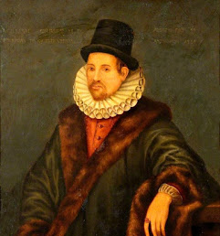
More interesting facts!
William Gilbert was a respected doctor and a physician to Queen Elizabeth the first at the end of her reign.
Gilbert used practical experiments to test his theories and his work was significant in Science.
Although magnetism were known to the Ancient Greeks (around 600BC) the understanding of how it worked didn't progress much until Gilbert took on the the task over 2000 years later!

Slide 5
Now try these questions…
Where does the word ‘electricity’ come from?
What were known as ‘lodestones’?
What was one of Gilberts experiments?
What did Gilbert discover?
Why do you think William Gilbert is famous?

Slide 6
Next job…
Look at the following questions:
Are magnetic forces able to act at a distance?
Can you explain how magnets attract or repel each other and attract some materials and not others?
Can you name a variety of everyday materials that are attracted to a magnet and some that are not?

Slide 7
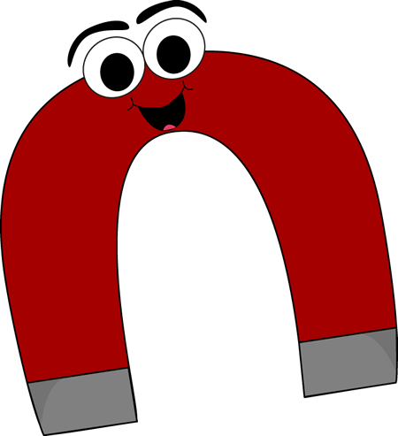
More information
Using the questions, I would like you to create a poster all about magnets. You must answer those questions on your poster.
The way in which you present your answers is up to you!

