Slide 1
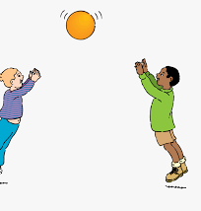
PE at Home
08.2.21
Hi Year 4,
I have a new challenge for you this week…I would like you to try the speed bounce challenge. See how many bounces you can do in 30 seconds. Try and beat your score each day! Here is a video to explain the challenge:
https://www.youtube.com/watch?v=zzWyMWAEfk4
To get you started, the next slide has 2 more PE lessons for you to try.

Slide 2
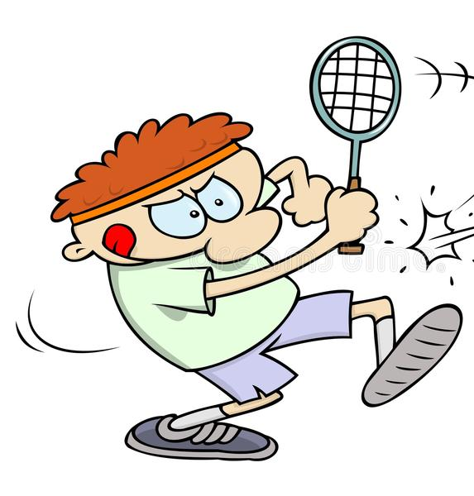
https://www.youtube.com/watch?v=1p4uz6uxbo8&list=PLYGRaluWWTojV3An2WEgsQ4qGFy_91jDL&index=18
https://www.youtube.com/watch?v=tQO0kwC-mmI&list=PLYGRaluWWTojV3An2WEgsQ4qGFy_91jDL&index=20
The first lesson helps you to improve both agility, balance and competitive controlled environment and the second one helps you to improve hand-eye-coordination

