Slide 1
Hello Year 2!
I hope you have all had a lovely weekend in the sunshine. I wonder how many signs of Spring you can spot this week when you are on your walks or in your garden?
We will continue with our live story sessions at 1:00 each day this week!
Have a lovely day,
from Mrs Southern

Slide 2
Mental Maths
https://www.topmarks.co.uk/maths-games/daily10
Choose: level 2 ➔ addition ➔ up to 25
You choose the time intervals. We are trying to improve your speed but you also need to be accurate. If you’d prefer not to use the timer then you don’t have to!

Slide 3
Phonics
Group 1:
Look at your spelling rule and spelling words on the next slides. Have a go at writing them out.
Group 2 and 3:
Read Write inc – Ruth Misken Read/write session online
Lexia
Write out spellings for this week.

Slide 4
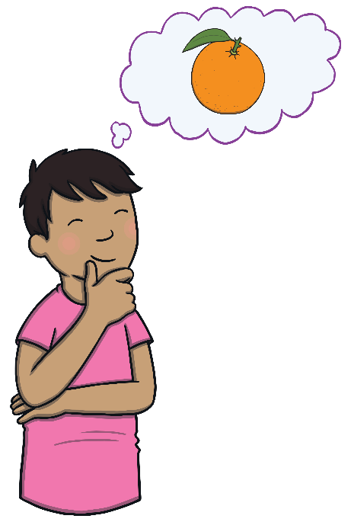
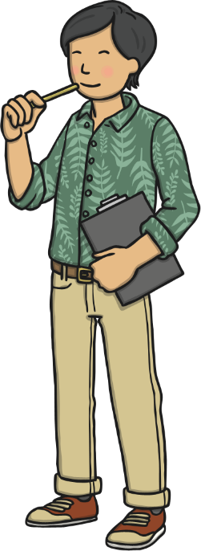
The Sound /o/ Spelt ‘a’
The sound /o/ is often spelt with ‘o’ but if the sound /o/ comes after the letter ‘w’ it is spelt with the letter ‘a’, for example:
want
watch
wander

Slide 5
Here are this week’s spellings to practise. Write them out.
want
watch
wander
quantity
squash
wash
what
squad
quarrel
quality
Check that you know the meaning off all these words.

Slide 6
Reading Comprehension
Each day this week there is a new chapter to read on Purple Mash. There is then a quiz and a grammar activity to go with it.
The story is called,
‘The Secrets of the Sandcastle’
I hope you enjoy it.

Slide 7
1.3.21
Re-read the story of Sir Scalleywag and The Golden Underpants. This is altogether on a Powerpoint for you to read.
Practise reading with fluency, intonation, expression and rhythm.

Slide 8
The three main characters are very different in personality and the way they speak.
Have a go at the worksheet on the website. You will need to read the speech and then sort it depending on whether you think it would be something King Colin would say, or not.

Slide 9
Now look at this page from the text. What do you think the characters might be saying?
Fill in the speech bubbles, on the sheet on the website.

Slide 10
Maths!
We are continuing to learn about shapes. This is our final week on shapes and will focus on 3D shapes.
Watch the video and then complete the worksheet on the website.
https://vimeo.com/508435282

Slide 11
Handwriting

Slide 12
Choose a subject to do this afternoon, from the grid on the website!
Enjoy!

