Slide 1
Maths
03.02.21

Slide 2
DMM
https://www.topmarks.co.uk/maths-games/daily10
Level 3– division – dividing by 4.

Slide 3
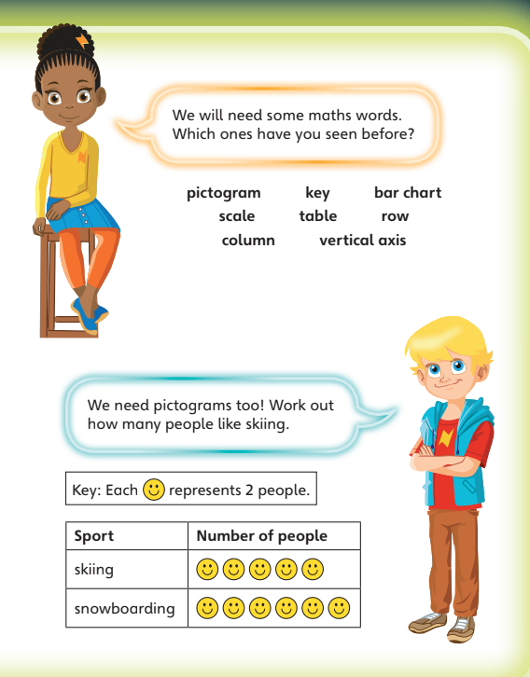

Slide 4
What are we learning?
Recap- I can use tally charts.

Slide 6
Watch the video
https://vimeo.com/500377891

Slide 8
1) How many fingers?
2) Which set does not show 25?
a) b) c)
3) How much?

Slide 9
1) How many fingers?
2) Which set does not show 25?
a) b) c)
3) How much?
30
27p

Slide 11
Teddy is drawing a tally chart while his mum unpacks the shopping.

Slide 13
Draw a tally to represent each type of fruit
Have a think

Slide 14
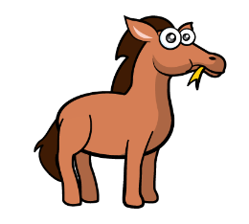
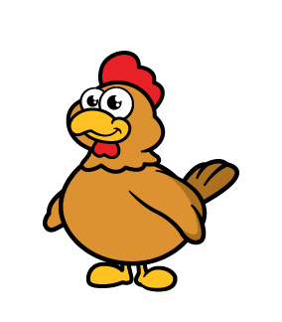
Animals | Tally | Total
Horses
Dogs
Chickens
Frogs
Sheep
1
2
7
4
9

Slide 15
Tally
Cars
Bikes

Slide 16
Which set of fruit matches the tally chart?
a) b) c)
Fruit | Tally
apples
pears
lemons
Have a think

Slide 18
Have a go at all of the questions on the worksheet

Slide 19
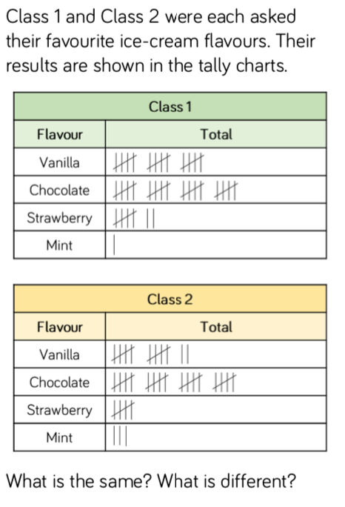
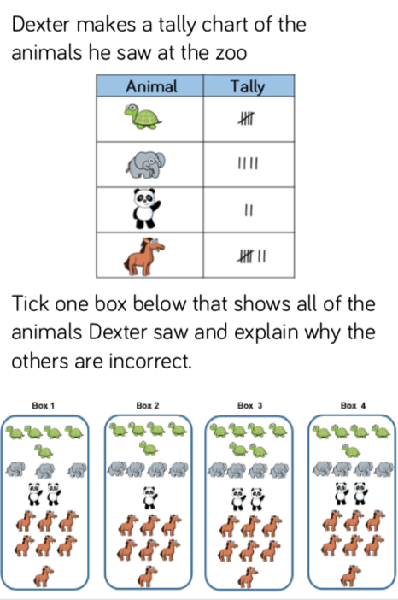
Reasoning and problem solving

