Slide 1
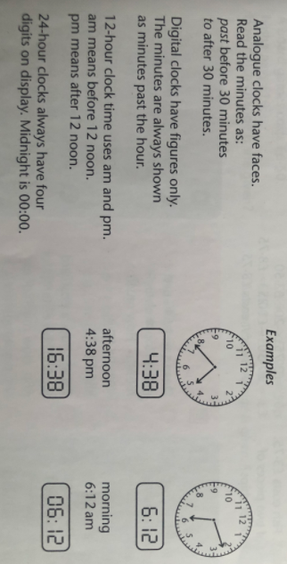
09.02.21 DMM: Let’s get your maths brains warmed up!
Today we are going to do an extended DMM to recap our learning about time which lots of us found challenging.
To remind you of important facts, read this information then try the task on the next sheet.

Slide 2
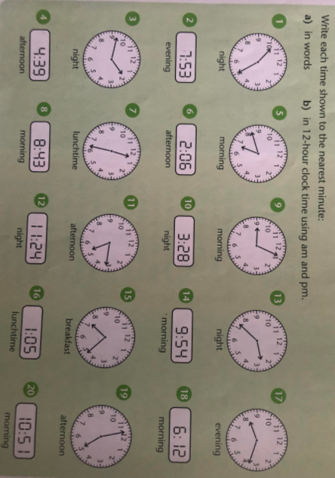

Slide 3
09.02.21 Maths
Hi Year 4,
Did you enjoy yesterday’s lesson on statistics? Do you understand what statistics is?
Statistics is gathering and presenting information in a clear way. The information is usually in numbers.
You can present statistics in lots of ways including pictograms, tally charts, block diagrams and tables.
We are thinking about pictograms. To be successful today:
I can construct pictograms.

Slide 4
09.02.21 Maths
Work through the lesson: watch the video and pause when it asks you to. Work out each question. Then create the pictogram as it asks. Send me your answers and your pictogram.
Click on the arrow for today’s lesson.

Slide 5
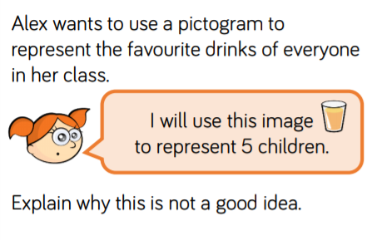
Reflect: I can construct pictograms.
Did you construct the pictogram?
How did you choose a scale?
Do you think it was the best scale to choose?
Challenge:

