Slide 1
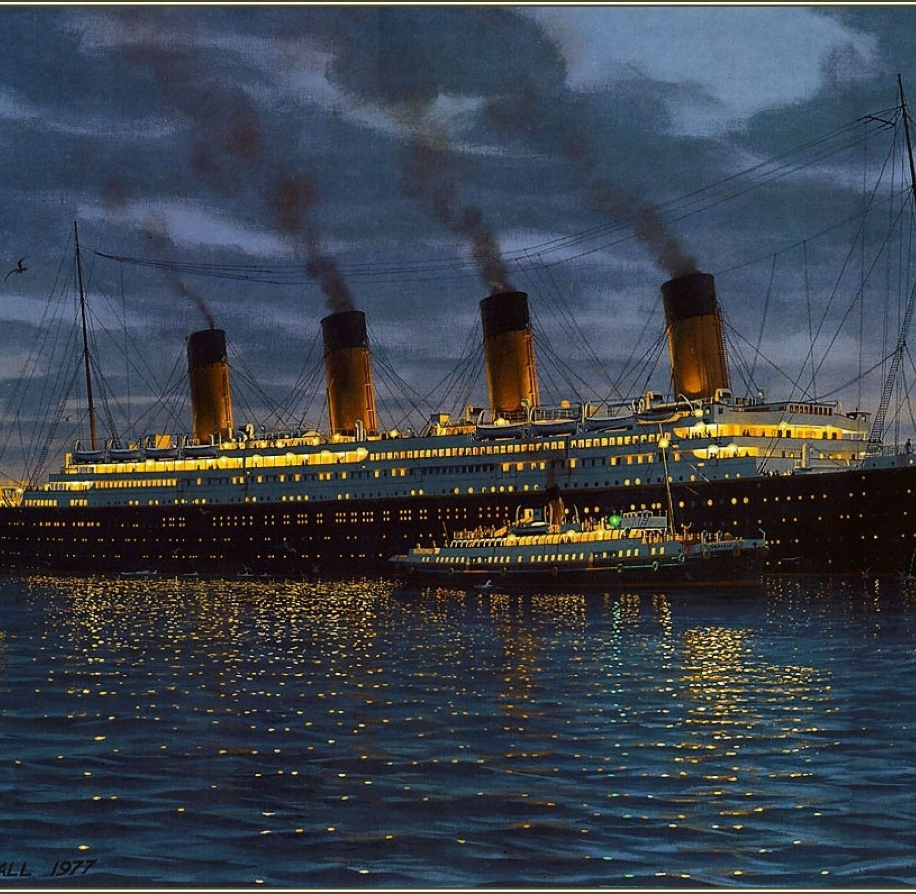
I can identify the features of a newspaper report
Wednesday 3rd February 2021

Slide 2
The sinking of the Titanic was reported in newspapers all over the world. Today we are going to identify the key features of a newspaper report…

Slide 3
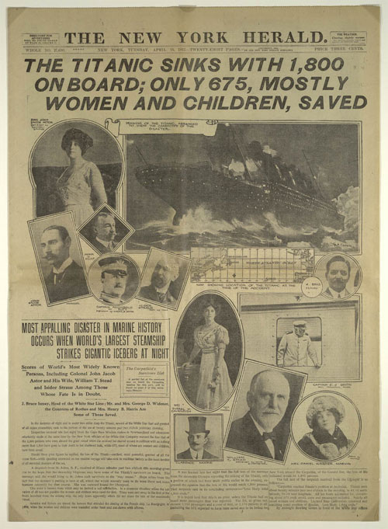
What are the key features of a newspaper article?

Slide 5
Read through this article carefully. Can you spot the key features?

Slide 6
Print out this slide and annotate it. You could colour code the features, using a key:
Alternatively, you could list examples of the key features on paper.

Slide 7
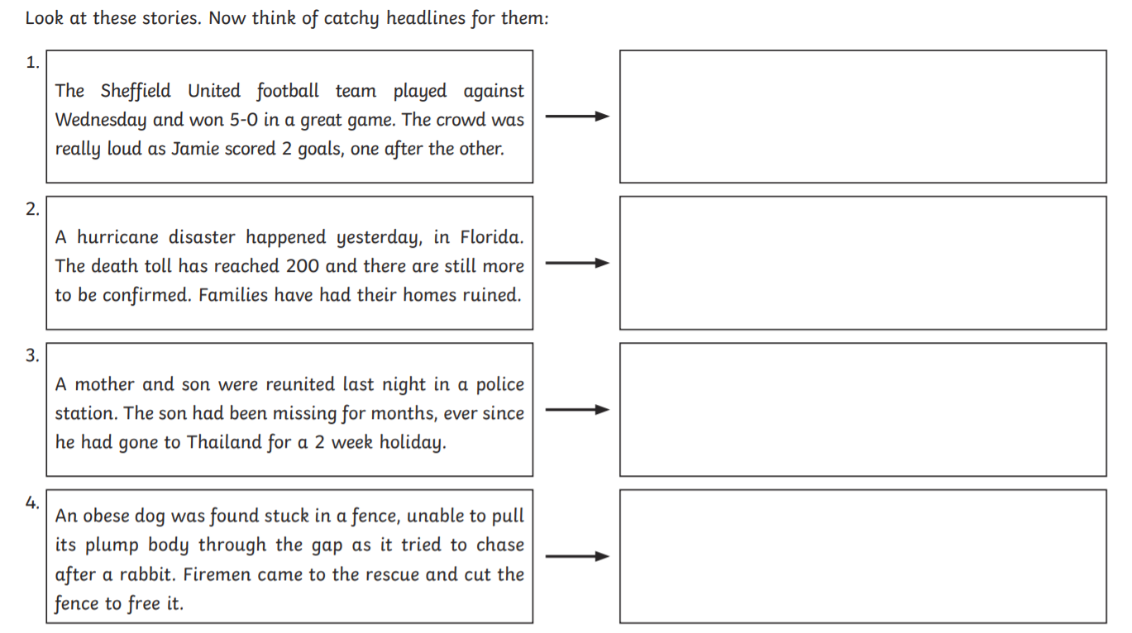
To finish, can you think of some catchy headlines for these stories? Remember, the best headlines use alliteration, or word play, such as puns or rhyme.

