Slide 1
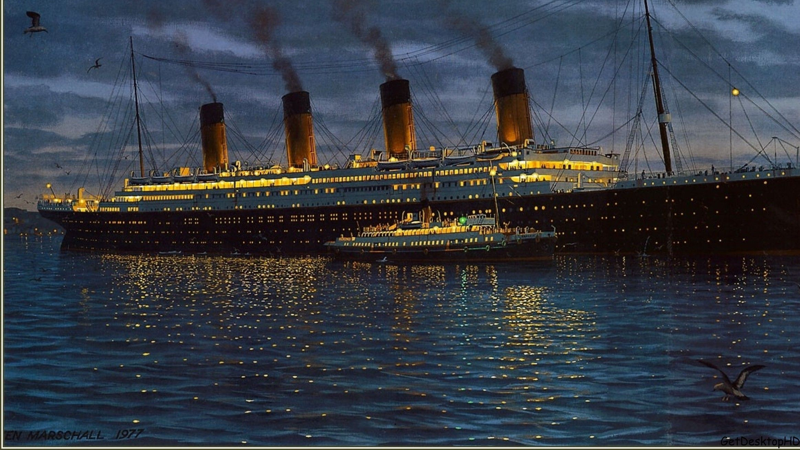
Significant Author Study: Michael Morpurgo
Monday 8th February 2021

Slide 2

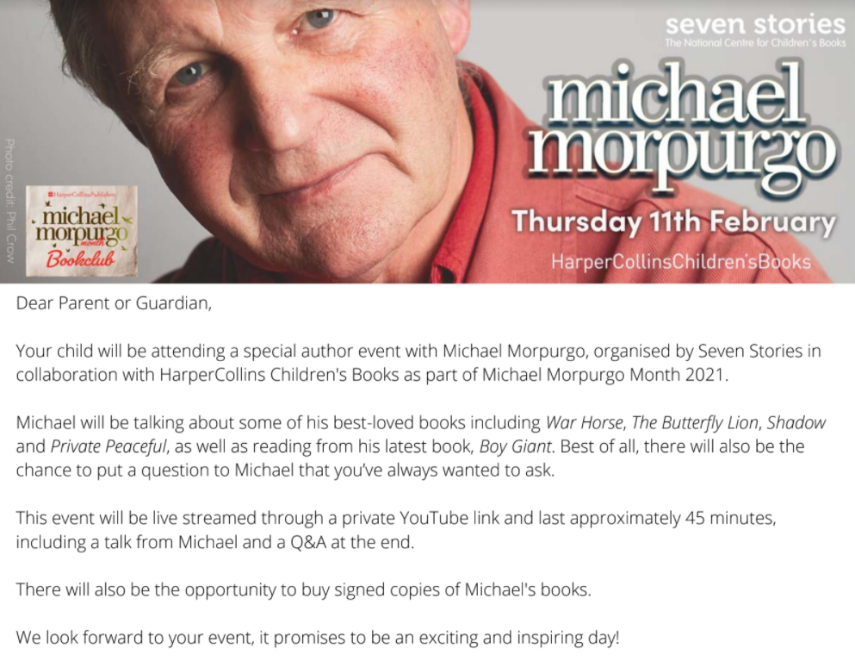
Click the loudspeaker to LISTEN to today’s instructions…

Slide 3

Today’s reading work is a ‘challenge by choice’ – choose the difficulty of reading activity that you feel most confident with.
The ‘one star’ text is the least challenging and the ‘three star’ text is the most challenging.
I hope you enjoy find out lots of interesting facts about Michael Morpurgo.

Slide 4
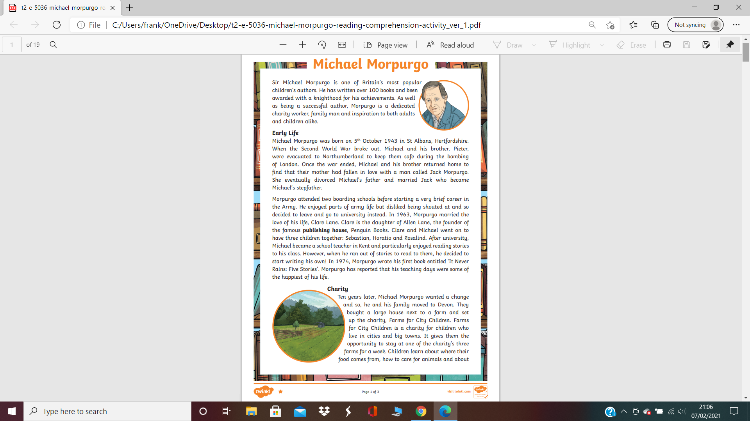
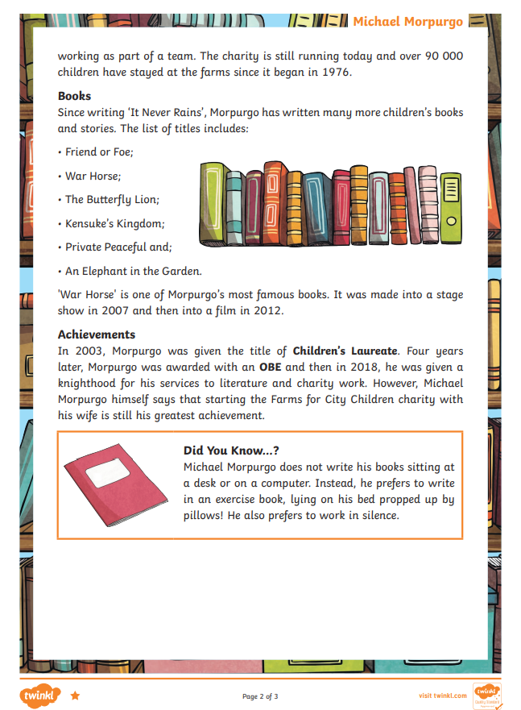
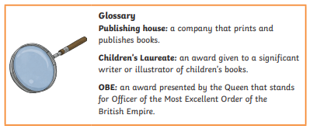

Slide 5
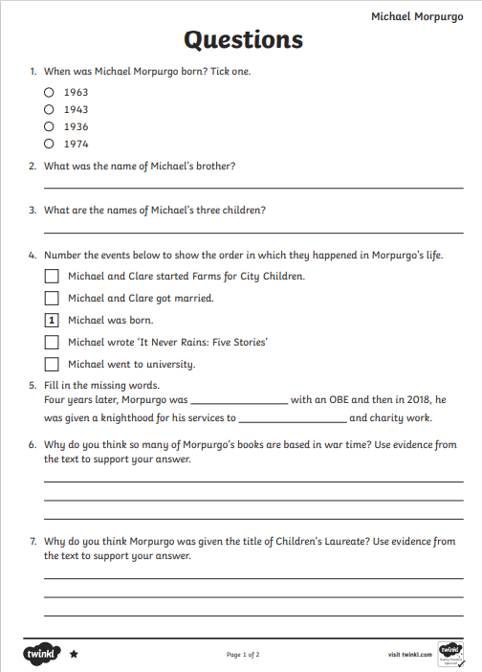
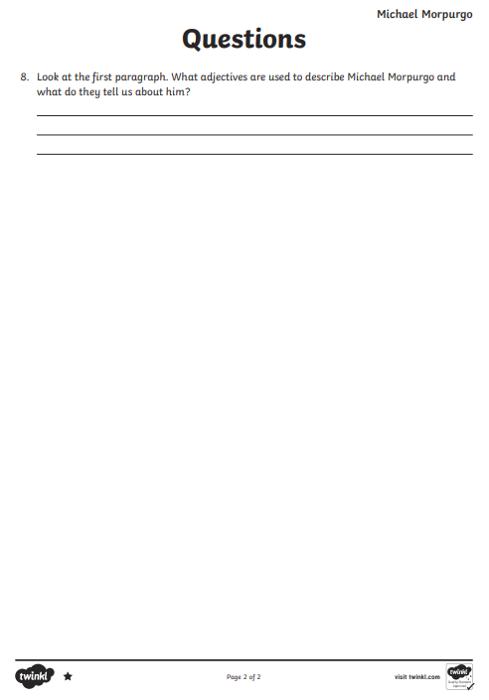

Slide 6
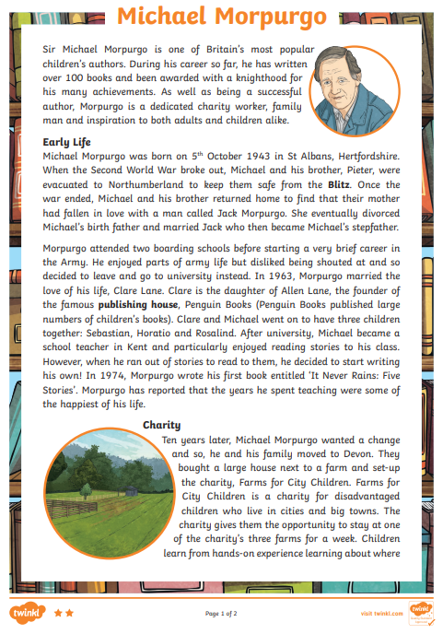
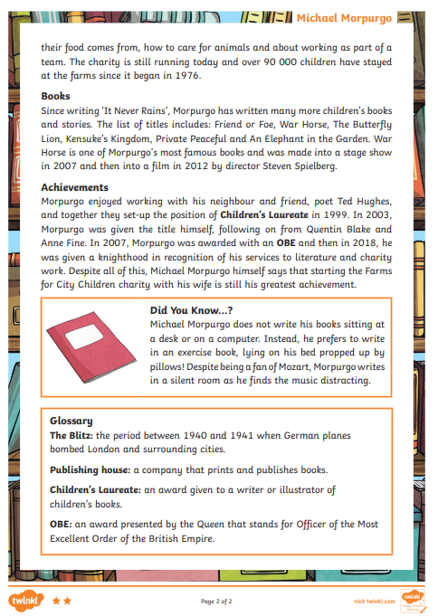

Slide 7
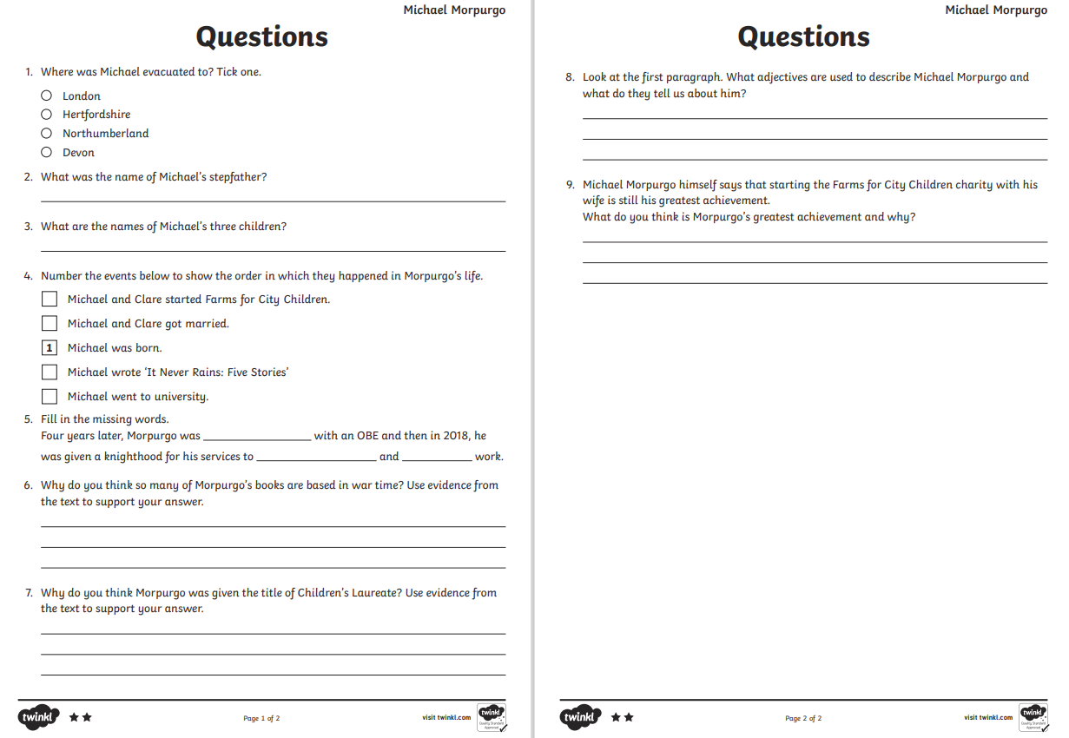

Slide 8
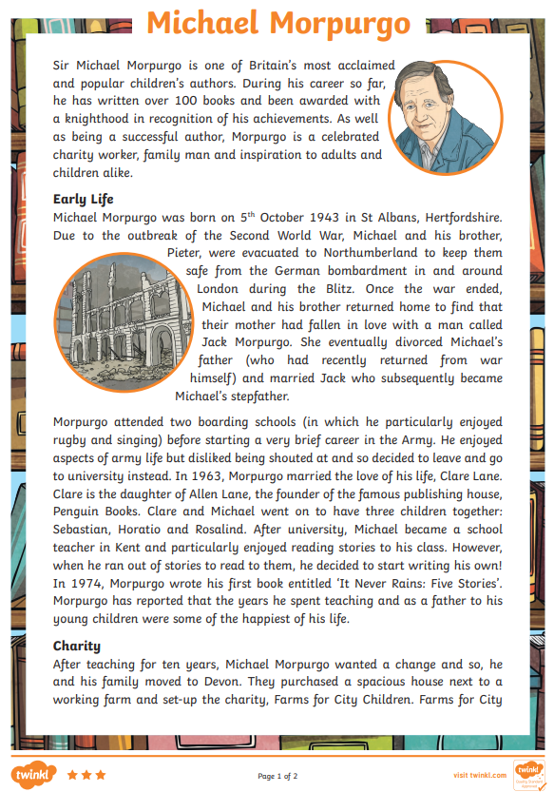
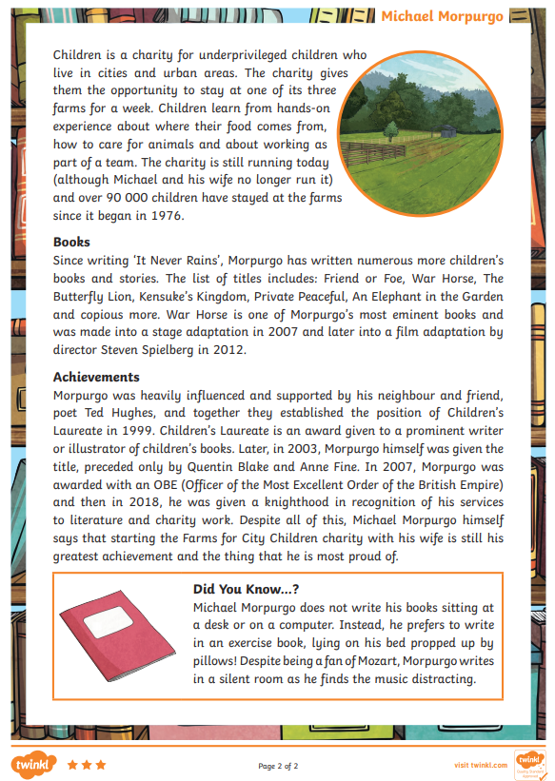

Slide 9
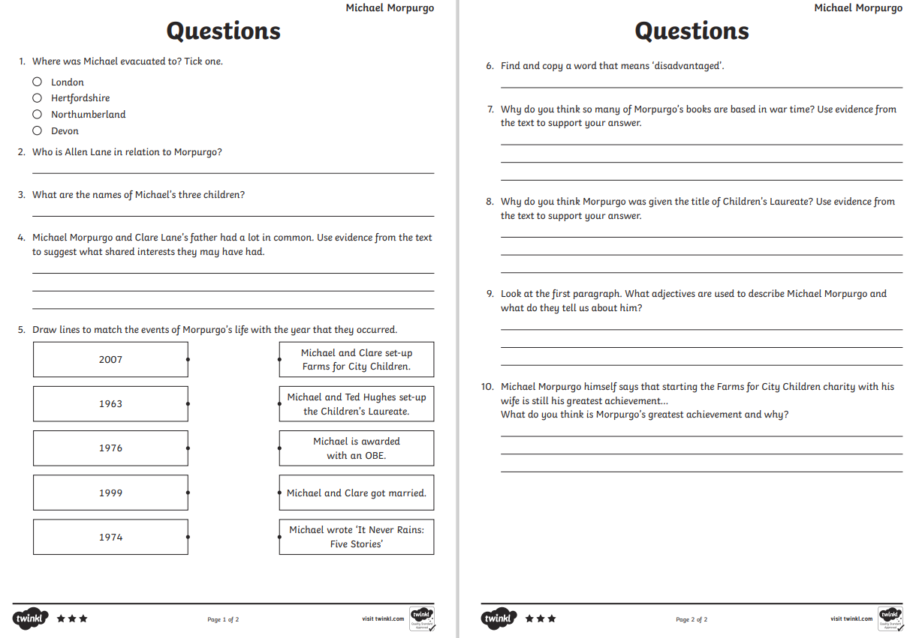

Slide 10
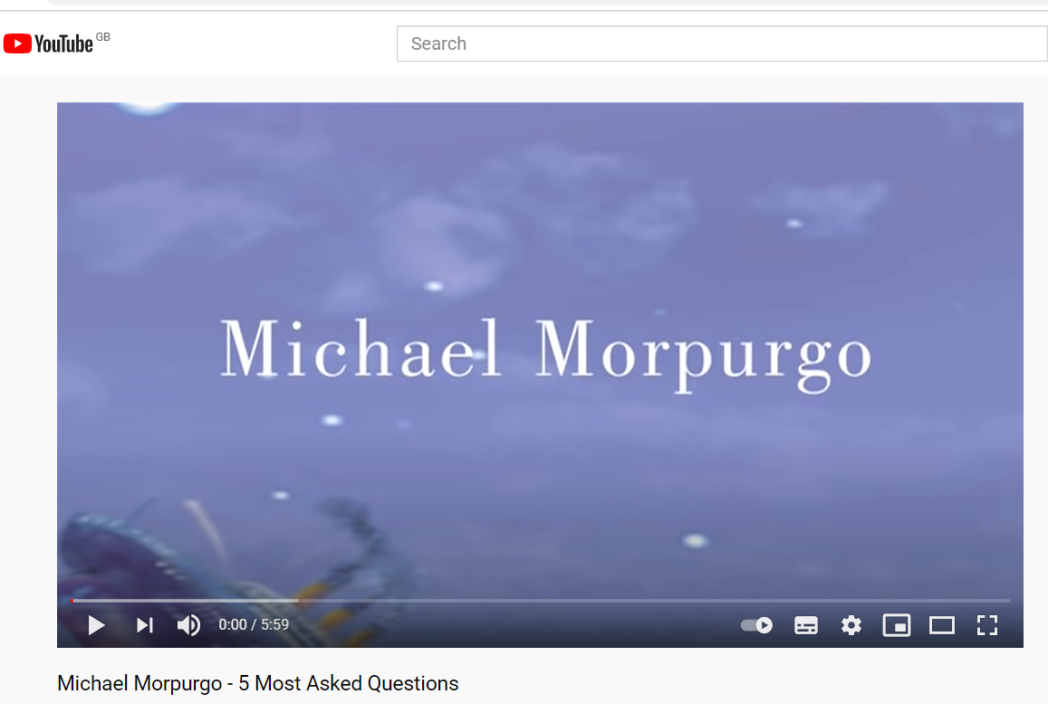
Now come up with three questions you would like to ask Michael Morpurgo and I will submit them to Seven Stories…
Before you write your questions (and to make your questions stand out from the crowd) watch this video about the questions Michael Morpurgo gets asked most frequently: https://www.youtube.com/watch?v=-MV9WqzT3TM

