Slide 1
Geography
1.3.21
Today we are going to look at the United Kingdom and where it is in the world.
We will learn what continent we are a part of and which countries are near to us. We will also name the bodies of water around us.

Slide 2
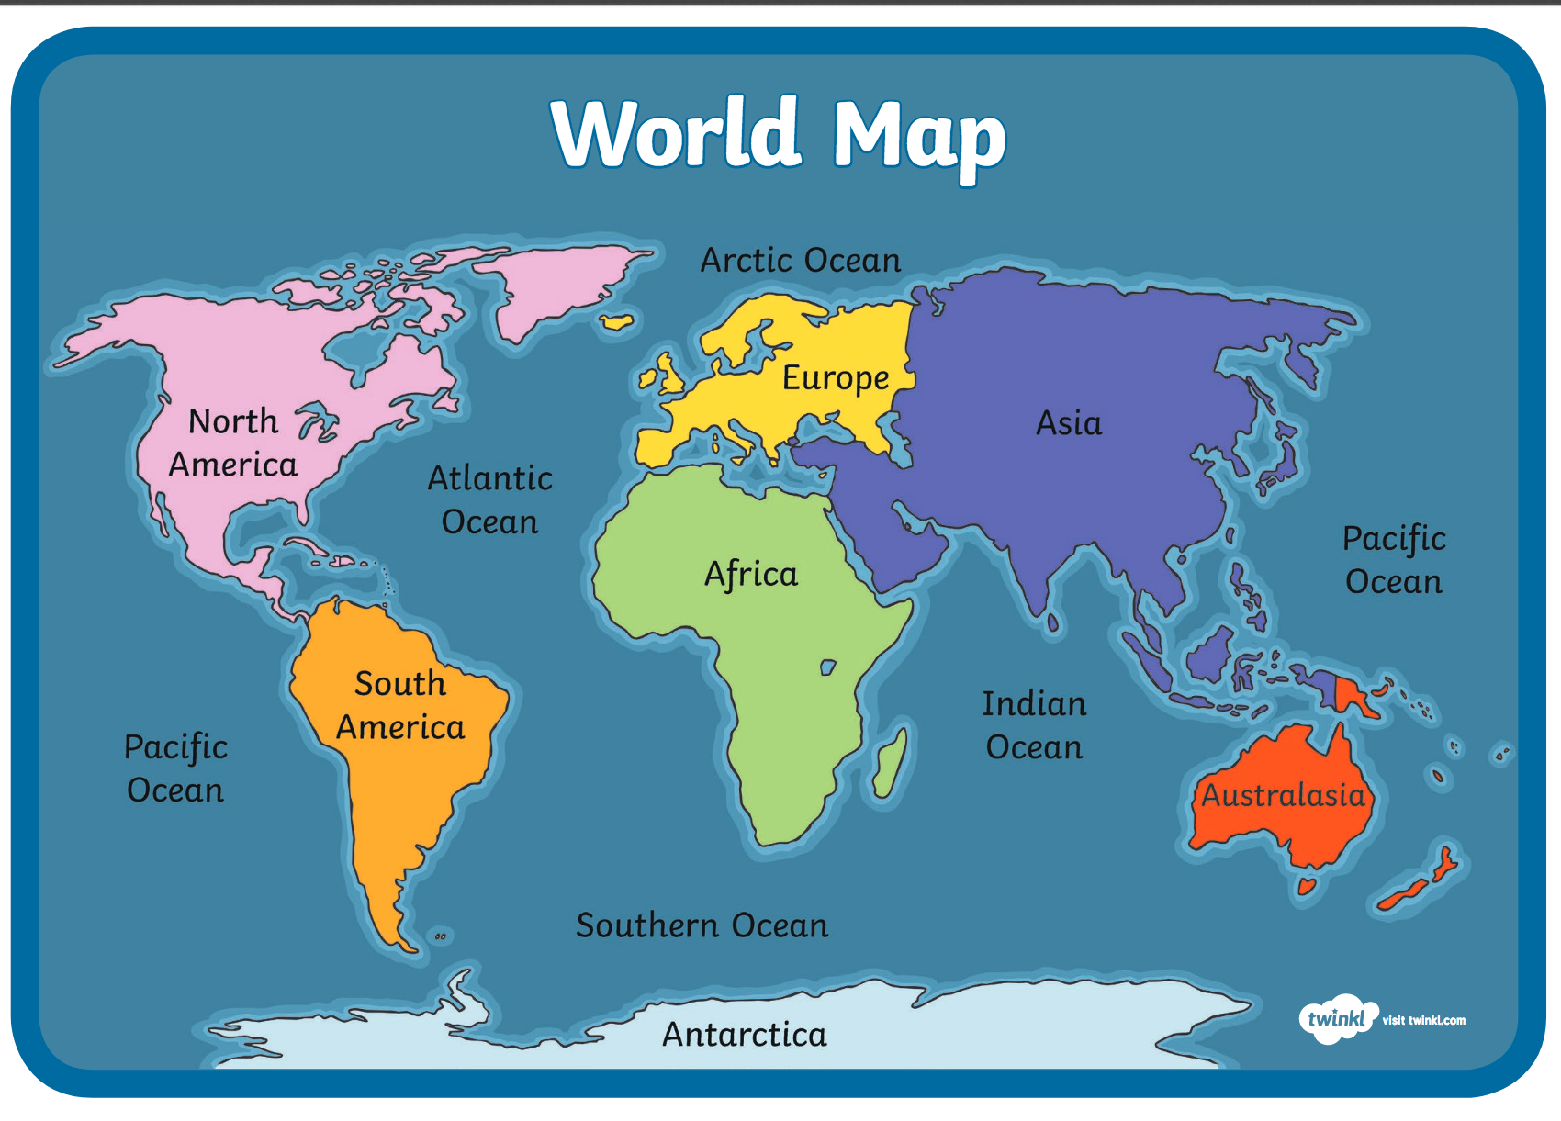
A continent is a group of countries.
The United Kingdom is a part of the continent of Europe.

Slide 3
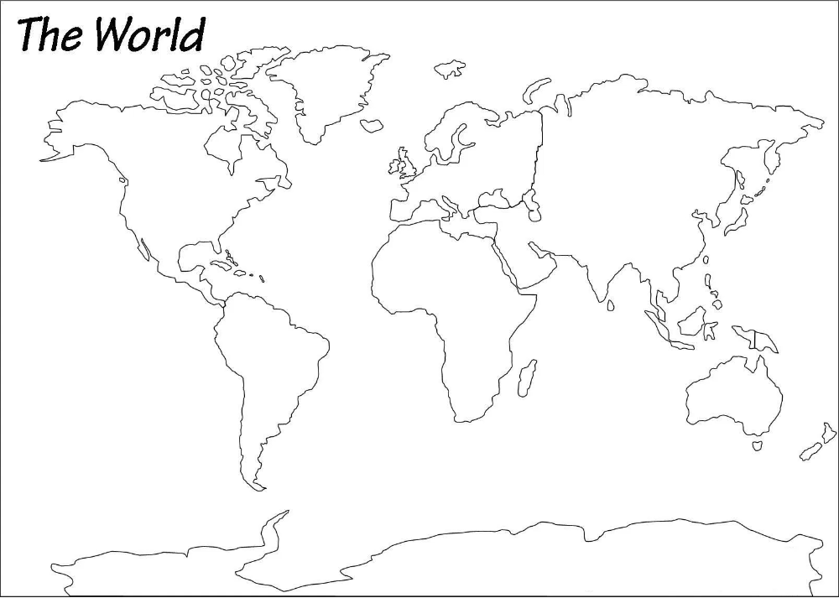
Can you find the United Kingdom on the world map?

Slide 4
On the world map, which is on the website, can you colour and label the United Kingdom?
Now use a map, atlas, globe or even google earth on the computer to find and label other countries in Europe.
Can you locate France which is where William I was coming from?
What about Germany which is where Queen Victoria’s husband was from or Greece where Prince Philip was born?

