Slide 1
Good Morning Year 2!
Happy Friday everyone!
How has everyone done with exercising this week?
We have been doing lots of exercises at school and we feel happier and healthier for doing it!
Perhaps you could do some exercise with your family this weekend.
Have a lovely weekend
From Mrs Southern xxx

Slide 2
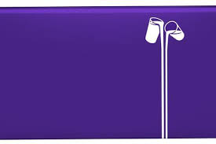
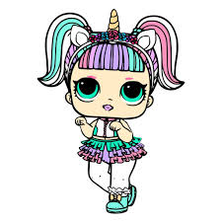
Fun Friday Quiz

Slide 3
5.2.21
Friday’s Maths Problem of the day!

Slide 5
Spelling Test
Good luck everyone!

Slide 6
King Henry VIII
Is famous for many reasons including his love for music and food as well as founding the Church of England.
He is also VERY well known for having had lots of wives…. Can you remember the rhyme about his wives from the video you watched in History?

Slide 7
Watch and make notes
Today your task is to watch an episode of Horrible Histories and make some notes with key facts. Your facts can be about King Henry VIII in general but I would like you to focus on facts about his wives.
It might be handy to watch the video all the way through first and then the second time watch it and pause it at important parts.
https://www.bbc.co.uk/iplayer/episode/b060fvs8/horrible-histories-series-6-6-horrid-henry-viii-special
Here is a link for a song about His wives. You can make notes from this too
https://www.youtube.com/watch?v=-fadCAHjN-s
Don’t forget what you learned about making notes in yesterday’s lesson.

Slide 8
We have now finished our block of work on Statistics.
Look a these words again. Do you know what they all are now?
Can you explain them to someone else?

Slide 9
Maths There is another 2do for you on Purple Mash today. There is also the end of unit summary sheet for you to complete. Try to read the questions and complete the sheet by yourself, as much as possible.

Slide 10
Children’s Mental Health Week: Be BRAVE!
If you want to….
Watch the clip from Harry Potter about children facing their fears. https://www.youtube.com/watch?v=AkqzW0JePyU
Think about these questions below:
What was brave about what the character in the story did?
How do you think he or she felt when they needed to be brave?
Can you think about all the brave things you’ve already done in your lives?
Who thinks it’s brave to ask for help if you need it and why? (Remember there are always people you can talk to)

Slide 11
Think about some examples of being brave.
Remember, accepting and asking for help is being brave too!
Now have a go at drawing or making your own brave cartoon character. Write words around your monsters about the qualities it will have, the things that will help it to be brave and a name!.

Slide 12
Have a lovely weekend everyone!
Let me know what you get up to.
Enjoy!

