Slide 1
Friday 5th February 2021

Slide 2
Morning Job

Slide 3
Spellings

Slide 4
Rockstars

Slide 5
Maths
Multiplication and Division assessment.

Slide 8
Break

Slide 9
English
I can write in active and passive voice.

Slide 10
Brightstorm- Chapter 25 The Ice Lake

Slide 11
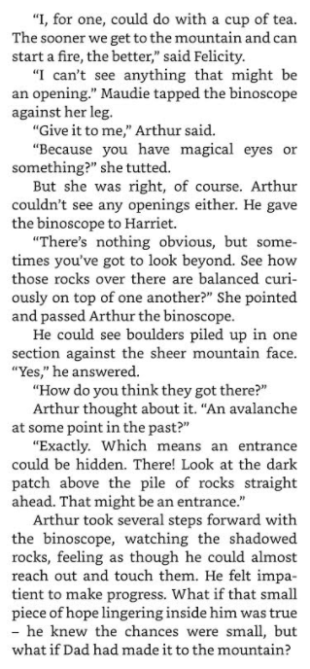
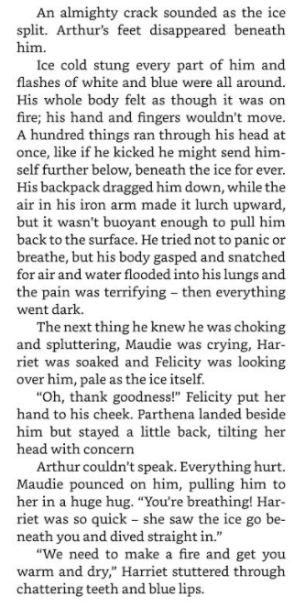

Slide 12
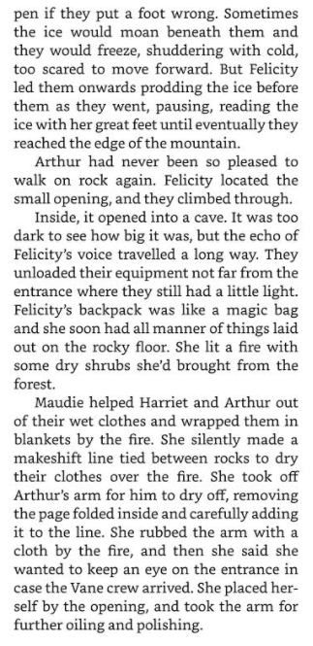
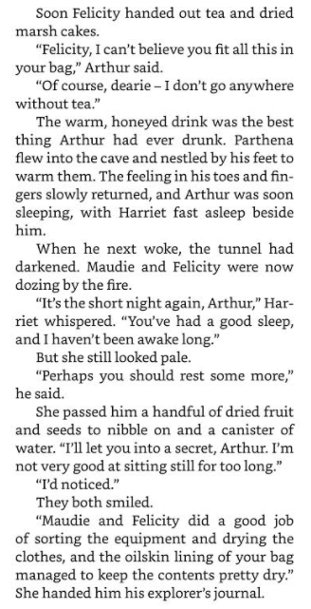

Slide 13
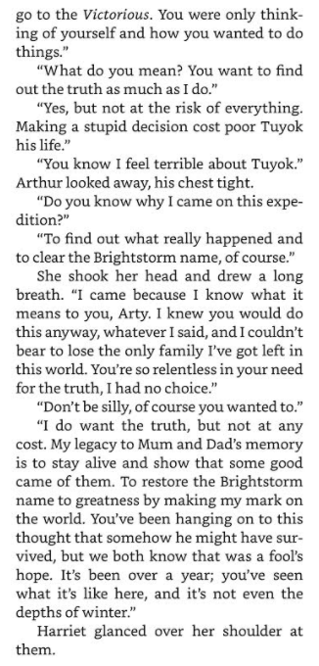
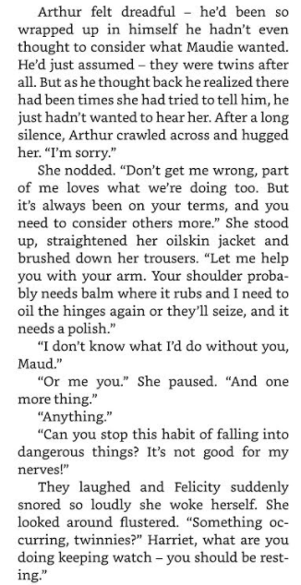

Slide 16
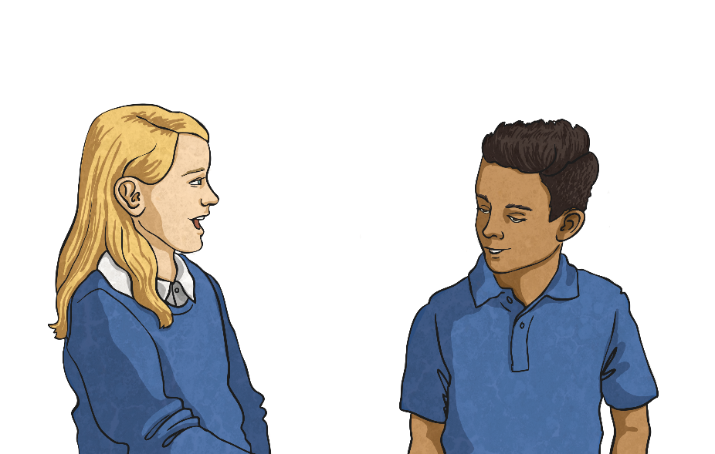
What Are Active and Passive Voice?
Can you write definitions for ‘active’ and ‘passive’ voice?
Active Voice
In an active sentence, the subject performs the action (the verb) to the object.
Passive Voice
In a passive sentence, the thing that would normally be the object gets turned into the subject through the use of the passive form of the verb. They often include a prepositional phrase starting with ‘by’.
Do you and your partner agree?

Slide 17
Identifying Parts of the Sentence
To be able to recognise and use active and passive voice, you must be able to identify the parts of the sentence. In the following sentences, identify the subject, action (the verb) and object:
The plane is boarded by the family.
The plane is boarded by the family.
The damage was caused by the storm.
The damage was caused by the storm.
Issac threw a ball at the window.
Issac threw a ball at the window.
The magician pulled a rabbit from the hat.
The magician pulled a rabbit from the hat.
Helen practised her recorder every day.
Helen practised her recorder every day.
The flowers were grown by my nan.
The flowers were grown by my nan.
Did you notice the preposition ‘by’ in some of these sentences?

Slide 18
Active or Passive Voice?
Now, sort these sentences into the correct places in the table below:
The plane is boarded by the family.
The magician pulled a rabbit from the hat.
Issac threw a ball at the window.
Helen practised her recorder every day.
The flowers were grown by my nan.
The damage was caused by the storm.
Active
Passive
The magician pulled a rabbit from the hat.
Issac threw a ball at the window.
Helen practised her recorder every day.
The plane is boarded by the family.
The damage was caused by the storm.
The flowers were grown by my nan.

Slide 19
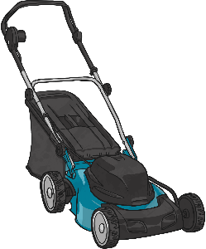
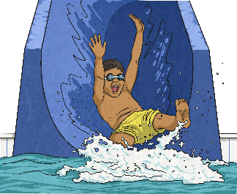
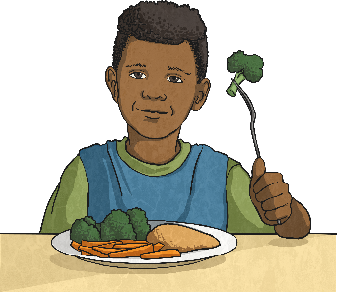
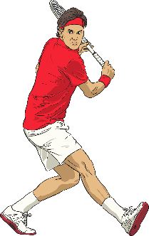
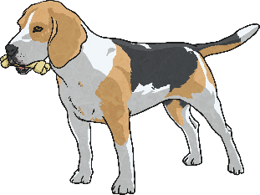
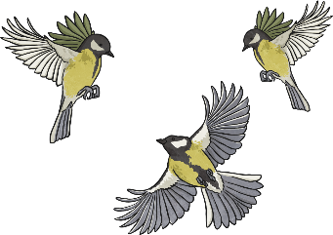
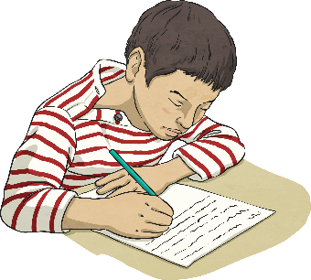
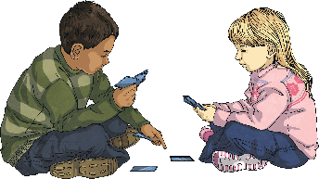
Your Turn – Active Sentences
Choose a square to reveal a picture. Write an active sentence about the picture:
?
?
?
?
?
?
?
?
?
?

Slide 20
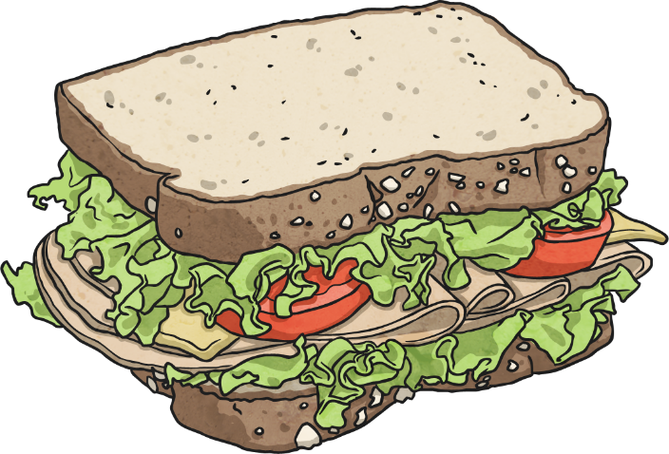
Changing Sentences
It is possible to change a sentence from active to passive voice, or from passive to active voice. It is important that you do not change the tense of the sentence. Have a go at altering these sentences:
On the plain, the lioness chased an antelope.
On the plain, an antelope was chased by the lioness.
Harry ate sandwiches for lunch.
Sandwiches were eaten by Harry for lunch.
The carrots are always eaten by my brother.
My brother always eats the carrots.
Are your new sentences active or passive?

Slide 21
Tricky Passive Sentences
Read these passive sentences. What do you notice about them?
The jewellery was stolen.
The jewellery was stolen.
The bicycle was ridden.
The bicycle was ridden.
The present was opened.
The present was opened.
They all have an action and a subject but none of them have a object. Sometimes the prepositional (by…) phrase can be removed and the sentence will still make sense – you just won’t know who/what performed the verb.

Slide 22
Activity - Brightstorm
Identify the subject, action and object in passive or active voice.
1. The sky-ship was boarded by the twins and the crew.
2. The damage was caused by the forest when the Aurora crashed.
3. Parthena flew to Lontown to give Arthur a locket.
Change from passive to active voice or active to passive.
1. The engine was fixed by Maudie.
2.Harried steered the ship towards the 3rd Continent
Challenge: (Create 1 Active Voice + 1 Passive Voice sentence)
1.
2.

Slide 23
Lunch

Slide 24
Music
https://classroom.thenational.academy/lessons/to-understand-how-rhythmic-cycles-feature-in-indian-classical-music-70v66r

Slide 25
Computing - Quiz
Log in to purple mash and complete the 2Do’s that have been set

Slide 26
Hometime

