Slide 1
English
Friday 12th February

Slide 2
I am successful if…
I can create a fact file about a country of my choice.

Slide 3
This week
You have all worked so hard this week! Today, we are going to put all of our notes together and create a double page spread.
We have done these in school before, so you should all be experts.
Make sure that your double page spread is neat, colourful and well presented!
I have included the information pages too, just in case you need some extra information!
I can’t wait to see them all!!!

Slide 4
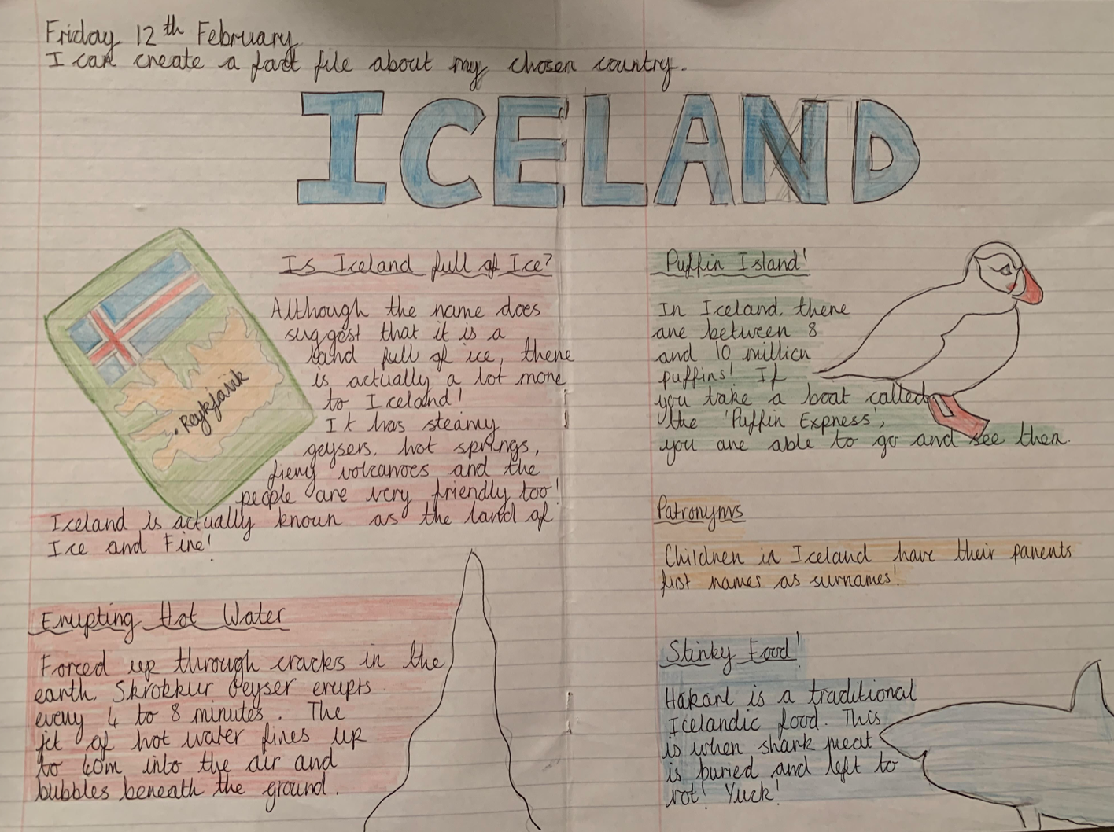
An example…

Slide 5
USA

Slide 7
Hong Kong

Slide 9
Brazil

Slide 11
Canada

