Slide 1
Tuesday 9th February English
Let’s start today’s lesson by thinking about spelling, punctuation and grammar that we have learned about.
On the Home Learning page you will find a worksheet to do today.
It asks questions about lots of SPaG work.
Try to do it on your own so you can find out how much you remember.

Slide 2
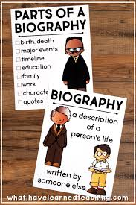
Writing a Biography
Yesterday you looked at the features of a biography and started to think about who you could write about.
Have you chosen? I can’t wait to find out who you are writing about!
Today’s lesson is all about research.

Slide 3
How to Research for your Biography
If you have books at home, use the contents and index to find information.
If you are using the internet, think about the important words to search.
Make sure you are safe online. Ask an adult to check if the website is suitable. Remember you could use Kiddle.
Carefully read the information.
Make notes. DO NOT copy out sentences. Just write the key words.
You will need to have lots of information to write a good biography so keep going…

Slide 4
How did you do?
Have you got lots of notes?
Remember you will need lots of information so go back and find some more if you don’t think you have enough.
Send me your notes when you are finished.

