Slide 1
Tuesday 2nd February English

Slide 2
Tenses
These are the tenses you have already learned about:
Now we will learn about Perfect Present.
Past
Perfect Present
Present
Future

Slide 3
Past and Present
Decide which columns these sentences belong in. You can talk to someone or, if you are working alone, just think about it.
Past | Present
I saw a film.
I drive a car.
I watch a film.
I eat a meal.
I listen to music.
I ate a meal.
I listened to music.
I drove a car.

Slide 4
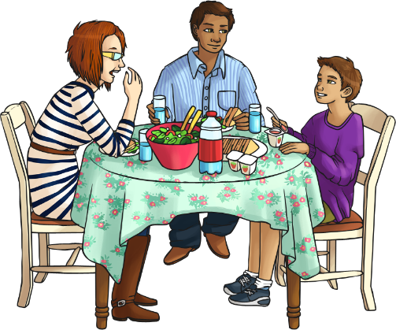
Past and Present
Decide which columns these sentences belong in.
Past | Present
I saw a film. I listened to music. I drove a car. I ate a meal. | I watch a film. I listen to music. I drive a car. I eat a meal.
I have eaten a meal.
Where would you place this sentence?
I have eaten a meal.
What do you notice about it?
It is in the past. It is called the Present Perfect tense.

Slide 5
What’s the difference between past and present perfect?
Before he came to our town, Kashaan was in Birmingham.
His mum got a new job so the family moved here.
When I met Kashaan, he spoke with a ‘Brummie’ accent.
My friend Kashaan has lived in this town for five years.
We have been best friends all that time.
His dad says he has taken on the way I speak.
past
now
future
It’s all about the timing…
Present perfect tense is used for activities that started in the past but are still true now, or have an effect on what is happening now.
Past tense is used for activities or events that started and finished in the past.

Slide 6
Making the Present Perfect Tense
A little extra word…
Present perfect tense uses the auxiliary verb HAVE before the main verb.
Use ‘have’ for I / you / we / they.
Use ‘has’ for he / she / it.
has
My friend Kashaan _____ lived in this town for five years.
We _____ been best friends all that time.
His dad says he _____ taken on the way I speak.
Unfortunately, the cat _____ been sick on the carpet – yuk!
Mum asked, “Where _____ you been all this time?”
What a shame; Sports Day _____ been postponed because of the rain.
_____ every person chosen a partner now?
“What ____ happened to all my pencils?” asked the teacher.
have
has
has
have
has
Has
has

Slide 7
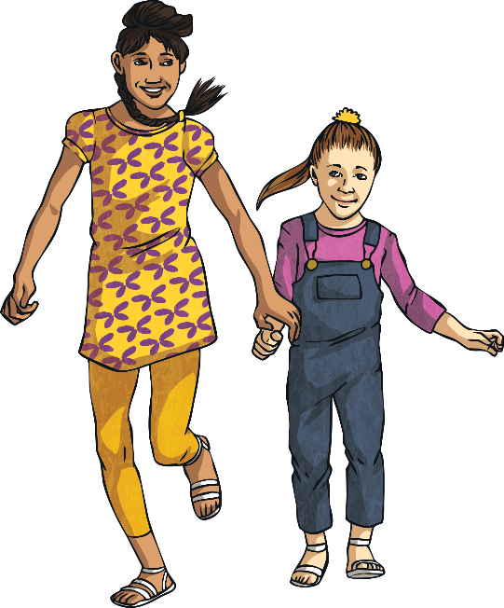
Your Turn!
Can you decide which verb form is correct?
1.
I went to the zoo yesterday.
I have been to the zoo yesterday.
Use simple past tense here!
2.
When you have eaten your dinner, you can go and play.
When you ate your tea, you can go and play.
Use present perfect tense here!
3.
I have lost my pencil during the last lesson.
I lost my pencil during the last lesson.
Use simple past tense here!
4.
Wait for me! I haven’t put my coat on yet.
Wait for me! I didn’t put my coat on yet.
Use present perfect tense here!
past
now
future

Slide 8
Complete these sentences.

Slide 9
Today we will read about a very famous villain. And we’ll also find out about tools that every villain needs. Remember the reciprocal reading strategies and use them to help you understand your reading: Predicting Questioning Clarifying Summarising

Slide 10
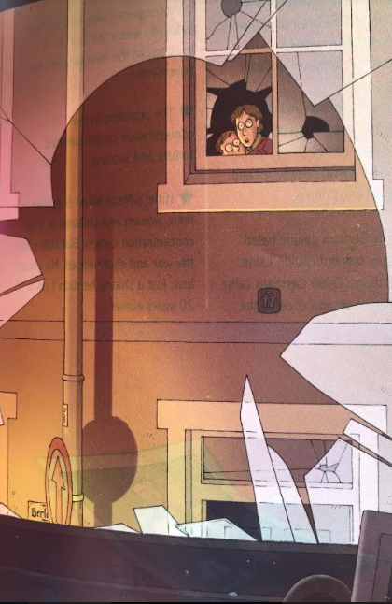
Read the next two slides about Hitler. Question: Think about what you have read about Hitler. If you met him, think of one question you would ask him. Summarise: what you think was Hitler’s worst crime.

Slide 11
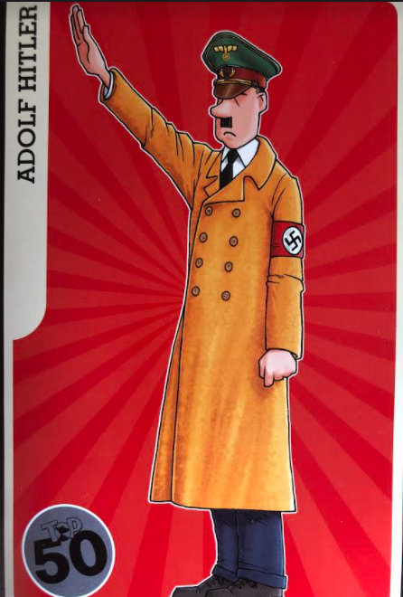

Slide 12
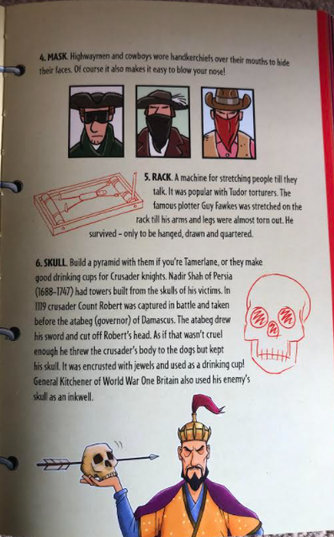
Read the next two slides to find out what every successful villain needs. We have been thinking about features of nonfiction texts. For today’s final activity you will think about diagrams, labels and captions.

Slide 13
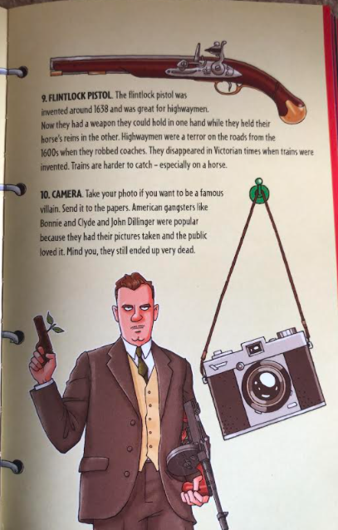
After reading this page, look at number 1 on the last screen. Design your own homemade armour. Look around your house for ideas. Draw a labelled diagram of your armour. Add captions for details.

