Slide 1
Design Technology
26.2.21
The DT unit, this half term is all about free standing structures.
Today you are going to investigate what free standing structures are.
Some useful terminology for this half term:
Free standing structure – Will be discussed in this lesson
Frame Structure – a structure made from thin components ie tent frame
Shell Structure – a hollow structure with a thin outer covering.
Stable - Will be discussed in this lesson.
Buttress – A structure added to a wall, tower or framework to make it more stable and reinforce it.

Slide 2
What is a stable, free standing structure?
A structure is ‘something that has been made or built from parts, for example a large building, a bridge or a chair.’
Free standing means something that can stand on its own – it doesn’t need someone to hold it or balance on something else.
Of course we also need our structures to be stable. Stable means ‘when something is firmly fixed or not likely to change or move.’

Slide 3
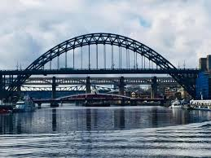
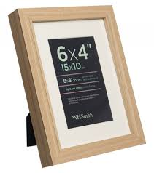
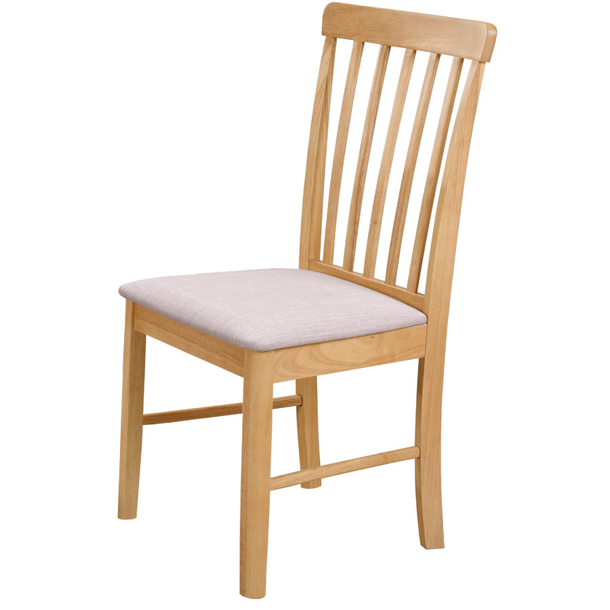
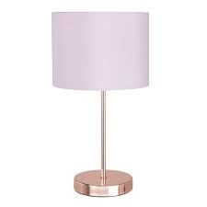
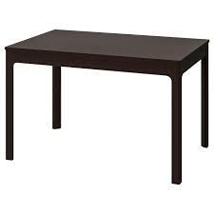
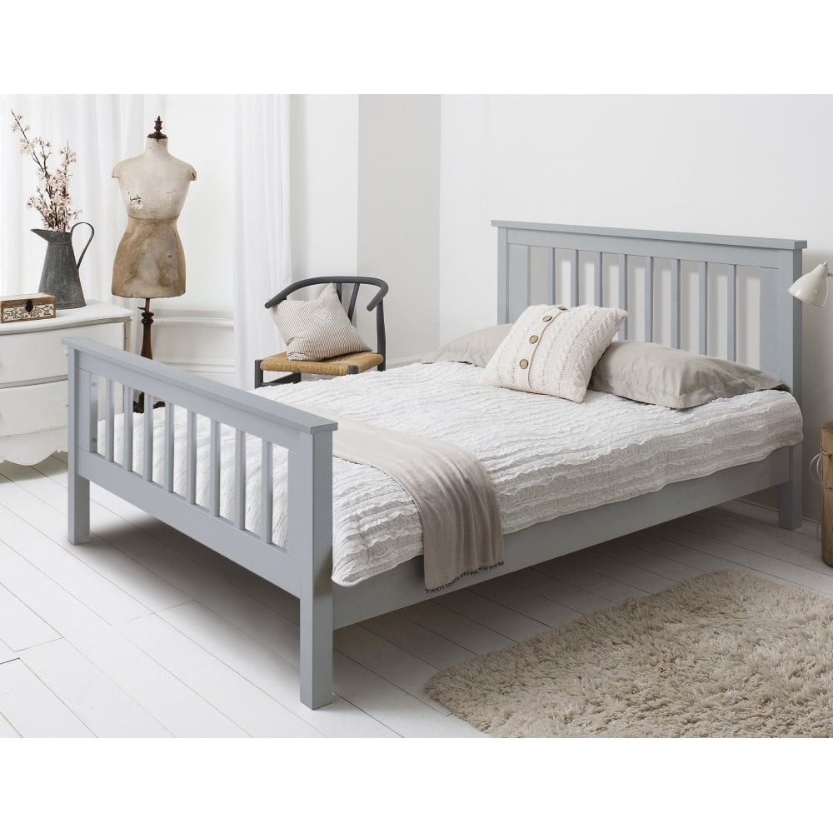
Now, have a hunt around your house to find some examples of free standing structures.
Click below for some examples that I found…
All of these, stand up on their own.

Slide 4
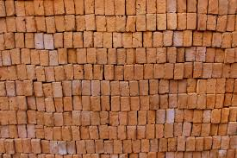
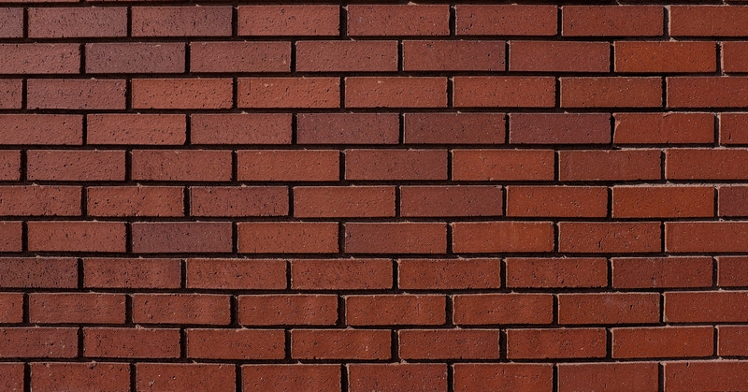
Let’s look at some ways we can make a stable structure.
Look at these two walls. Which one is strongest? If you could tap a brick at the bottom on each one… what do you think would happen?
Stable structure
Which structure do you think is most stable?

Slide 5
Wider bases and buttress for stability
As a free standing structure becomes taller, its centre of gravity rises. Stability in a structure can generally be increased by making the base wider, making the base heavier or adding buttresses.

Slide 6
Now its your turn…
I would like you to use a construction kit that you have at home to make a free standing structure. You could use lego, mobilo or even junk materials. Anything you have will work!
Consider what you are going to make first - a slide, a chair, a swing, a house?
Now think carefully about how you will make your structure stable.

