Slide 1
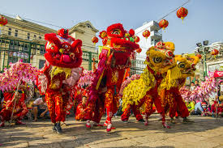
Celebrating Chinese New Year!
Maths!

Slide 2
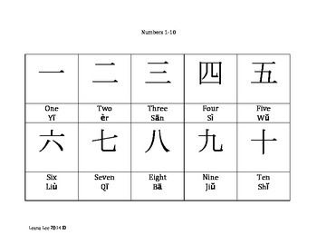
Look at the following numbers in Chinese.
Press the speaker to hear the number being said.
Now have a go yourself at counting in Chinese.

Slide 3
Numbers in Chinese are very straight forward because after number 10 ,
Number 11 is 10 and 1 ➔

Slide 4
Now that you are super with your numbers in Chinese, have a go at these calculations
1. + =
6. - =
2. + =
7. - =
3. + =
8. - =
4. + =
9. - =
5. + =
10. - =

Slide 5
And now try these…
1. x =
6. ÷ =
2. x =
7. ÷ =
3. x =
8. ÷ =
4. x =
9. ÷ =
5. x =
10. ÷ =

Slide 6
Well done!
Why don’t you impress your family by setting them some calculations in Chinese!

