Slide 1
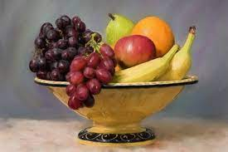
Giuseppe Arcimboldo
Portraits with a difference!

Slide 2
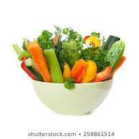
Giuseppe Arcimboldo
For our final lesson on portraits, we are going to look at some very strange paintings.
Have you heard of Giuseppe Arcimboldo? That is a funny name, right?
He was born in Milan Italy, in 1527. He is most famous for his portraits of human heads made up of vegetables, fruit, flowers, and all sorts of other things.

Slide 3
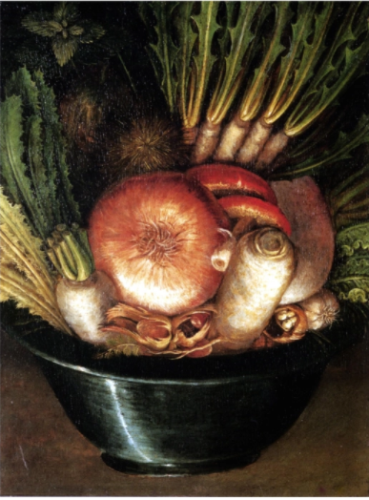
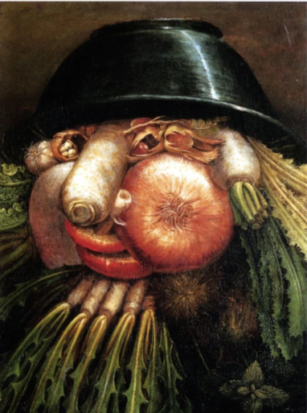
Now what do you see?
It’s the same picture upside down.
What do you see?
A bowl of vegetables?

Slide 4
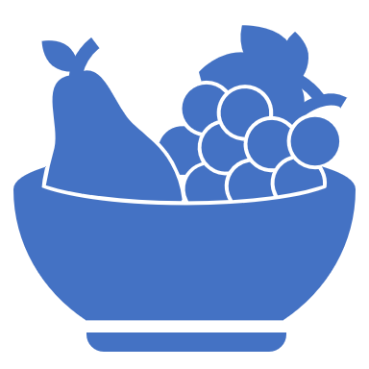
Look at some of his other paintings.
What do you notice?
The entire faces are made of things like fruit, vegetables, flowers, kitchen items, and even sea creatures!
Look closely at the faces.
What do you see?

Slide 5
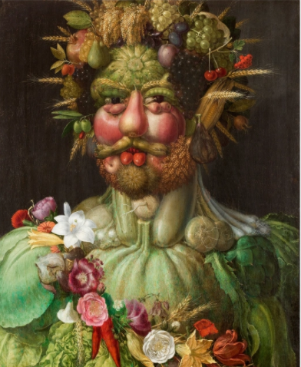
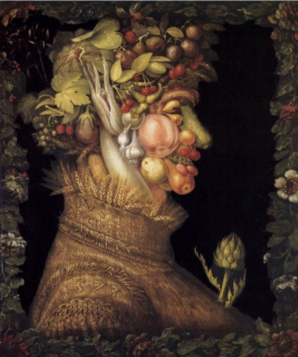
Can you name ten different things Giuseppe used to make the faces?

Slide 6
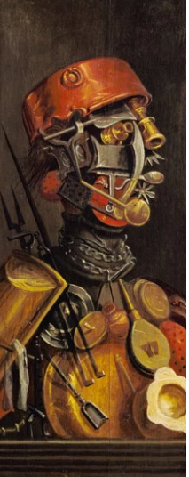
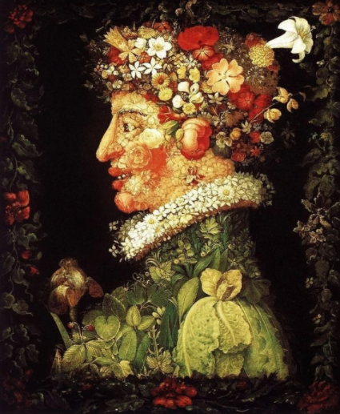
Today, art students discuss whether or not Arcimboldo painted these for fun, or if he was kind of crazy. Which do you think it was?

Slide 7
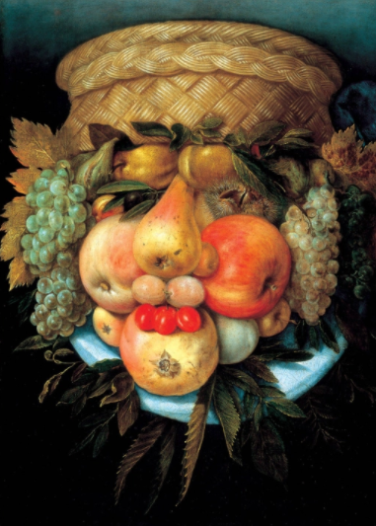
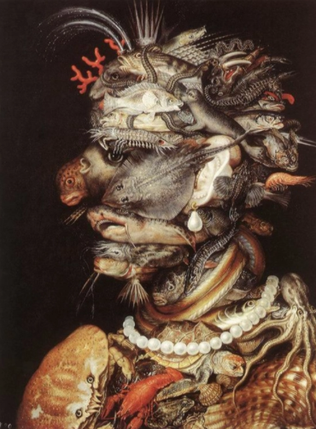
Every part of the picture is made from something, not just the eyes, nose and mouth.

Slide 8
Today, you get to create a face made out of fruits & veggies like Arcimboldo.
First look around your house for things that could make the face
Make some sketches on paper to figure out how you want to put the face together
Then draw it with a pencil
Finally, paint or colour it.
Have fun!!

