Slide 3
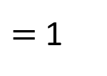
Use multilink and base ten
to represent these expressions.
a) 2$x$ $+$ 3 b) 2$x$
c) 3$x+$ 1 d) 4 $+$ $x$
2) Write each statement as an algebraic expression.
3 more than $t$
double $t$
$t$ divided by 6
$=$ $x$
$=$ 1

Slide 4

Use multilink and base ten
to represent these expressions.
a) 2$x$ $+$ 3 b) 2$x$
c) 3$x+$ 1 d) 4 $+$ $x$
2) Write each statement as an algebraic expression.
3 more than $t$
double $t$
$t$ divided by 6
$=$ $x$
$=$ 1
$t+$ 3
2$t$
$\frac{t}{\text{6}}$

Slide 6
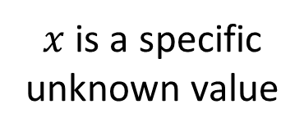
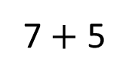
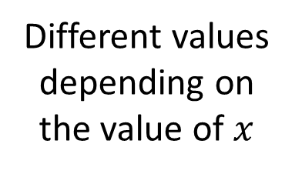
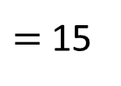
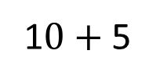
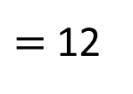
Expression
Equation
$x+$ 5
$x+$ 5 $=$ 11
Different values depending on the value of $x$
$x$ is a specific unknown value
7 $+$ 5
$=$ 12
1$0+$ 5
$=$ 15

Slide 7
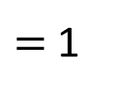
$=$ $x$
$=$ 1
Words | Concrete | Algebra
I think of a number
$$x$$
Add 5
$x+$ 5
My answer is 7
$$=$$
$x+$ 5 $=$ 7

Slide 8
$=$ $x$
$=$ 1
Words | Concrete | Algebra
I think of a number
$$x$$
Multiply by 2
2$x$
Add 3
2$x+$ 3
My answer is 7
2$x+$ 3 $=$ 7
$$=$$
Have a think

Slide 9
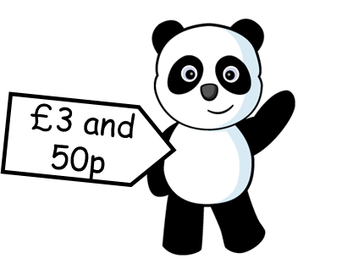
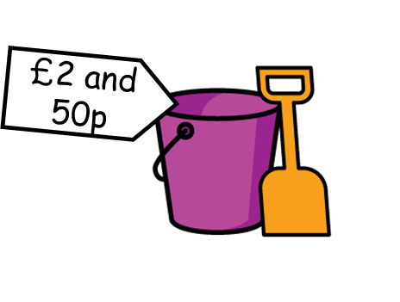
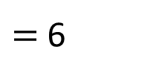
£2
£$t$
£$p$
£3
£$y$
The total cost of the rugby ball and the panda is £6
Form an equation to represent this information.
2
$=$ 6
$$+ p$$
Have a think

Slide 10
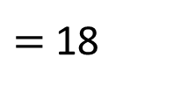
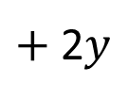
£2
£$t$
£$p$
£3
£$y$
The total cost of a train, two bucket and spades and one t-shirt is £18
Form an equation to represent this information.
3
$$+ t$$
$+$ 2$y$
$=$ 18
Have a think

Slide 11
Have a go at questions 1 - 2 on the worksheet

Slide 12
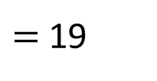
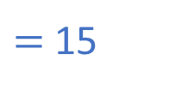
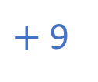
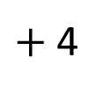
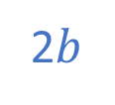
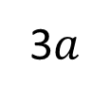
Write an equation to represent the bar model.
19
$$a$$
$$a$$
$$a$$
4
$$a+a+a$$
3$a$
$+$ 4
$=$ 19
15
$$b$$
$$b$$
9
2$b$
$+$ 9
$=$ 15
Have a think

Slide 13
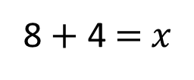
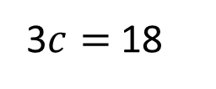
Draw a bar model to represent each equation.
3$c=$ 18
18
$$c$$
$$c$$
$$c$$
8 $+$ 4 $=$ $x$
$$x$$
8
4
Have a think

Slide 14
Have a go at the rest of the questions on the worksheet

Slide 15
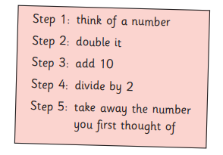
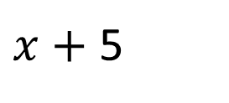
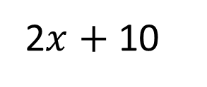
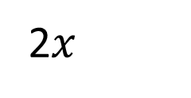
$$x$$
2$x$
2$x$ $+$ 10
$x$ $+$ 5
5
What if step 3 was to add 16
What will the answer be then?

