Slide 1
04.02.21 Science
Hi Year 4,
In today’s lesson you are going to be learning all about the water cycle and the scientific vocabulary used to describe it.
I would like you to play close attention to the evaporation and condensation parts of the cycle. Please read the slides carefully and watch the video.
There are some activities for you to complete throughout the lesson.
Make sure you complete the worksheet at the end of the lesson.

Slide 2
Success Criteria:
I can define what the words evaporation, condensation and precipitation mean in the water cycle.
I can describe the water cycle and its different stages using scientific vocabulary.
I can label a diagram of the different stages of the water cycle accurately and use the correct scientific vocabulary.

Slide 3
First, I would like you to write down the the following words on a piece of paper.
Evaporation -
Condensation -
Precipitation -
As you work through the lesson listen out for these words and when you know what they mean write down the definition for each word. Try and explain the role it plays in the Water Cycle.

Slide 4
Click on the raindrop to watch a video about the water cycle!

Slide 5
The following 6 slides have important information describing and showing you how the different stages of the water cycle work.
Please read the information carefully as you will need to use this information to help you define the keywords you have written down from the previous slide and to help you understand what the water cycle is and how it works.

Slide 6
What Is the Water Cycle?
More than three quarters of the Earth's surface is water.
Some of this water evaporates in the heat of the Sun.
When the water has evaporated, it is in the form of water vapour.
Clouds are made from water vapour that has condensed to form tiny water droplets.
When the water droplets get too big, they fall from the clouds.
The water droplets can fall as rain, hail or snow.
Three hundred millions litres of water falls on dry land each day.

Slide 7
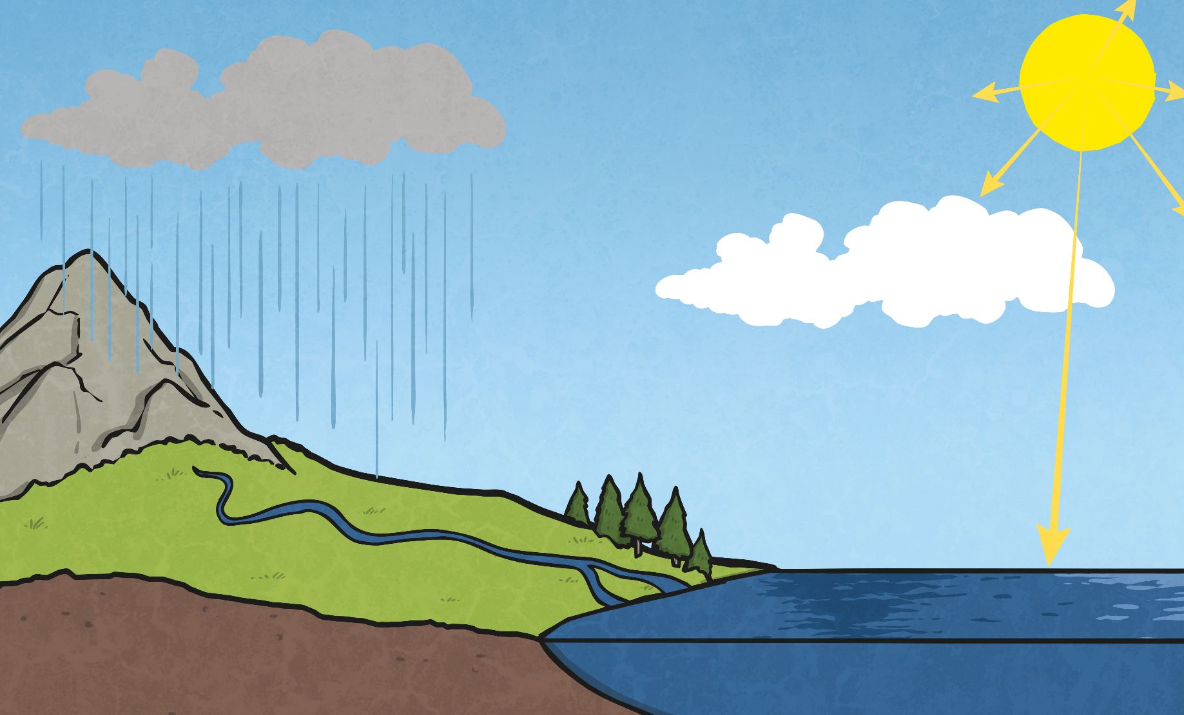
What Is the Water Cycle?

Slide 8
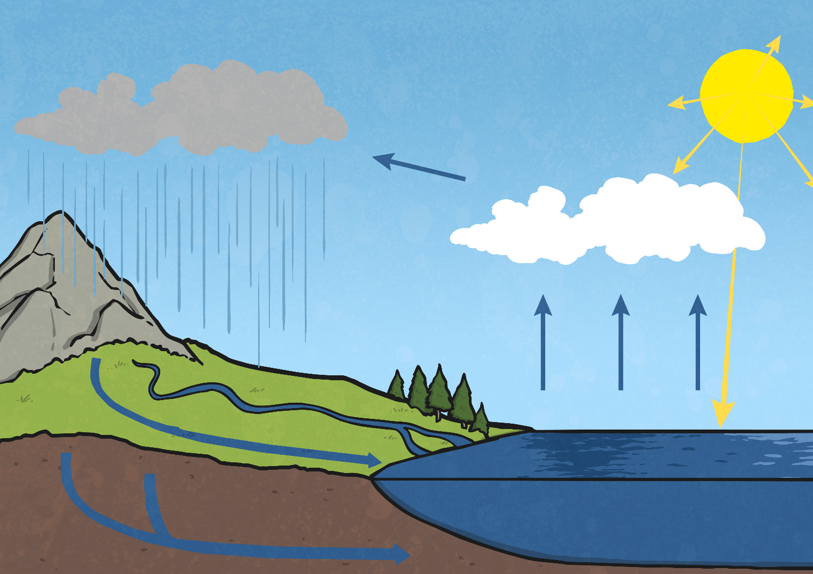
The Stages of the Water Cycle
sun
precipitation
wind
rain
condensation
evaporation
collection
ground
run-off
rivers and
streams
underground
water
sea

Slide 9
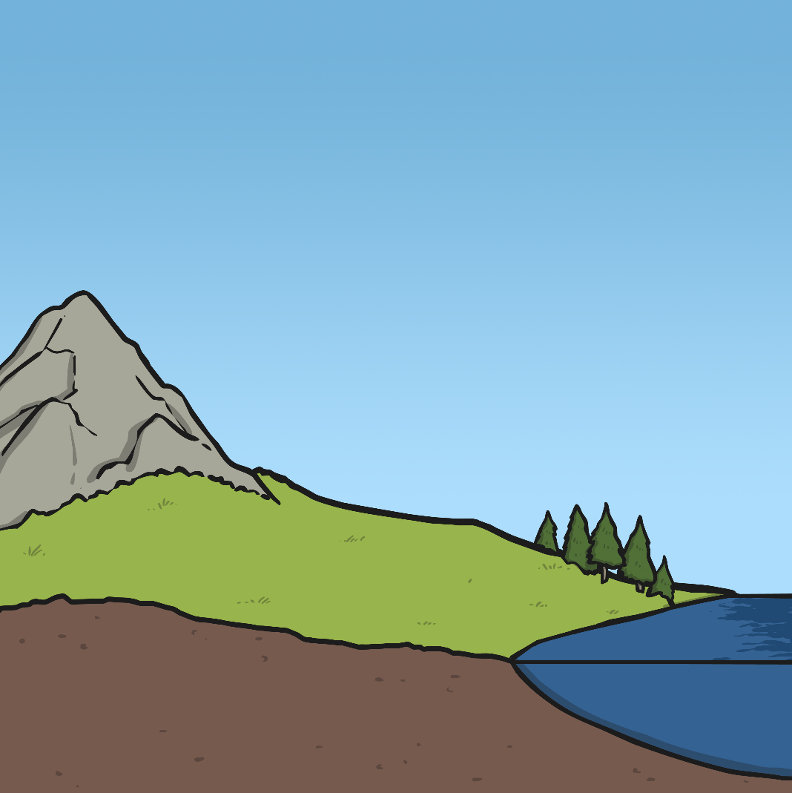
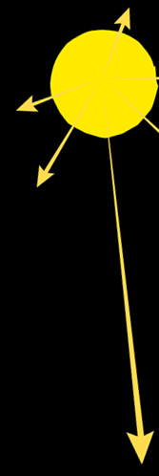
The Stages of the Water Cycle
Evaporation
Heat from the Sun causes water to evaporate from seas, lakes, rivers and streams. Water also evaporates from puddles and ponds.
This evaporation happens even on cloudy or cold days.
The liquid water turns into water vapour when it has evaporated.
sun
evaporation
sea

Slide 10
The Stages of the Water Cycle
Condensation
The water vapour in the air rises, and as it does so, it cools down.
Eventually, it cools enough for the water vapour to condense and form small droplets of water.
The droplets of water clump together to form clouds.
wind
sun
condensation
evaporation
sea

Slide 11
The Stages of the Water Cycle
Precipitation
As more water vapour condenses, more water droplets are formed in the clouds.
Eventually, the water droplets are large enough and heavy enough to fall back to the surface of the Earth.
These droplets of water fall from the clouds in the form of rain, sleet, hail or snow.
precipitation
wind
sun
precipitation
condensation
rain
evaporation
sea

Slide 12
The Stages of the Water Cycle
Collection
When water falls back to Earth as precipitation, the water may fall on oceans, lakes, rivers or on the ground.
Water that falls on the ground is either absorbed into the soil, and is used as drinking water for animals and plants, or it runs over the ground and collects in the oceans, lakes and rivers.
This water is then evaporated and the cycle starts all over again!
wind
sun
precipitation
condensation
rain
rivers and
streams
evaporation
ground run-off
underground
water
sea

Slide 13
Sort the Stages
Rearrange the letters of each word below to make the name of a stage of the water cycle.
Can you put the stages in order?
donsaictenon
lictencool
condensation
collection
1
2
cronitpitpeia
vaintoreapo
precipitation
evaporation
3
4

Slide 14
On the following slide there is a diagram of the water cycle. Your job is to either print off the blank copy and use the word bank to the right to label the diagram, or to draw your own water cycle and use the picture of the cycle and the word bank to help you. There is a larger version of the diagram and word bank on the last slide.

Slide 15
Label the diagram of the water cycle using the words in the list to help you!

Slide 17
Well done, in today’s lesson you have learned the different stages of the water cycle and used key scientific vocabulary to accurately discuss and label a diagram of the cycle stages.
Success Criteria:
I can define what the words evaporation, condensation and precipitation mean in the water cycle.
I can describe the water cycle and its different stages using scientific vocabulary.
I can label a diagram of the different stages of the water cycle accurately and use the correct scientific vocabulary.

