Slide 1
12.02.21 Science
Hi Year 4,
In today’s lesson we are going to be looking at the water cycle again but this time we are going to focus on evaporation and condensation.
You will need to watch the video on the first slide and complete the activity and quiz on the BBC Bitesize website, then read through the presentation slides carefully and complete the activities.

Slide 2
Success Criteria:
I can define the words evaporation and condensation in the water cycle.
I can discuss the role of the evaporation and condensation stages in the water cycle.
I can discuss and observe different examples of evaporation and condensation.
Notes:
.

Slide 3
Click on the raindrop to watch the animation about the water cycle and complete the sorting activity and the quiz on the website.

Slide 4
On the following slides you will learn about evaporation and condensation in more detail. There is a mixture of written information, pictures and videos for you to look at. I hope you have fun learning about this!
Click the cloud to watch a video first!.

Slide 5
Without looking at your work from last week, write down a definition for evaporation and condensation. Check if you are correct on the next slide…

Slide 6
Did you write something like this?
Evaporation – the process where water is heated by the sun and the water particles change state from a liquid to a gas (water vapor).
Condensation – the stage where the water particles cool down and clump together to form clouds.
Well done!

Slide 7
Success Criteria:
I can define the words evaporation and condensation in the water cycle.
I can discuss the role of the evaporation and condensation stages in the water cycle.
I can discuss and experiment different examples of evaporation and condensation.
Well done, you can define evaporation and condensation!!!

Slide 8
Do you know what evaporation is?
Think about what is happening in the pictures you see next.

Slide 9
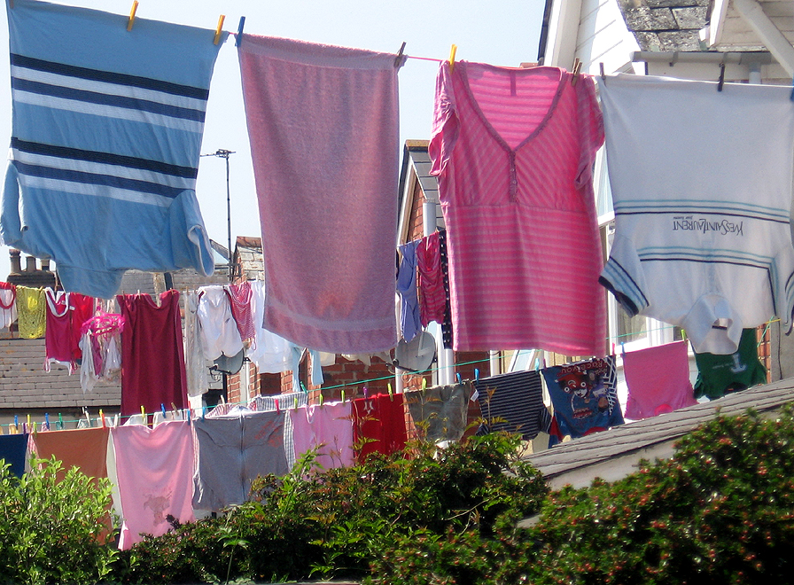
Photo courtesy of crabchick (@flickr.com) - granted under creative commons licence - attribution

Slide 10
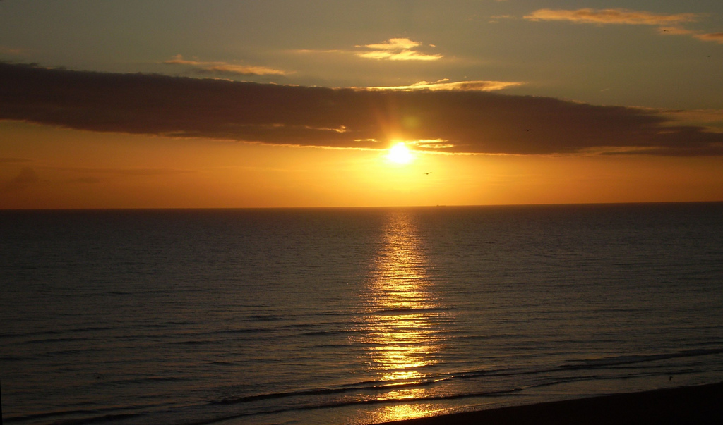
What body of water can you see? Is there a heat source?
Photo courtesy of Elsie esq. (@flickr.com) - granted under creative commons licence - attribution

Slide 11
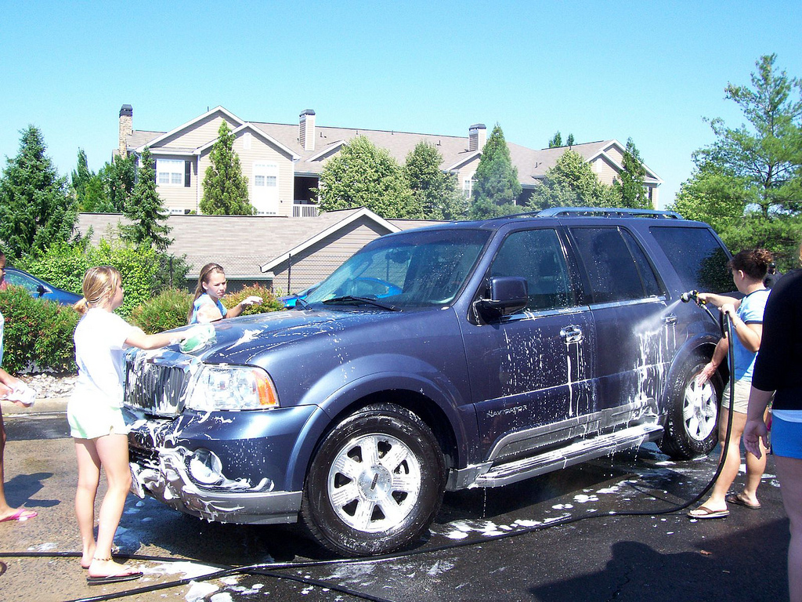
What about here? Has the heat source changed or stayed the same?
Photo courtesy of SYA Extreme (@flickr.com) - granted under creative commons licence - attribution

Slide 12
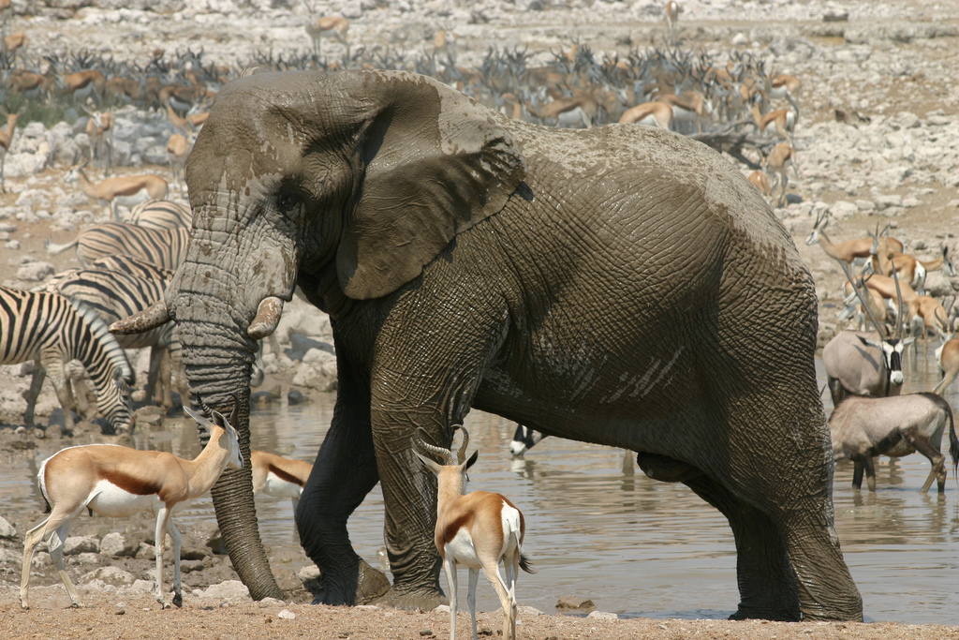
Think about the water on the elephant. Will the water stay on the elephant all day? How will the water leave the elephants skin?
Photo courtesy of Erwint (@flickr.com) - granted under creative commons licence - attribution

Slide 13
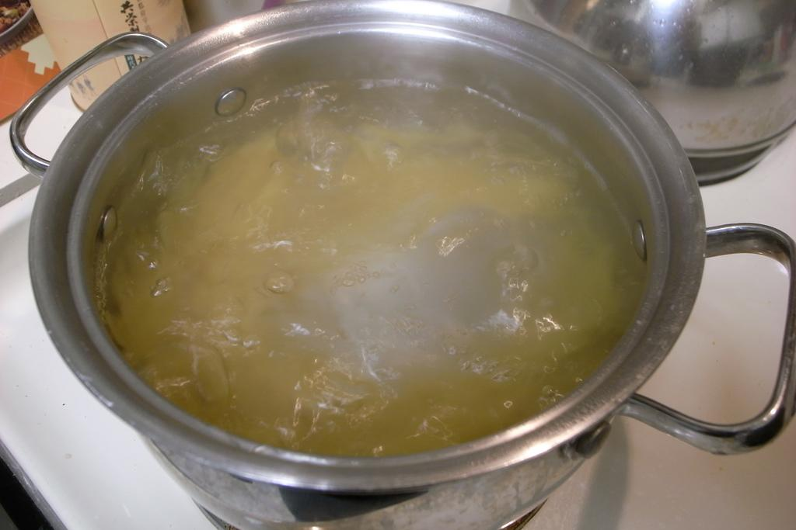
What is different about the heat source here than in the previous photos?
The heat source in this photo is the hob! Instead of the sun in the previous photos!
Photo courtesy of naotakem (@flickr.com) - granted under creative commons licence - attribution

Slide 14
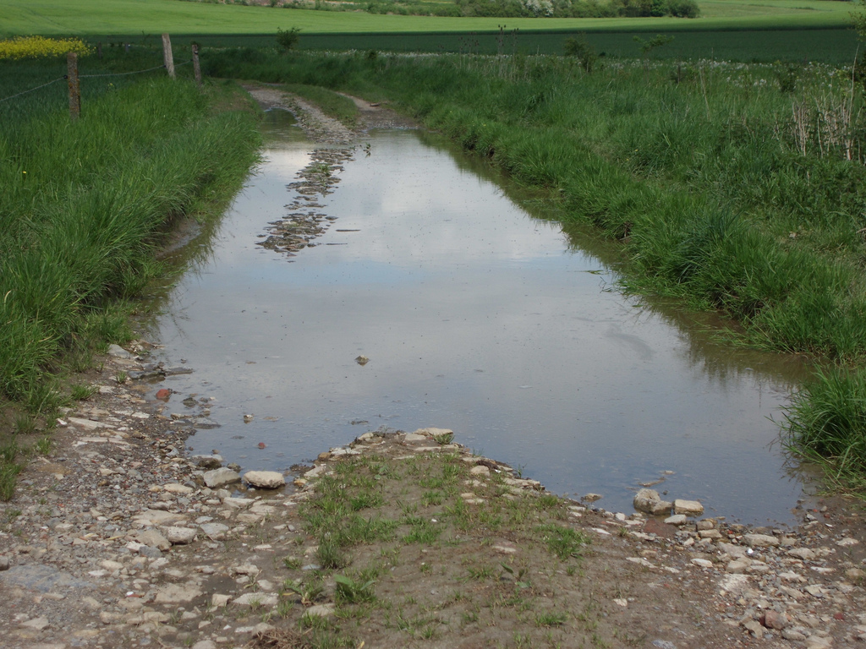
What body of water can you see here? Is there a heat source? Do you think the temperature will be as warm here then in the previous photo?
Photo courtesy of Ruben Holthuijsen (@flickr.com) - granted under creative commons licence - attribution

Slide 15
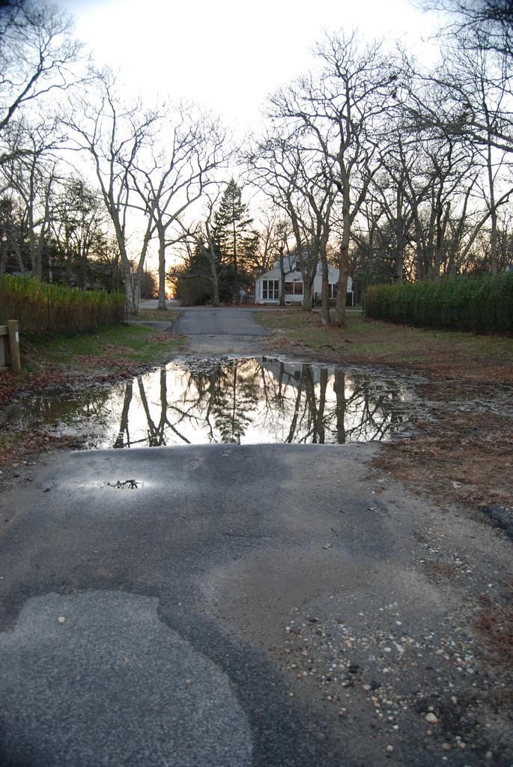
Evaporation!
Evaporation is the changing of a liquid into a gas.
Evaporation happens all around us without us knowing it.
A puddle on the road begins to ‘disappear’ as it is evaporating.
Photo courtesy of Webb Zahn (@flickr.com) - granted under creative commons licence - attribution

Slide 16
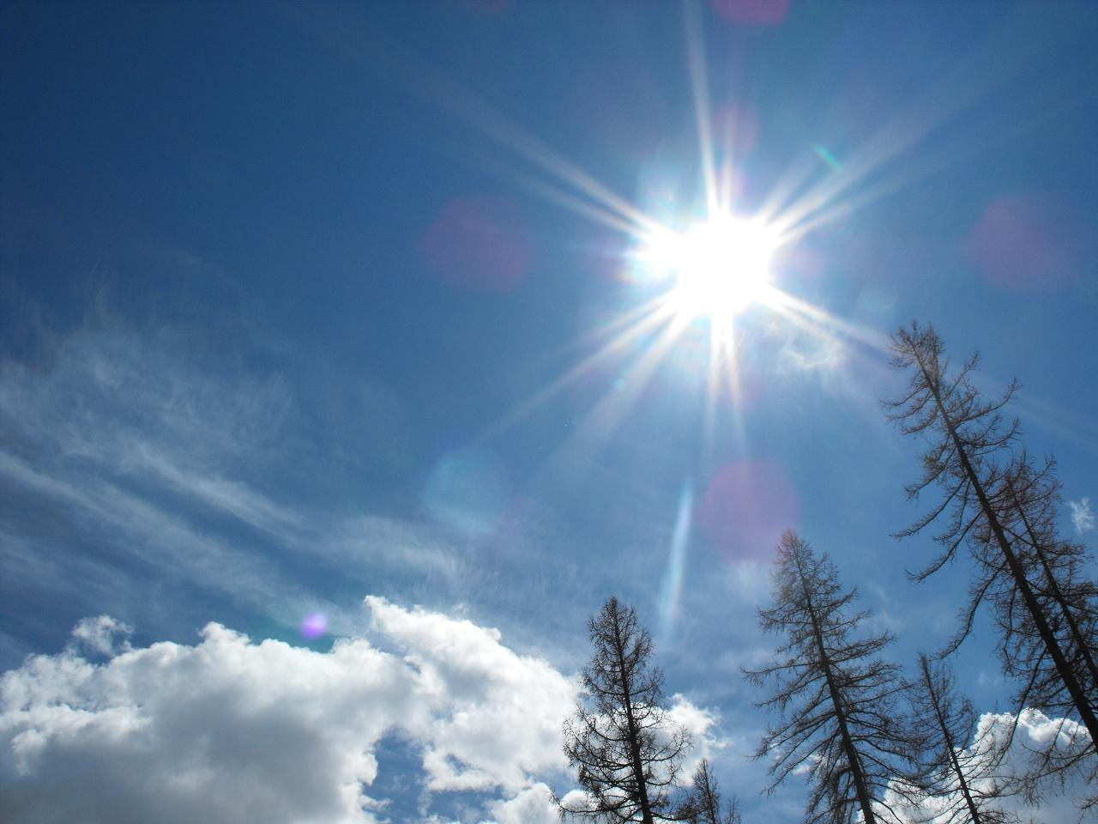
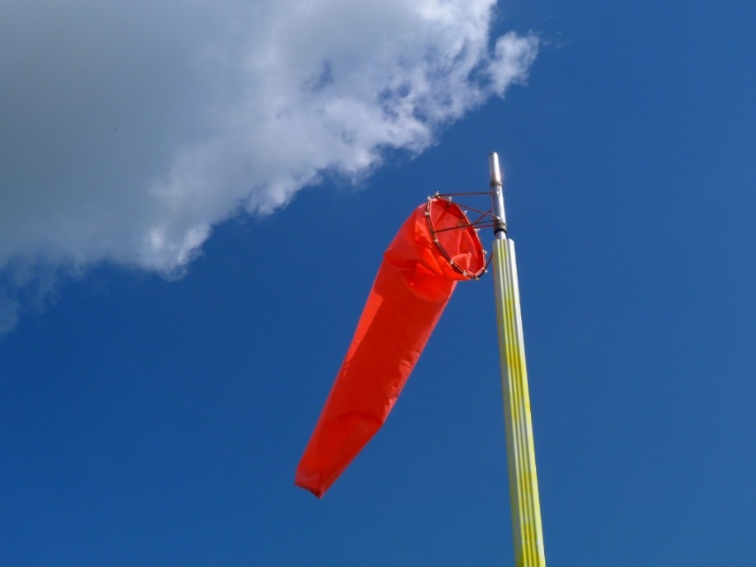
Evaporation happens at a faster rate by:
The temperature being warmer.
The air moving more quickly in a breeze.
Photo courtesy of gr33n3gg and Rusty Clark (@flickr.com) - granted under creative commons licence - attribution
Photo courtesy of gr33n3gg and Rusty Clark (@flickr.com) - granted under creative commons licence - attribution

Slide 17
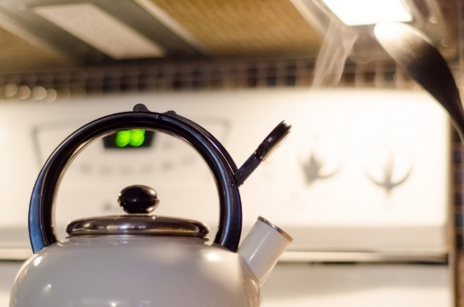
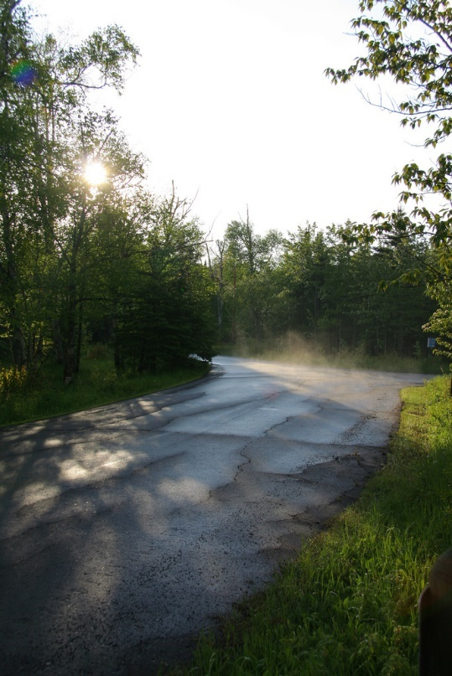
Evaporation is when a liquid changes into a gas. It occurs on the surface of a liquid at any temperature. This is a very slow process and different to boiling, in which bubbles form in the liquid before it turns to vapor.
If we left a kettle for a very long time, the water would eventually evaporate. If we switched it on, it would very quickly boil.
We can sometimes see steam rising from the ground after it has rained. This too is evaporation.
Photo courtesy of kelly.sikkema and Rusty Clark and Mulad (@flickr.com) - granted under creative commons licence - attribution

Slide 18
Other examples of evaporation include:
Warm-air hand dryers
Blowing on ink to dry it
Washing drying on a sunny, breezy day
Hair dryers
Can you think of any other examples?
Photo courtesy of crabchick (@flickr.com) - granted under creative commons licence - attribution

Slide 19
Evaporation in the water cycle:
Water is heated by the sun and turns to vapour and clouds.
When the water droplets in a cloud merge and get heavier, they fall as rain which allows plants to grow.
So evaporation is vital for water to travel to different places in its gaseous state.
(This is when the water is in the form of water vapour).

Slide 20
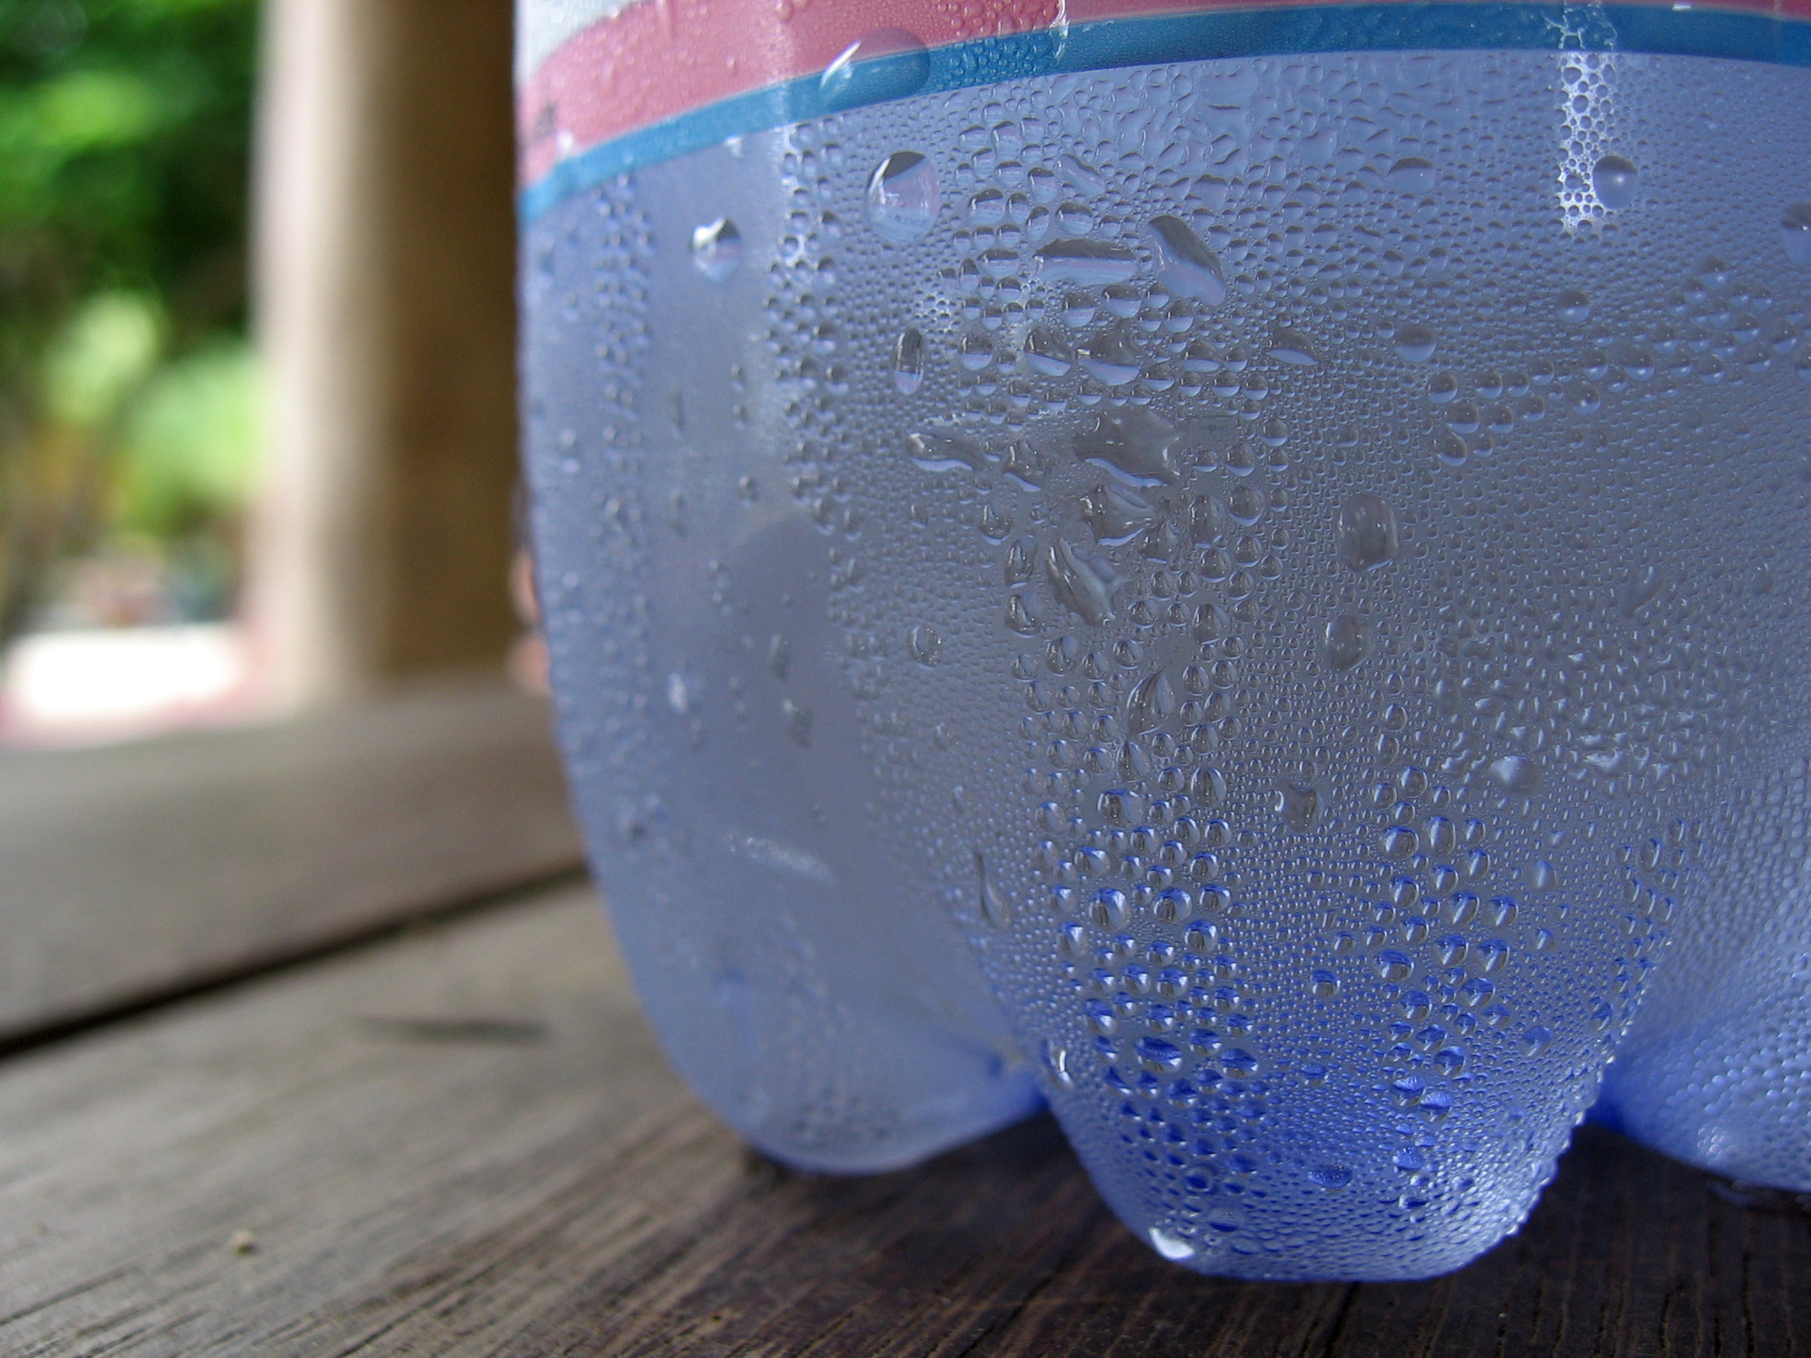
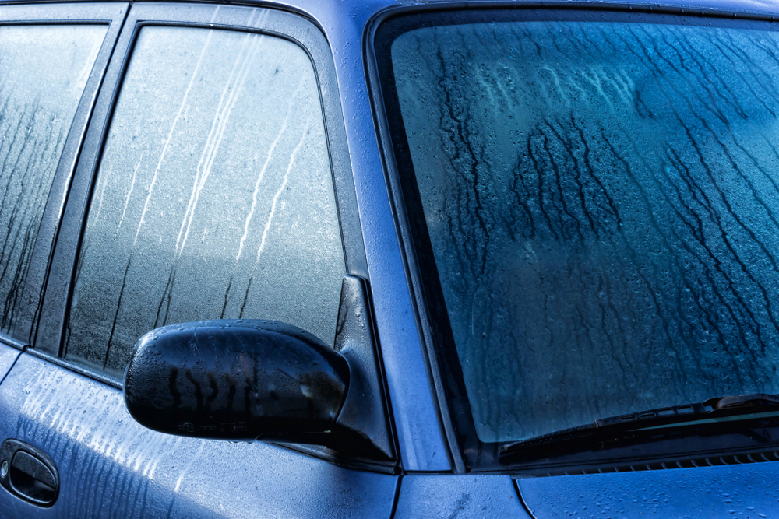
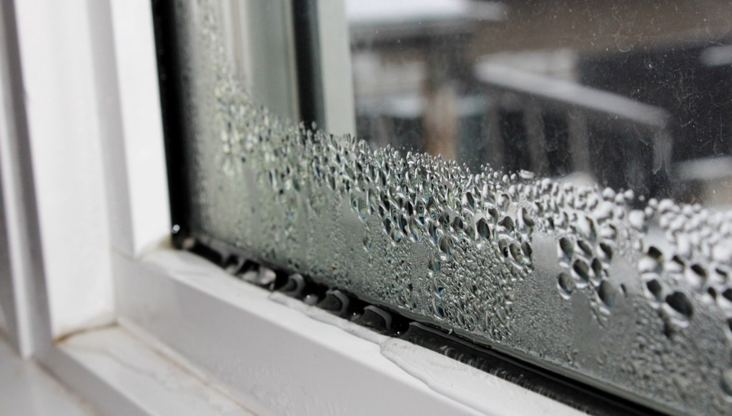
Condensation
Can you see the condensation in these pictures? Think about why this might be happening? Think about temperature!

Slide 21
Condensation
Condensation happens all around us!
In fact, condensation is really easy to spot in our daily lives, for example:
Water droplets on the inside of windows
Dew on grass
A steamed up mirror
Reading glasses fogging up
Water droplets on the outside of your cold drink

Slide 22
Condensation in the water cycle:
Condensation plays an important role in the water cycle, creating clouds. It's the process where a gas (water vapour) turns back into a liquid, due to a reduction in the energy of its particles.
This is the opposite of evaporation.
The clouds created by condensation may produce precipitation, which is the main route for water to return to the Earth's surface within the water cycle.

Slide 23
Success Criteria:
I can define the words evaporation and condensation in the water cycle.
I can discuss the role of the evaporation and condensation stages in the water cycle.
I can discuss and observe different examples of evaporation and condensation.
Well done, you can discuss the role of evaporation and condensation in the water cycle and now you will look at different examples of evaporation and condensation in real life!

Slide 24
Quick Task!
Washing drying on a line
Condensation
A mirror misting in a bathroom
Puddles drying up
Paint drying
Car windows fogging up on a cold day
Evaporation
A hairdryer
Complete the sorting activity. You need to decide whether each sentence is an example of evaporation or condensation.
Water droplets on the inside of a window
A plant’s leaves wilting
Water droplets on a cold can of fizzy drink

Slide 25
You need to copy this text onto your paper and fill in the missing words. Use the word box to help you.

Slide 26
On the last slides I have included some fun mini experiments for you to maybe have a go at later date! They will allow you observe evaporation and condensation happen in real life!
Notes:
I actually think rather than this slides you could add speech bubbles to the activity slides.

Slide 27
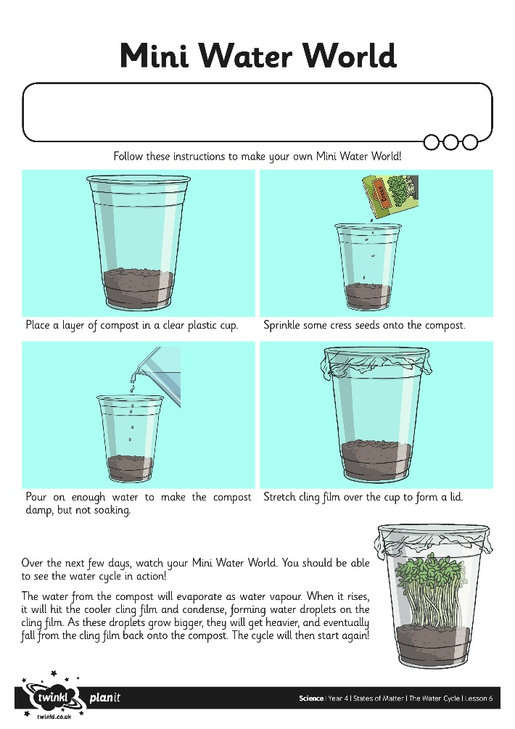
Mini Water Worlds
You could give it a go and make your own mini water world to watch the water cycle in action!
Follow the instructions on your Mini Water Worlds Activity Sheet.
The instruction sheet for this activity is on the school website under today’s date.

Slide 28
Condensation and Evaporation experiments.
EVAPORATION EXPERIMENTS:
Mark lines on a clear container of water and check the level over several days. You can have a covered container for comparison.
Hand up two matching wet cloths, and use a fan to blow air on one. Wind will speed up the drying process as water vapour is quickly carried away.
Observe puddles on a rainy day, and check back to see if they get smaller after the rain has stopped. You can use cones to mark the edges.
CONDENSATION EXPERIMENTS:
Boil water in a pan with the lid on and watch what happens to the lid on the inside.
Go to the bathroom and turn on a warm shower. Look at your shower screen and observe the condensation process.

Slide 29
Well done, in today’s lesson you have discussed and described the role of the evaporation and condensation stages in the water cycle.
Success Criteria:
I can define the words evaporation and condensation in the water cycle.
I can discuss the role of the evaporation and condensation stages in the water cycle.
I can discuss and observe different examples of evaporation and condensation.

