Slide 1


Slide 3
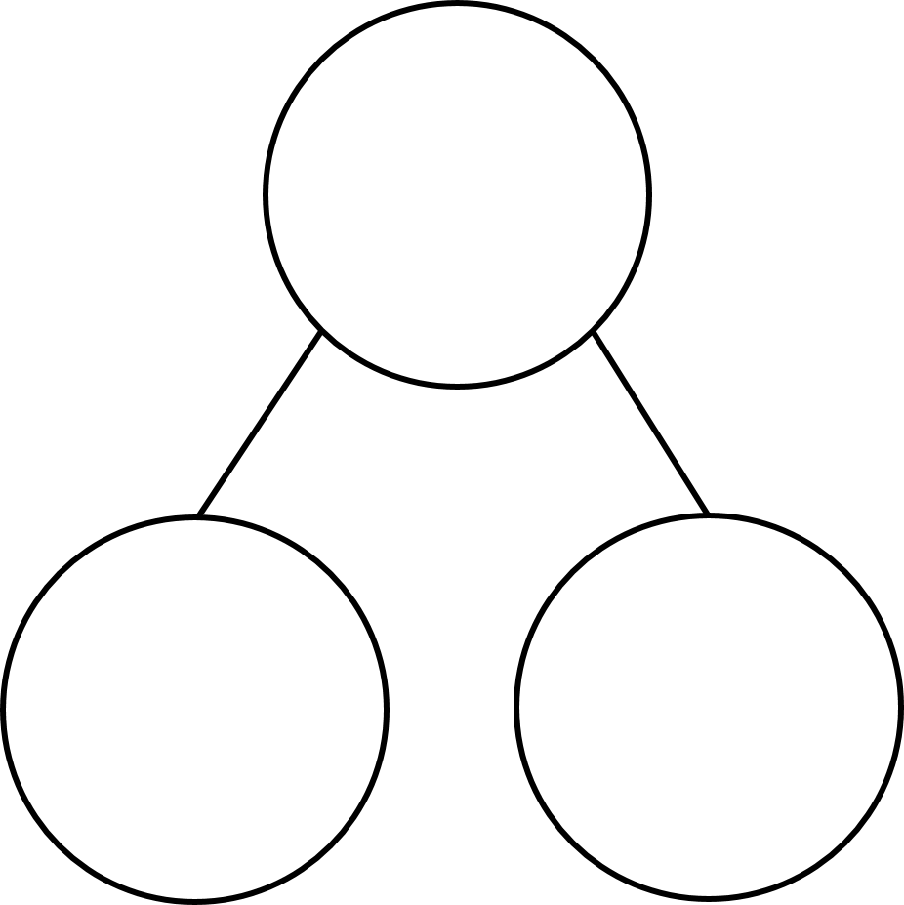
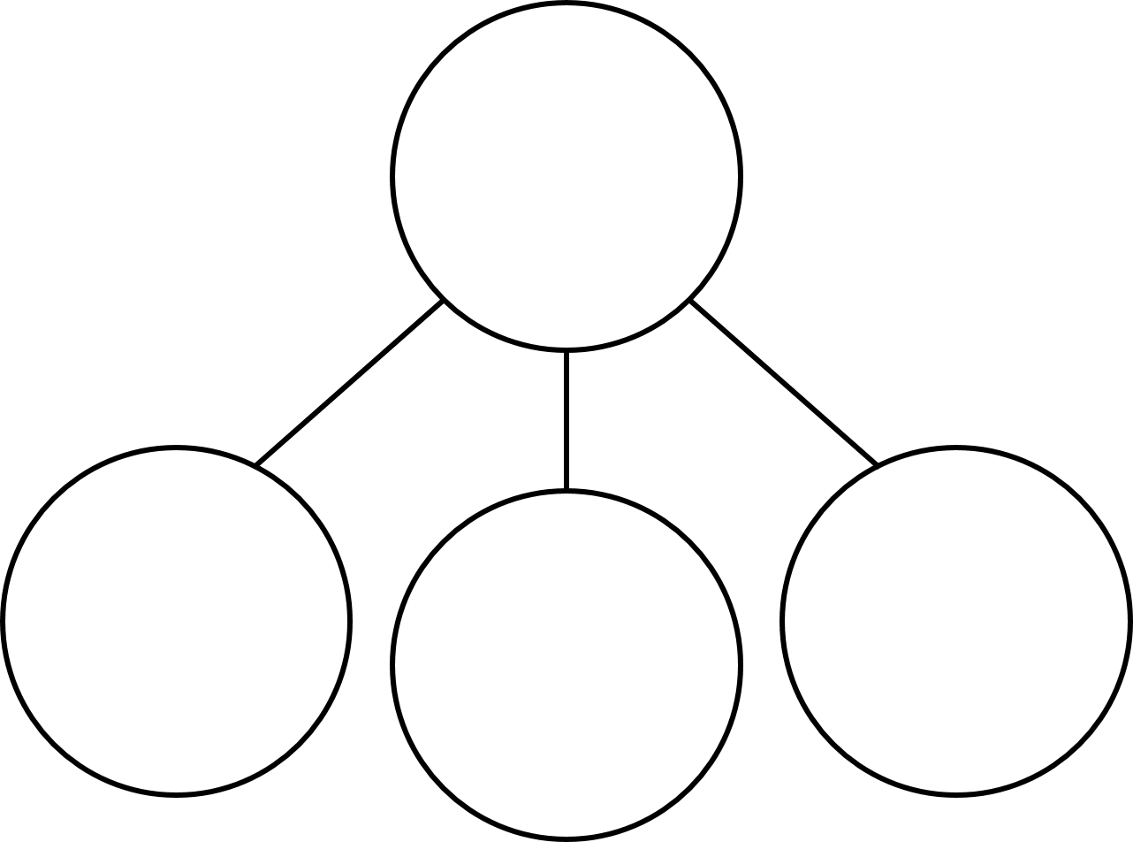


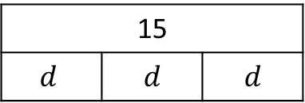
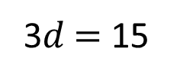
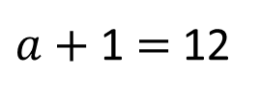
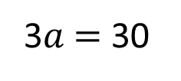
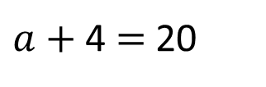
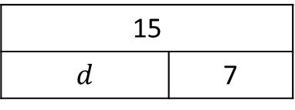
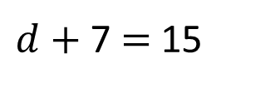
1) Write the value of the multilink cube in each question.
2) Find the value of d in each bar model.
20
30
12
$a+$ 4 $=$ 20
3$a$ $=$ 30
$a+$ 1 $=$ 12
15
$$d$$ | $$d$$ | $$d$$
15
$$d$$ | 7
3$d$ $=$ 15
$d+$ 7 $=$ 15

Slide 4
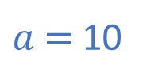
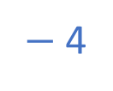
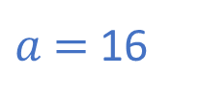
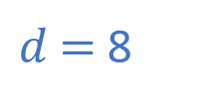
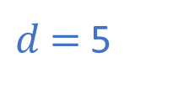
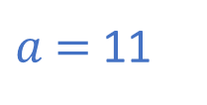
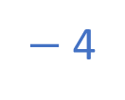
1) Write the value of the multilink cube in each question.
2) Find the value of d in each bar model.
20
30
12
$a+$ 4 $=$ 20
3$a$ $=$ 30
$a+$ 1 $=$ 12
$−$ 4
$−$ 4
$a$ $=$ 10
$a$ $=$ 11
$a$ $=$ 16
15
$$d$$ | $$d$$ | $$d$$
15
$$d$$ | 7
3$d$ $=$ 15
$d+$ 7 $=$ 15
$d$ $=$ 5
$d$ $=$ 8

Slide 6






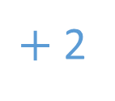
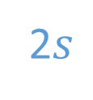
Alex and Jack have the same number of sweets.
Form an equation to represent this.
2$s$
$+$ 2
$$=$$
10
Have a think

Slide 7
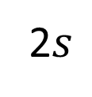
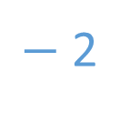

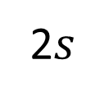

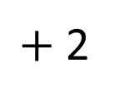

2$s$
$+$ 2
$$=$$
10
$−$ 2
$−$ 2
2$s$
$$=$$
8

Slide 8
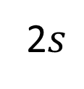


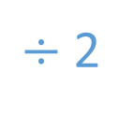

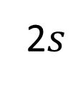


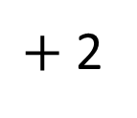

2$s$
$+$ 2
$$=$$
10
$−$ 2
$−$ 2
2$s$
$$=$$
8
$÷$ 2
$÷$ 2
$$s$$
$$=$$
4

Slide 9
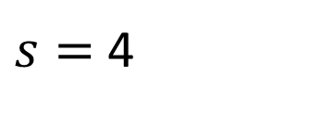

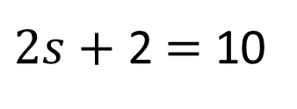
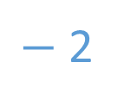



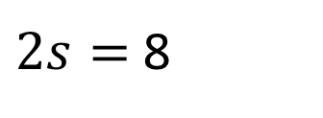

2
10
8
$$s$$
$$s$$
2
$2s+$ 2$=$ 10
$−$ 2
$−$ 2
$2s=$ 8
$÷$ 2
$÷$ 2
$s=$ 4

Slide 10

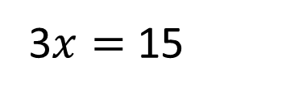
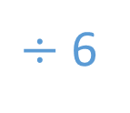
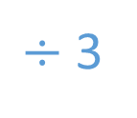
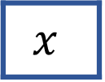
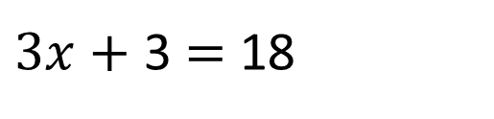
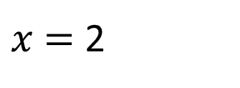

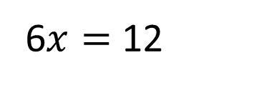
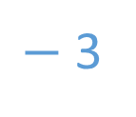
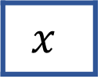
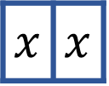

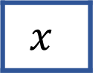
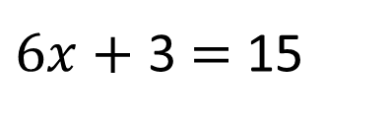

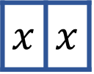


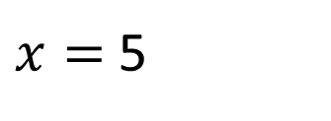

Have a think
Find the value of $x$in each bar model
18
15
$$x$$
$$x$$
$$x$$
3
$$x$$ | $$x$$
$$x$$ | $$x$$
$$x$$ | $$x$$
3
$3x+$ 3 $=$ 18
$6x+$ 3 $=$ 15
$−$ 3
$−$ 3
$−$ 3
$−$ 3
3$x=$ 15
6$x=$ 12
$÷$ 3
$÷$ 3
$÷$ 6
$÷$ 6
$x=$ 5
$x$ $=$ 2

Slide 11
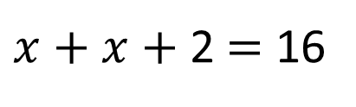



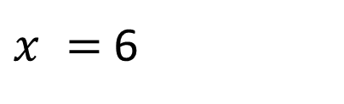

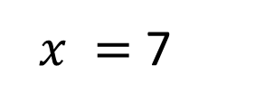

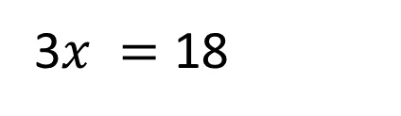

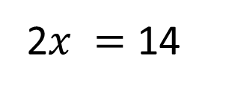

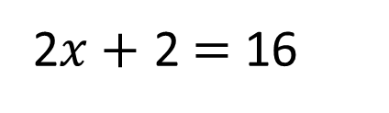


16
14
21
18
$x+x+$ 2$=$ 16
3$x+$ 3$=$ 21
2$x+$ 2$=$ 16
$−$ 3
$−$ 3
$−$ 2
$−$ 2
3$x =$ 18
2$x =$ 14
$÷$ 3
$÷$ 3
$÷$ 2
$÷$ 2
$x =$ 6
$x =$ 7
Have a think

Slide 12
Have a go at questions
1 - 4 on the worksheet

Slide 13























Solve the equations
Have a think
12 $=$ 3$y$ $+$ 6
4$t −$4 $=$ 36
12
$$t$$
$$t$$
$$t$$
$$t$$
$$y$$
$$y$$
$$y$$
6
40
4
36
12 $=$ 3$y$ $+$ 6
4$t −$4 $=$ 36
$−$ 6
$−$ 6
$+$ 4
$+$ 4
6$=$ 3$y$
4$t$ $=$ 40
$÷$ 3
$÷$ 3
$÷$ 4
$÷$ 4
2$=y$
$t$ $=$ 10

Slide 14


A scarf costs £$S$
A book costs £4 less than the scarf.
The total cost of both items is £26
How much does the book cost?
Scarf
£26
Book
£4
Have a think

Slide 15

A scarf costs £$S$
A book costs £4 less than the scarf.
The total cost of both items is £26
How much does the book cost?
Scarf
£15
£26
Book
£11
£15
£4
£30
30 $÷$ 2 $=$
15
The book costs £11

Slide 16








Work out the cost of one apple.
87 p
64 p
3$a$ $+$ $b=$ 87
2$a$ $+$ $b=$ 64
$$a$$
$=$ 87 $−$ 64
$$a$$
$=$ 23
One apple costs 23 p
Have a think

Slide 17
Have a go at the rest of the questions on the worksheet

