Slide 1
Good morning, Year 6!
Let’s start with a warm-up, and do our Daily Ten mental maths. Level Six, Digit Values -> Upto 999,999 today. Set the timer at a speed that’s suitable for you.
https://www.topmarks.co.uk/maths-games/daily10
Here are your maths slides for Tuesday 2nd February. Today’s learning objective is to continue our work on finding rules for number sequences. Today you will be looking for a two-step rule to describe a pattern.
Watch this video before you begin today’s work:
https://vimeo.com/499980302
Remember that some of these new objectives are challenging, and we would usually discuss them together as a class. Please email us at year6home@heddon-school.co.uk if you need any help or want to ask any questions.
You are all doing an amazing job. Keep up the super work! ☺

Slide 4
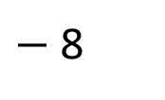
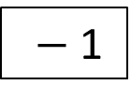
1) Write the missing function in the function machine.
2) Calculate the missing inputs and outputs for the function machine.
Input
Output
36
9
100
25
Input
Output
127
2

Slide 5
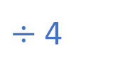
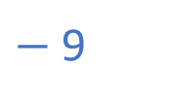
1) Write the missing function in the function machine.
2) Calculate the missing inputs and outputs for the function machine.
Input
Output
36
9
100
25
Input
Output
127
119
10
2

Slide 7
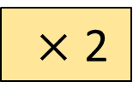
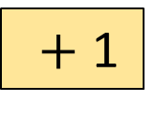
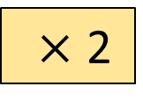
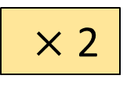
A function machine is a way of writing rules.
Input
Output
3
?
7
10
?
50
?
?
11
Have a think

Slide 8
A function machine is a way of writing rules.
Input
Output
3
7
10
?
21
50
?
101
?
5
11

Slide 9
Input
Functions
Output
I wonder if it makes a difference which order the functions are in …
Have a think

Slide 10
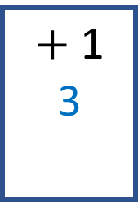
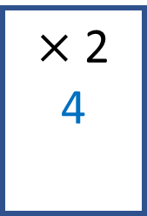
Input
Functions
Output
1
3
1
4

Slide 11
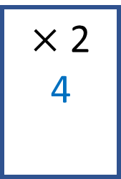
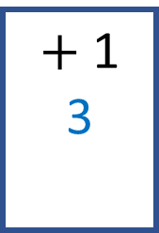
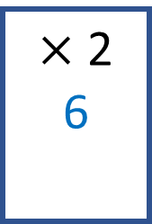
Input
Functions
Output
2
5
2
6
If the inputs are the same, the output for the second machine is always 1 greater.
Do you agree with Dexter?

Slide 12
Have a go at questions 1 - 3 on the worksheet

Slide 13
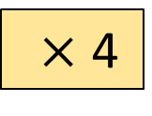
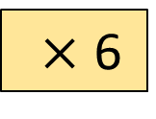
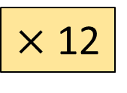
True or False
These function machines will give the same output if the input is the same.
Input
Output
Have a think

Slide 14
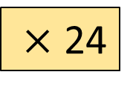
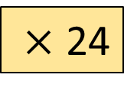
True or False
These function machines will give the same output if the input is the same.
Input
Output
2
48
2
48

Slide 15
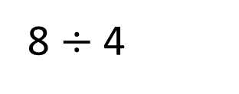
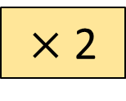
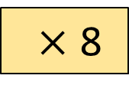
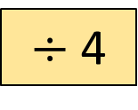
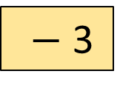
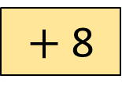
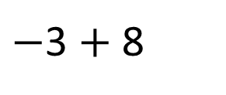
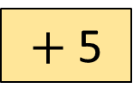
For each function machine, write a single step that would give the same output.
Input
Output
Have a think

Slide 16
Eva is ordering some crayons online. She needs to buy 22 crayons altogether.
How much will it cost for 22 crayons including delivery?
30p each
£1.60 to deliver
Create a function machine to help you.
Have a think

Slide 17
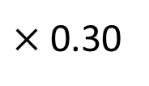
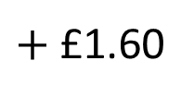
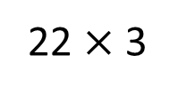
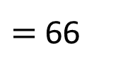
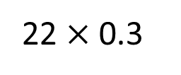
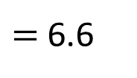
Eva is ordering some crayons online. She needs to buy 22 crayons altogether.
How much will it cost for 22 crayons including delivery?
£8.20
30p each
£1.60 to deliver
Input
Output
22
£8.20
£6.60

Slide 18
Have a go at the rest of the questions on the worksheet

