Slide 1
Wednesday 27th January 2021

Slide 2

Rockstars

Slide 3
French

Slide 4

You are going to :-
Revise months in French
Learn the alphabet in French
Revise or research other words in French

Slide 5

Ecoutez !
Listen to this song of French months
Listen to, then stand up whenever you hear your birthday month.
Challenge: On paper, write down the months whilst you are listening without pausing the song.

Slide 6

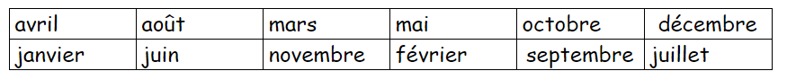
Match up the French months with their seasons. You could do this by printing off the page if you can, or double clicking on the boxes to type.
Le printemps
l’été
l’automne
l’hiver
.
Answers: mars, avril, mai (printemps) juin, juillet, août (été), septembre, octobre, novembre (automne)

Slide 7

Did you know…?
The French letters of the alphabet are the same as the 26 in the English alphabet.
BUT they are not pronounced quite the same.
Generally, what has an ‘ee’ sound in English (B,C,D,G,J, P, T, V) has an ‘ay’ sound (as in day or play) in French.
Can you spot them in this song?
What about these letters E, H, I, Q, R, W, X, Y, what do they sound like?

Slide 8
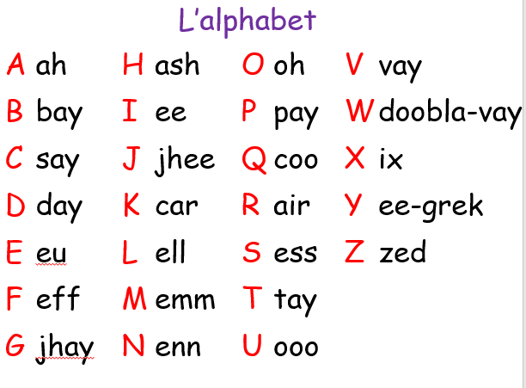

Write down a French word beginning with each letter. It can be something you know from your lessons, or look it up on Google.
Comment ça s'écrit ?
How do you spell that?
Work out how to spell your first name and write it down like this.
Je m’appelle Harry, ça s'écrit ash - eu - air - air - eegrek
Replace the example above with your name.

Slide 9


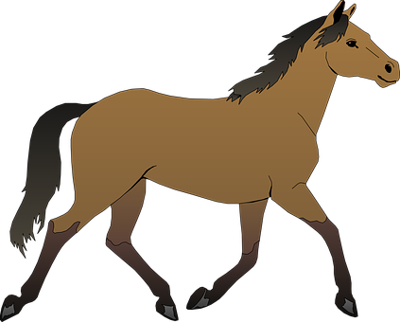
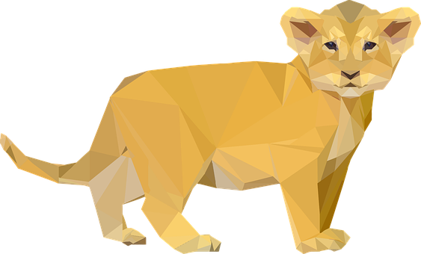
Optional: which letters are missing from these animal nouns?
C _ A T S E _ P E N T
C H I _ N _ A M S T E R
C H E _ A L O I S E A _
T O R _ U E L I _ N
Answers: chat - ash, chien - eu, cheval - vay, tortue - tay, serpent - air, hamster - ash, oiseau - oo, lion - oh

Slide 10
Optional: which letters are missing from these animal nouns?
C H A T S E RP E N T
C H I E N HA M S T E R
C H E VA L O I S E A U
T O R TU E L I ON
Answers: chat - ash, chien - eu, cheval - vay, tortue - tay, serpent - air, hamster - ash, oiseau - oo, lion - oh

Slide 11
Maths
Long Multiplication Consolidation

Slide 12

Please LISTEN!!!

Slide 13
Watch again!!!
https://vimeo.com/488553863

Slide 14
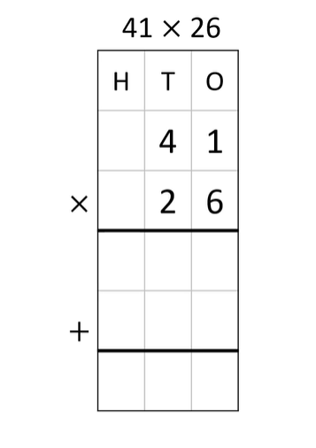
Give this a go…

Slide 15
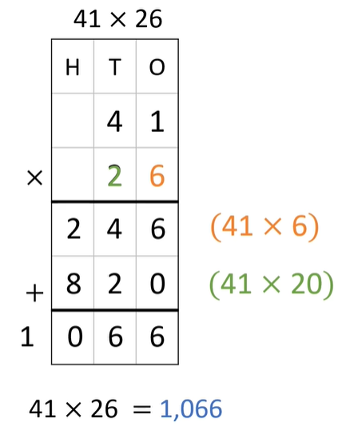
Did you get this?

Slide 16
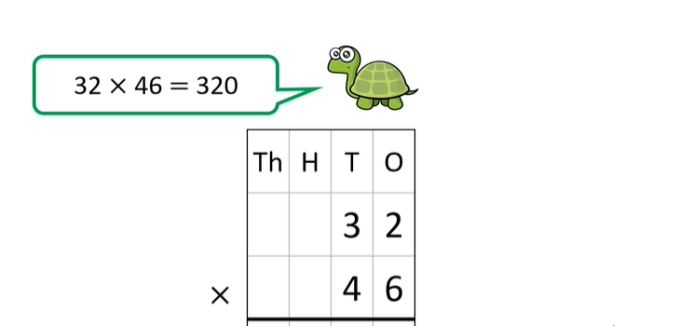
Is tiny right? If not please work out the following long multiplication correctly!

Slide 17
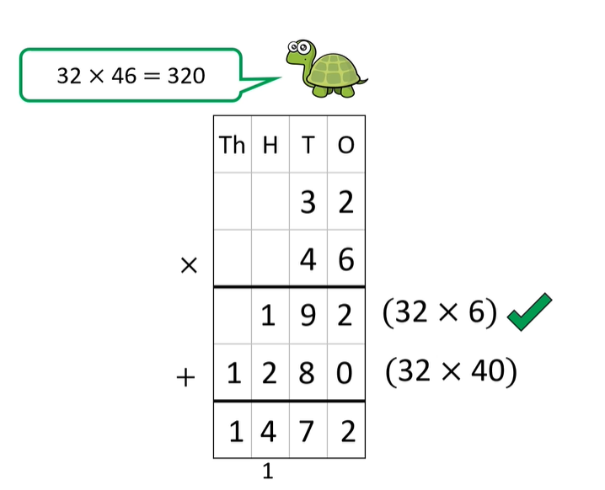
Did you get this?

Slide 18
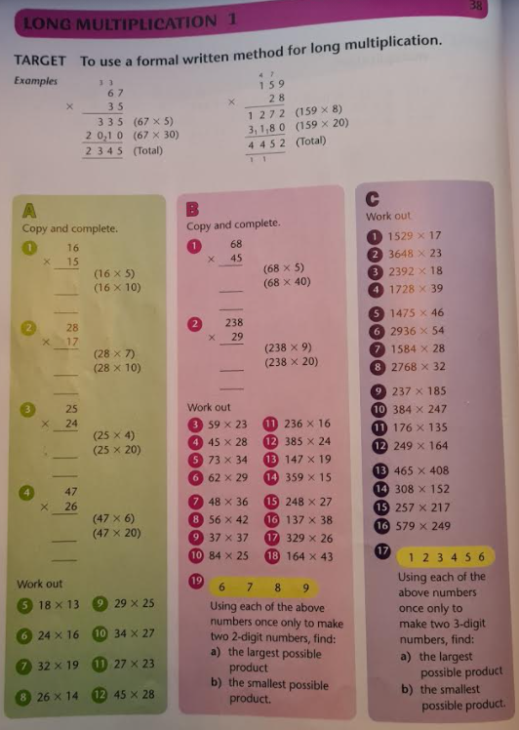
A, B, C – Choose and complete a section!

Slide 19
Break

Slide 20


English – Chapter 18 “Great Glacies”

Slide 21
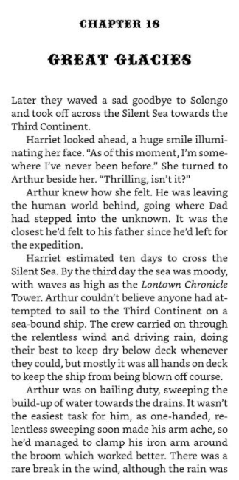
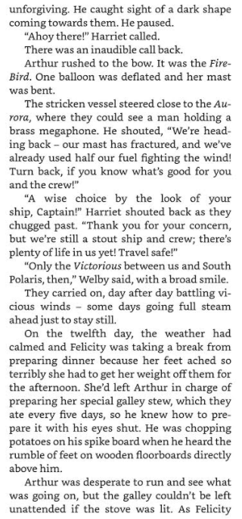
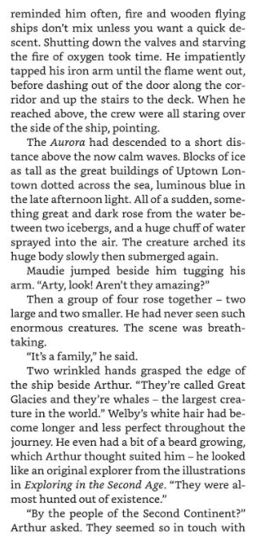

Slide 22
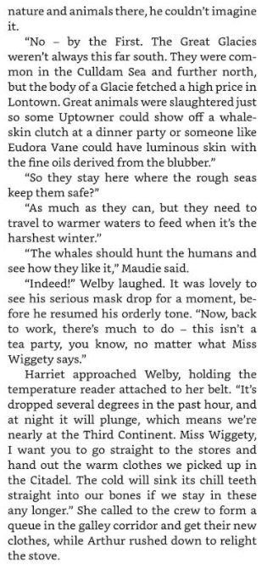
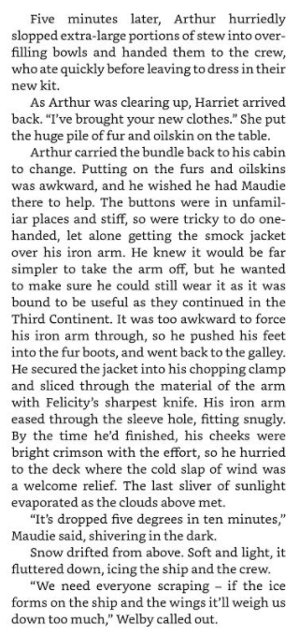
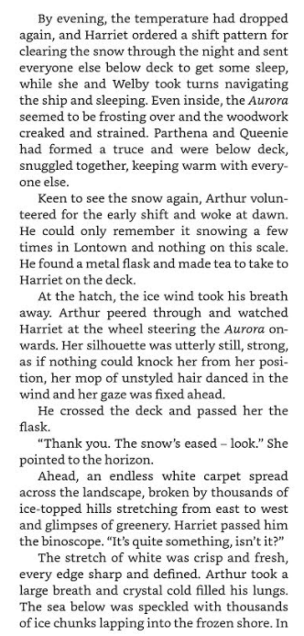

Slide 23
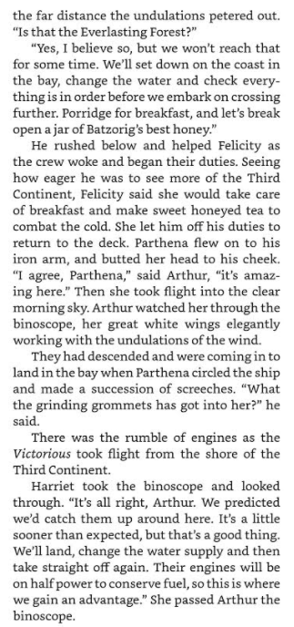


Slide 24
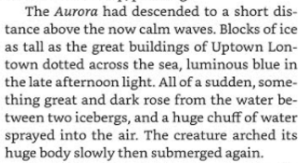

Activity – Writing a setting description
The Aurora is sailing on its way to South Polaris…
The Aurora is mid-way between the Second and Third Contenent.
There is cold water, snow, icebergs, greenery, Glacies and frost!
Vashti Hardy briefly describes the setting:

Slide 25
Activity – To write a setting description
Read Chapter 18 again and get a picture in your mind of what the setting is like that Arthur and Maudie are travelling through.
How might you improve it or what would you change completely?
You are going to write your own version of the setting and what you think it looks like!
Remember to add:
Personification
Metaphors
Adjectives
5 Senses – Hear, Smell, Taste, Touch, See

Slide 26
Example
As the Aurora effortlessly glided through the crisp, blue winter sky, Arthur looked out onto the horizon hoping to see the sun show its glowing, glistening face once again. As he stared out into the abyss, his gaze was met by two gargantuan, Great Glacies. They slowly meandered through the crashing waves with ease, as they then breached the water to share a friendly “hello” with the crew of the Aurora. Among the snow tipped peaks of the mountains ahead sat a few sprigs of grass, twisting and turning in the brisk breeze. The ship looked even more like an iceberg as the snow fell, it was covered in a thick, cold blanket.

Slide 27

Lunch

Slide 28
Poetry

Slide 29


Light in the dark

Slide 30
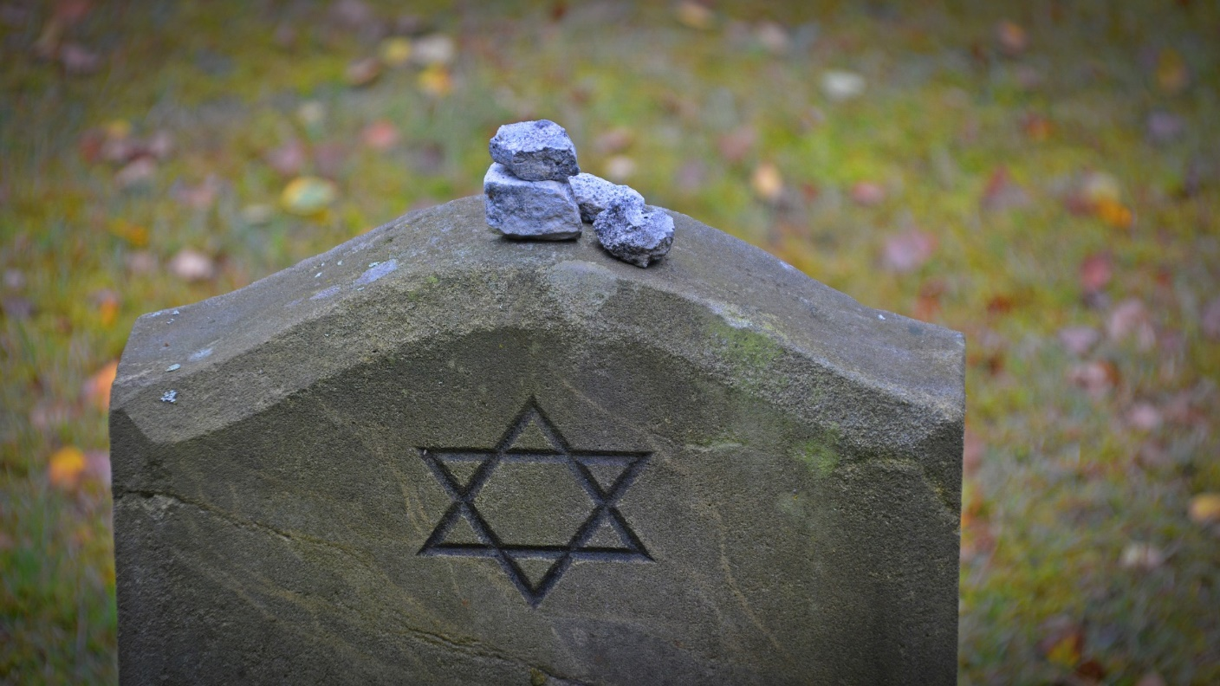
Holocaust Memorial Day
27th January
Aim: To understand why Holocaust Day is remembered.

Slide 31
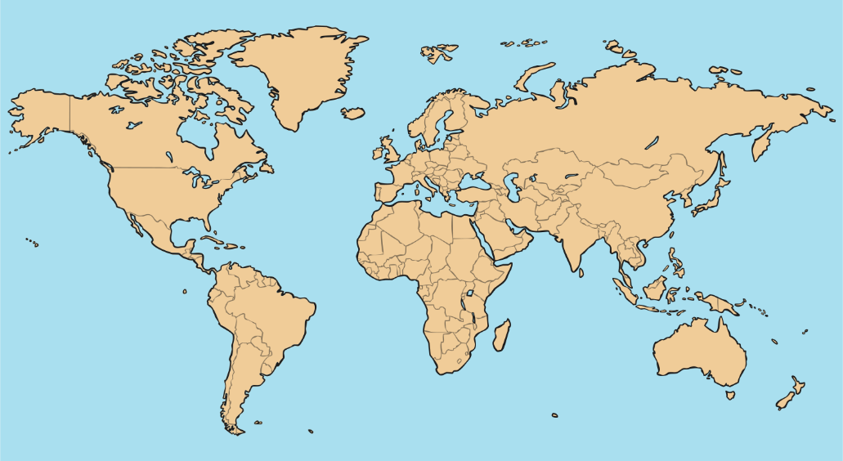
What Is the Holocaust
Memorial Day?
Each year on or around 27th January, we learn about events that have happened in the past, when people were treated badly. This is so that we can learn from them and make sure they don’t happen again.
Holocaust Memorial Day is the day that the British Government has chosen to remember the Holocaust, Nazi persecution and terrible crimes committed during conflicts in Cambodia, Rwanda, Bosnia and Darfur.
Bosnia
Darfur
Cambodia
Rwanda

Slide 32
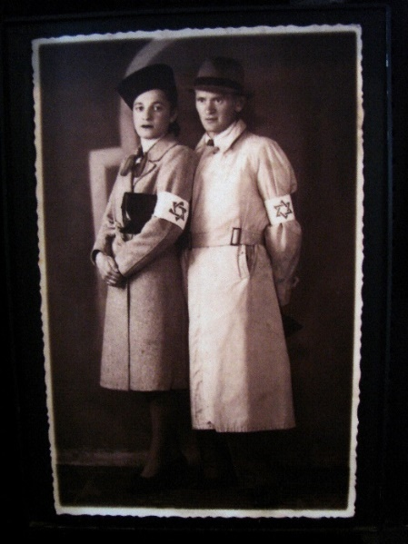
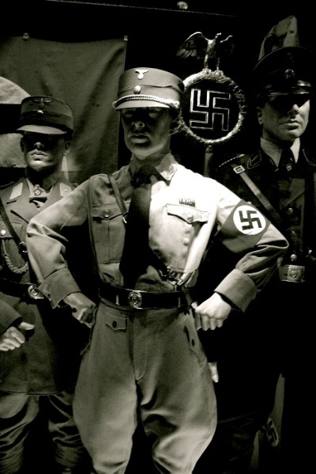
What Was the Holocaust?
The Nazis, the people in charge of Germany from 1933-1945, did not like Jewish people.
They encouraged ordinary citizens to make life difficult for Jewish people.
People were allowed to abuse them, physically and emotionally. Many Jewish people and families decided to move to Amsterdam in the Netherlands to set up a new home.
The Nazis said that all Jews had to wear a yellow star of David on their outer clothing so people could see exactly who was Jewish.
The Holocaust was a movement that started with discriminating against Jewish people. It ended with millions of people being killed because of who they were.
Photos by Adam Jones, Ph.D. - Global Photo Archive and jamiejohndavies (@flickr.com) are licensed under CC BY 3.0.

Slide 33

What Did the Nazis Do?
Nazis said that Jewish people could not:
sit on the benches in parks;
go to the swimming pool;
own a bike or a radio;
go to restaurants or German shops;
own a passport or vote in the elections;
attend school or university;
go to the cinema, theatre, concerts, exhibitions, beaches and holiday resorts;
…and many other everyday rights which other German people had.
How would you feel if you weren’t allowed to have a bike, a television or a tablet, just because of your religion?

Slide 34
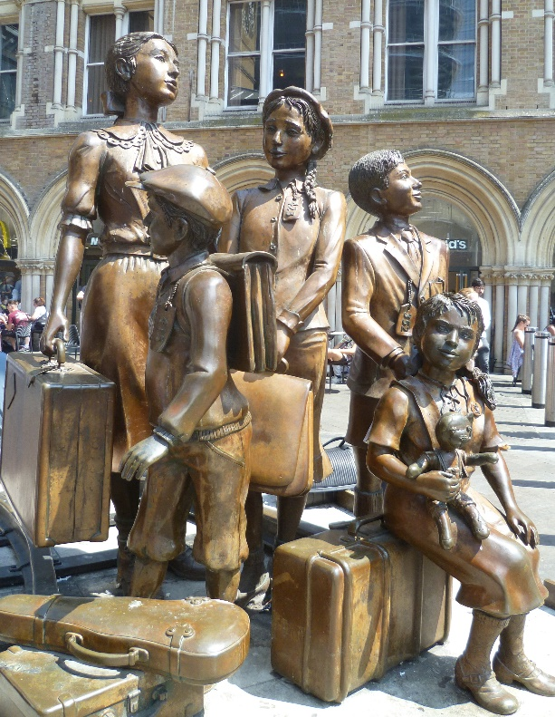
Jewish Children
Many Jewish parents decided to send their children to England as they thought it would be safer for them.
A special organisation, called Kindertransport, helped children to leave Germany and travel to England to make a new home with a new family.
The children would not have been given long to pack their suitcases.
Imagine you were told you were going on a journey but you didn’t know where you were going or how long you were going for.
What would you pack?

Slide 35
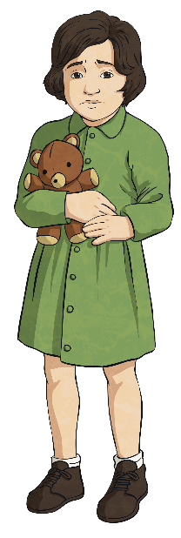

Kindertransport
Many Jewish children had to say goodbye to their parents, as the special organisation was for children only.
They boarded trains with their suitcases and eventually arrived in England.
They travelled across Europe and the journey lasted for two days.
Many children’s parents were killed in the Holocaust and they were often taken to start a new life in England without their friends or family. Many never returned to their old homes.

Slide 36
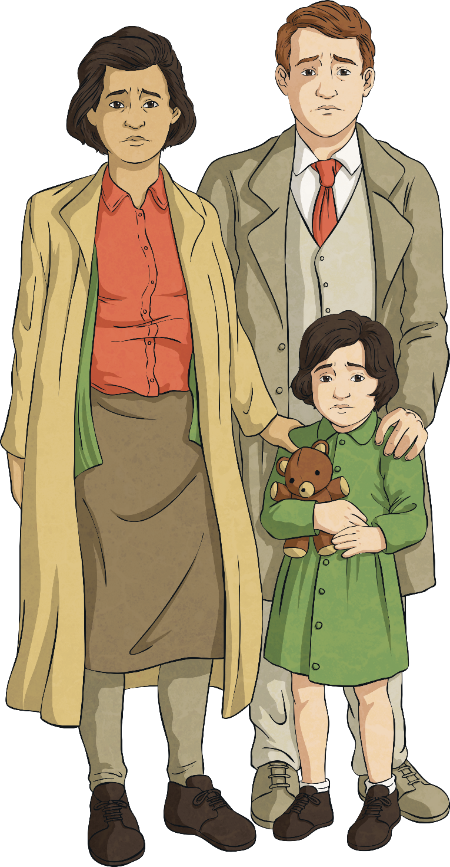
Remember Them
It is believed that more than 11 million people died in the Holocaust, six million of which were Jews; that is more than the entire population of Scotland! There were also other groups of people whom the Nazis did not like.
There have been many other instances of genocide around the world. Bosnia, Rwanda, Sudan and many other countries have lost thousands of lives to hate and prejudice.
Holocaust Memorial Day asks for remembrance of all the lives lost to these atrocities and to also reflect on how to prevent it from happening again.

Slide 37

2021 Theme
Each year, Holocaust Memorial Day has a different theme. This year’s theme is Be the Light in the Darkness.
What do you think this means?

Slide 38
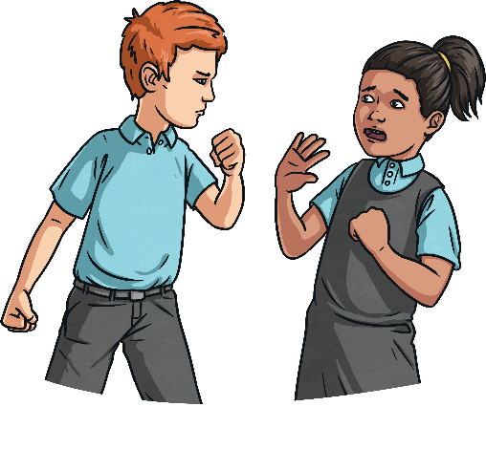
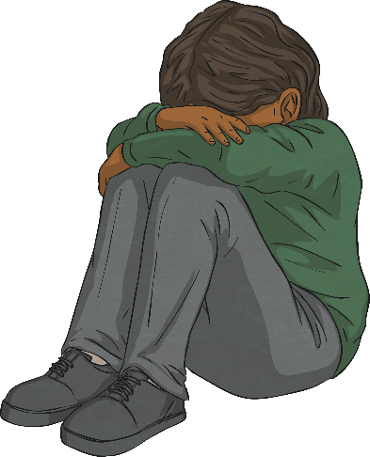
‘Be the Light in the Darkness’
What do you think is meant by ‘the darkness’?
In this instance, the darkness refers not only to the prejudice and hate that some people chose, and choose, to feel towards others…
but also to the emotional pain felt by those affected.

Slide 39

‘Be the Light in the Darkness’
How do you think people can be ‘the light’?
By resisting the choice to hate, even when under pressure to hate others.
By helping those that need it.
By lighting the way with kindness and giving hope to those suffering from persecution.
By speaking out and ‘shining a light’ on instances where people are persecuted.

Slide 40
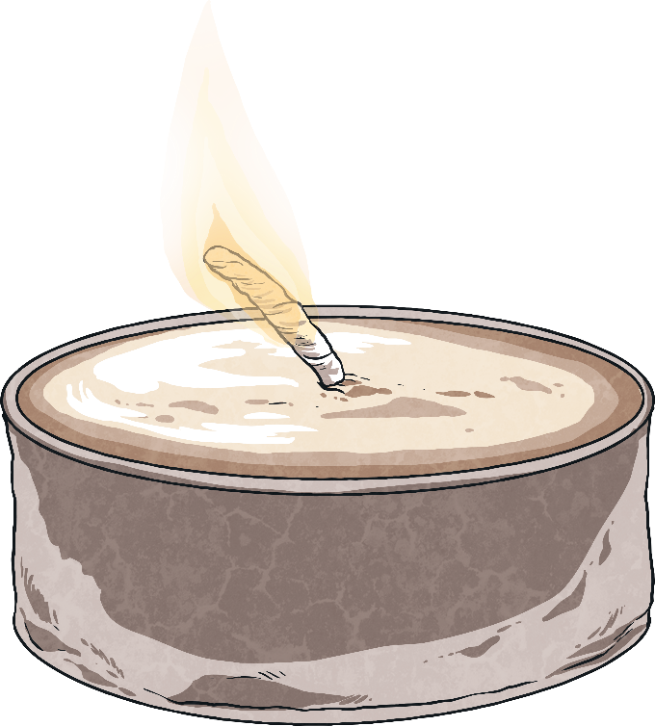
What Can We Do to Be the Light?
Spread awareness of injustices.
Share with someone else what you have learnt:
Create a poster;
Take part in an assembly;
Learn someone’s story and share it.
Take part in a minute’s silence and reflect.
Be kind to everyone.

Slide 41
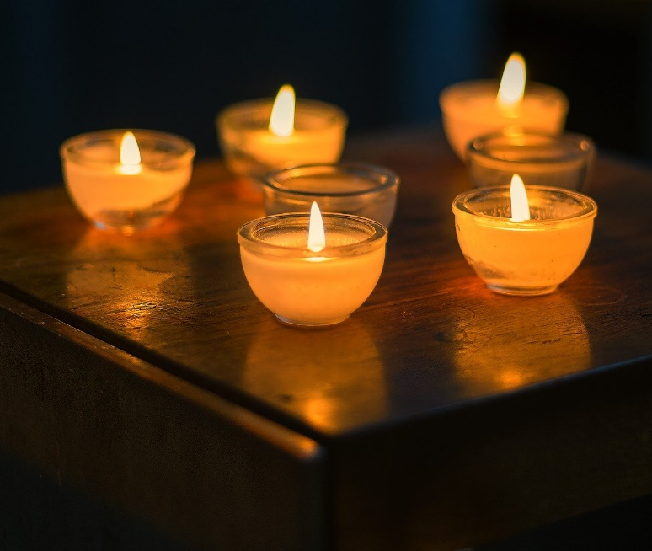
A Moment of Reflection
Discrimination still happens today.
Although Holocaust Memorial Day asks us to remember and learn from the past, we need to keep the lessons alive and be the light every day.
Let us now remember those who have not survived genocide and those whose lives were forever changed as a result.
We are going to have a minute of silence.

Slide 42


Be the Light
One solitary light can be dimmed and easily extinguished but if everyone takes responsibility to be the light, it will shine brighter and stronger and reach farther than before.

Slide 43

Activity: Poem for Holocaust Memorial Day
You are going to create a poem for Holocaust Memorial Day!
This year’s HMD theme is based on “Being a light in the dark.”

Slide 44
Poem
You can create and decorate your poem however you see fit.
It could rhyme, however, it does not have to.
It could be written as an acrostic poem, haiku etc
You might want 3 verses or 5.
Use the slides to help you understand clearly what exactly is being remembered and why!
THIS IS TOTALLY UP TO YOU AN WHAT YOU WANT TO CREATE!!! Keep in mind that the theme is LIGHT IN THE DARK… Make sure to include this in your poem!

Slide 45
