Slide 1
Good Morning Year 2! I hope you have had a lovely sleep and feeling ready for today’s learning! From Mrs Southern

Slide 2
26.1.21
1. 37 + 28 =
2. 43 + 19 =
3. 67 + 25 =
4. 87 + 32 =
5. 39 + 28 =
68 – 32 =
74 - 41 =
83 – 61 =
98 - 36 =
75 – 43 =
Don’t forget to show your working out for these calculations. They shouldn’t be done mentally.

Slide 3
Phonics
Group 1 spellings:
Have a look at the Spelling Powerpoint on the website to explain the rule for this week’s spellings.
There is also a fortune teller which you can make to help you.
Group 2 and 3 spellings:
Online ReadWrite lessons.
Lexia
Practise spellings and sound (‘ore’ and ‘aw’ as or) for this week

Slide 4
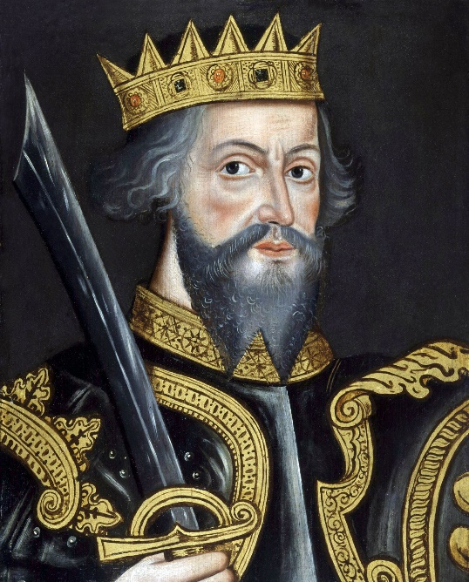
English
This week’s English lesson’s are all based on our new Monarch. I hope you all had a chance to do the History yesterday.
We are learning about William I (also known as William the Conqueror). He became the King of England, after a brutal battle, nearly 1000 years ago!

Slide 5
Today’s English task is to find out more about William I.
Read ‘William the Conqueror’ PDF on the website. You can read this with a grown up. Make some notes of facts about William.
Watch Horrible Histories episode about William the Conqueror. Make some notes about him.
https://www.bbc.co.uk/iplayer/episode/b05y0mzt/horrible-histories-series-6-3-wicked-william-the-conqueror-special
Remember when making notes just write key points.

Slide 6
Writing task
Write sentences to include the facts that you have learned about William I.
There is a ‘2 Do’ set on Purple Mash if you wanted to do this on the computer.

Slide 7
Maths
https://vimeo.com/501671369
Worksheet is attached on the website

Slide 8
Handwriting

Slide 9
Choose a subject to do this afternoon.
The Foundation Subject’s lesson grid is on the website.
Enjoy!

