Slide 1
Tuesday 5th January 2021

Slide 2
SPaG – Semi colons and colons

Slide 3
Using a Semi-colon
A semi-colon contains a comma and a full stop. It is helpful to remember this. A semi-colon is stronger than a comma, but not as final as a full stop.
;

Slide 4
Semi-colons are used to link sentences that are closely related.
For example:
The wood was silent and absolutely still; Little Red Riding Hood realised that she had not truly seen its beauty until now.
A semi-colon works perfectly here to allow a smooth transition between sentences.
A full stop between the sentences might detract from the impact of Little Red Riding Hood’s observation and create too great a ‘stop’. Using a comma here would be incorrect; a comma cannot be used to link two independent sentences.

Slide 5
Semi-colons can also be used to link one sentence to another closely related sentence that uses a conjunctive adverb.
For example:
The wolf liked Little Red Riding Hood. Nevertheless, he was looking forward to eating her.
The wolf liked Little Red Riding Hood; nevertheless, he was looking forward to eating her.
Little Red Riding Hood didn’t like the forest much. However, she did like visiting Grandma.
Little Red Riding Hood didn’t like the forest much; however, she did like visiting Grandma.

Slide 6
Other examples of conjunctive adverbs which could be preceded
by a semi-colon:
otherwise
therefore
moreover
nevertheless
thus
besides
accordingly
consequently
instead
hence

Slide 7
However, you do not always have to use a conjunctive adverb after a semi-colon. Here are some great examples of sentences which contain a semi-colon that is not followed by a conjunctive adverb:
Grandad is going bald; his hair gets thinner each time we see him.
We had too many fumbles; we lost the game.
Shaun wanted to call our new puppy Scritch; I hated the name.
I am so sorry; will you ever be able to forgive me?
As you can see in these sentences, using a semi-colon works perfectly to allow a smooth transition between sentences.

Slide 8
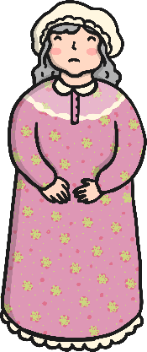
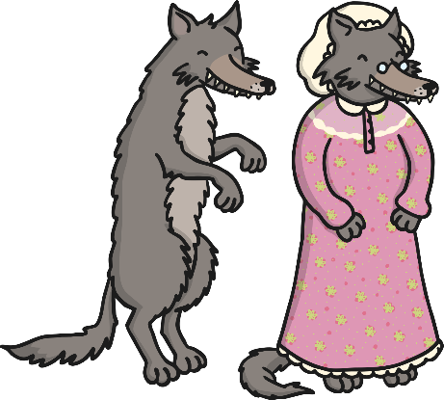
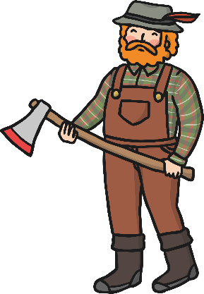
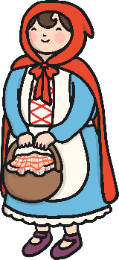
A semi-colon can also be used to separate items in a list (where the list also contains commas).
For example:
There are lots of characters in the story: Big Bad Wolf, the baddie; Little Red Riding Hood, the heroine; Grandma, the victim; and Mr Woodcutter, the rescuer.
We spoke to the main characters: Grandma, 81; Big Bad Wolf, 30; Little Red Riding Hood, 11; and Mr Woodcutter, 55.

Slide 9
Using a Colon
A colon looks like two full stops, one above the other. A helpful thing to remember about colons is that because they look like two full stops, they can only be used at the end of an independent clause.
:

Slide 10
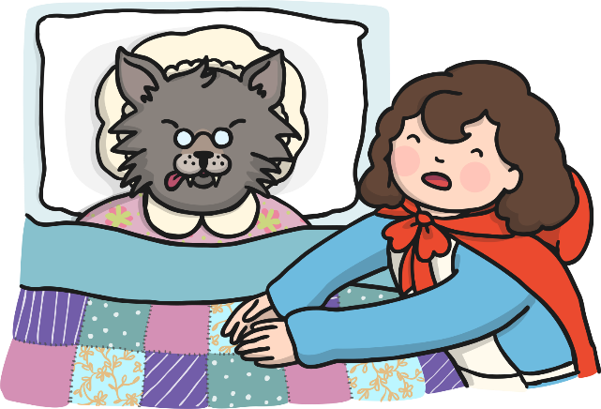
Colons are used to expand a sentence.
A colon is used to introduce an idea that is an explanation or continuation of the one that comes before the colon.
For example:
There was only one thing the wolf wanted to do now: eat that juicy Little Red Riding Hood.
The flaw in the wolf’s plan was clear to see: he looked nothing like Grandma.

Slide 11
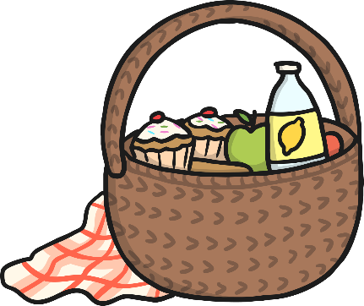
Colons are used to introduce a list.
For example:
There were a few reasons that the wolf did not make a convincing Grandma: his eyes, his ears, his gruff voice and his sharp, pointy teeth.
Little Red Riding Hood carried a selection of provisions for Grandma: a loaf of bread, some apples and a freshly-wrapped pat of butter.

Slide 12
Useful Summary
Context | Semi-colon? | Colon?
To introduce a list
To separate items in a list
To link closely related sentences
To expand a given idea
To introduce a quotation
To join sentences which use an adverbial

Slide 13
Semi-colon or Colon?
Quiz

Slide 14
Question 1
A or B: which is punctuated correctly?
A
I love the sound of the birds singing; however, I hate being woken up by them.
B
I love the sound of the birds singing: however, I hate being woken up by them.
= correct
= incorrect

Slide 15
Question 2
A or B: which is punctuated correctly?
A
The woods here are beautiful; peaceful, quiet and lush.
B
The woods here are beautiful: peaceful, quiet and lush.
= correct
= incorrect

Slide 16
Question 3
A or B: which is punctuated correctly?
A
Mother’s words came to me; ‘Take care in the woods!’
B
Mother’s words came to me: ‘Take care in the woods!’
= correct
= incorrect

Slide 17
Question 4
A or B: which is punctuated correctly?
A
Little Red Riding Hood took the map with her; it was not very helpful.
B
Little Red Riding Hood took the map with her: it was not very helpful.
= correct
= incorrect

Slide 18
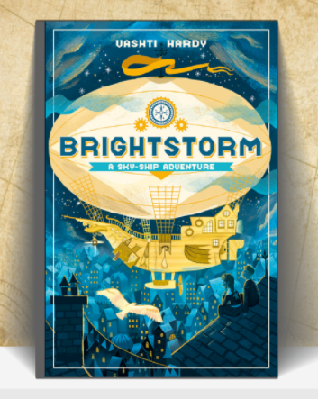
English – Brightstorm Chapter 2

Slide 21
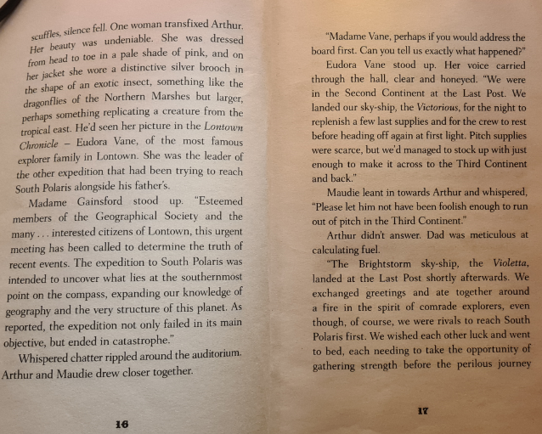

Slide 22
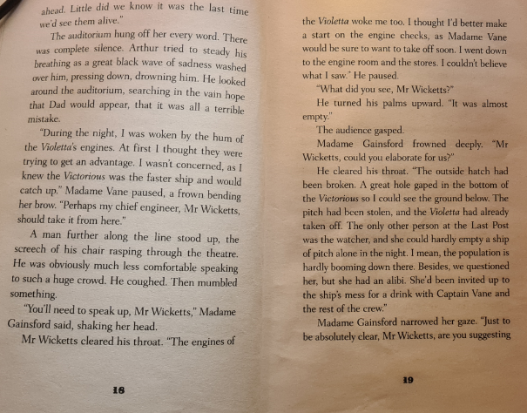

Slide 23
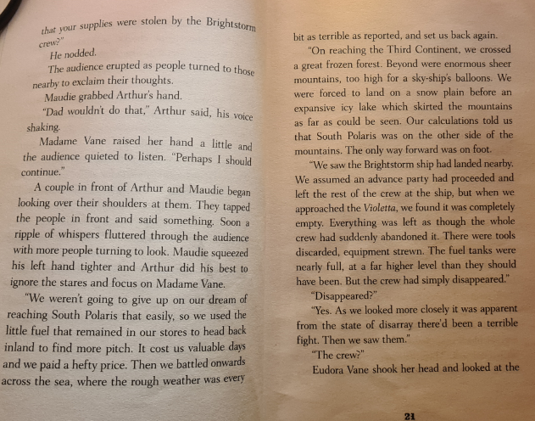

Slide 26
Break

Slide 27
DMM
1. Write down the first (6) multiples of:
A) 2 B) 5 C) 10
2. Write these numbers in descending order:
A) 245, 254, 2245, 5520, 32, 87 B) 100, 900, 1750, 1570, 3347
3. Multiply the following:
A) 100 x 10 = B) 1 x 100 = C) 8 x 1000 =
4.) 5 cm = ____ mm
5.) 150 mm = _____ cm

Slide 28
Maths I can measure the perimeter of a shape on a grid.

Slide 29
Watch this video
https://vimeo.com/477525533

Slide 32
1) Which unit could not be used to measure perimeter?
inch km ml mm
7 + 7 + 4 + 4 = 7 × + 4 ×
3) 8 + 6 + 6 + 8 = + 16
4) Which shape’s perimeter would be hardest to measure using only a ruler?
Circle Pentagon Trapezium Triangle

Slide 33
1) Which unit could not be used to measure perimeter?
inch km ml mm
7 + 7 + 4 + 4 = 7 × + 4 ×
3) 8 + 6 + 6 + 8 = + 16
4) Which shape’s perimeter would be hardest to measure using only a ruler?
Circle Pentagon Trapezium Triangle
2
2
12

Slide 35
1 cm
6 cm
3 cm
3 cm
6 cm
Perimeter $=$ the length around a closed 2D shape
6 + 3 + 6 + 3 = 18 cm
6 + 3 =
9
6 × 2 + 3 × 2 = 18 cm
9 × 2 =
18 cm

Slide 36
What is the perimeter of this rectilinear shape?
1 cm
2 cm
2 cm
4 cm
4 cm
2 cm
6 cm
Do I need to count all the squares?
Have a think
2 + 2 + 4 + 2 + 6 + 4 = 20 cm
20 cm
6 + 4 = 10
10 $×$ 2 = 20 cm

Slide 37
Have a go at questions 1 - 2 on the worksheet

Slide 38
1 cm
2
2 cm
1
3
A
8 $+$ 4 $=$ 12
3
1
22 cm
12 $×$ 2 $=$ 24
1
3
1
1
2
1
1
8
1
1
B
4
24 cm
Have a think
Which shape has the greater perimeter?
Shape B

Slide 39
Have a think
Draw a rectangle with a perimeter of 20 cm
Two pairs of equal sides
1
1
× 2 + × 2 = 20
10
0
9
18
20 $−$ 18 $=$ 2
10
9
10
9
Have a think
8 and 2
7 and 3
6 and 4
5 and 5
1

Slide 40
1 cm
4 cm
1 cm
5 cm
3 cm
Have a think
9 cm
Is this closed shape’s perimeter greater than 22 cm?
9 + 3 + 1 + 4 + 5 =
Yes
9 + 1 + 3 + 4 + 5 =
22 cm

Slide 41
Have a go at questions 3 - 7 on the worksheet

Slide 42
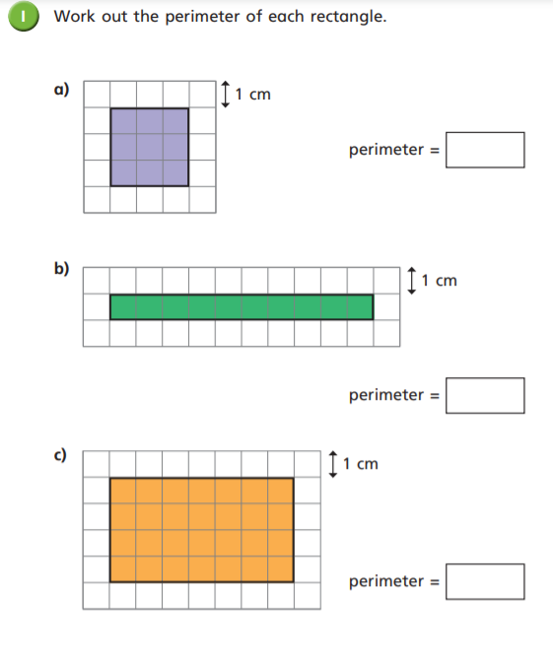
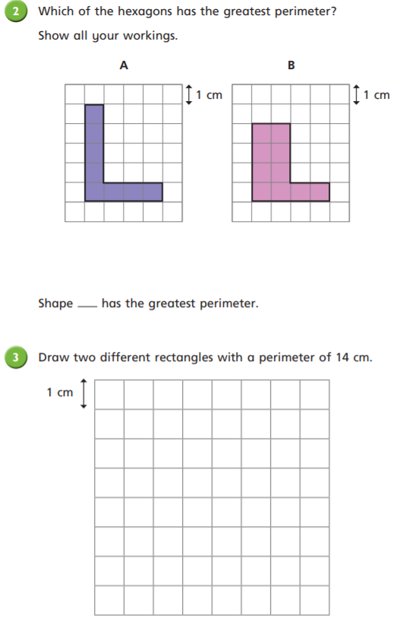

Slide 43
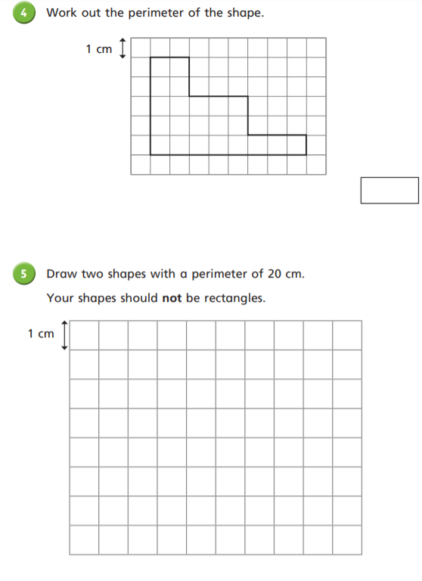
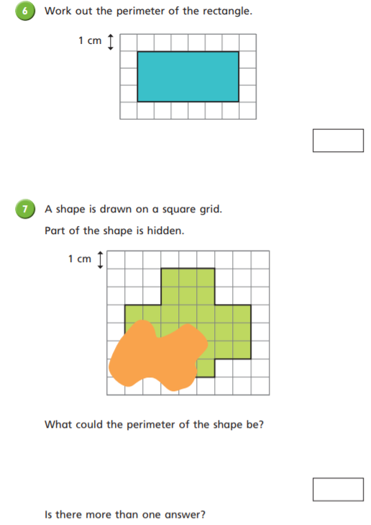

Slide 44
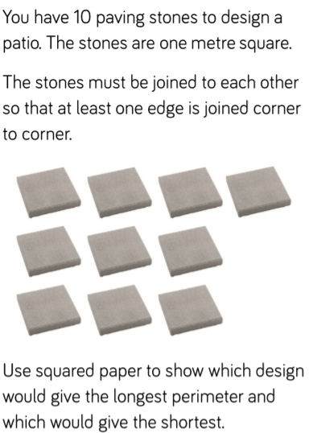
Plenary – In your books

Slide 45
Lunch

Slide 46
Art - Local Art
Lesson 1 – Antony Gormley

Slide 47
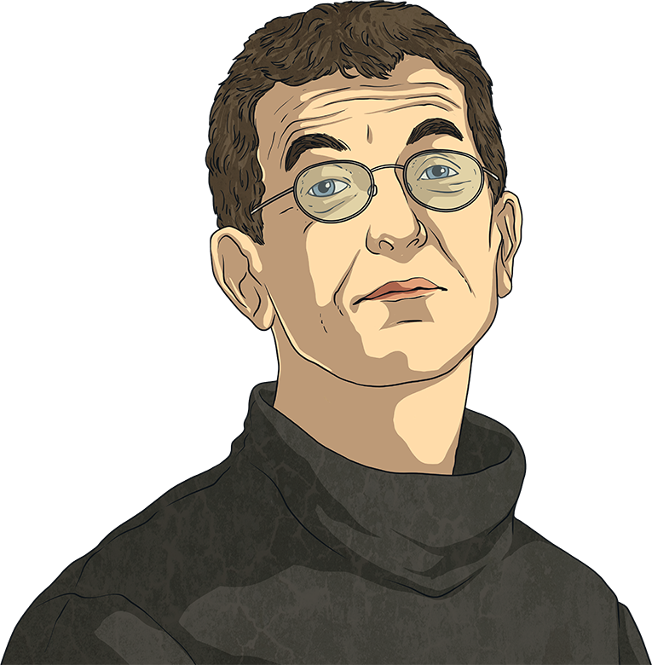
Antony Gormley
sculptor – An artist who creates sculptures. Sculpture is three-dimensional art made by carving, modelling, making casts or constructing.
Antony was born on 30th August 1950 in London. He was the youngest of seven children. Antony went to boarding school in Yorkshire and then Cambridge University. After university, Antony studied art at several art colleges in London.
Antony Gormley is a British sculptor. His work has been displayed across the globe and many of his sculptures are world-famous.

Slide 48
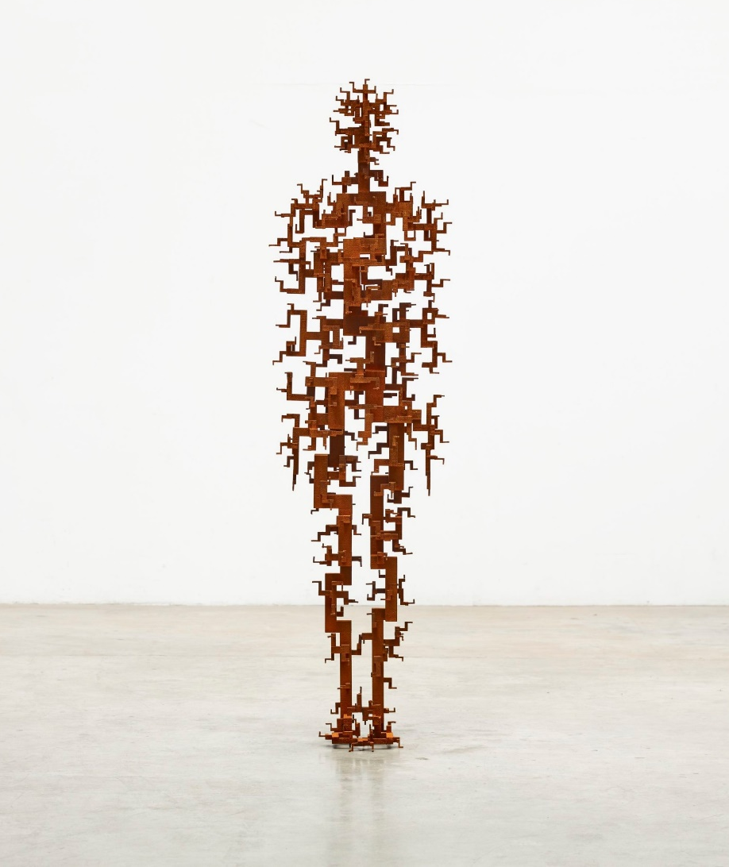
Antony Gormley
Antony is married to the artist Vicken Parsons. They have three children: Ivo, Paloma and Guy.
In 1994, Antony won the Turner Prize, one of the most important awards in art. In 1997, he was given an OBE (Order of the British Empire) and in 2004 he was given a knighthood. This means his full title is Sir Antony Gormley, OBE, and his wife’s title is Vicken Parsons, Lady Gormley.
Talk About It
If you won an award, what do you think it would be for?

Slide 49
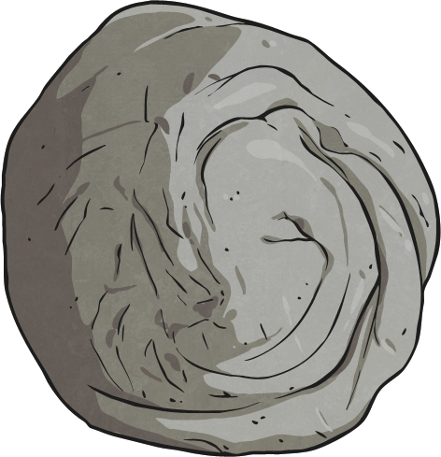
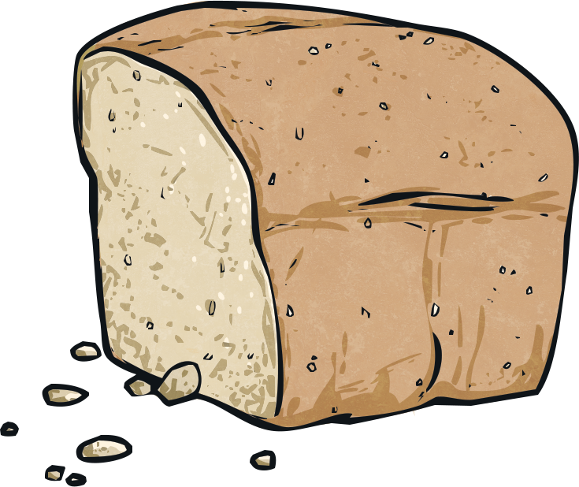
Antony Gormley’s Sculpture
Antony’s sculptures are mainly based on the human body.
Many of Antony’s sculptures are based on his own body. He makes casts of his body to create the shape. He does this by wrapping parts of himself in cling-film (avoiding his face) and then covering this in a quick-drying material, such as clay. Once the material is dried, it is cut in half. This is then used as a mould for Antony to fill with different materials to create body shapes.
One example of Antony using body shape in sculptures is a piece called ‘Bed’, which was part of his first public art show. ‘Bed’ was made up of 8640 pieces of bread laid out in the shape of a bed. Antony then ate some of the pieces of the bread, leaving two body-shaped impressions in the bread, as if people had been lying on a bed.
Notes:
Note: Ensure you have a discussion with your children on the dangers of using this ‘body casting’ method on the face.

Slide 50
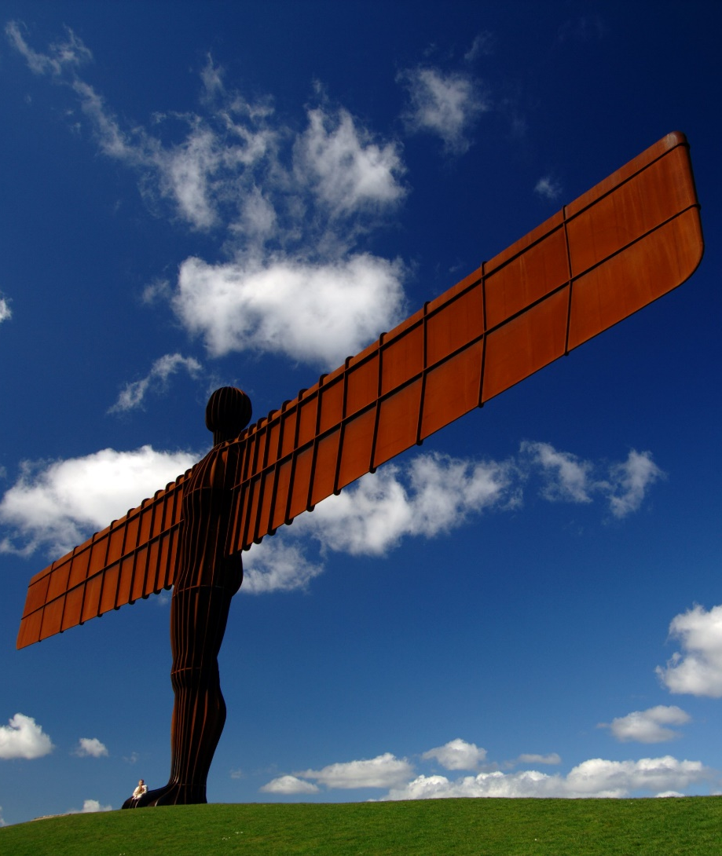
The Angel of the North, 1998
Explaining why he chose to make a sculpture of an angel, he said, “No one has ever seen one and we need to keep imagining them.”
This is one of Antony’s most famous sculptures. It is on the top of a hill next to the A1 in Gateshead in the north east of England.
It is 20 metres high and its wingspan is 54 metres. It weighs 200 tonnes. Underneath the hill are concrete piles 20 metres deep to keep the angel in place.
Did You Know?
The angel’s wingspan is the same size as that of a jumbo jet plane!

Slide 51
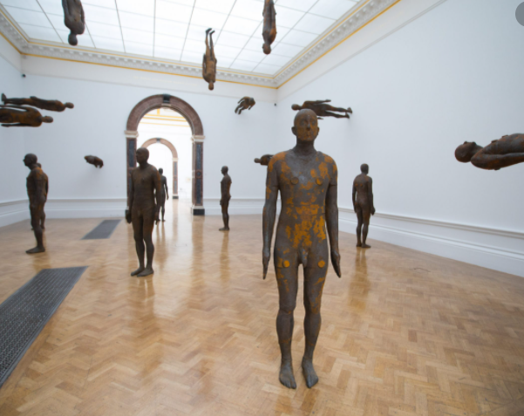
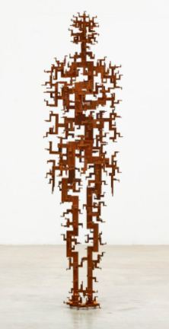
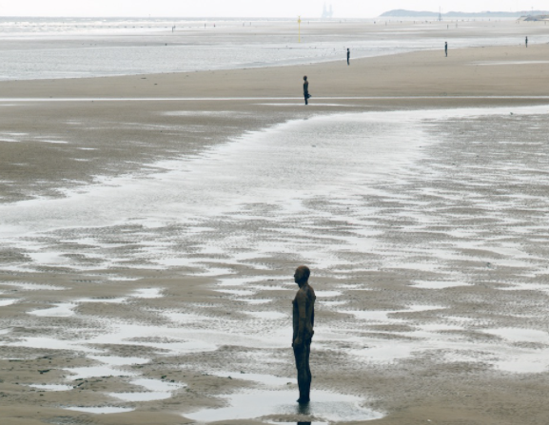
What do you notice?

Slide 52
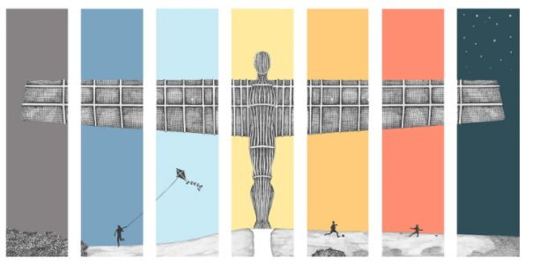
The most famous of them all…

Slide 53
This week and next week you are going to sketch and create a unique sketch of the Angel of the North!!!

Slide 54
In you sketch books you are going to create the Angel of the North
Week 1 – Using Pencil draw a detailed picture of the Angel of the North.

Slide 55
Hometime

