Slide 1
5.1.2021
Complete the following:
2 + 2 =
2 x 2 =
3 + 3 =
2 x 3 =
5 + 5 =
2 x 5 =
4 + 4 =
2 x 4 =
6 + 6 =
5 + 5 + 5 =
3 x 5 =
4 x 4 =

Slide 2
Story Writing!
Do you have any stories at homes based around castles or with a King and Queen as characters?
Today you are going to write your own story with a royal theme. Before you start, think carefully about the characters and what might happen. You might want to draw a quick story mountain to plan your ideas.
Use the pictures on the next 2 slides to help with prompts and key words.
Note to parents: This story will form part of our teacher assessment so please don’t feel you need to help or support them too much, but just encourage them to keep writing and ensure the story is complete.

Slide 3
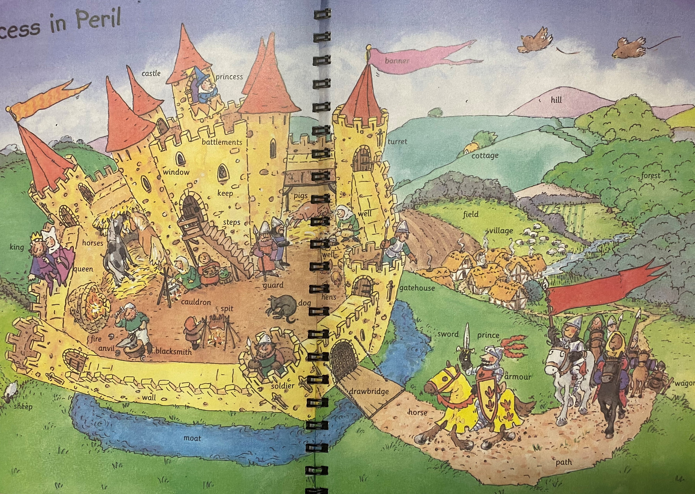

Slide 4
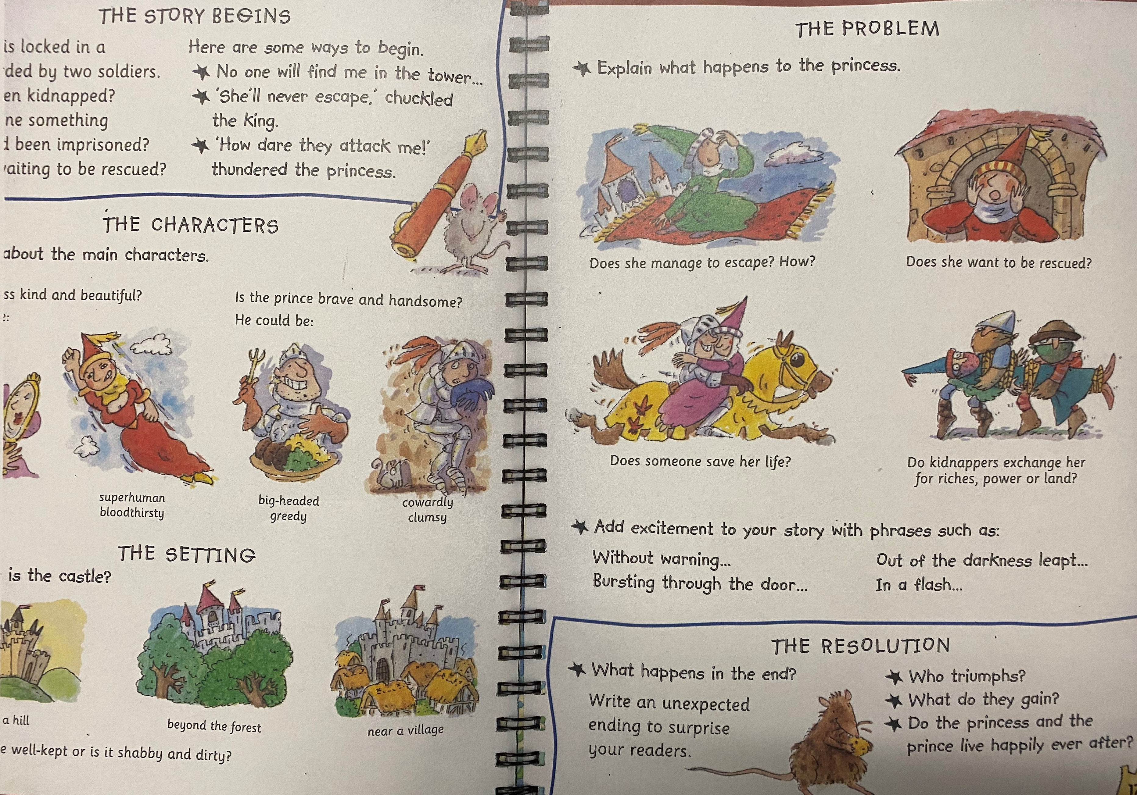

Slide 5
When writing your story remember;
To think about each sentence and say it in your head before you write it down.
Begin each sentence with a capital letter and finish with a full stop (or another appropriate punctuation mark ! or ?)
Spell key words correctly and sound others out carefully
Think about how you can make your writing more interesting with conjunctions (and, but, so) and noun phrases.

Slide 6
Maths
Work through the video below and find the worksheet on the website
https://vimeo.com/488111269

Slide 7
Handwriting
The handwriting sheets for this week are on the website. There are 6 sheets on one document and you can choose one to do each day. Remember to clearly show your tall letters and low letters and ensure all the other letters are the same size.

Slide 8
Computing
This half term we are going to be learning about the Internet and how to use it to do effective research.
Log onto Purplemash for your ‘to-dos’.

Slide 9
PE!
Enjoy some exercise around your house. Perhaps you could find some exercise videos to follow online – Joe Wicks still has his videos on youtube.

Slide 10
Reading - Don’t forget to read daily and record in your yellow reading diary.
Spellings – an email was sent with this half term’s spellings, before Christmas.
I look forward to seeing the work you have achieved today. Send any work, photos, comments or questions to:
year2home@heddon-school.co.uk

