Slide 1
Tuesday 19th January 2021

Slide 2
Morning Job

Slide 3
Maths
I can multiply 3-digit numbers by a 1 digit number.

Slide 4
https://vimeo.com/486775113

Slide 7
1) 2 × 2 =
2) 40 × 2 =
3) 2 × 300 =
4) 342 × 2 =

Slide 8
1) 2 × 2 =
2) 40 × 2 =
3) 2 × 300 =
4) 342 × 2 =
4
80
600
684

Slide 10
Hundreds | Tens | Ones
243
4 times
243 × 4 =
9
7
2

Slide 11
Have a think
Hundreds | Tens | Ones
3 × 150 =
450

Slide 12
Have a go at questions 1 and 2 on the worksheet

Slide 13
103 × 4 =
412
H | T | O
1 | 0 | 3
 |  | 4
3 × 4 =
12
0 × 4 =
0
100 × 4 =
400
$$×$$
Hundreds | Tens | Ones
4
1
2
1
103
100
3
0

Slide 14
Have a think
246 × 4 =
984
H | T | O
2 | 4 | 6
 |  | 4
$$×$$
9
8
4
1
2

Slide 15
7 × 153 =
1,071
 | H | T | O
 | 1 | 5 | 3
 |  |  | 7
Th
3 × 7 = 21
50 × 7 = 350
$$×$$
100 × 7 = 700
1
0
7
1
153
3
2
5 tens × 7 = 35 tens
100
3
50
35 tens + 2 tens = 37 tens
1 hundred × 7 = 7 hundreds
7 hundreds + 3 hundreds = 10 hundreds

Slide 16
Have a go at questions 3 - 5 on the worksheet

Slide 17
7
× 6
$=$ 4
2
147 × 6 $=$
?
The answer will have 2 ones.
3
× 2
= 6
383 × 2 =
?
The answer will have 6 ones.

Slide 18
Have a think
1) 215 × 3 =
5
The answer will have ___ ones.
2) 7 × 153 =
1
The answer will have ___ one.

Slide 19
$\text{250}$ × 4
= 1,000
247 × 4 =
1,088
The answer must be less than 1,000

Slide 20
Have a go at questions 6 - 8 on the worksheet

Slide 21
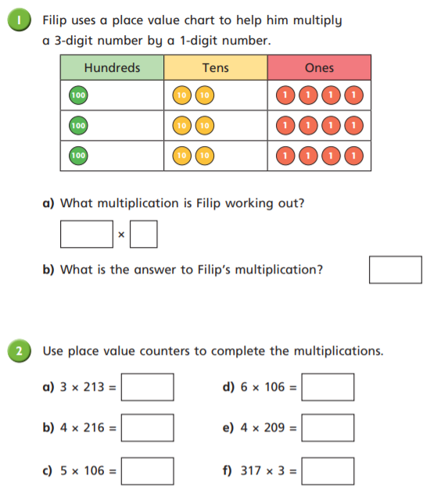
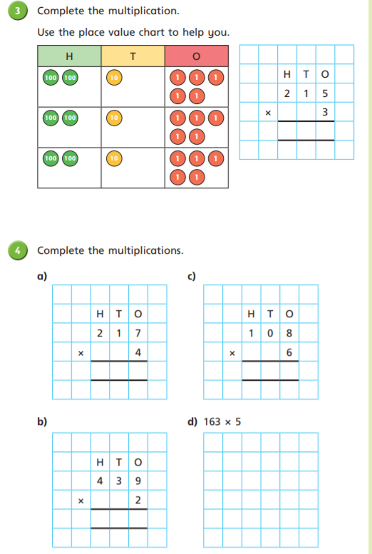

Slide 22
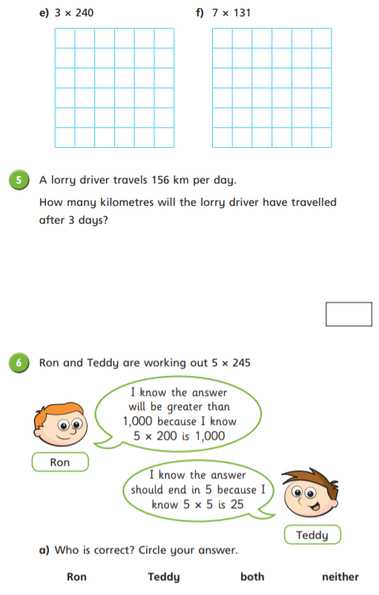
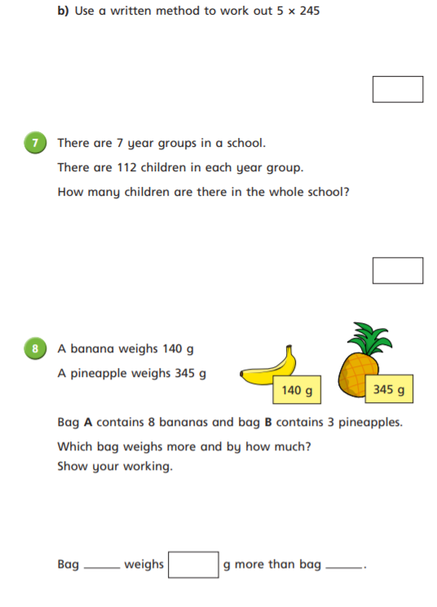

Slide 23
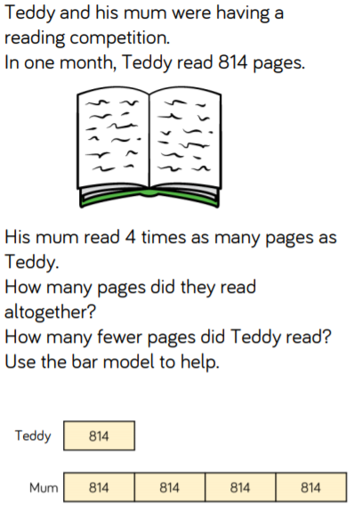
Optional Challenges:

Slide 24
Break

Slide 25
English
I can use a dictionary to identify the meaning of a word and a thesaurus to find synonyms.

Slide 26
Brightstorm – Chapter 12 The Aurora

Slide 27
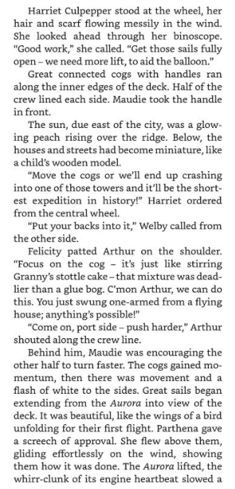
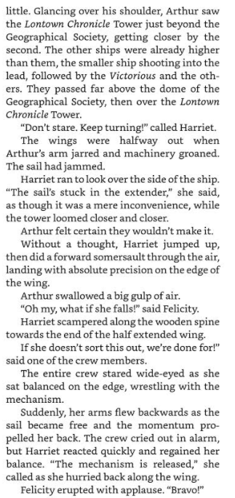

Slide 28
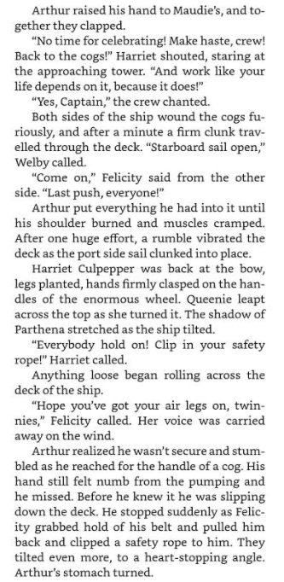
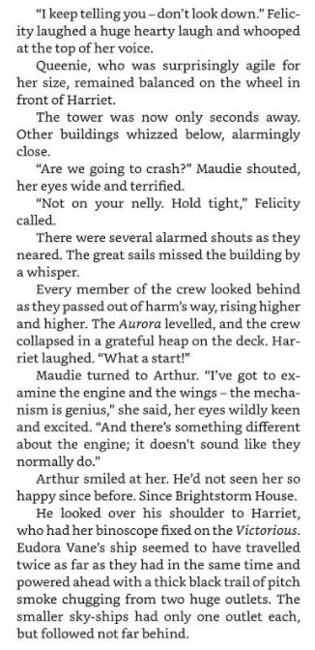

Slide 29
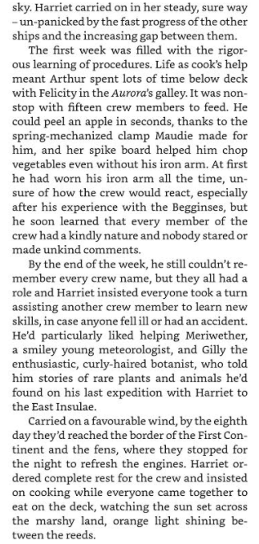
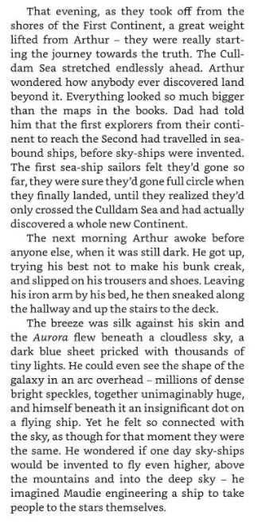

Slide 30
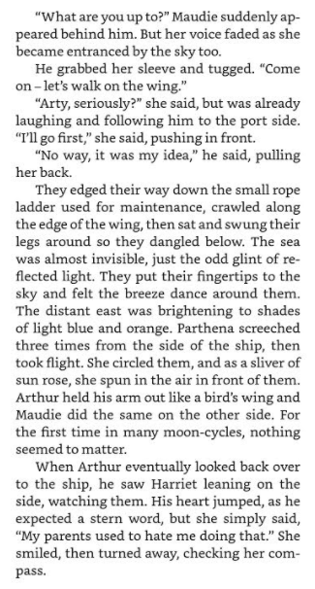

Slide 31
Activity – Dictionary and Thesaurus task
Word Meaning Synonym
Rhytmically
Effortlessly
Inconvenience
Precision
Streamlined
Decoy
Entranced

Slide 32
Lunch

Slide 33
Art – North East Artist Norman Cornish

Slide 34
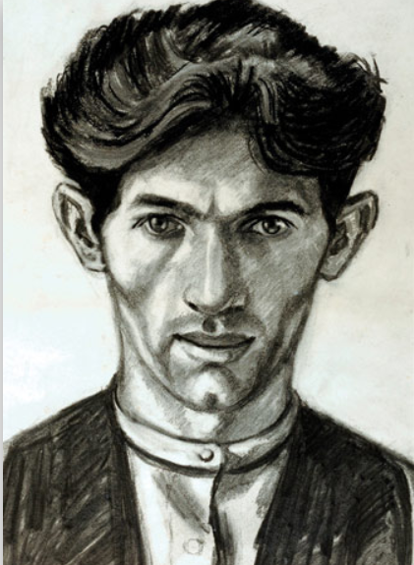
Norman Cornish

Slide 35
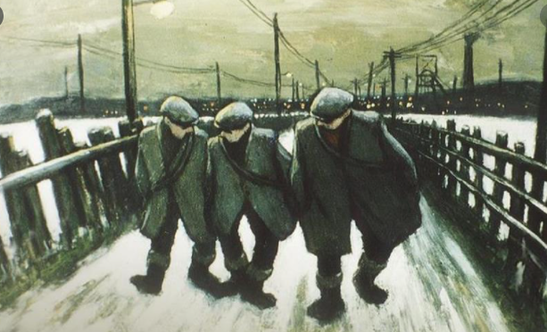
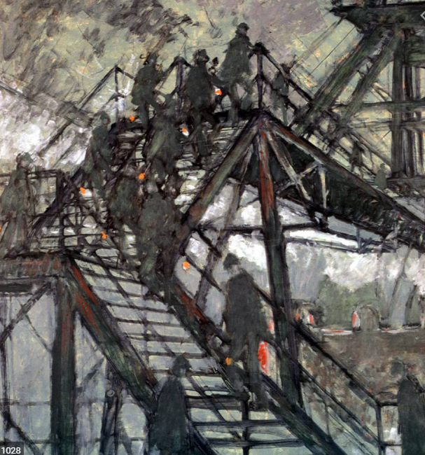
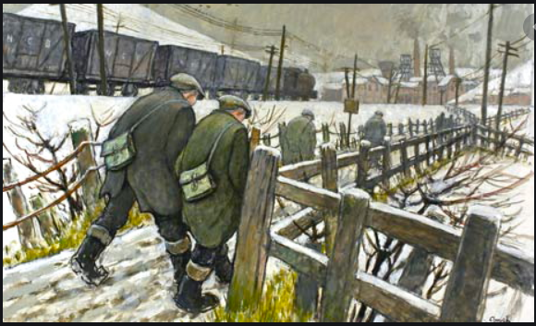

Slide 36
What do you realise?
Is there a common theme? Did his life inspire his art?
What do you think he might be trying to portray in his art?
Does he use paint or charcoal or pencil?
What else do you like or dislike about his work?

Slide 37
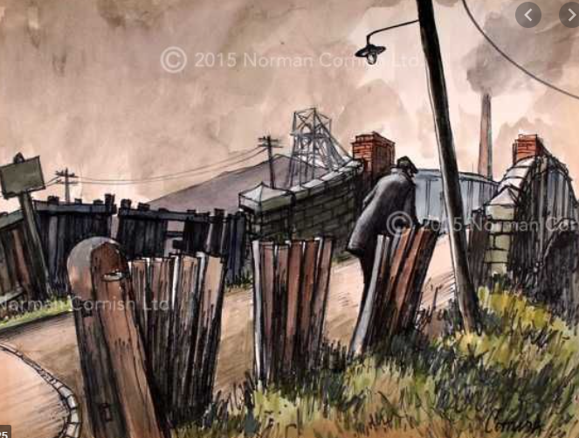
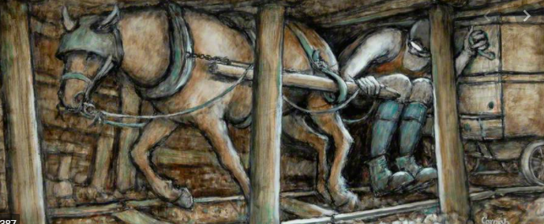

Slide 38
Activity – Next 2 weeks
Over the next 2 weeks you are going to sketch and experiment with drawings, related to Norman Cornish’s subject area of “Miners”
Norman Cornish liked to draw Miners in settings near the mines or in the mines themselves.
He sketched ideas in pencil and then used colours such as black, grey, brown, dark green etc to help bring his work to life.
You are going to use sketching to try and replicate some of Cornish’s most famous paintings as seen in the previous slides. As this is to be completed over 2 weeks it should not be rushed so take your time. Once you are happy with your sketch you can add colour.

