Slide 1
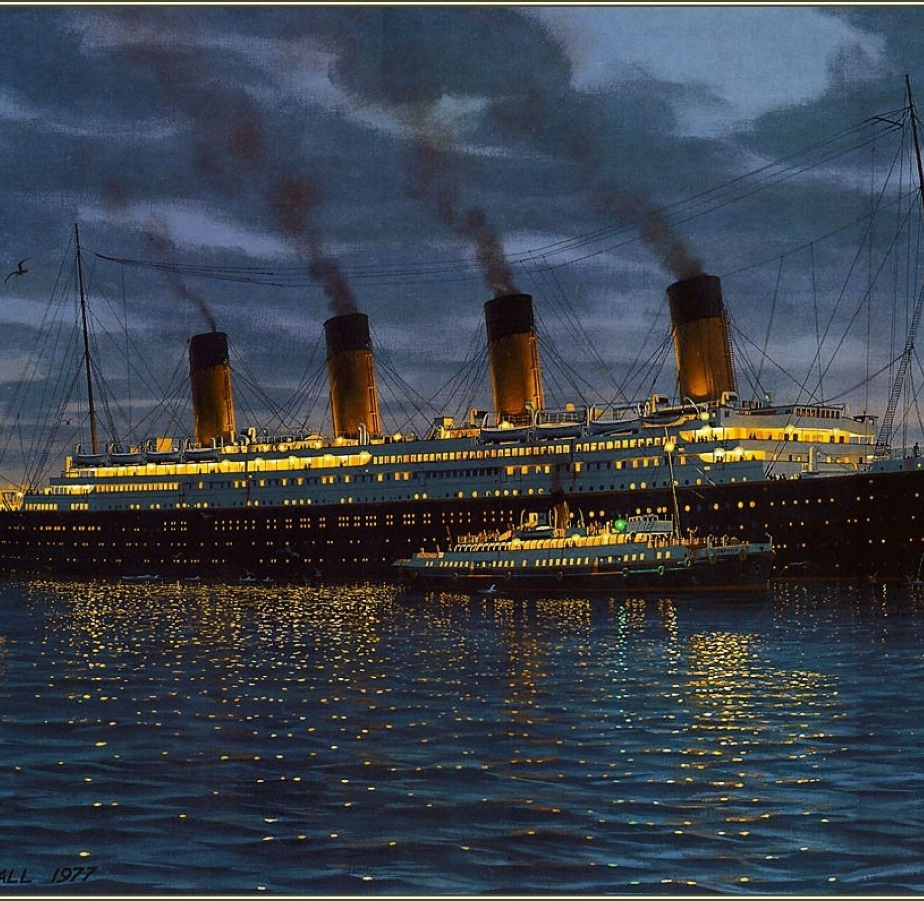
I can develop my initial ideas, drawing on reading and research
Tuesday 12th January 2021

Slide 2
Before we begin, enjoy reading the next Chapter of our class text, ‘Kaspar Prince of Cats.’

Slide 3
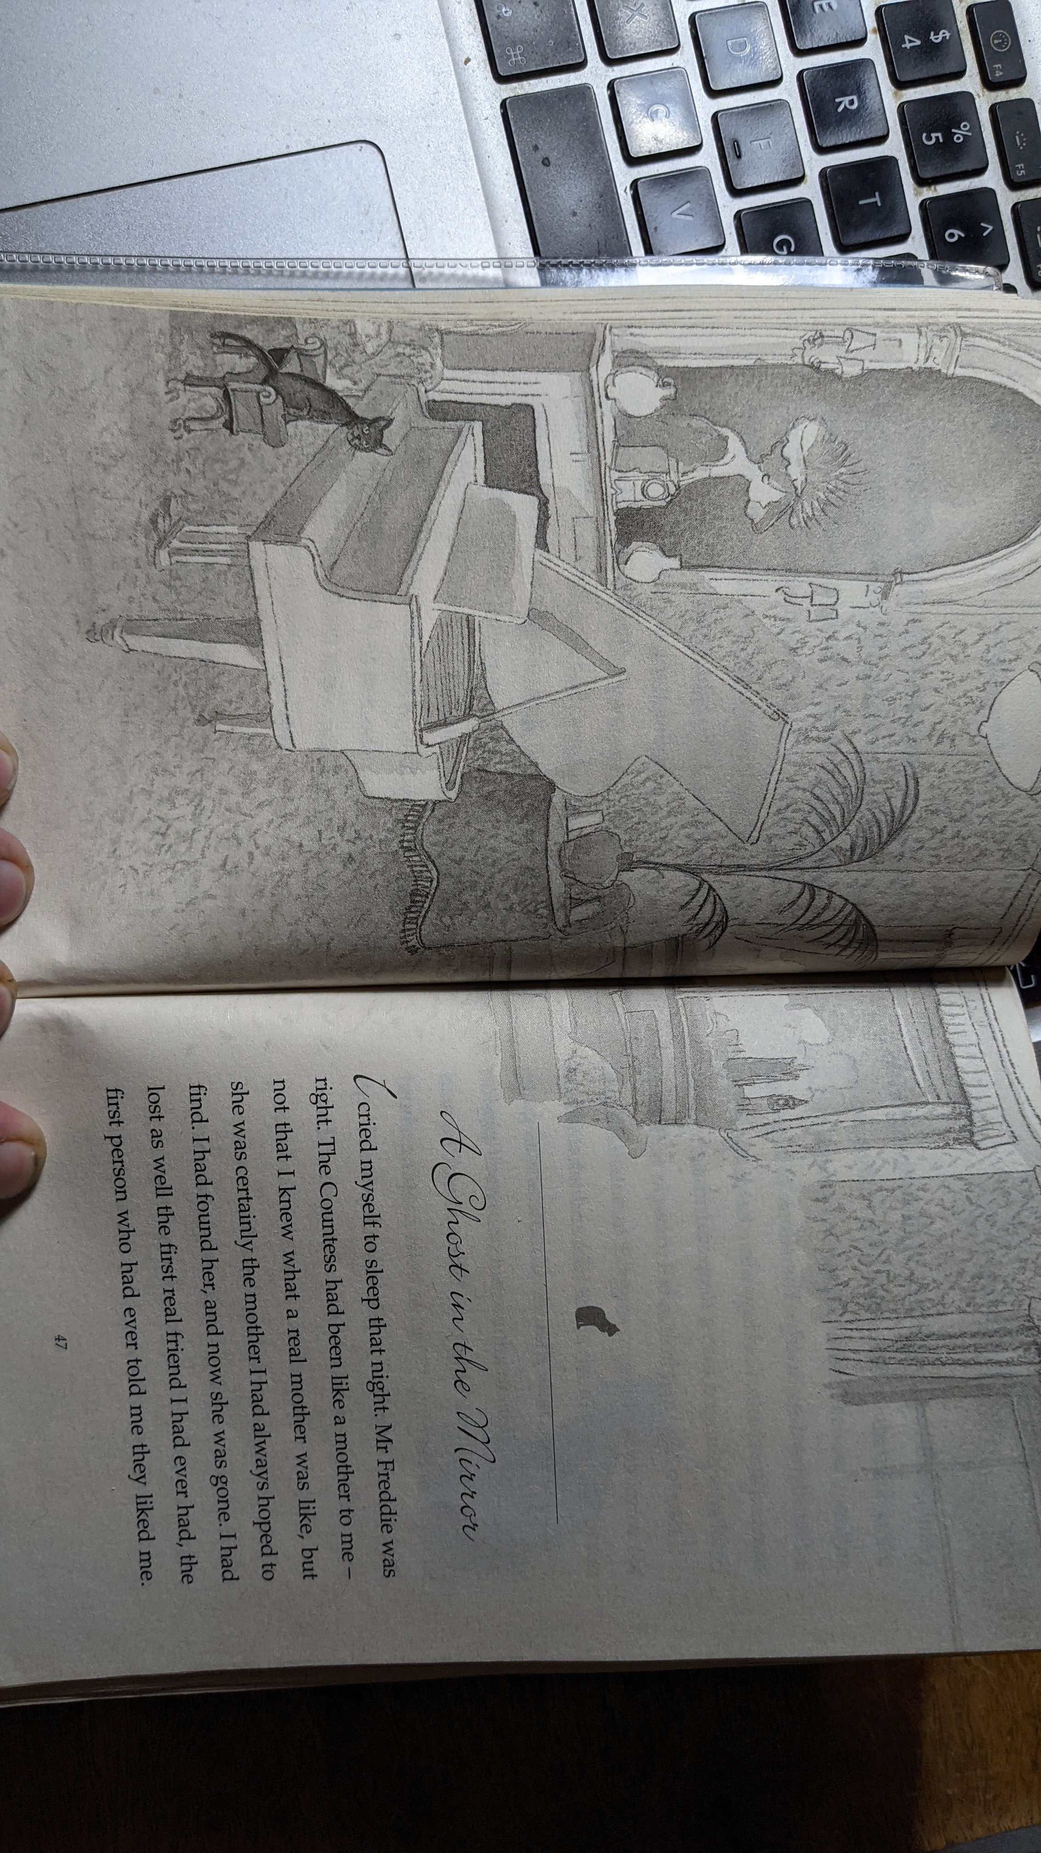

Slide 4
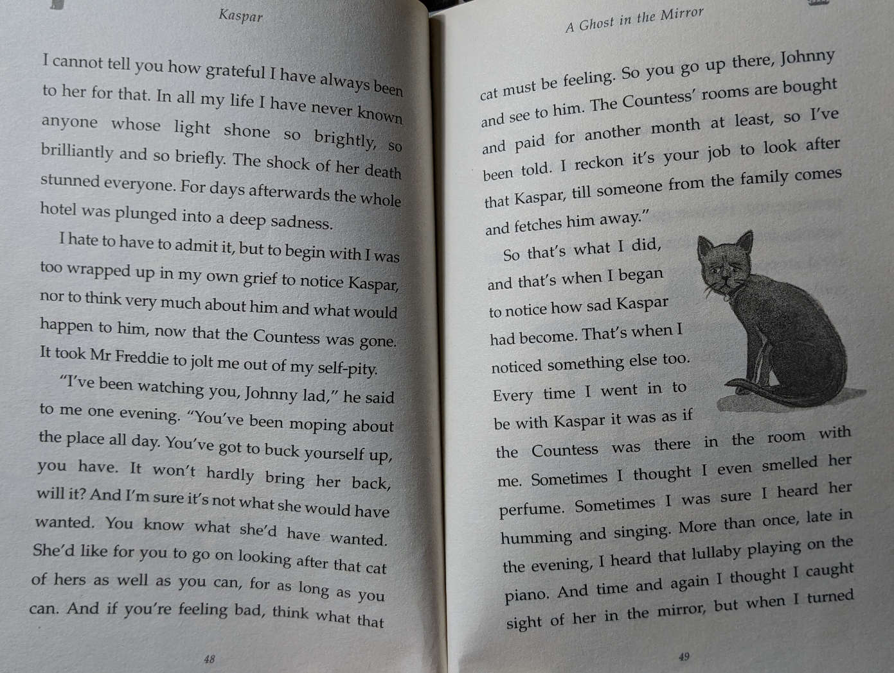

Slide 5
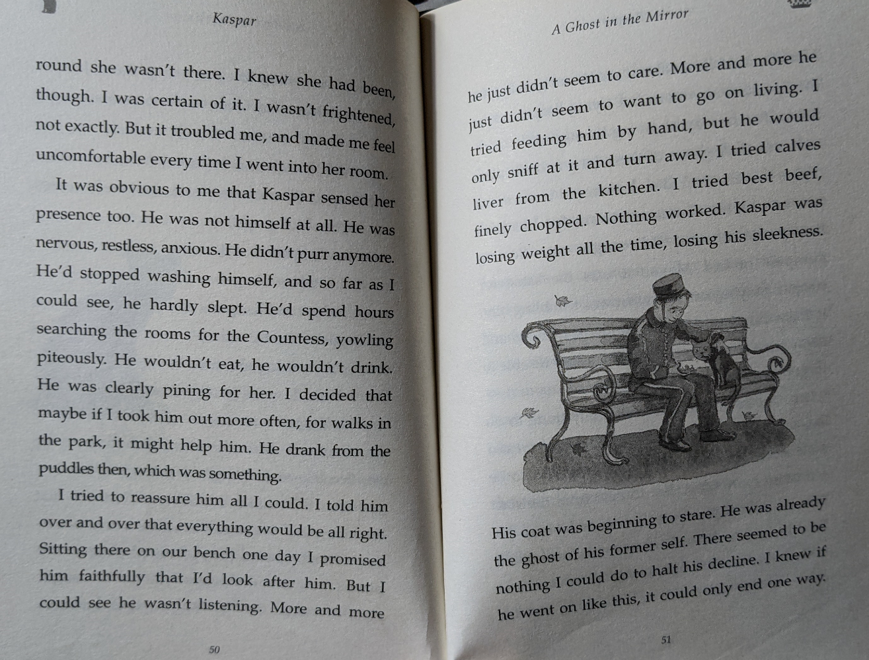

Slide 6
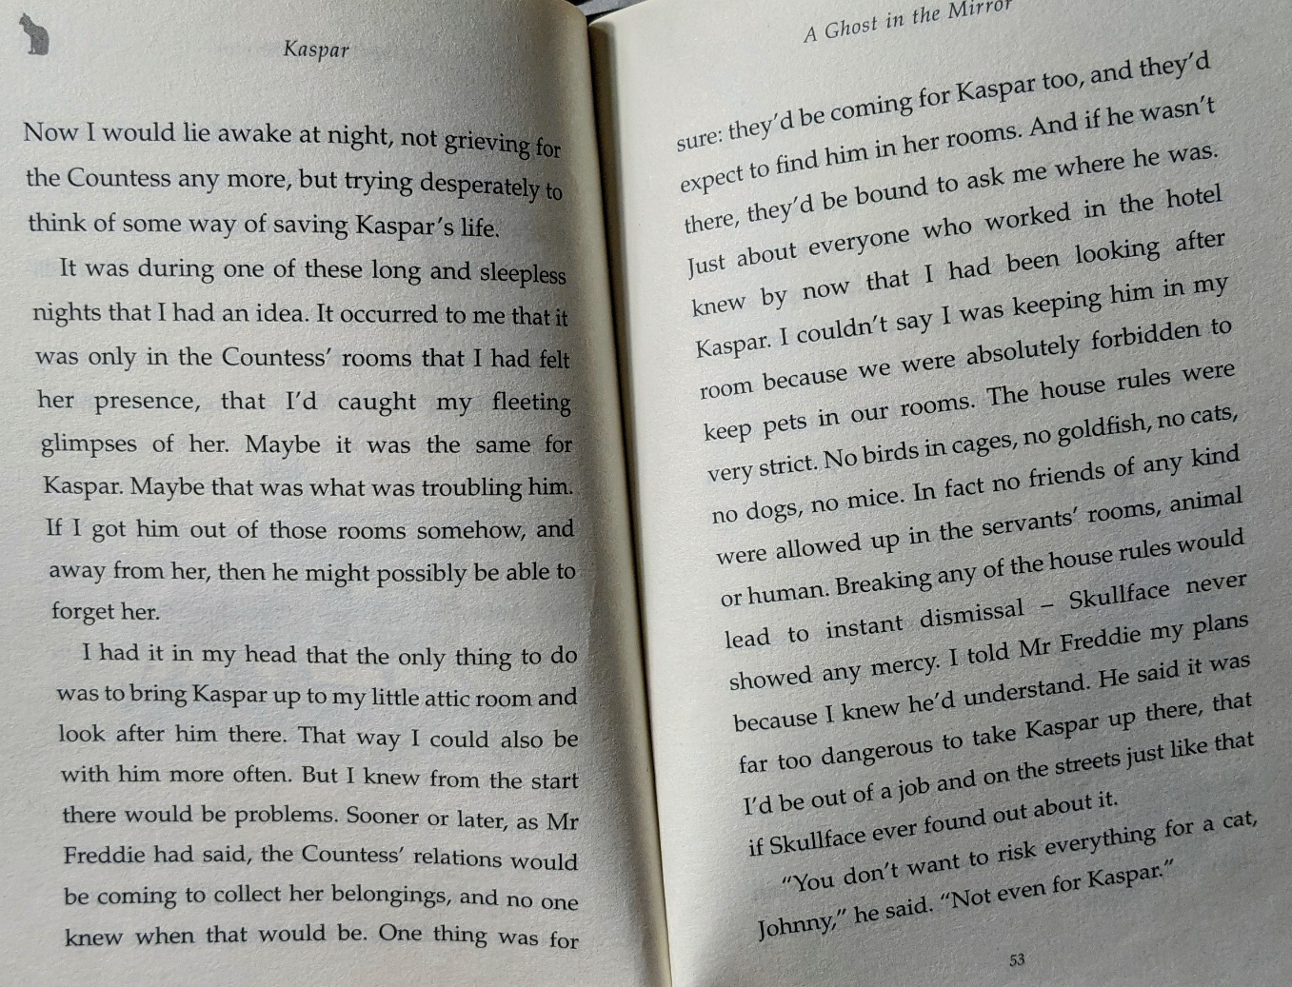

Slide 7
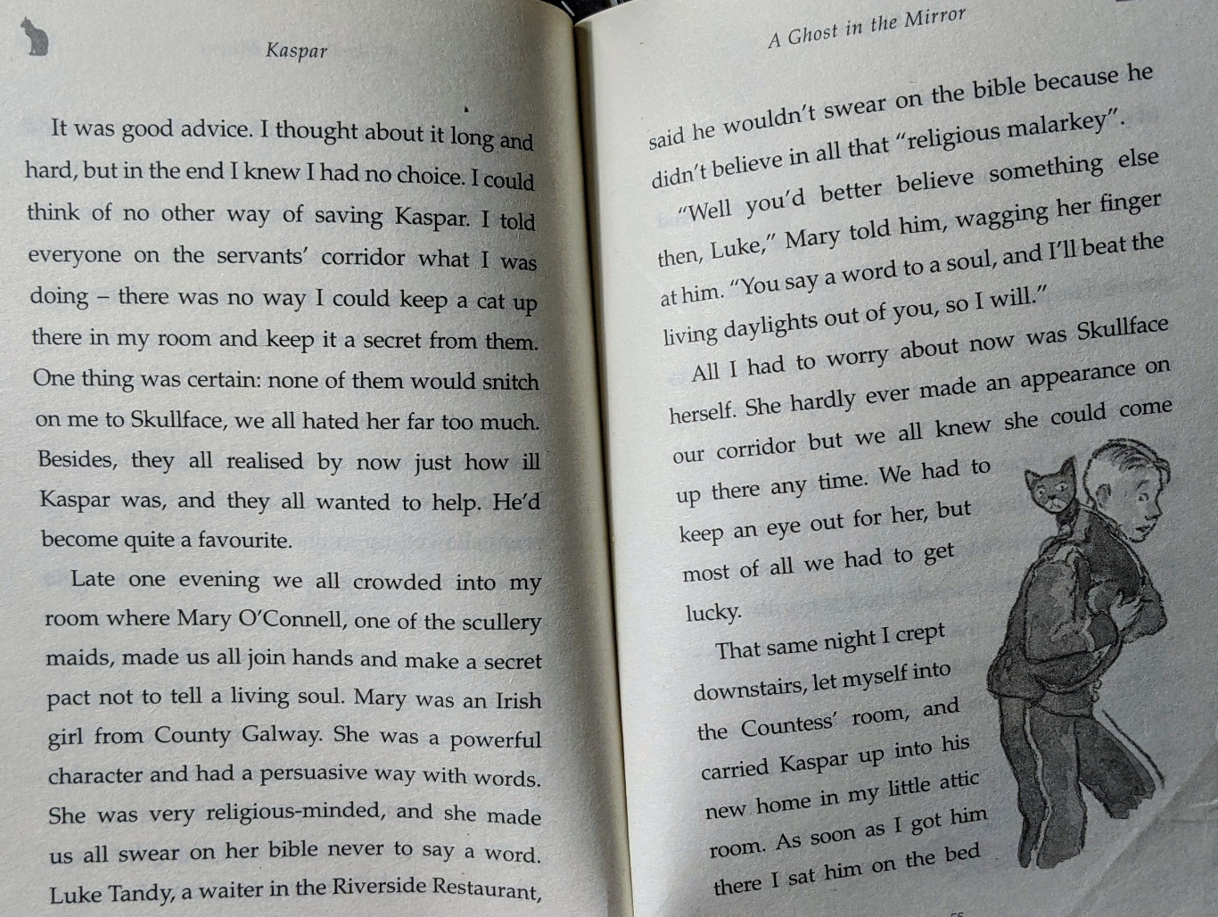

Slide 8
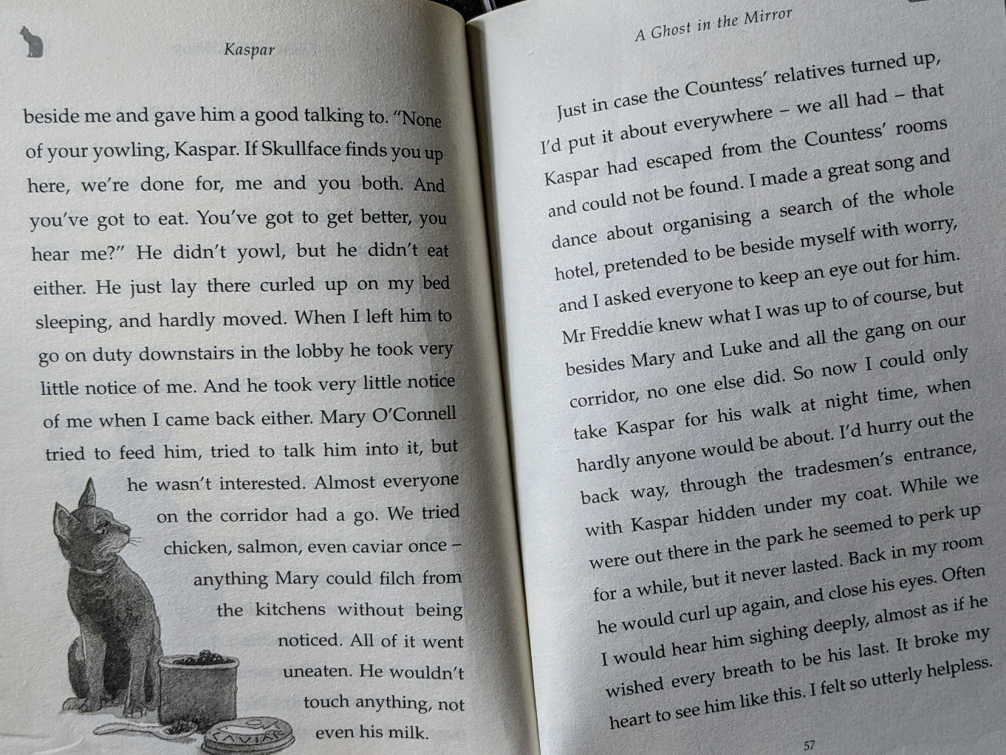

Slide 9
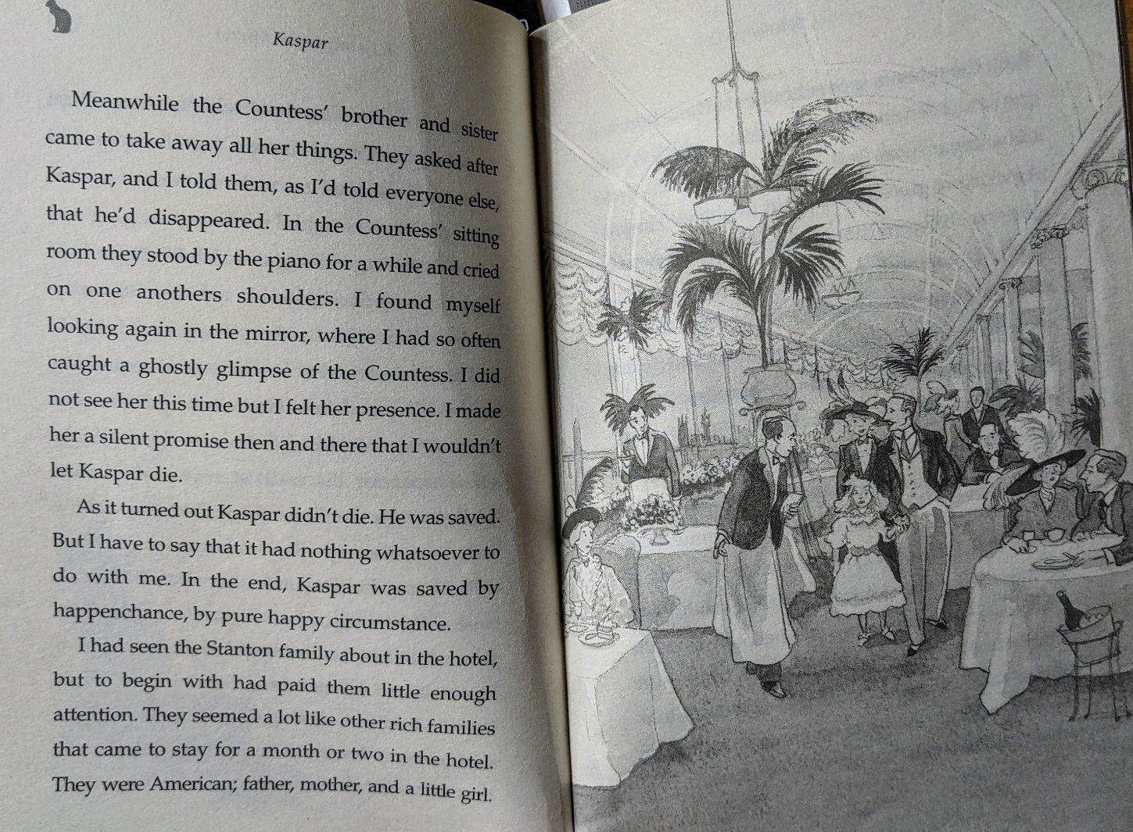

Slide 10
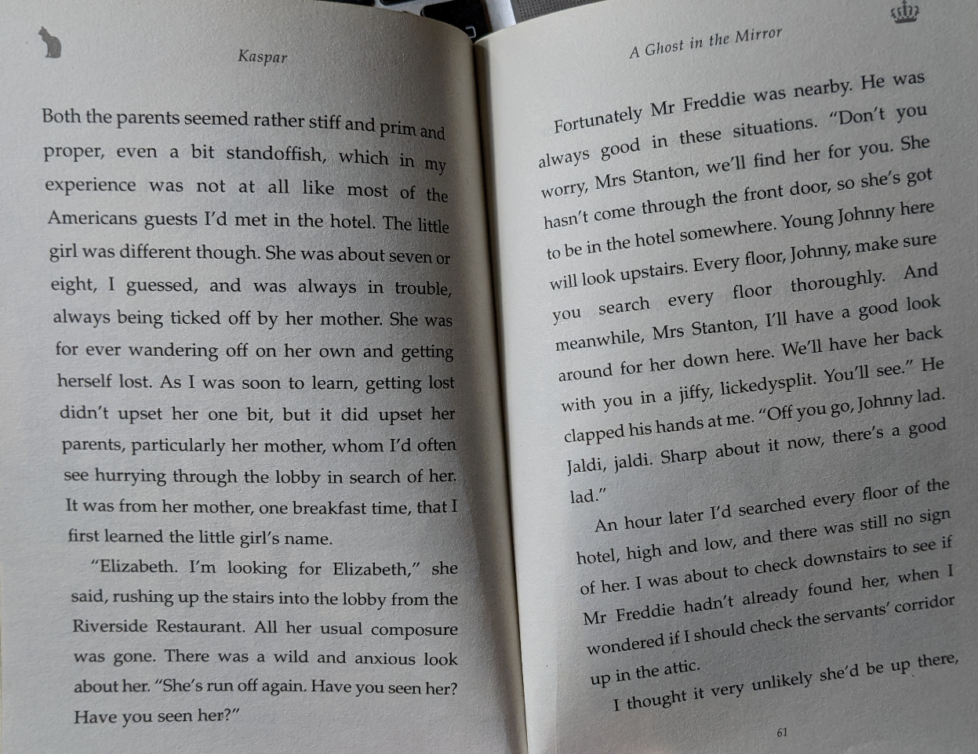

Slide 11
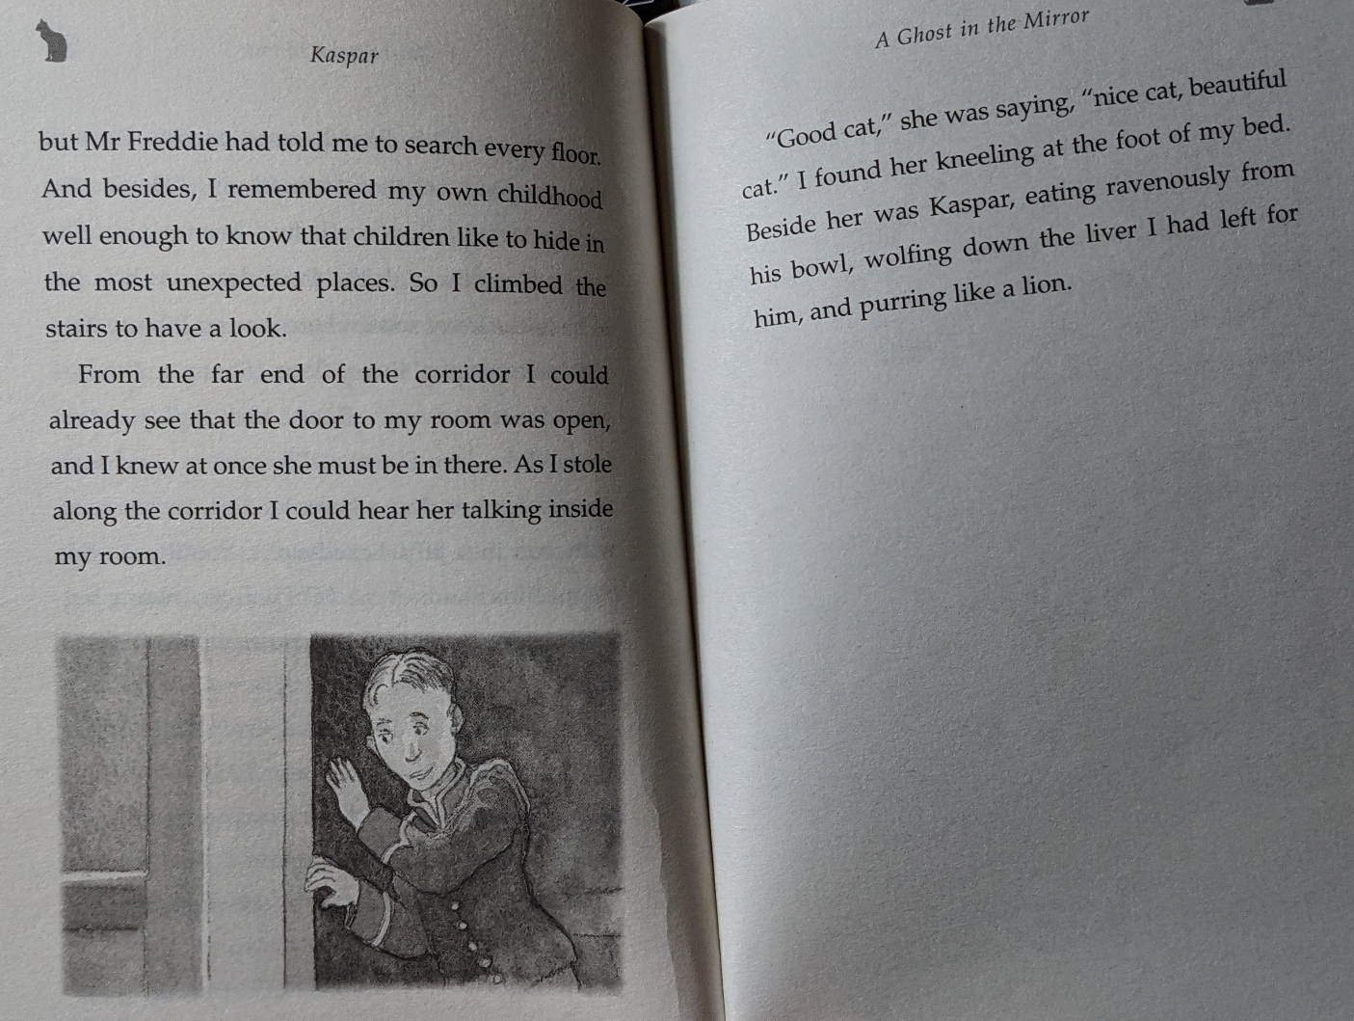

Slide 12
Yesterday, you gathered some research about the Titanic. Today, I want you to read an information text all about the Titanic and answer some comprehension questions on the subject. If you learn anything new as you read the text, you can add it to your notes! Tomorrow, you are going to begin writing your very own non-fiction book about the disaster, so we need to make sure you’re a Titanic expert!

Slide 13
There are three levels of difficulty for today’s reading activity. Select the text and questions that you feel most confident with. One star (emerging) Two star (expected) or Three star (exceeding).

Slide 14
In preparation for tomorrow’s work, can you think of some subheadings you could use to organise your notes?
Look at the subheadings on the information text you’ve read today →
You could make your subheadings into questions to intrigue the reader to discover the answers:
Who built the Titanic? What caused the collision?
Or perhaps you could ‘jazz up’ your subheadings with some alliteration:
Crafty Construction / Posh and Poor Passengers / Fantastic Facilities
You could even include a pun:
‘The Sea-nic Route’
‘No lifeboats? That’s just the tip of the iceberg!’

