Slide 1
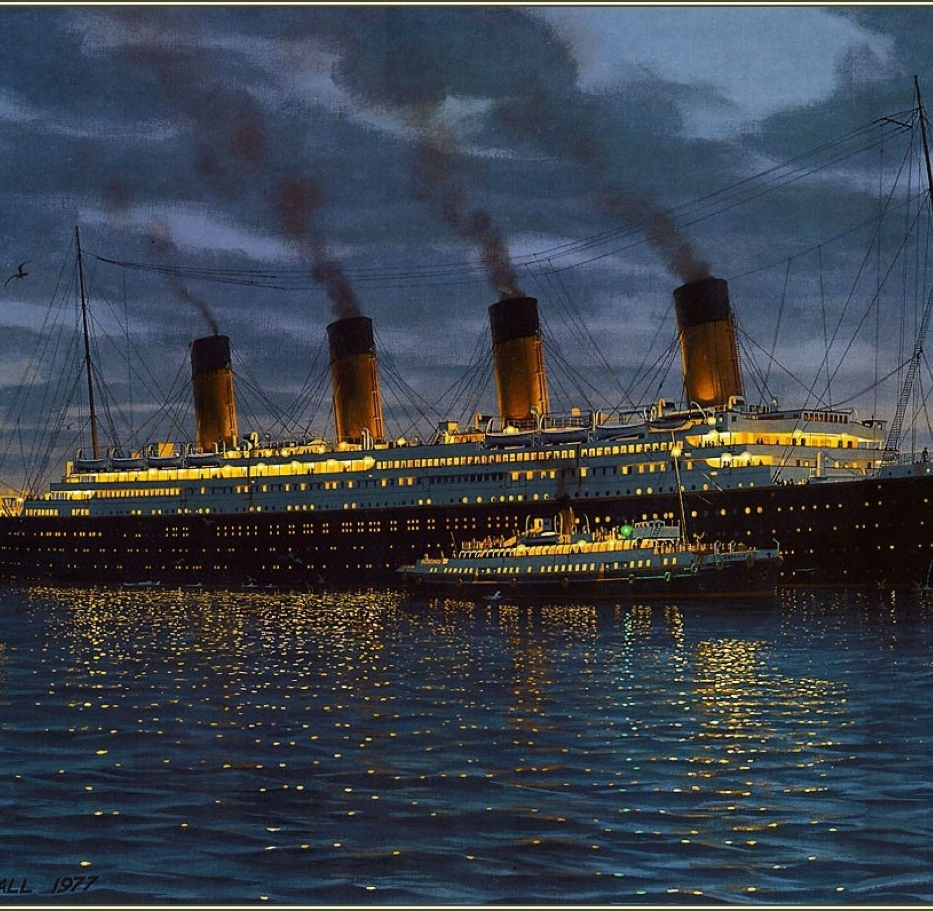
I can create a non-fiction text, thinking about key features, layout, purpose and audience
Wednesday 13th January 2021

Slide 2
Before we begin, enjoy reading the next Chapter of our class text, ‘Kaspar Prince of Cats.’

Slide 3
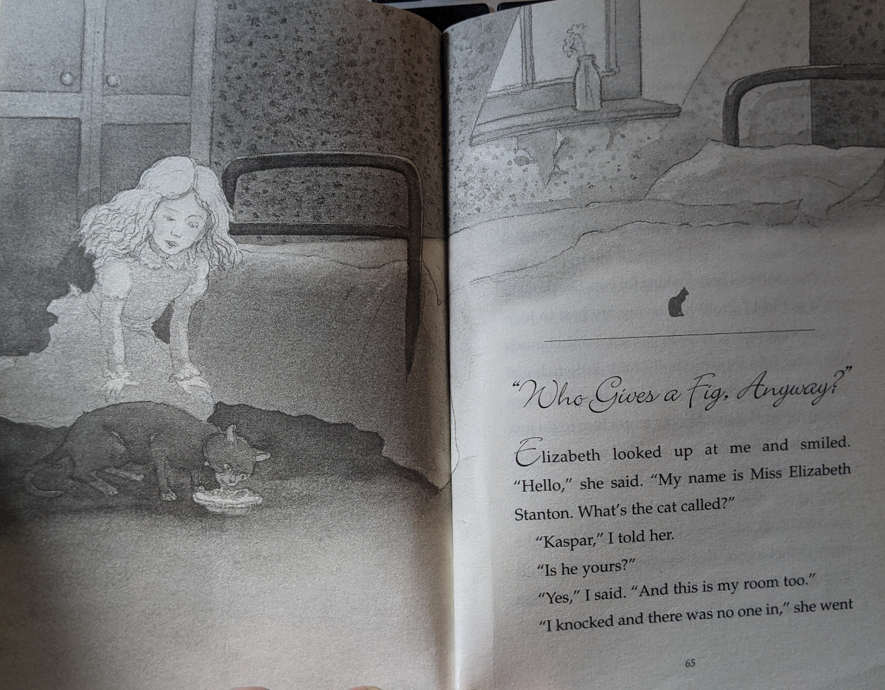

Slide 4
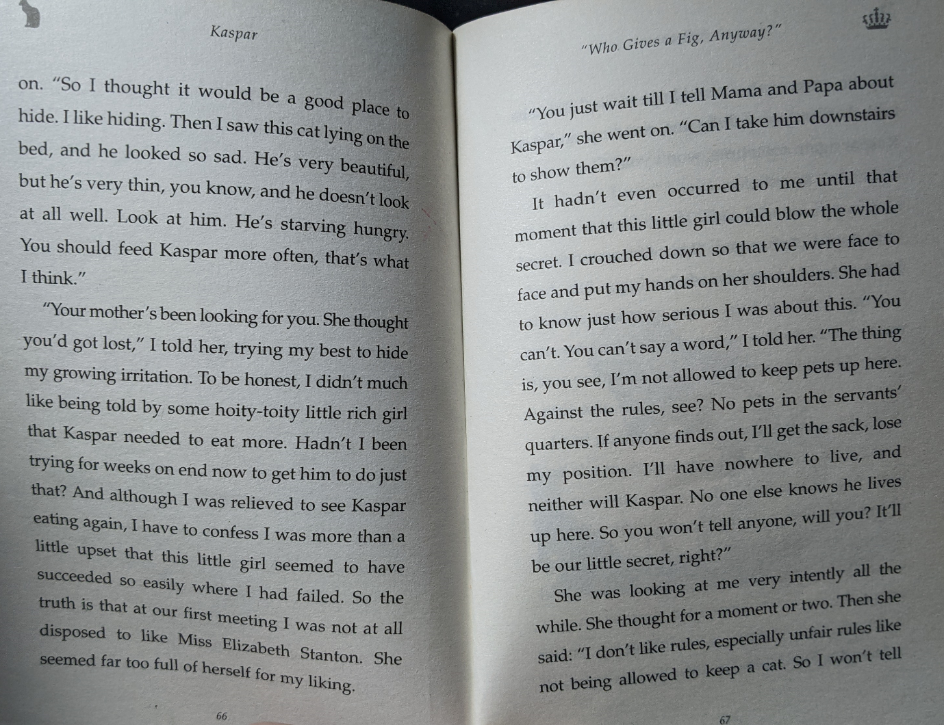

Slide 5
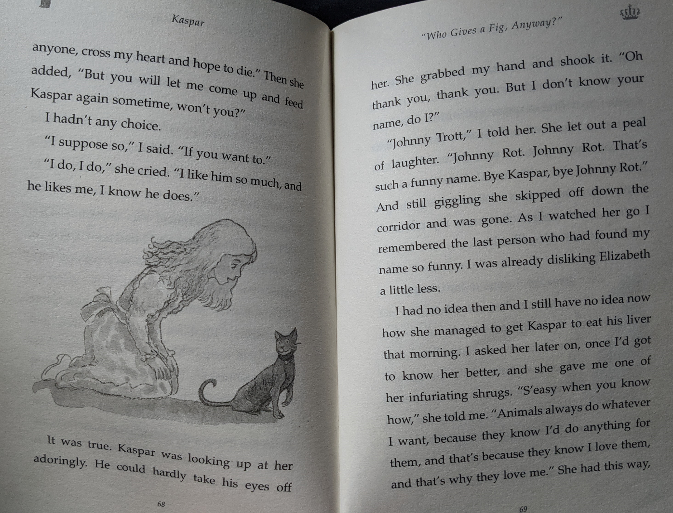

Slide 6
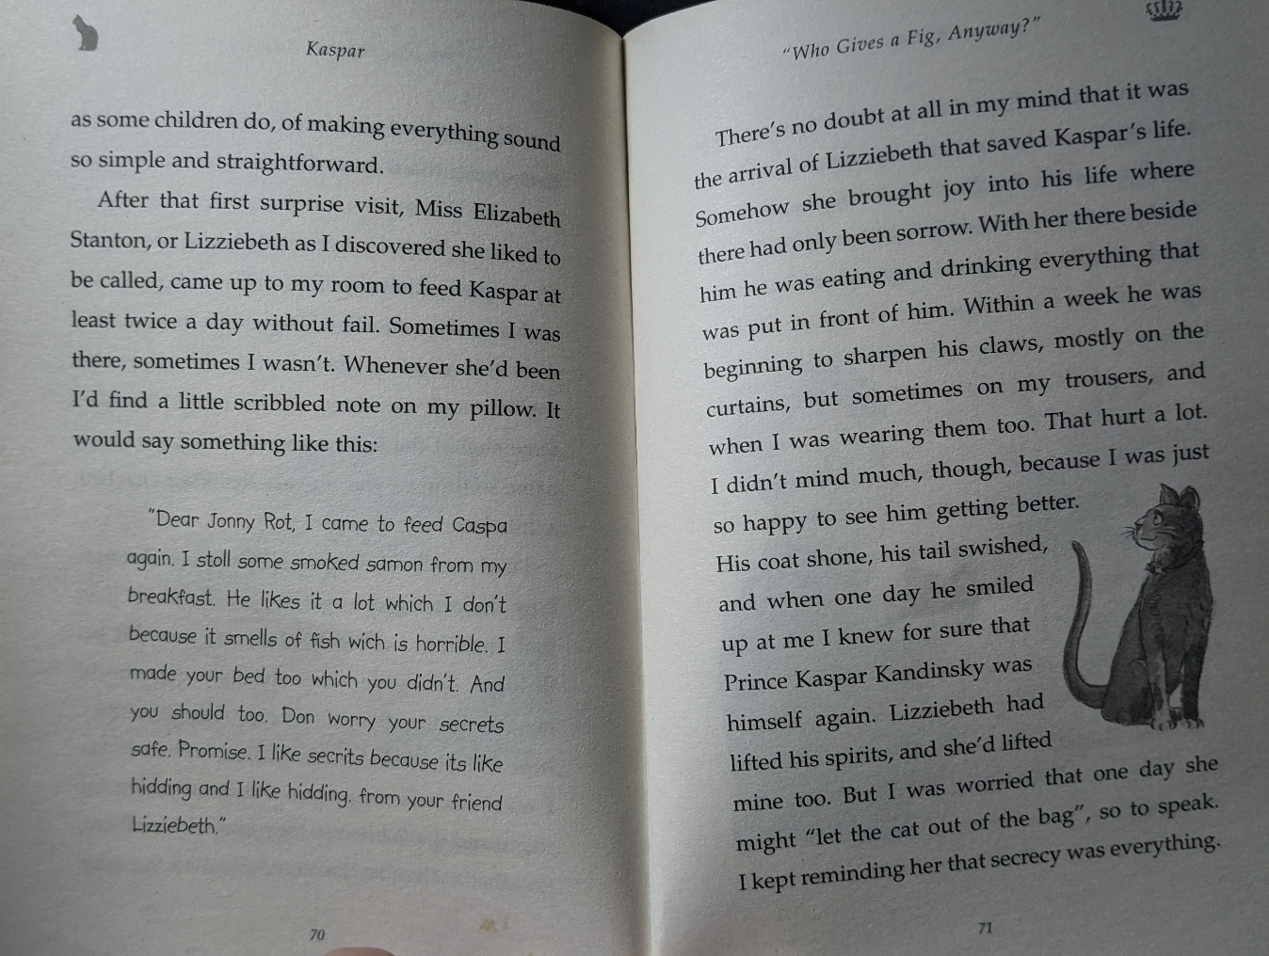

Slide 7
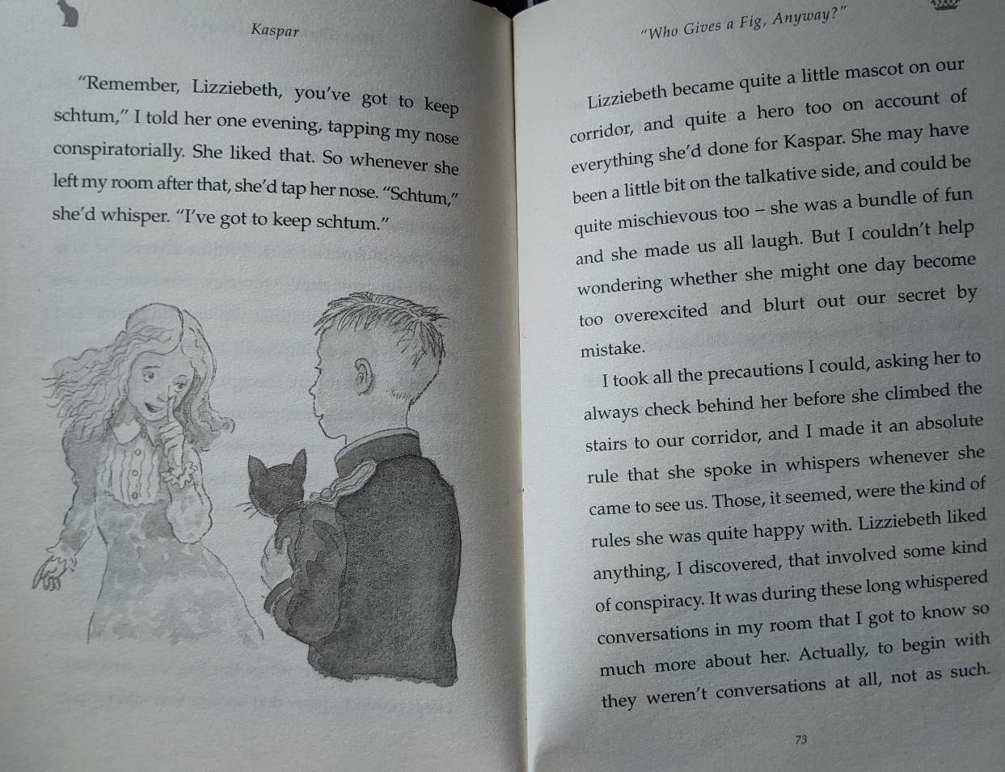

Slide 8
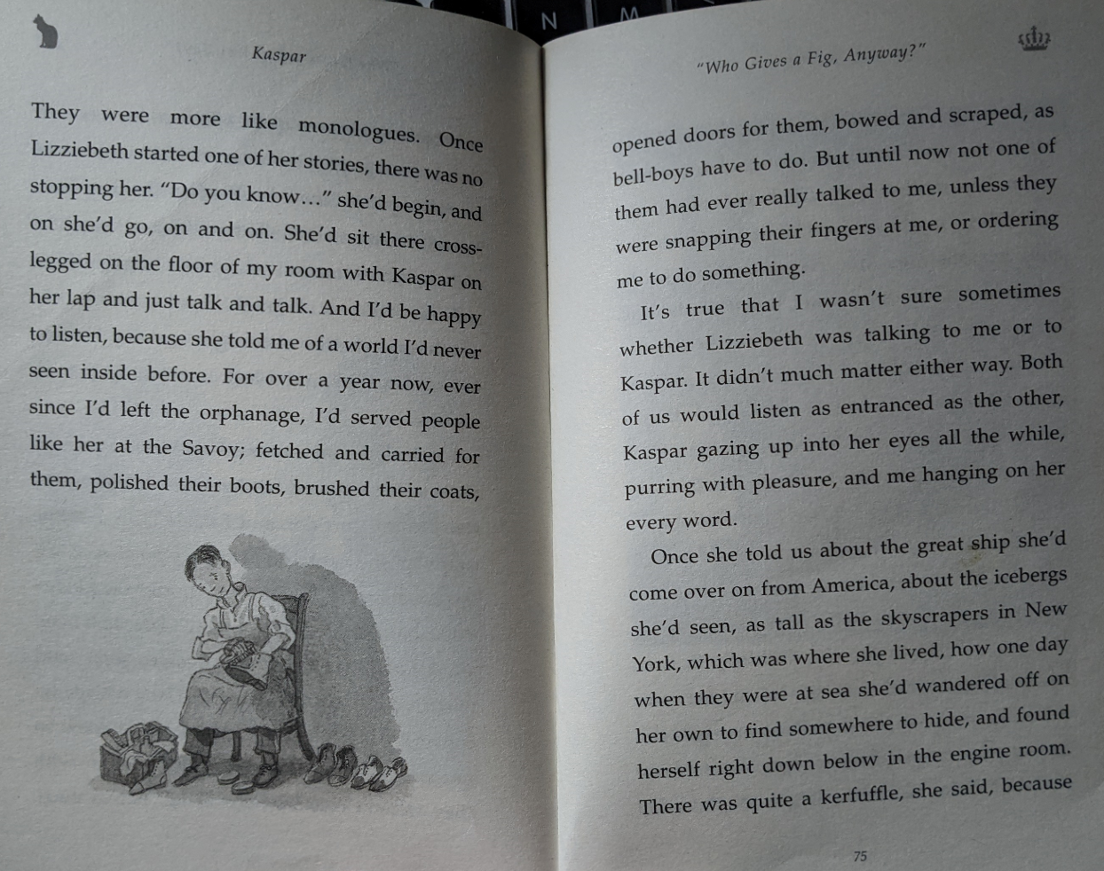

Slide 9
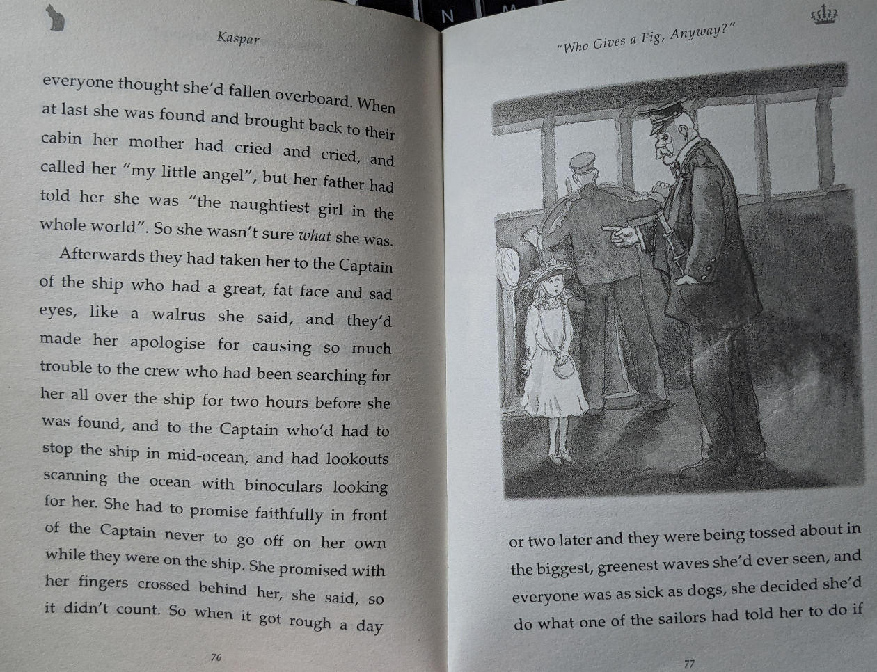

Slide 10
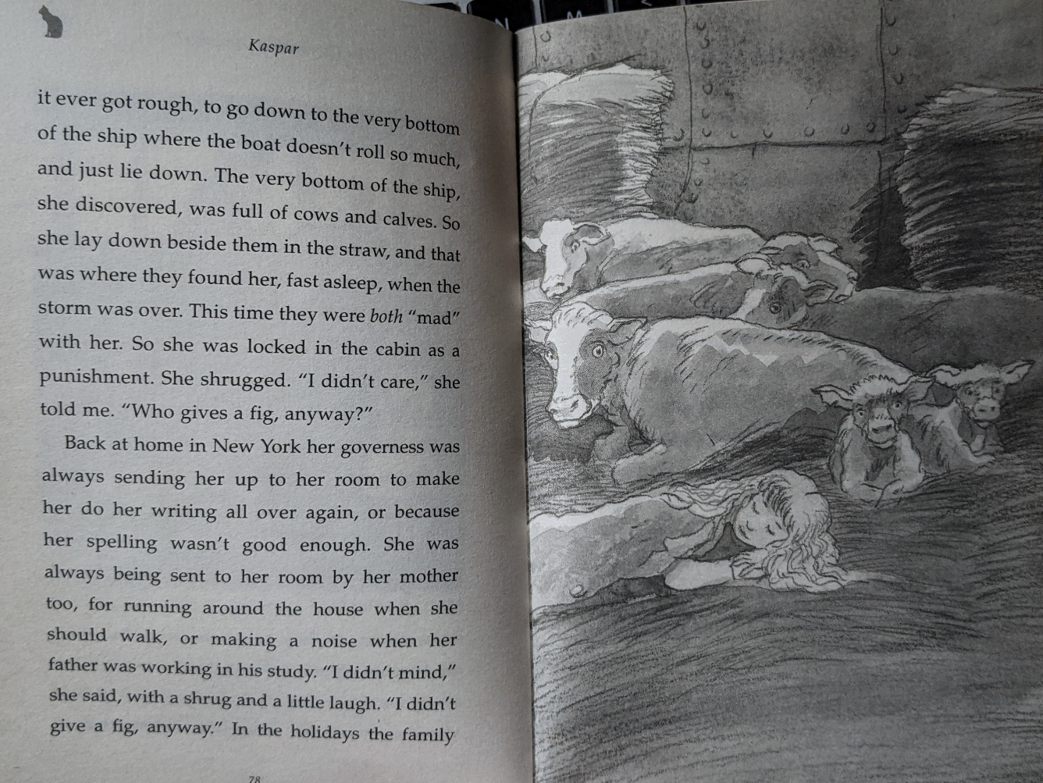

Slide 11
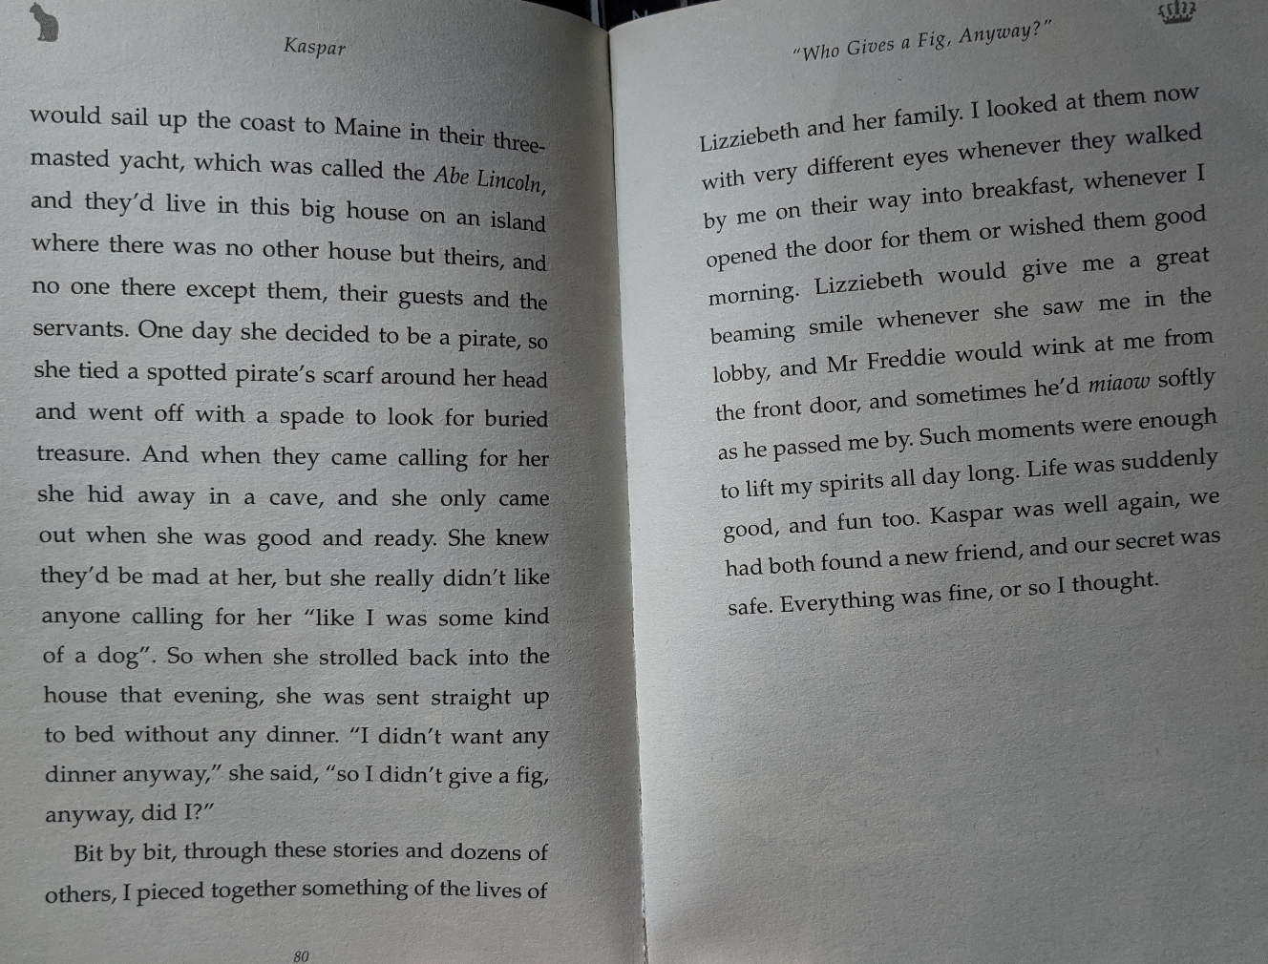

Slide 12
Over the next three lessons (13/01/21-15/01/21) I would like you to create a non-fiction book all about the Titanic.

Slide 13
Success Checklist:
I have included a front cover
I have included a contents page
I have included headings and subheadings
I have included images and captions
I have included a ‘fun fact’ or a ‘did you know?’
I have included page numbers
I have included a mini glossary
I can include a range of punctuation including , () : ; ! ? …
I can use a range of sentence openers
I can use some ambitious vocabulary

Slide 14
A few good examples…

Slide 15
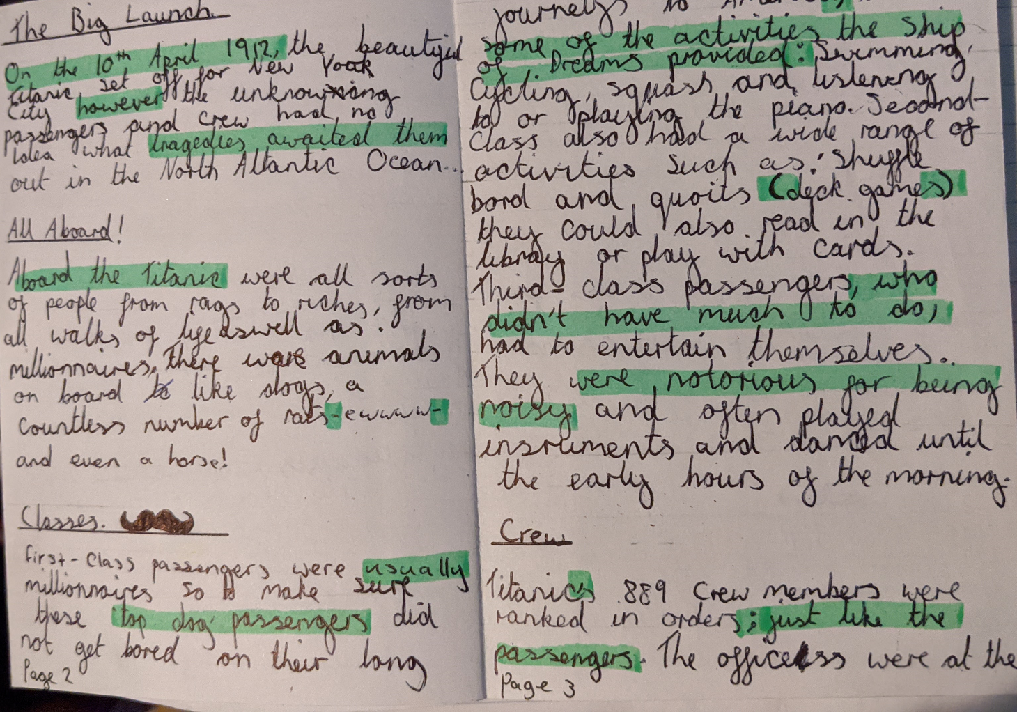
What makes them effective?

Slide 16
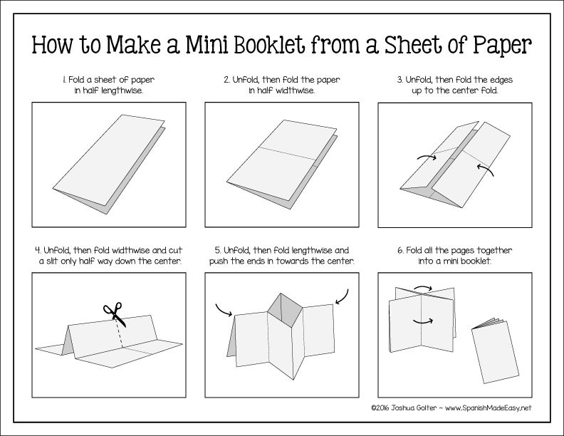
You can present your book in any way you like, but here is one example…
You can watch a quick tutorial here: https://www.youtube.com/watch?v=21qi9ZcQVto

Slide 17
Can you include some helpful headings?
Look at the subheadings on the information text you read yesterday →
You could make your subheadings into questions to intrigue the reader to discover the answers:
Who built the Titanic? What caused the collision?
Or perhaps you could ‘jazz up’ your subheadings with some alliteration:
Crafty Construction / Posh and Poor Passengers / Fantastic Facilities
You could even include a pun:
‘The Sea-nic Route’
‘No lifeboats? That’s just the tip of the iceberg!’

Slide 18
There are many non-fiction books about the Titanic disaster…

Slide 19
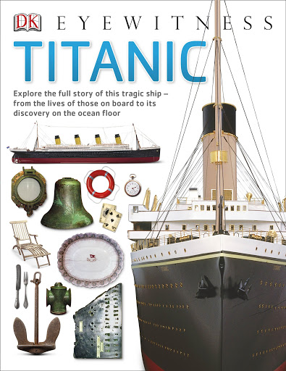
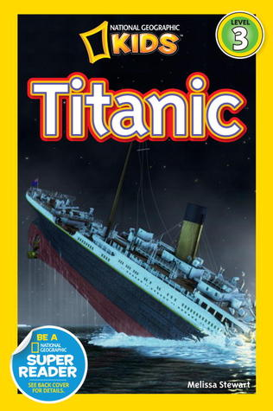
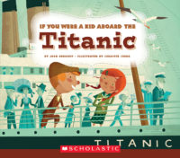
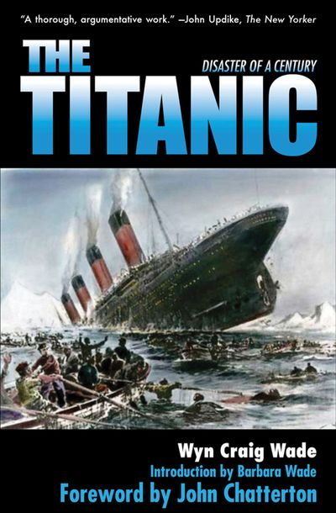
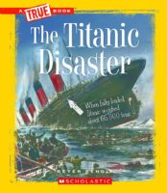
What your non-fiction book will look like and the language you use will depend on your target audience- is it aimed at children, teenagers, adults, historians? It’s up to you!

