Slide 1
English
Thursday 14th January

Slide 2
I am successful if...
I can consider how a characters’ emotions can change throughout a story.

Slide 3
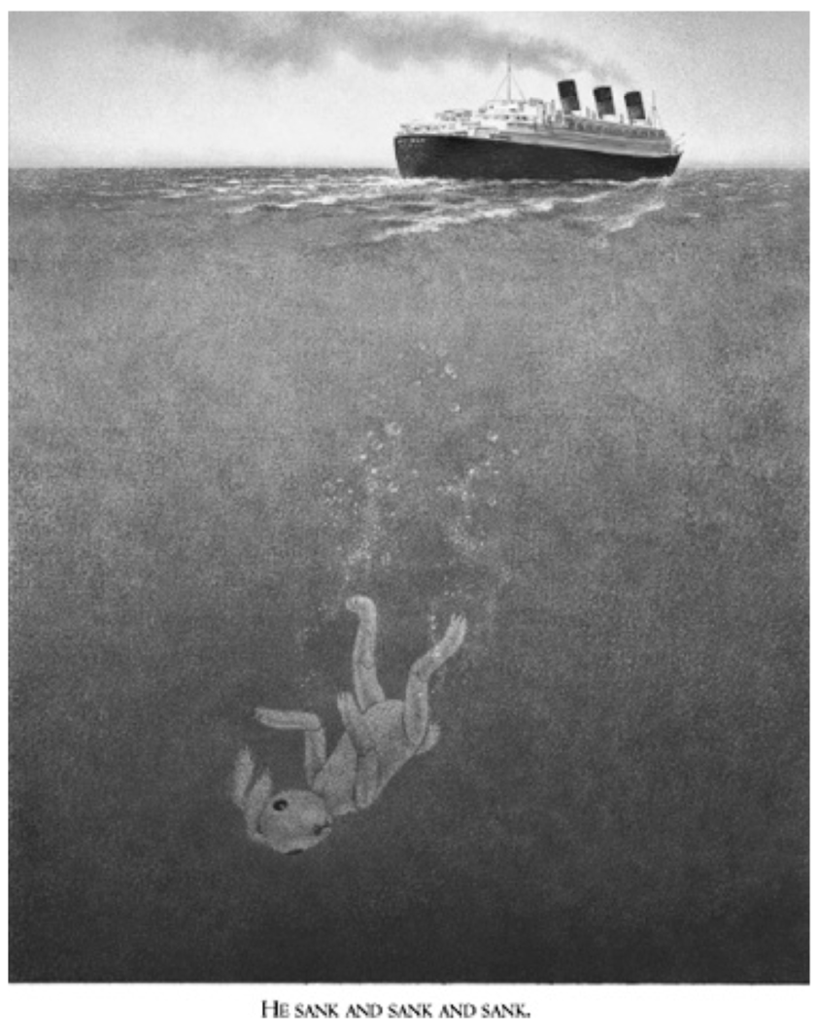

Slide 4
Discuss…
What do you think will happen to Edward?
As we read chapter 6 and 7, listen out for clues as to what Edward is thinking and feeling.

Slide 6
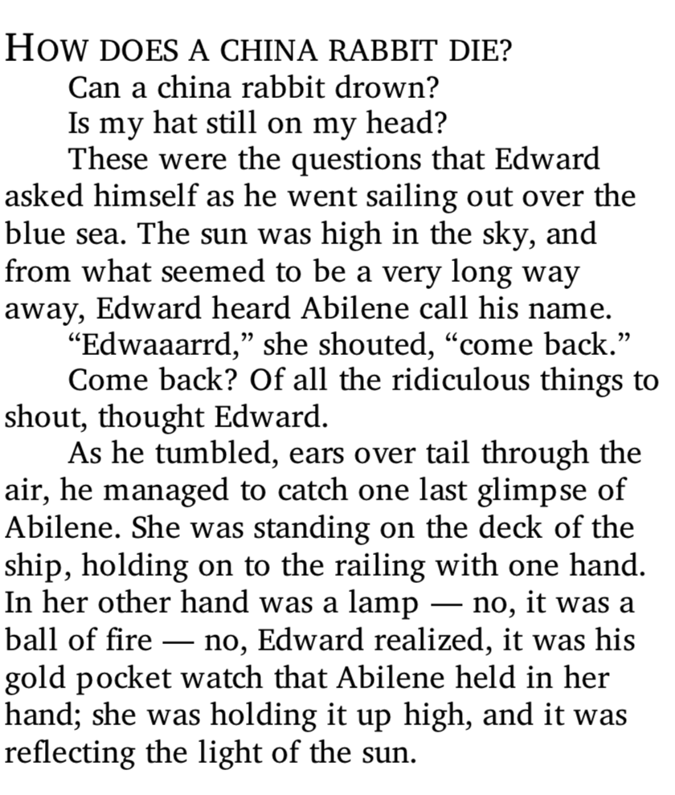

Slide 7
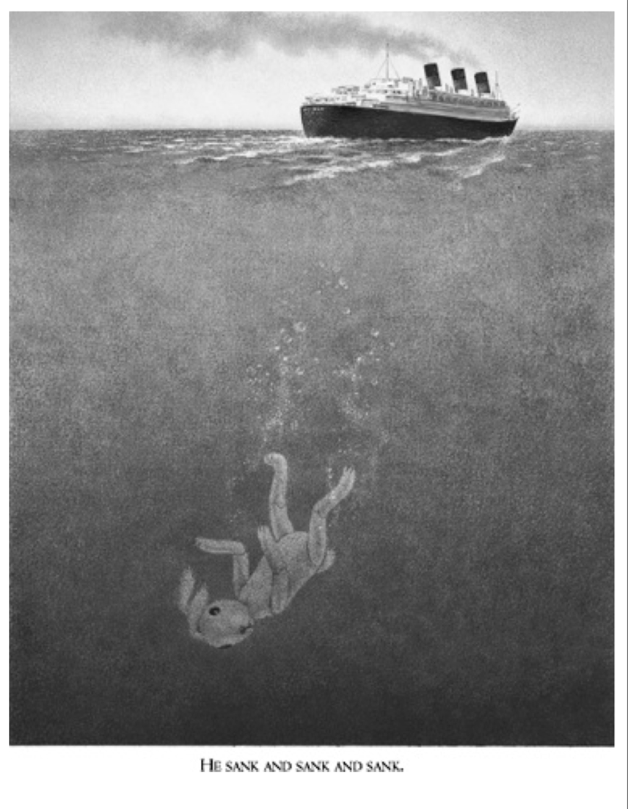

Slide 8
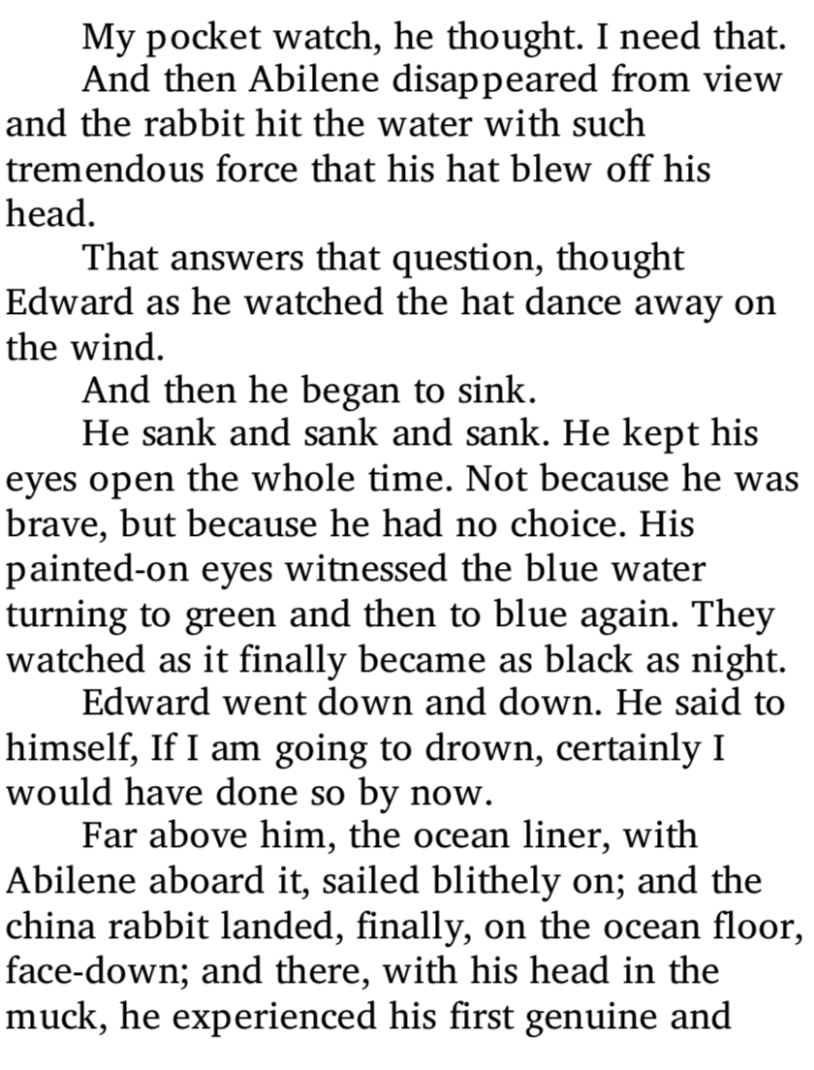

Slide 10
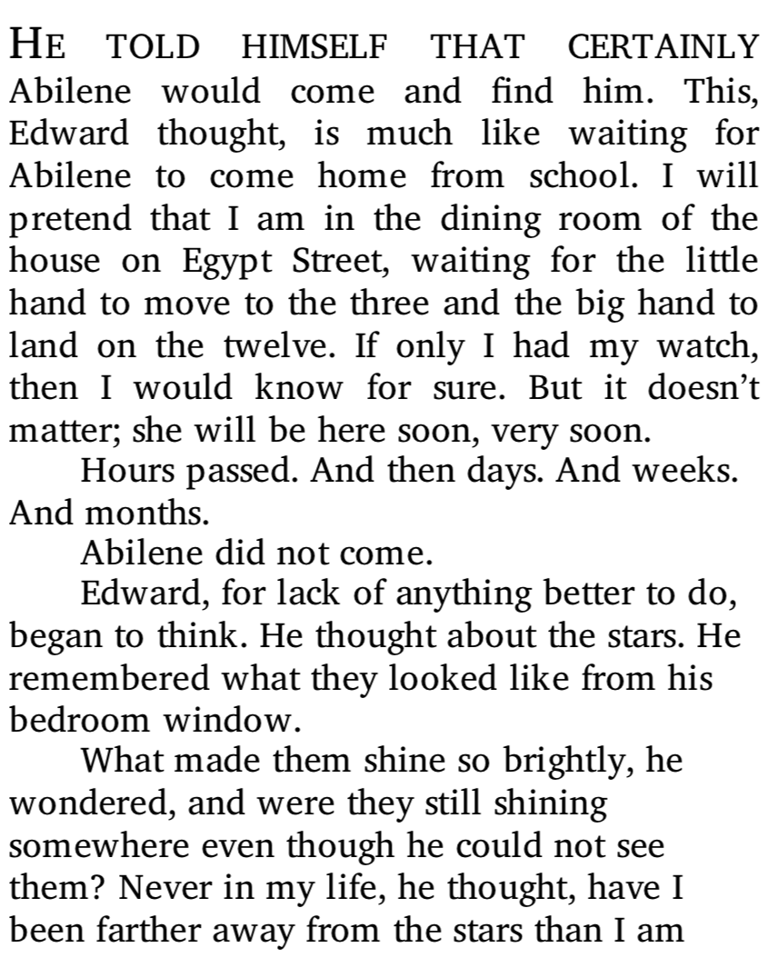

Slide 11
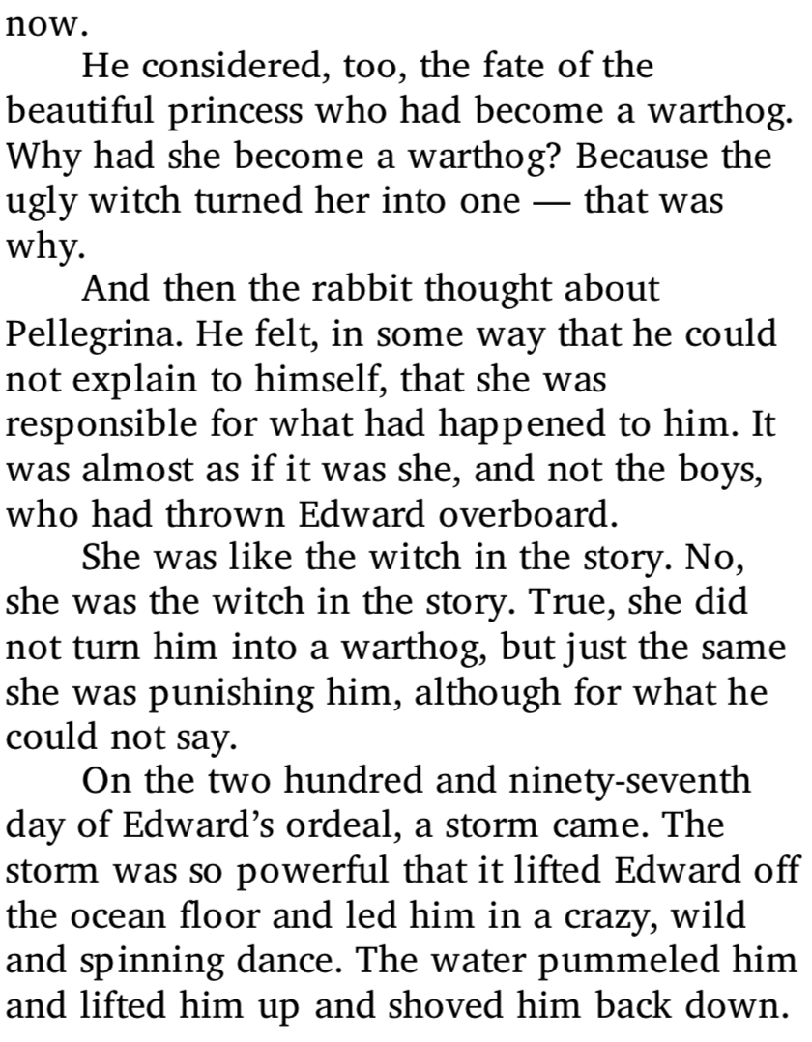

Slide 12
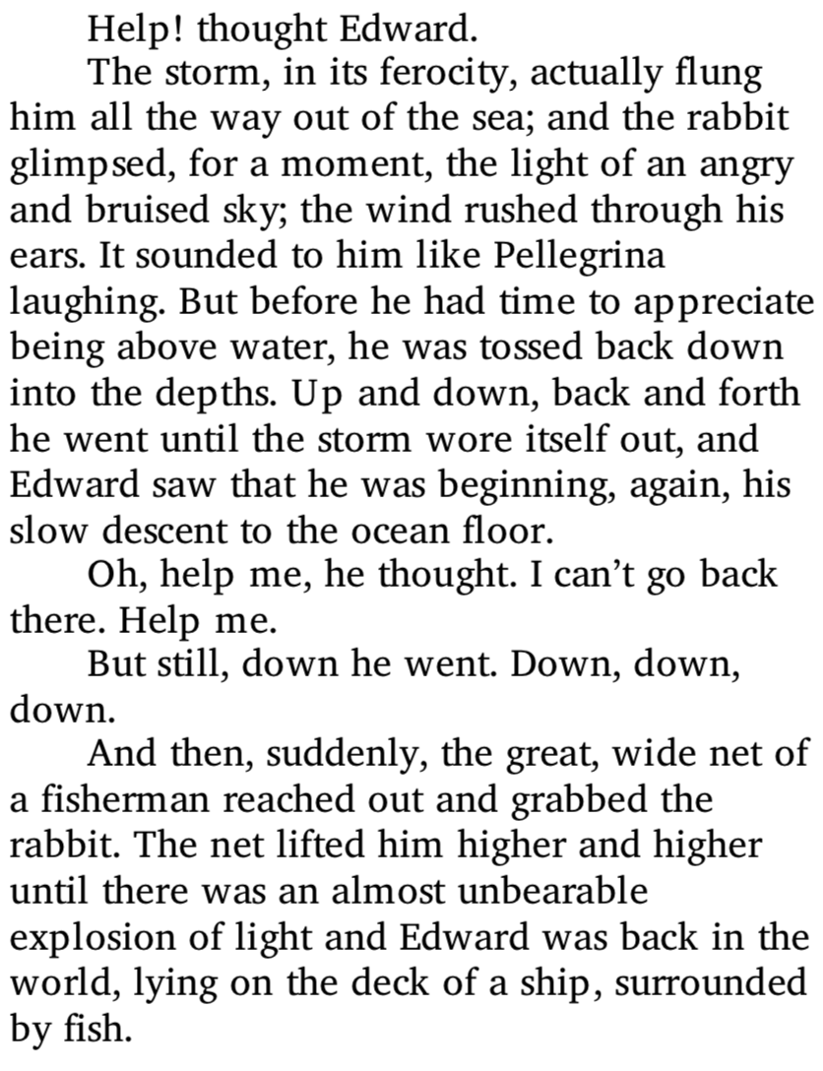

Slide 13
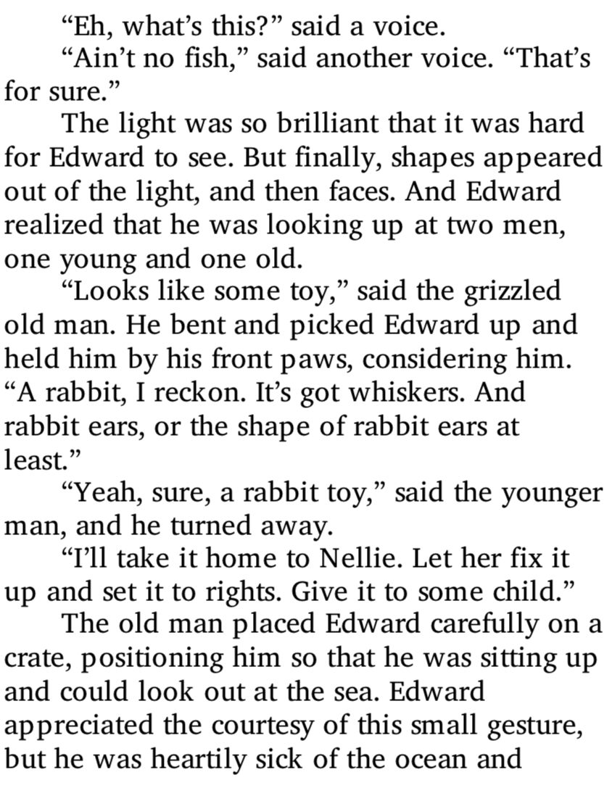

Slide 14
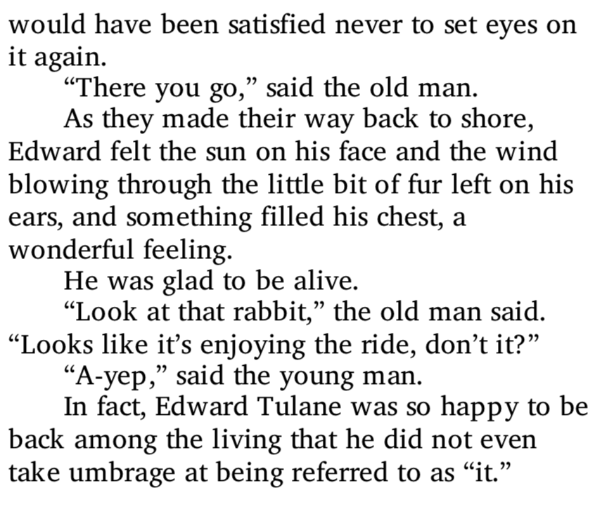

Slide 15
How was Edward feeling?
Think about the story so far. Consider how Edward has been feeling throughout the story.
Use the following template (or draw your own) to map out the story so far. Underneath each picture, write a sentence to describe how Edward is feeling.

