Slide 1
English
Thursday 7th January

Slide 2
I am successful if...
I can write a diary entry to show how a character may be feeling.

Slide 4
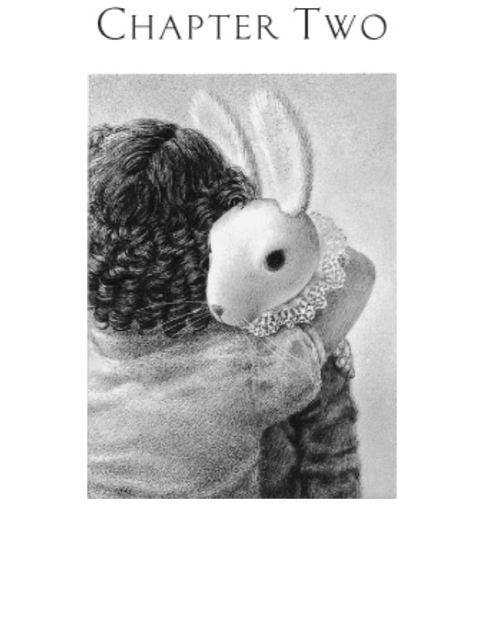

Slide 5
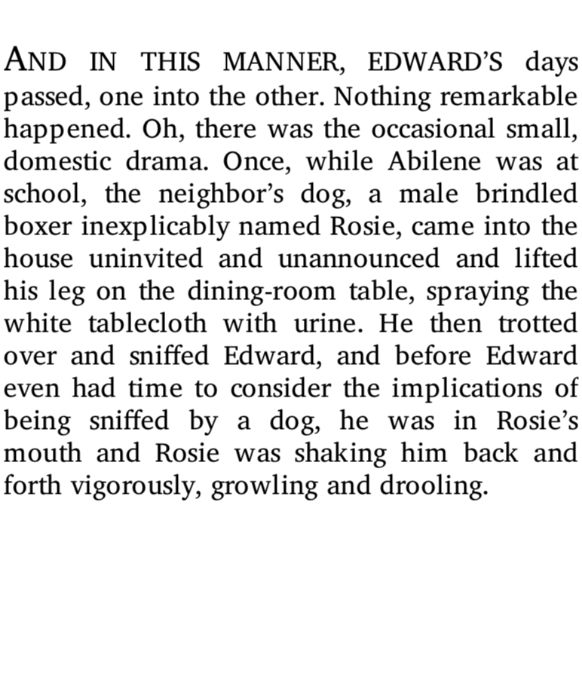

Slide 6
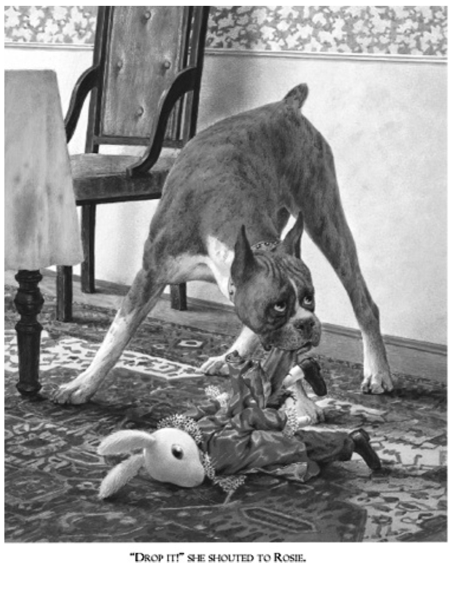

Slide 7
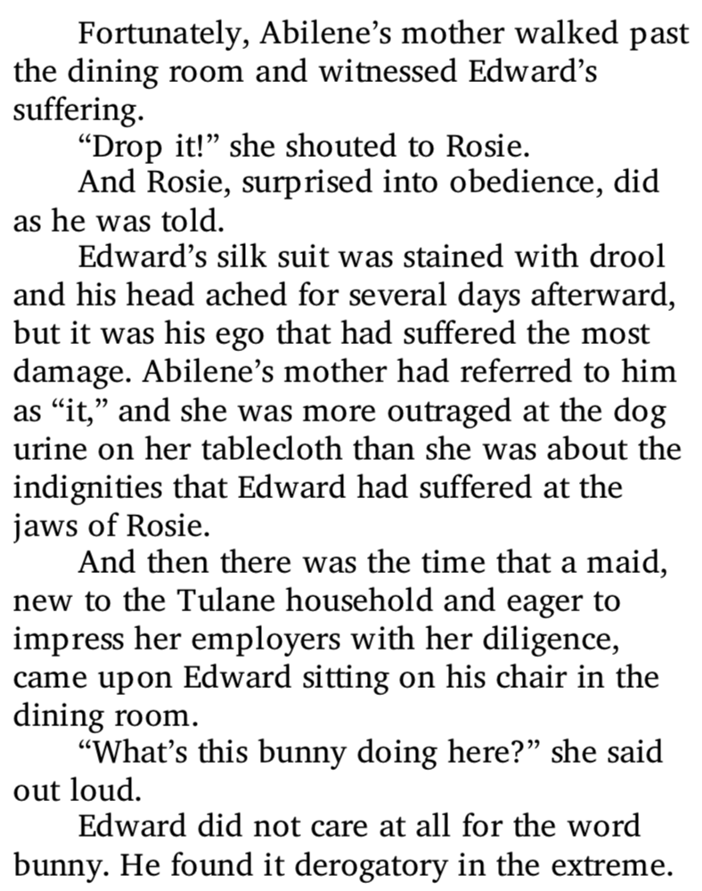

Slide 8
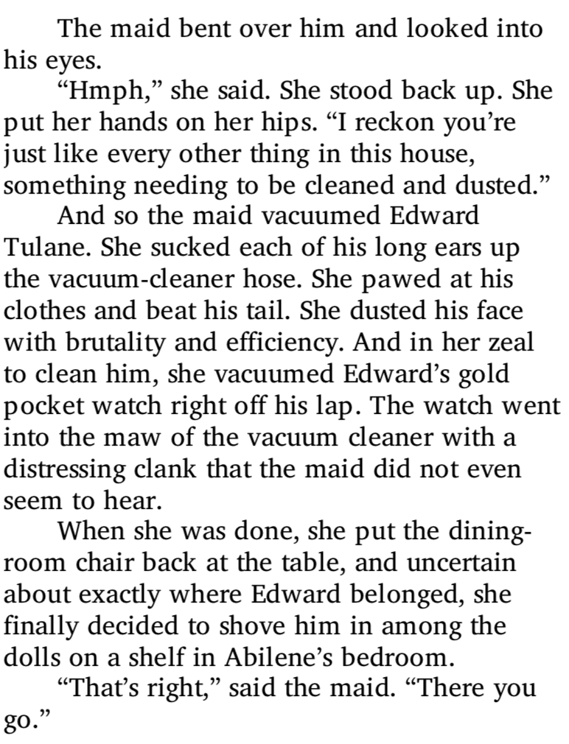

Slide 9
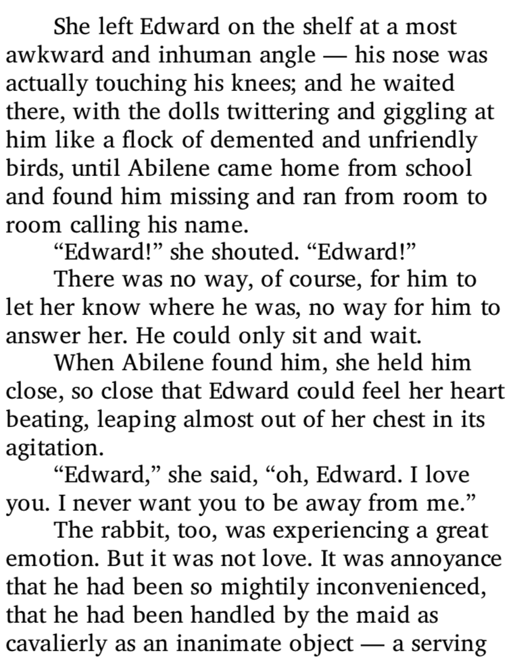

Slide 10
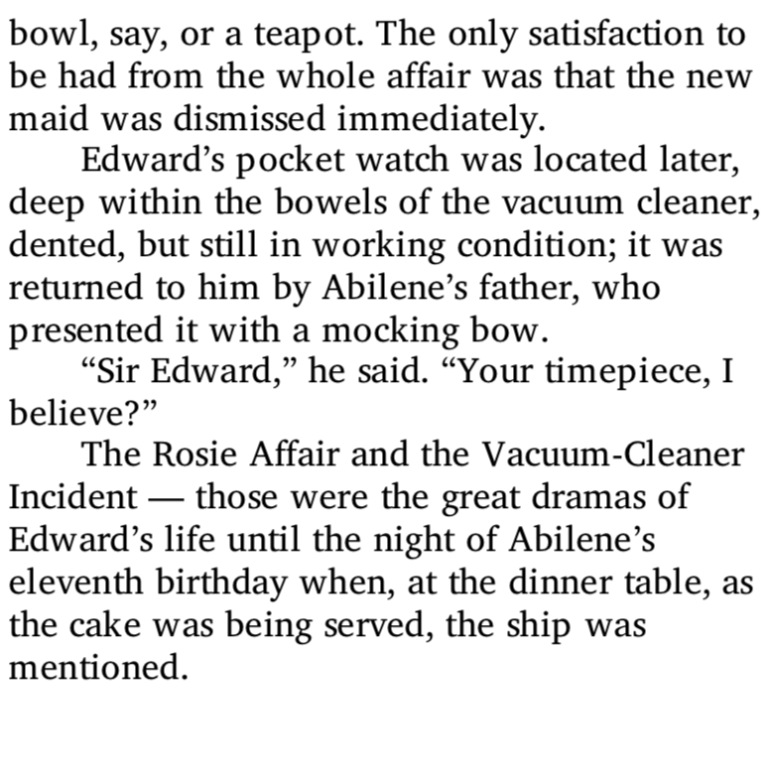

Slide 11
Discuss
Summarise what has happened in Chapter 2.
Does it reveal more aspects of Edward’s personality? Have we changed our thoughts on Edward?
What do you think the worst thing is that has happened to Edward? The dog, Abilene’s mother calling him ‘it’, being hoovered by the maid and calling him ‘bunny’ or being put on the shelf next to the dolls?

Slide 12
Time to act
Now, pretend that you are Edward. You are a china rabbit, you think very highly of yourself and you have just gone through such a terrible ordeal!
First, you were attacked by a dog! Then you were called ‘it’! Next you were hoovered and then put on a shelf just like a toy!
Think about how you are feeling. Annoyed, irritated, furious?

Slide 13
Your task
Write a diary entry as Edward. Choose at least 1 of the events that has just happened in the story to write about. Describe how you are feeling.
Remember, when you are writing, try to show aspects of Edward’s personality. You are writing as Edward, so use ‘I’!
We know that he is vain, selfish and arrogant. How can you demonstrate this in your diary?

Slide 14
Plenary
Read through your diary and check for any mistakes. Have you used the correct punctuation? Have you used full stops?
Have you shown how Edward might be feeling?

