Slide 1
7.1.21
Write these as a multiplication calculation and work them out…
5 + 5 + 5 =
2 + 2 + 2 + 2 + 2 + 2 + 2 + 2 + 2 =
10 + 10 + 10 + 10 + 10 =
3 + 3 + 3 =
5 + 5 + 5 + 5 + 5 + 5 + 5 + 5 + 5 + 5 =
2 + 2 + 2 + 2 + 2 =
3 + 3 + 3 + 3 + 3 =
10 + 10 + 10 + 10 =
Write these as
addition calculations
and work them out…
9) 7 x 2 =
10) 8 x 2 =
11) 5 x 10 =
12) 3 x 3 =
13) 6 x 5 =
14) 3 x 10 =
15) 7 x 10 =

Slide 2
SPAG
There is a 2do set on purple mash called ‘coordination’ for you to do.
Spellings
Practise writing out your spellings 3 times.

Slide 3
English
We are going to start looking at our new text today.
Have a look at the pictures on the next page. What do they show? What do you think the book is about? What kind of text do you think it might be? – fiction or non-fiction?
Have some time looking at the pictures and discussing them with someone at home or writing your ideas down.

Slide 4
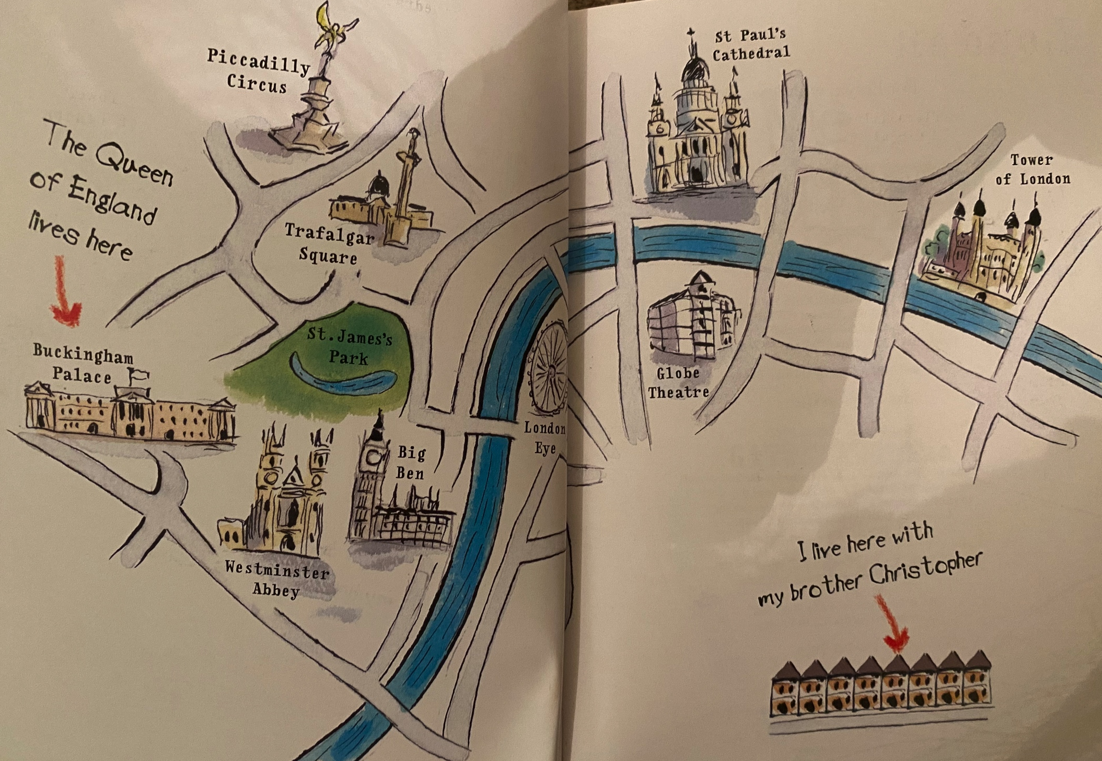

Slide 5
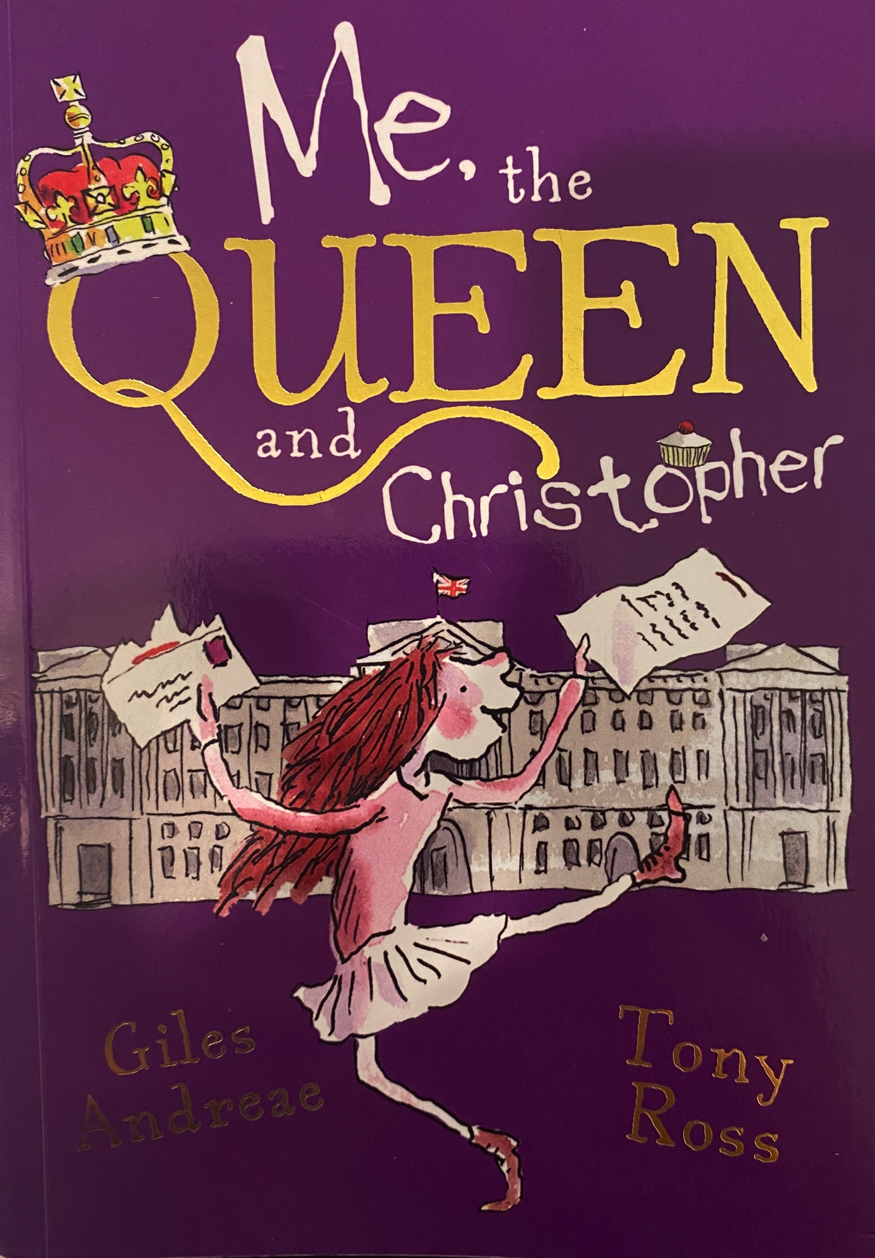
This is our new text!
It’s a great book which you will all love.
Click through the next slides to read the first few pages of the book.

Slide 6
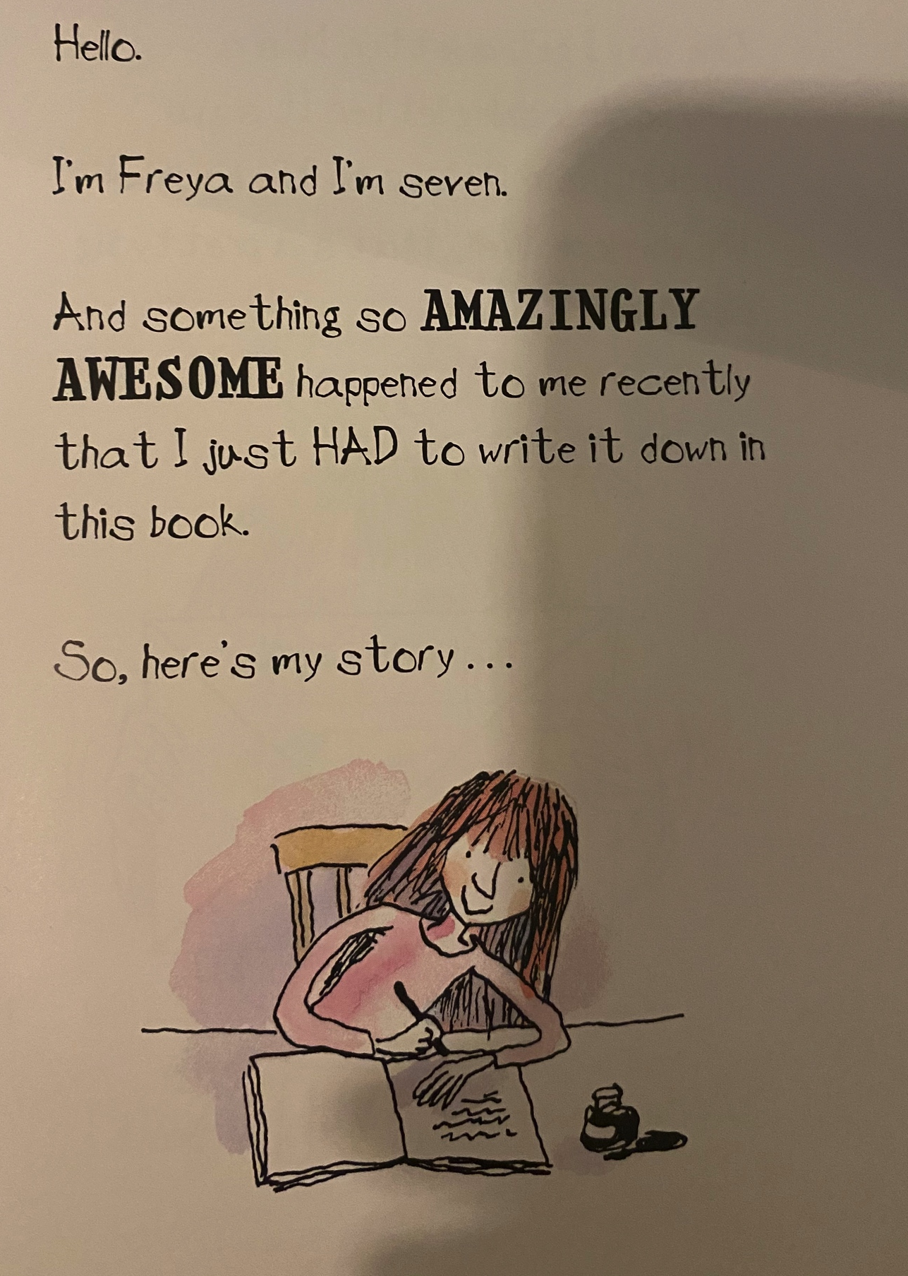

Slide 7
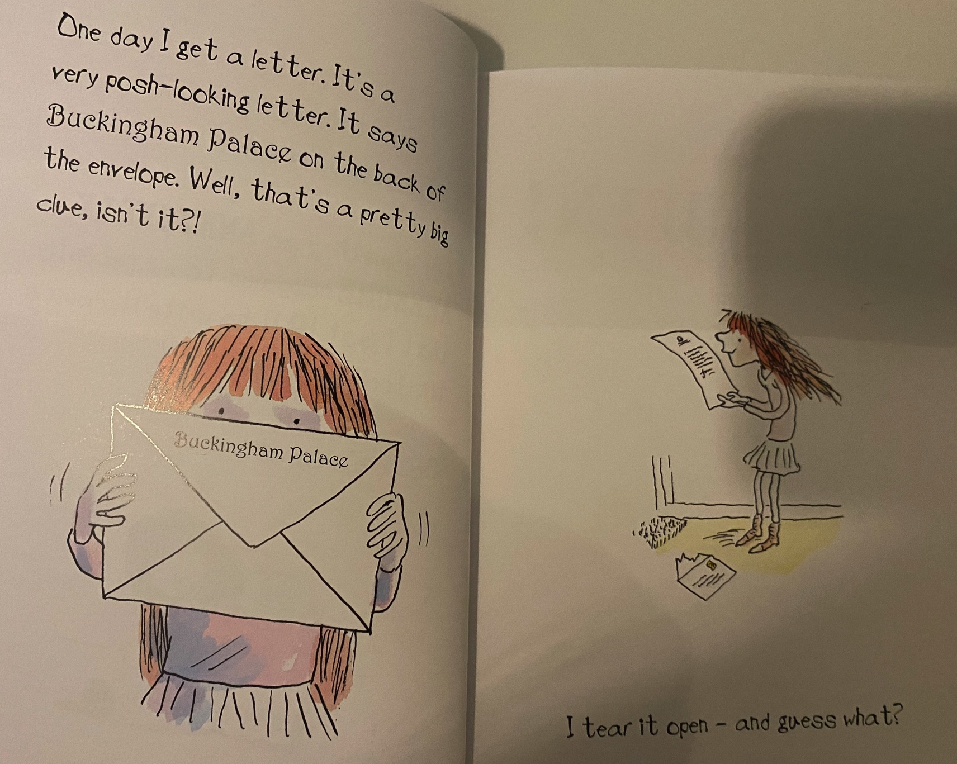

Slide 8
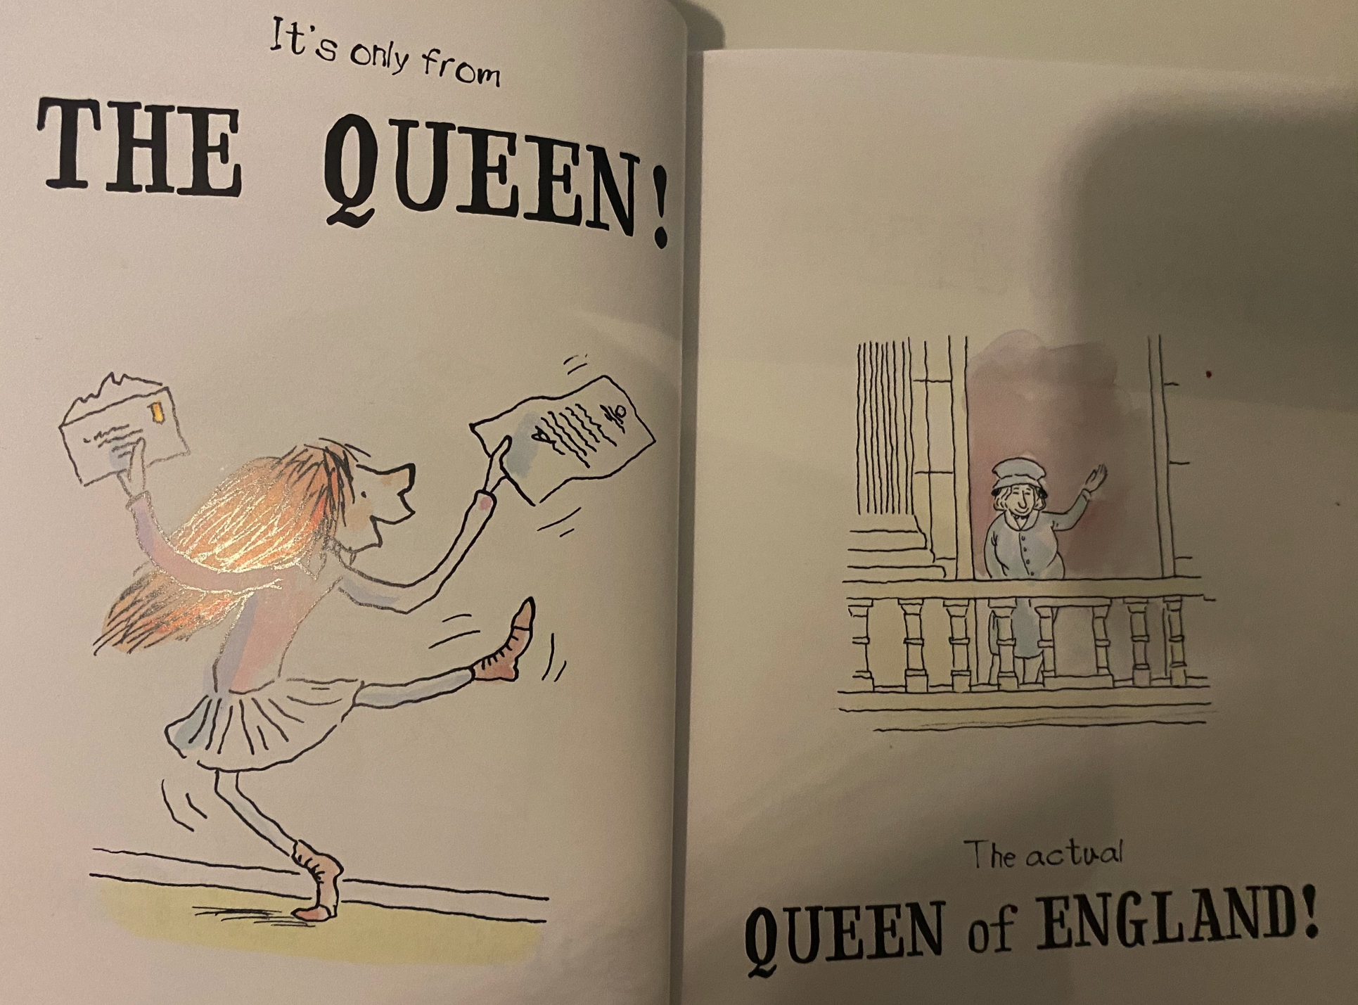

Slide 10
WOW! An invitation from the Queen? Can you imagine how excited Freya must be?
I would like you to imagine that you have just received an invitation from the Queen. Can you write a reply to her?
Remember if you are writing to someone as important as the Queen, you will need to use formal language and ensure your sentences all make sense.
Look at the reply on the following page and then have a go at writing your own.

Slide 11
Dear Your Majesty,
I am delighted to receive your invitation to come for tea with you at Buckingham palace. Of course I would love to come and I will make sure I wear my most beautiful dress. My favourite sandwiches are cheese and I love sticky chocolate cake as a treat. I can’t wait to tell all of my friends about this opportunity when I get back to school but I don’t think they will believe me.
Thank you very much
Yours sincerely
Jenny

Slide 12
Maths
Click on the following link for your maths lesson today about using arrays.
https://vimeo.com/490417143

Slide 13
Handwriting
The handwriting sheets for this week are on the website. There are 6 sheets on one document and you can choose one to do each day. Remember to clearly show your tall letters and low letters and ensure all the other letters are the same size.

Slide 14
Science
Our new science topic this half term is all about materials.
Follow the link below to watch the Oak Academy lessons about materials. This week I would like you to watch lesson 2 and 3 (you can watch 1 if you would like to as well).
https://classroom.thenational.academy/units/materials-de3f
Once you have watched the video I would like you to investigate some materials around your house. Find some objects and group them according to their materials. I then want you to write some words to describe the properties of the materials. There is a recording sheet for you to use on the website (if you want) and on the next slide are some words which you should use to describe the materials.

Slide 15
Materials
Do you know what all of these mean? If you don’t perhaps you could find out. Use them to describe the properties of the materials you find.
Strong absorbent transparent opaque
malleable stretchy soft rough
waterproof smooth shiny dull

Slide 16
Music
https://classroom.thenational.academy/units/pitch-c0a5

