Slide 1
Thursday 7th January 2021

Slide 2
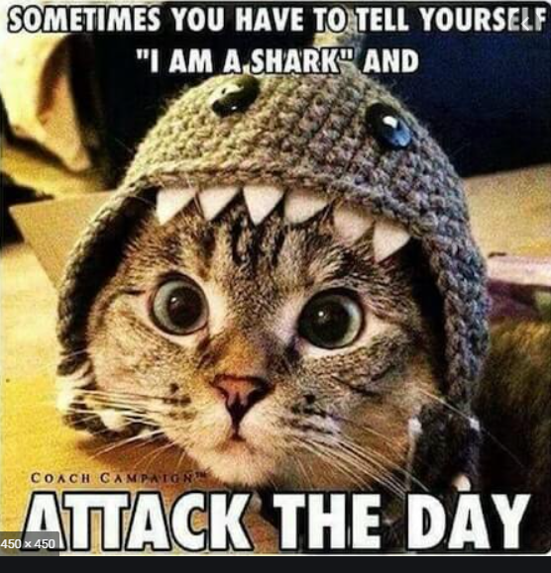
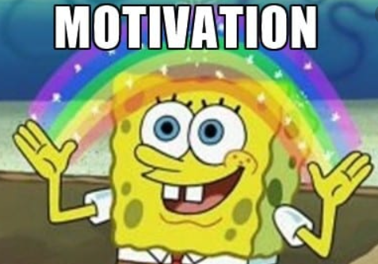
Daily morning tasks:
Task 1
Practice your spellings for the week. (look – cover – write – check)
Task 2
Complete the morning maths task on slide 3
Task 3
Read from your library or reading book for 15 minutes

Slide 3
85,703
Add 5000.
Take away 3200.
Is this an odd number? Explain a quick way of how you know!
What is the total of 85,703 and 25,000?
Complete the following sequences:
2, 3, 5, 7, ____, 13, _____,_____, 23 (Prime numbers)
1050, 1000, _____, 900, _____, ______, 750.
150, 300, 450, _____,______, 900, _____.
Challenge: If you want to you can complete your square and cubed numbers from 1 - 12

Slide 4
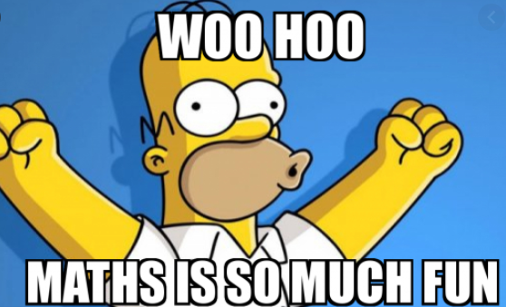
Maths:
I can measure and calculate the Perimeter of rectilinear shapes.

Slide 5
Maths video for today’s lesson.
https://vimeo.com/477528259

Slide 8
1) 5 + 9 + 7 + 1 + 5 + 3 =
2) A rectangle’s sides are 11 mm and 3 mm.
What is the rectangle’s perimeter?
3) ___ $−$ 13 = 13
4) 57 = 66 $−$ ___

Slide 9
1) 5 + 9 + 7 + 1 + 5 + 3 =
2) A rectangle’s sides are 11 mm and 3 mm.
What is the rectangle’s perimeter?
3) ___ $−$ 13 = 13
4) 57 = 66 $−$ ___
5 + 5 + 9 + 1 + 7 + 3 =
30
28 mm
26
9

Slide 11
Perimeter $=$ the length around a closed 2D shape
1 cm
1 cm
2 cm
3 cm
5 cm
3 cm
2 cm
5 cm
2 cm
+ 3 cm
+ 3 cm
+ 2 cm
+ 5 cm
+ 5 cm
= 20 cm

Slide 12
6 cm
4 cm
4 cm
? cm
7 cm
5 cm
3 cm
3 cm
1 cm
= 26 cm
7 cm + 6 cm + 4 cm + 5 cm + 3 cm + 1 cm

Slide 13
13 cm
13 cm
3 cm
8 cm
8 cm
9 cm
6 cm
13 cm $−$ 8 cm
= 5 cm
5 cm
3 cm + 13 cm + 9 cm + 5 cm + 6 cm + 8 cm
= 44 cm

Slide 14
2 m
1)
30 m
3 m
Have a think
5 m
8 m
2)
46 cm
5 m
14 cm
6 cm
7 m
9 cm
2 cm
10 cm
3)
3 cm
10 cm
10 cm
4 cm
7 cm
14 cm
4 cm
23 cm $=$ 7 cm $+$ cm $+$ 14 cm
4 cm
2
?
23 cm
74 cm

Slide 15
Have a go at questions 1 - 4 on the worksheet

Slide 16
3 cm
Have a think
5 cm
5 cm
Perimeter =
16 cm
Perimeter =
32 cm
26 cm
3 cm
5 cm
5 cm
3 cm

Slide 17
Have a think
A photo frame is 15 cm long and 12 cm high.
The border around the photo window is 2 cm wide.
15 cm
2 cm
11 cm
10 cm
12 cm
8 cm
2 cm
2 cm
What is the perimeter of the photo window?
38 cm

Slide 18
Have a go at questions 5 - 7 on the worksheet

Slide 19
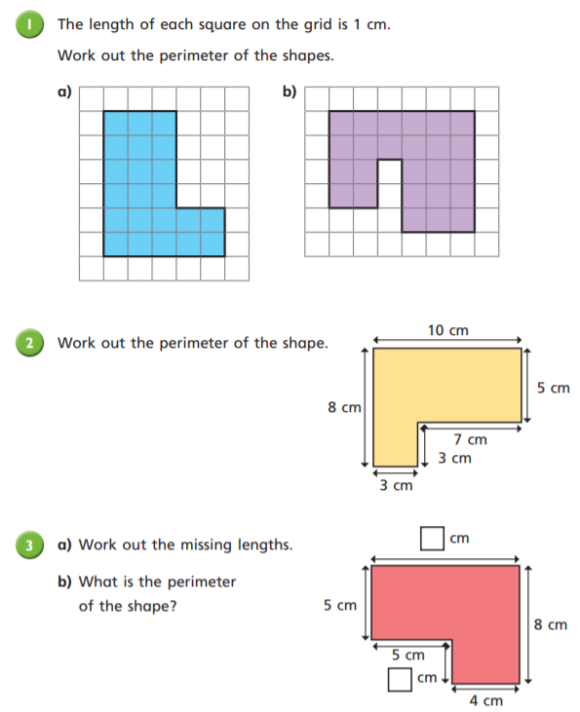
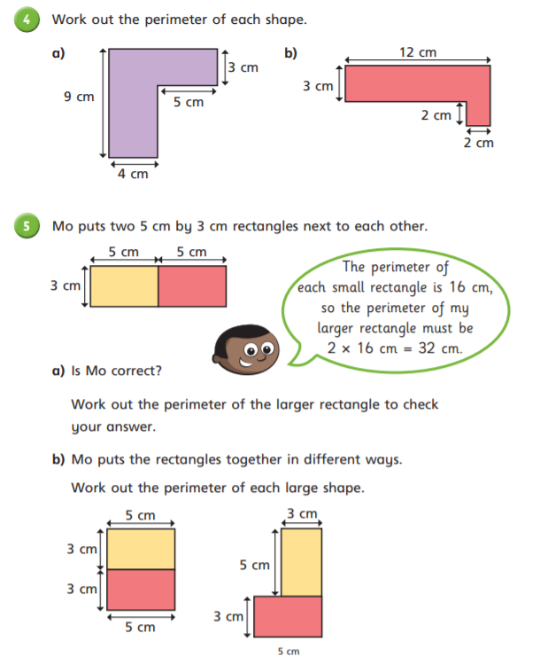

Slide 20
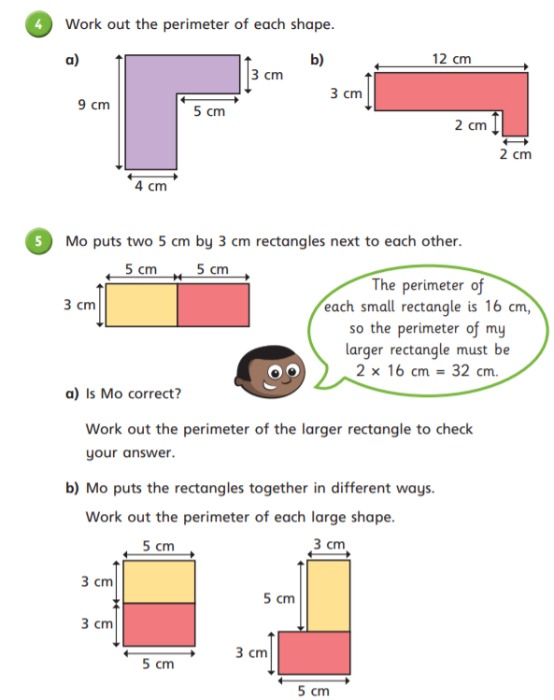

Slide 21
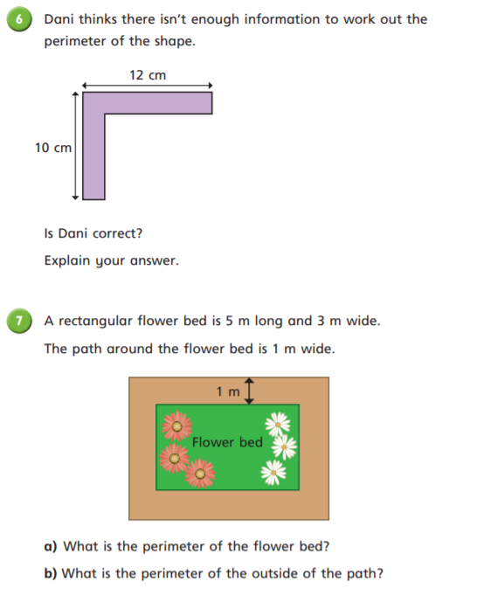
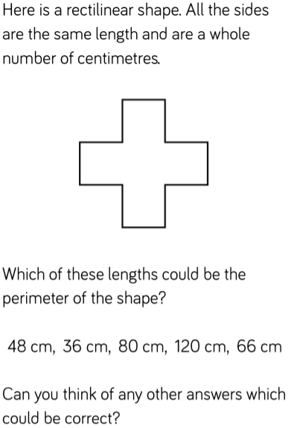
Optional Challenges

Slide 22
Plenary:

Slide 23
Break

Slide 24
English -
I can use evidence from the text to justify my thoughts and opinions

Slide 25
Chapter 3 - Recap
Arthur and Maudie return to their house after they have been to the hearing at the Geographical Society. Once the children returned they sat in the library; Mistress Poacher disappeared and left the children alone in the house. Later on, the children were greeted by Mr Smethwyck (representative from the insurance company) he told them that because their father breached the terms of the contract the children would lose their home and everything in it, making them homeless.
After that, the children were sold to Mr and Mrs Beggins by Mistress Poacher. The children then headed to the slumps of Lontown to work for the Beggins family. Once the children arrived at the house they were taken up three flights of stairs and shown their freezing cold room.

Slide 26
English – Brightstorm Chapter 4

Slide 27
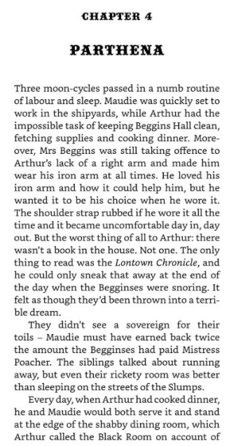
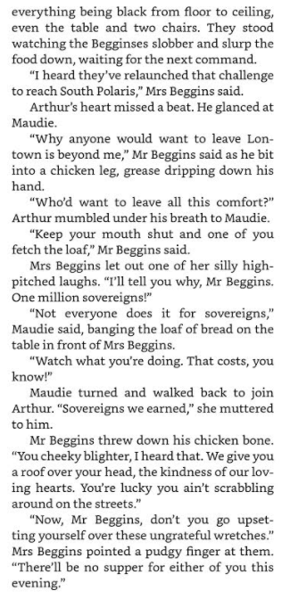
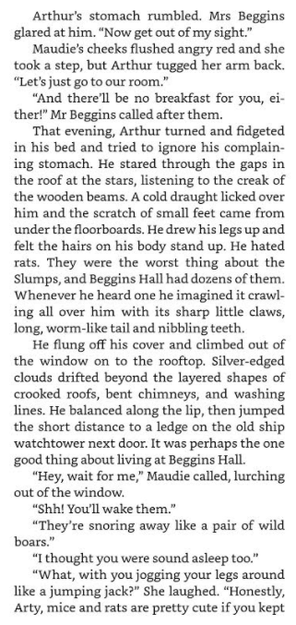

Slide 28
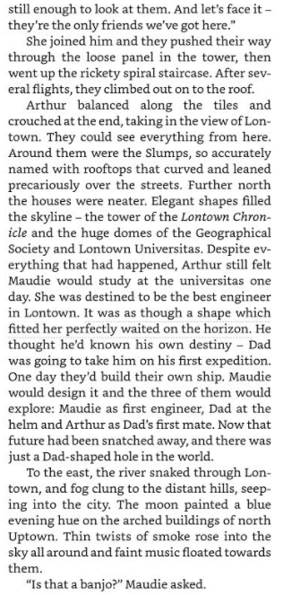
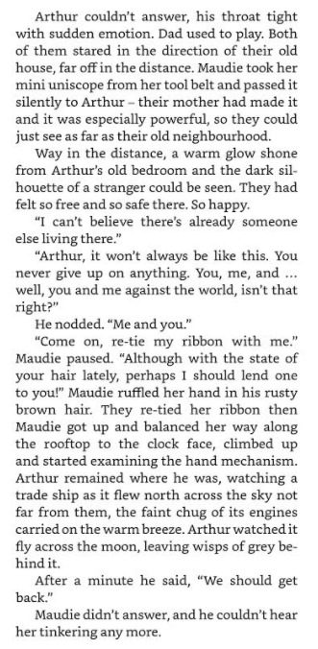
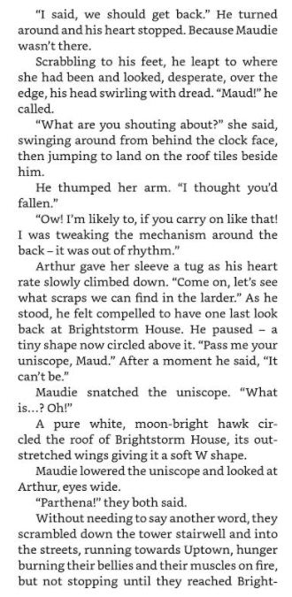

Slide 29
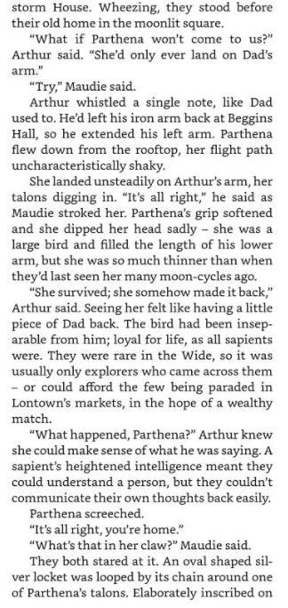
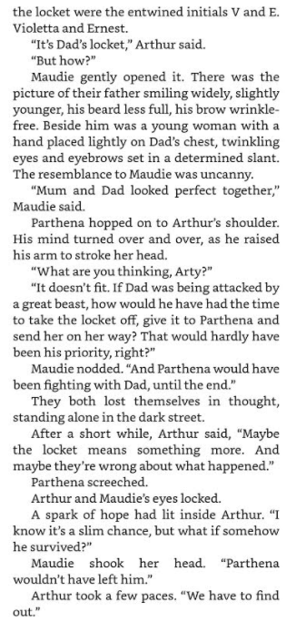
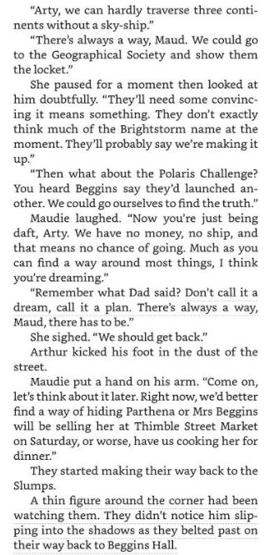

Slide 30
How do you feel after reading that Chapter?
Record a few thoughts and feelings:
Consider how the children might be feeling.
Why do you think Mr and Mrs Beggins are being so nasty to the children?
How do you feel towards the children and towards Mr and Mrs Beggins?

Slide 31
By the end of Chapter 4…
You should be feeling quite frustrated and upset for the twins Arthur and Maudie.
Why do you feel sorry for them? Think about the way the chapter has been written.
What has Vashti Hardy (author) done to make you feel annoyed at Mr and Mrs Beggins?

Slide 32
You are going to create a spider diagram!!!
Vashti Hardy creates an uneasy atmosphere in the Beggins household.
(What does Vashti Hardy write to make us feel this way?)
The Beggins never gave the children anything nice for their hard work – “They didn’t see a sovereign for their toils”
Vashti Hardy makes Mrs Beggins seem nasty and cruel by the way she talks to Arthur – “Mrs Beggins was still taking offence to Arthur’s lack of a right arm.”

Slide 33
Your Activity:
You are going to find at least 6 pieces of evidence from the text to show that the Beggins were not very nice to the children.
Remember when you are quoting from the text you need Quotation Marks (“ ”)
You will need to evidence to back up your opinion!!!
Use my 2 examples from slide 32 to help you complete the task accurately.

Slide 34
Lunch

Slide 35
Science:
Properties and change of materials
Lesson 1
Learning objective: To know that some materials will dissolve in liquid to form a solution, and describe how to recover a substance from a solution.

Slide 42
Video clips:
https://www.bbc.co.uk/bitesize/topics/zjty4wx/articles/zpbdpbk
https://www.bbc.co.uk/bitesize/topics/zjty4wx/articles/zk9mt39
https://www.youtube.com/watch?v=iGiL9Nm5DiI

Slide 44
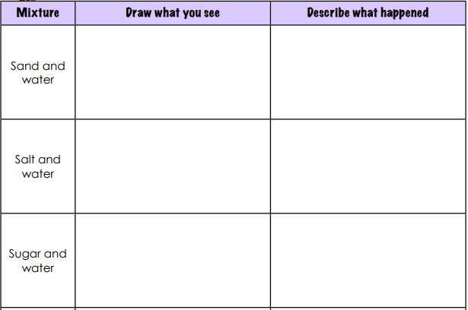
https://www.youtube.com/watch?v=iGiL9Nm5DiI

Slide 45
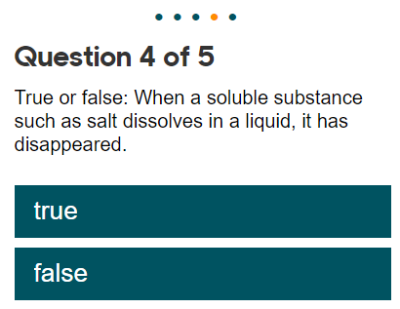
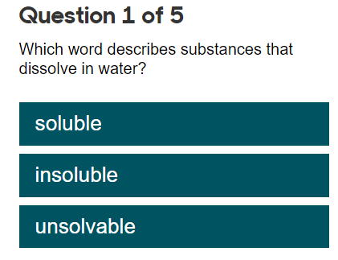
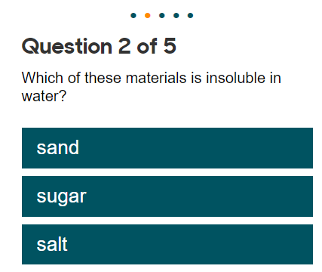
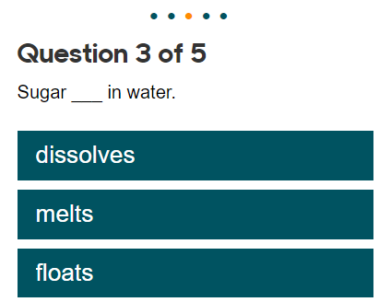
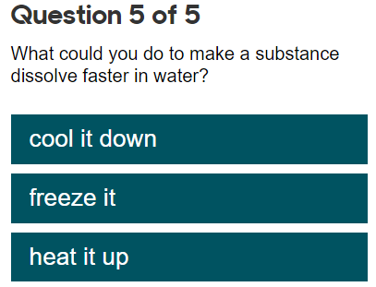
Complete the quiz:

