Slide 1
Thursday 28th January 2021

Slide 2
Morning Job – Spelling Practice
LOOK – COVER – WRITE -CHECK
Challenge: Pick 3 words and write them in a sentence.

Slide 3
Maths

Slide 4
Get ready questions

Slide 5
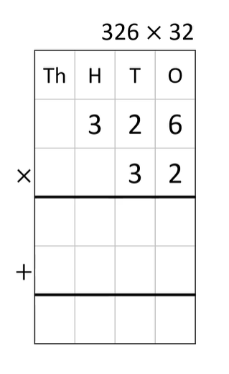
GIVE IT A GO!!!

Slide 6
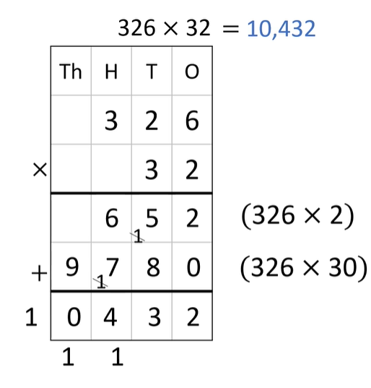
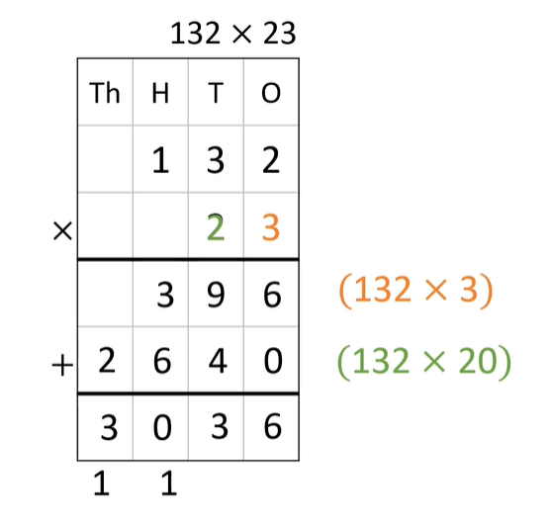
DID YOU GET THIS?

Slide 7
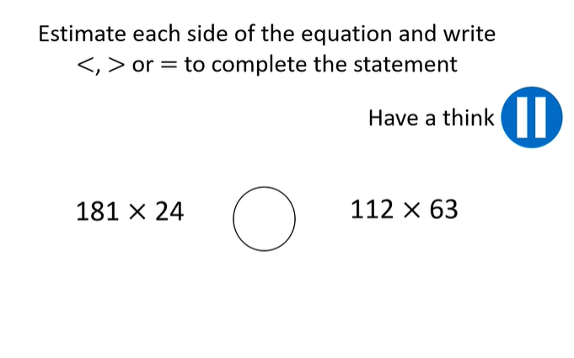
Give it a go…

Slide 8
How did you find it? Did you get this?

Slide 9
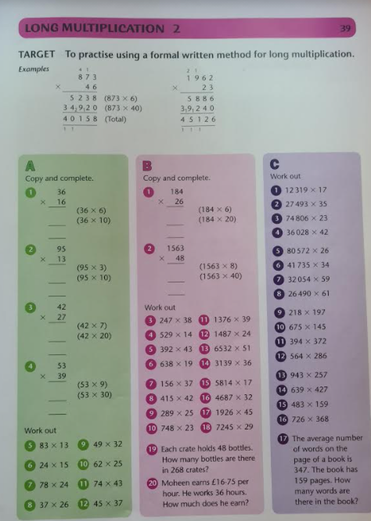
A, B or C?
GIVE IT A GO!!!

Slide 10
Break

Slide 11
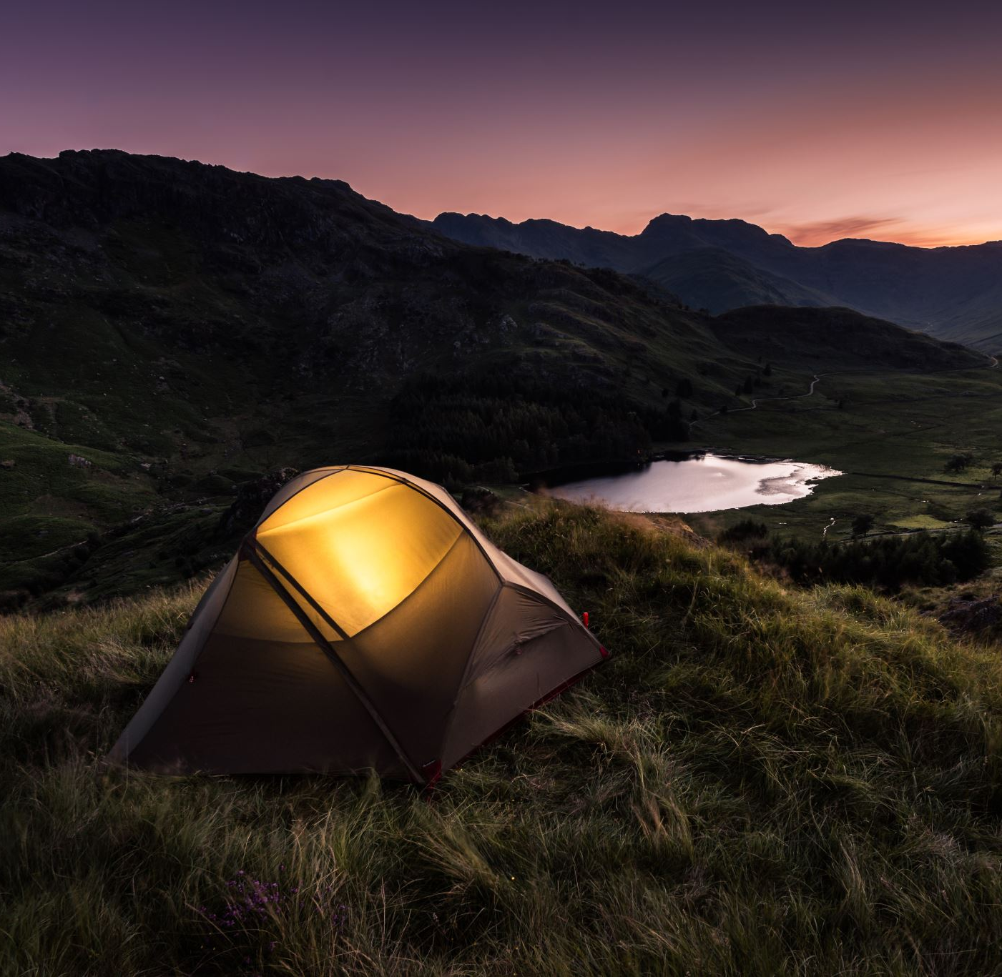
English

Slide 12
Chapter 19 “The Case Against Eudora Vane”

Slide 13
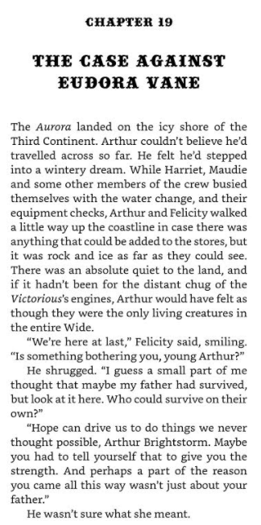
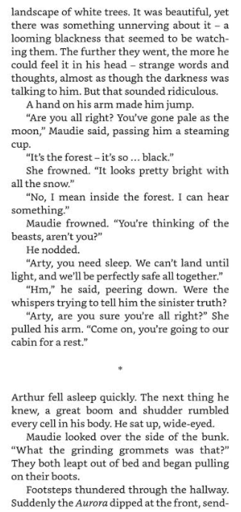
110
111
112

Slide 14
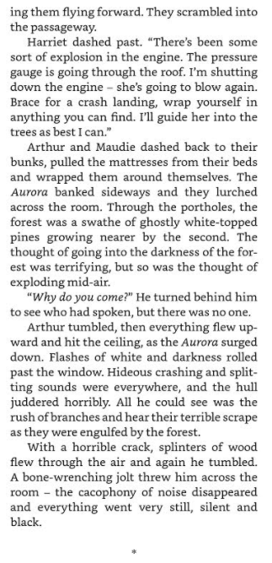
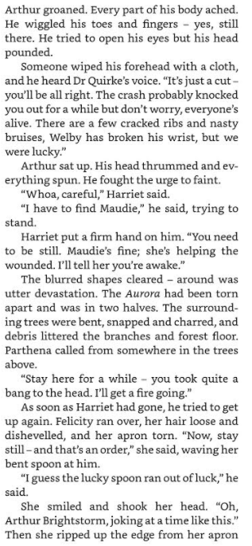
113
114
115

Slide 15
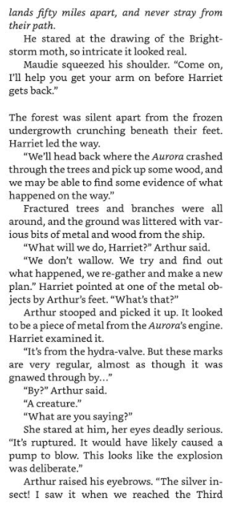
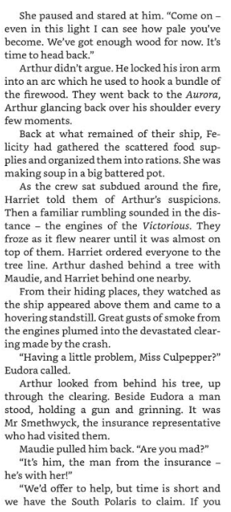
116
117
118

Slide 16
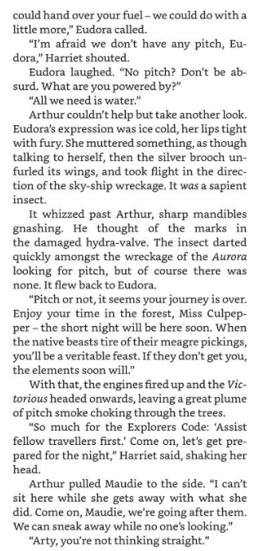
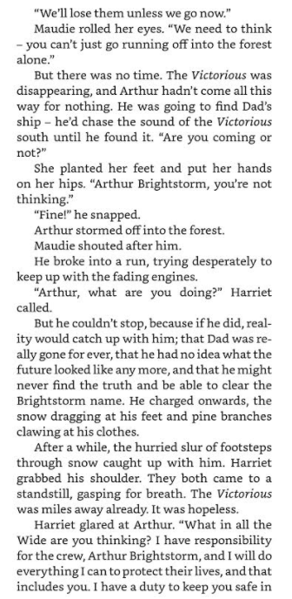
119
120
121

Slide 17
122

Slide 18
Comprehension
1. Where did the Aurora land and what adjective is used to describe the shore?Pg110
2. What does Felicity say about hope? Pg110
3. Where was the Aurora headed? Pg 111
4. What did Arhtur say to Maudie about the forest below? Pg111
5. What phrase does Vashti Hardy use to describe how the moon shone? Pg111
6. What woke Arthur up out of his sleep? Pg112
7. Who told Arthur “It’s just a cut, you'll be alright” Pg114
8. What did Harriet find after the crash and return to Arthur? Pg114
9. Who assessed the state of the engine? Pg115
10. “Sabotage” is used on Pg 117 what does it mean and can you find 3 synonyms for it?

Slide 19
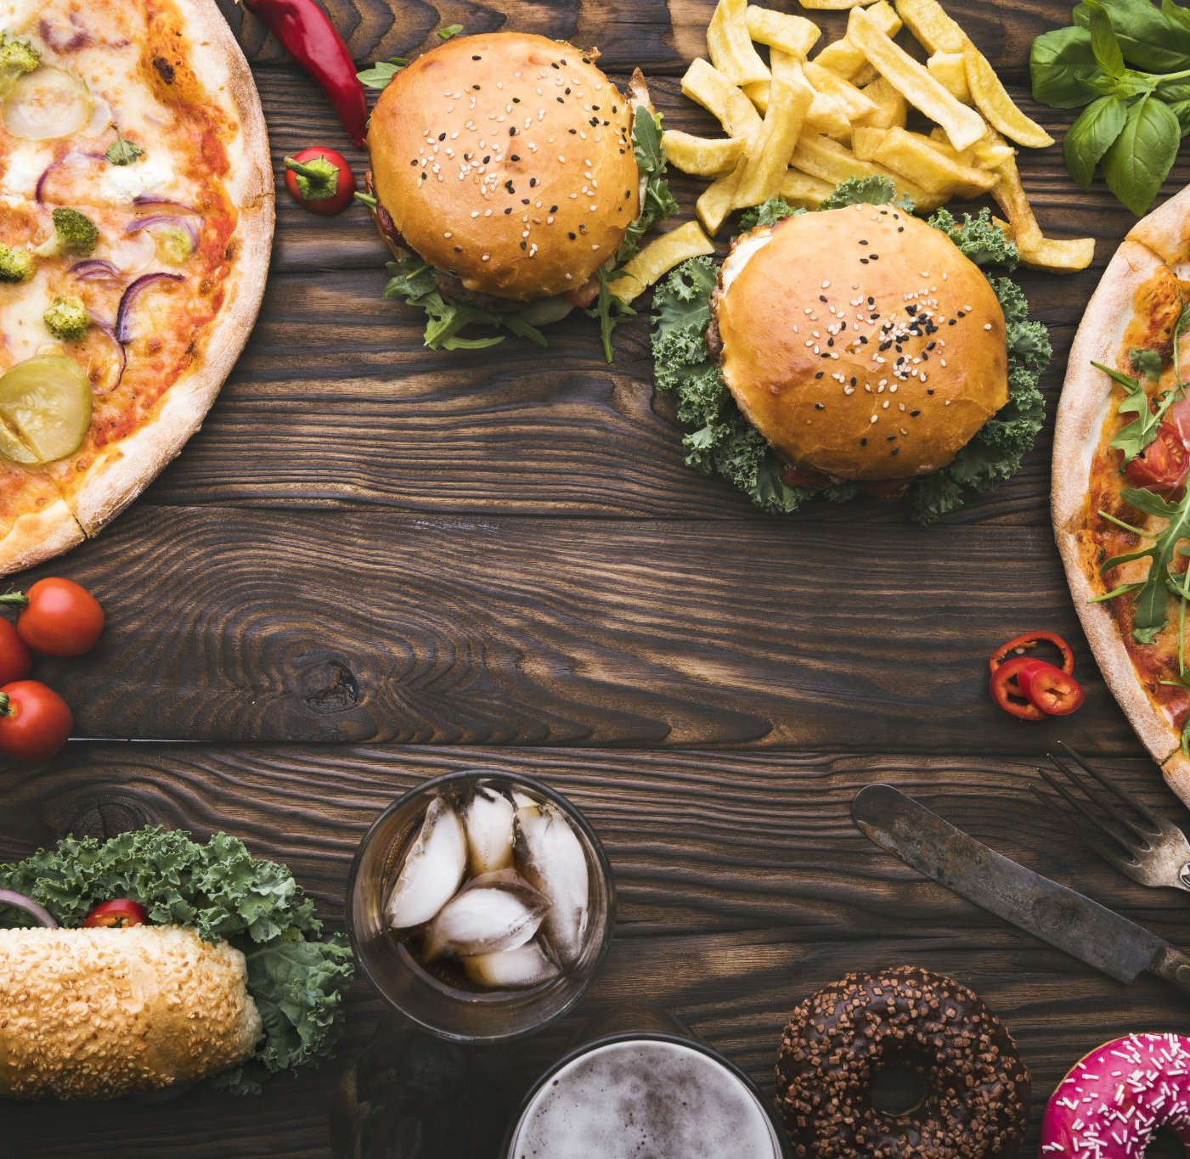
Lunch

Slide 20
History
I can create historically valid questions.

Slide 21
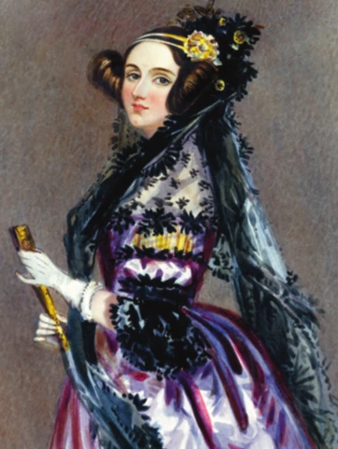

Slide 22
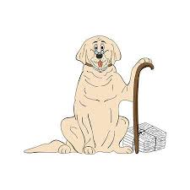
To ask historically valid questions
Chester

Slide 23
C- Characteristics
H- Historical Links
E- Evidence
S- Significance
T- Timeline
E- Elsewhere
R- Response

Slide 24
C- Characteristics
What was she like?

Slide 25
H- Historical Links
How has the past influenced this?
How did this influence the future?
How does she compare to other people we have studied?

Slide 26
E- Evidence
What is the evidence for this event?

Slide 27
S- Significance
What was her main achievement?
What is significant about her?

Slide 28
T- Timeline
When did this happen?
What happened before and after?

Slide 29
E- Elsewhere
What was going on in other places at the time?

Slide 30
R- Response
What do I think about her?

Slide 31
Slavery in America
Charles Darwin set sail to the Galapagos
Cholera epidemic in Europe
First Railroad in Europe built in Belgium
Hans Christian Andersen published his first fairytales
War between native Americans and European settlers
Queen Victoria came to power

Slide 32
Activity – Research Task
Use “CHESTER” to find out about Ada Lovelace.
Record your answers however you would like to! It could be a research essay (A4 page) or it could be a fact file or a poster it is up to you.
You must include CHESTER and use the questions from it to include in your work!

